Slide 1
Council of Nicea & Council of Constantinople

Slide 2
Earlier debates
Korintlis, 11: 4
Galatyalılar, 1: 6

Slide 3
Korintlis, 11: 4 Çünkü size gelen ve bizim tanıttığımızdan değişik bir İsa’yı tanıtanları pekâlâ hoş görüyorsunuz. Ayrıca, aldığınız ruhtan farklı bir ruhu ve kabul ettiğinizden farklı bir müjdeyi kabul ederek bunları hoş görüyorsunuz.
Galatyas1: 6 Sizi Mesih’in lütfuyla çağıranı bırakıp değişik bir müjdeye böylesine çabuk dönmenize şaşıyorum. 7Aslında başka bir müjde yoktur. Ancak aklınızı karıştıran ve Mesih’in müjdesini çarpıtmak isteyen kimseler vardır

Slide 4
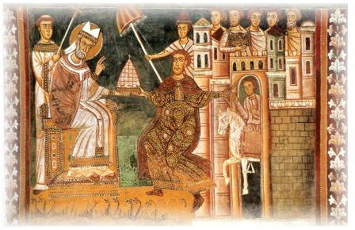
Positive Effects of Constantine’s rule
Christianity transformed from a persecuted minority religion to an official religion of the Empire
Bishops given honors and were allowed to function as judges
More humane punishments
Building of new churches with public money
Christians influence society in positive ways
New converts
Monasticism developed rapidly
Peace allowed a persecuted church to be secure
Pope Sylvester I and Constantine

Slide 5
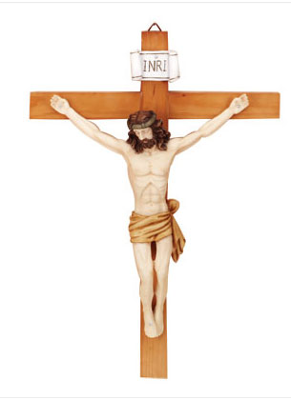
The Church Grows
By the middle of the fourth century, Christianity was a significant influence in the Roman Empire -- a social 'glue,' holding the Empire together.
But the Church struggled with internal divisions, and for Constantine, division in the Church threatened political instability.
Doctrine had developed and solidified during persecution; challenges to Christian beliefs continued

Slide 6
Seven Ecumenical Councils
In the history of Christianity, the first seven ecumenical councils, from the First Council of Nicaea (325) to the Second Council of Nicaea (787), represented an attempt by Church leaders to reach an orthodox consensus, restore peace and develop a unified Christendom. Eastern Orthodox, Oriental Orthodox, Nestorian, Roman Catholic, Anglican, and some Lutheran churches all claim to trace the legitimacy of their clergy by apostolic succession back to this period and beyond, to the earlier period referred to as Early Christianity.

Slide 7
First Council of Nicaea (325)
Emperor Constantine convened this council to settle a controversial issue, the relation between Jesus Christ and God the Father. The Emperor wanted to establish universal agreement on it. Representatives came from across the Empire, subsidized by the Emperor. Previous to this council, the bishops would hold local councils, such as the Council of Jerusalem, but there had been no universal, or ecumenical, council.

Slide 8
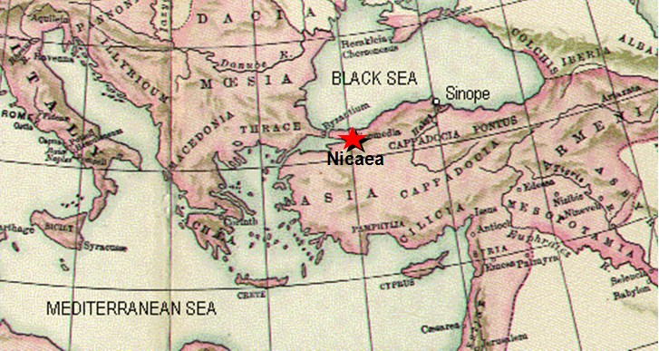
COUNCIL OF NICEA
Date: 325 AD
Place: Nicea
Participants: 318 representatives from five areas (Alexandria, Antioch, Rome, Constantinople, Jerusalem)
Reason for Council: Respond to Arianism & defend the faith

Slide 9
Arianism
Christ did not always exist
Christ was divine but CREATED being - He was created by God the Father and therefore did not always exist and is therefore less than God the Father.

Slide 10
COUNCIL OF NICEA
ARIANISM
Founder: Arius, a priest in North Africa
Applied the human relationship between earthly father and earthly son to God the Father and God the Son
While the Father was there before ages, the Son wasn’t, and therefore, the Son was created by the Father
Logical consequence of this belief: Only the Father was eternal and the Son was one of the creations
Son is NOT co-eternal with the Father

Slide 11
COUNCIL OF NICEA: OUTCOME
KEY DEFENSE
If Christ were not God Then He becomes a created being
If Christ were not God Then He couldn’t have saved us
If Christ were a man Then He can’t make us sons of God
THEREFORE, CONCLUSION OF ARIAN BELIEF
CHRIST COULDN’T HAVE SAVED US
Contradicts JOHN 1:12

Slide 12
COUNCIL OF NICEA: OUTCOME
KEY DEFENSE
According to JOHN 1
Christ is Son of God
He is one essence with the Father
He was with the Father at all ages
Both Father and Son are above time
Christ is God
He cannot be a created being
IF
THEN

Slide 13
COUNCIL OF NICEA: OUTCOME
Defended the divinity of Christ
Developed the Creed
Excommunicated Arians from the Church
Defined the beginning of the Great Lent
Determined the time of Easter
Discussed how to integrate Christians who returned to the Church (Schism of Meliton)
Outlined guidelines for the relationship among the diocese
Ex: bishop of one diocese cannot go to another bishop’s diocese without his permission
THEOLOGICAL
ADMINSITRATIVE

Slide 14
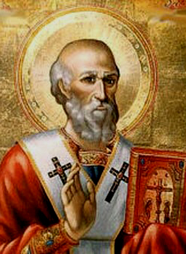
COUNCIL OF NICEA: KEY FIGURE
Born in 295 AD
Served as a deacon to the patriarch Alexandrus
Defended the divinity of Christ at the Council of Nicea
Became the patriarch shortly after the Nicean Council at 33 years of age
Integrated monasticism into church life
Removed from office five times (17 years) by the king based on accusations of murder brought by the Arians
Remained in exile intermittently before he returned to Alexandria to resume his post as patriarch
Served as patriarch for 45 years.
Saint Athanasius
Notes:
Find another icon – st. mary coptic church of pasadena, ca

Slide 15
St. Athanasius
Before age 20, he wrote On the Incarnation, explaining that Jesus Christ was both God and Man
He was a deacon during the Council of Nicea and the primary person who refuted Arius’ arguments.
He was ordained the 20th Patriarch after Pope Alexander died in 328 AD
Pope Alexander-I had expelled Arius from the Church and from Egypt prior to the Council of Nicea and he lead the fight against Arius’ heresy along with St. Athanasius.

Slide 17
Arius vs Athanasius
Arius said the Son said, “My Father is greater than I,” (John 14:28), so, the Son is not the same like the Father but less than He is.
Athanasius responded by saying that the Son in flesh is less than the Father as He said, "If you loved Me, you would rejoice because I said, 'I am going to the Father,' for My Father is greater than I." (John 14:28 continued)
That means that He, in His flesh, will go to the Father who is greater than the flesh of the Son, as He, in His Divinity, is in the bosom of the Father all the time

Slide 18
Arius vs Athanasius
Arius said that our Lord Jesus Christ said, "All authority has been given to Me in heaven and on earth." (Mathew 28:18).
Athanasius responded by stating that the Son, as He is born from the Father before all ages, has gained all authority and He considered Himself equal to the Father when He said, “Go and baptize in the name of the Father and of the Son and of the Holy Spirit.” (Matthew 28:19)

Slide 19
Arius vs Athanasius
Arius said that our Lord Jesus Christ said He can't do His will but the will of His Father (John 5:30), thus He is less than the Father.
Athanasius responded by saying that our Lord Jesus Christ spoke in many situations as being God incarnate who became man. But speaking as the divine God He said, "He who has seen Me has seen My Father," and "I am in My Father and My Father in Me”. (John 14:9, John 14:11)

Slide 20
The Nicene Creed
WE BELIEVE IN ONE GOD: THE FATHER ALMIGHTY, MAKER OF HEAVEN
AND EARTH: THE VISIBLE AND THE INVISIBLE.
WE BELIEVE IN ONE LORD JESUS THE CHRIST, THE ONLY BEGOTTEN
SON, BORN OF THE FATHER BEFORE ALL AGES. LIGHT OF LIGHT, VERY
GOD OF VERY GOD; BEGOTTEN NOT CREATED. CONSUBSTANTIAL WITH
THE FATHER; BY WHOM WERE ALL THINGS MADE. THIS IS HE WHO FOR
US HUMANS, AND FOR OUR SALVATION, CAME DOWN FROM HEAVEN,
AND WAS MADE MAN BY THE HOLY SPIRIT AND THE VIRGIN MARY.
HE WAS INCARNATE; CRUCIFIED UNDER PONTIUS PILATE, HE
SUFFERED, WAS BURIED AND ROSE FROM THE DEAD ON THE THIRD
DAY ACCORDING TO THE SCRIPTURES.
HE ASCENDED UP TO HEAVEN AND SITTETH AT THE RIGHT HAND OF HIS
FATHER, FROM WHENCE HE SHALL COME IN GLORY TO JUDGE THE
LIVING AND THE DEAD; FOR WHOSE KINGDOM THERE IS NO END.
WE BELIEVE IN THE HOLY SPIRIT."

Slide 21
Arians do not believe in the traditional doctrine of the Trinity
God, the Father, ("unbegotten" God; Almighty God) always existing and who is the only true God (John 17:3). The Son of God, Jesus Christ, ("only-begotten God" John 1:18; Mighty God Isaiah 9:6) begotten before time began (Proverbs 8:22-29; Revelation 3:14; Colossians 1:15) and who is Lord/Master (1 Cor 8:6). The Holy Spirit (the illuminating and sanctifying power, who is neither God the Father nor Lord/Master. First Corinthians 8:5-8:6 was cited as proof text:
Indeed, even though there may be so-called gods in heaven or on earth — as in fact there are many gods and many lords/masters — yet for us there is one God (Gk. theos – θεός), the Father, from whom are all things and for whom we exist, and one Lord/Master (kyrios – κύριος), Jesus Christ, through whom are all things and through whom we exist.

Slide 22
God the Father ("unbegotten"), who is the only true God from Son of God ("only-begotten"), who is Lord/Master; and the Holy Spirit (the illuminating and sanctifying power), who is neither God the Father nor Lord/Master.
ome of them say that the Son is an eructation, others that he is a production, others that he is also unbegotten. These are impieties to which we cannot listen, even though the heretics threaten us with a thousand deaths. But we say and believe and have taught, and do teach, that the Son is not unbegotten, nor in any way part of the unbegotten; and that he does not derive his subsistence from any matter; but that by his own will and counsel he has subsisted before time and before ages as perfect as God, only begotten and unchangeable, and that before he was begotten, or created, or purposed, or established, he was not. For he was not unbegotten. We are persecuted because we say that the Son has a beginning but that God is without beginning.

Slide 23
COUNCIL OF CONSTANTINOPLE
Constantinople
Date: 381 AD
Place: Constantinople
Participants: 150 bishops
Reason for Council: King Constantine called this council to define the faith concerning the divinity of the Holy Spirit

Slide 24
COUNCIL OF CONSTANTINOPLE
KEY HERESY - EUNOMIANISM
Founder: Eunomius, a priest
Denied Holy Spirit as God because of his misinterpretation of the Scripture
1st ARGUMENT: Since angels are called spirits and they are created beings, the Holy Spirit is also a created being
2nd ARGUMENT: The Holy Spirit is not mentioned in Scripture with the definite article “the”

Slide 25
COUNCIL OF CONSTANTINOPLE
KEY DEFENSE
If we deny the divinity of the Holy Spirit, then we don’t believe of the Son (because the Holy Spirit is the Spirit of the Son and of the Father), so we don’t believe in the Holy Trinity
The work of the Holy Spirit in us proves that He is God
Notes:
Need to expand this slide

Slide 26
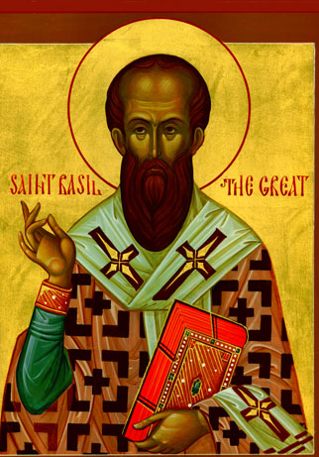
COUNCIL OF CONSTANTINOPLE: KEY FIGURE
Born in 329/330 AD
Received instruction about the Christian faith through his grandmother; raised in an influential Christian family
Focused the majority of his life on defending the faith against Homoean policy (Son is similar to the Father, not of one essence of the Father)
Wrote two major writings against Eunomius and defended the divinity of the Holy Spirit
Saint Basil the Great
Notes:
Find another icon

Slide 27
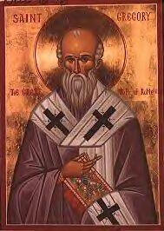
COUNCIL OF CONSTANTINOPLE: KEY FIGURE
Born 329/330 AD in Nazianus
Friend of Saint Basil the Great
Loved rhetoric and high learning
Served as leader of the Council of Constantinople
Proclaimed his “five theological orations” concerning the Trinity for which he earned the honorary title “the theologian”
Wrote many sermons, letters and poetry during the final part of his life
Also wrote a liturgy we use today
Saint Gregory the Theologian
Notes:
Change icon

Slide 28
COUNCIL OF CONSTANTINOPLE: OUTCOME
Expanded the Creed concerning the divinity of the Holy Spirit
Excommunicated (aforoz) the Eunomians

Slide 29
CREED: KEY PHRASES – SCRIPTURAL EVIDENCE
Matt 6:9
John 1:18
Psalm 27:1
John 8:12
2 Cor 4:13
Other Scriptural Evidence
Hebrews 1:5
Philippians 2:6
1 Thess 5:9
1 Timothy 3:16
John 14:36
Notes:
Philip shaff – History of the Church – find more scriptural references for the creed; columns to show the nicene creed predated 317 AD

Slide 30
TODAY’S CREED
Today’s Creed is a combination of both Councils of Nicea and Constantinople
God is One in Three Different Persons, but not separate as they are not bound by space and time
The Creed reaffirmed the relationship of the Trinity: Father, Son and Holy Spirit are Co-Eternal, Co-Existent, Equal, Co-Substantial

