Slide 1
Popular Culture & Literature

Slide 2
Sources
John Storey, Cultural Theory and Popular Culture. Routledge, 2015.
Holt N. Parker, “Toward a Definition of Popular Culture”. History and Theory 50/2, 2011.
Matthew Shneider-Mayerson, “Popular Fiction Studies: The Advantages of a New Field”. Studies in Popular Culture 33/1, 2010.
Scott McCracken, Pulp: Reading Popular Fiction. Manchester UP, 1998.
Ken Gelder, Popular Fiction: The Logics and Practices of a Literary Field. Routledge, 2004.

Slide 3
What is culture?
a general process of intellectual, spiritual and aesthetic development
(great philosophers, great artists, great poets)
a particular way of life, whether of a people, a period or a group
(holidays, religious celebrations, youth subcultures)
the works and practices of intellectual and especially artistic activity
(poetry, the novel, ballet, opera, fine art)

Slide 4
What is popular?
well liked by many people
inferior kinds of work
work deliberately setting out to win favour with the people
culture actually made by the people for themselves

Slide 5
Popular Culture

Slide 6
A Phenomenon
Dating back to or caused by the Industrial Revolution.
A culture that emerged following industrialization and urbanization.
It goes hand in hand with the capitalist market economy.
Culture made possible by technological change, by the use of the means of mass cultural production.
mass-produced (unlike folk culture)
mass-consumed (unlike high culture)

Slide 7
First Definition
Culture that is widely favoured or well liked by many people.
sales numbers (books, cds, dvds)
attendance records (concerts, sports, festivals)
audience preference figures (tv programmes)
But “high culture” can also be popular in that sense.

Slide 8
Second Definition
Culture that is left over after we have decided what is high culture.
for ex.: complexity, difficulty, hence an exclusive audience
texts and practices that fail to meet the required standards to qualify as high culture
popular culture as inferior culture
mass-produced commercial culture
culture of the subordinate classes (=anarchy)

Slide 9
Why Was It Considered as a Threat of Anarchy?
Consider the shifting dynamics in the 19th century with industrialization and urbanization
a new working-class culture
the franchise of the male urban working class
the culture of a majority vs a powerful minority
threat of political disorder

Slide 10
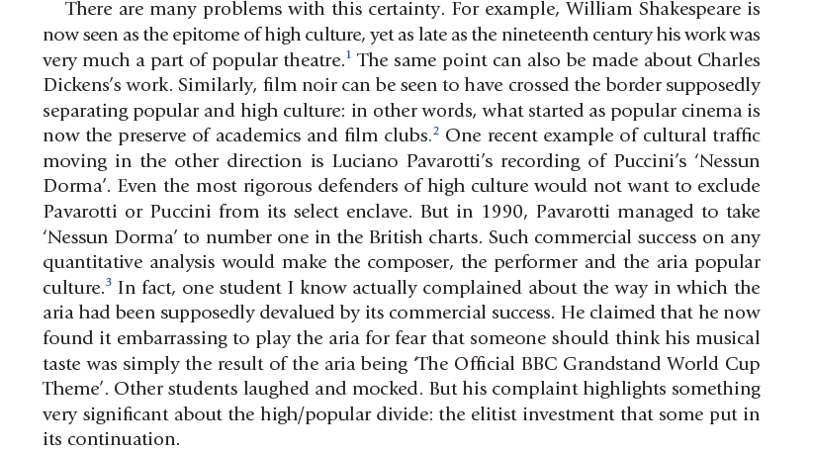
Notes:
Now there are videos on youtube. Talent shows. Britain’s Got Talent.

Slide 11
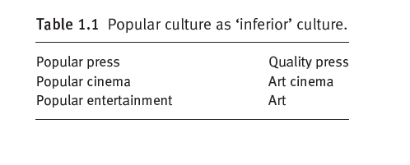

Slide 12
Third Definition
Popular culture is mass culture.
a commercial culture
mass-produced for mass consumption
its audience is a mass of non-discriminating consumers
formulaic and manipulative
public fantasy, a collective dreamworld, escapism

Slide 13
Fourth Definition
Culture that originates from ‘the people’.
an ‘authentic’ culture of ‘the people’.
folk culture: a culture of the people for the people
Who are ‘the people’?

Slide 14
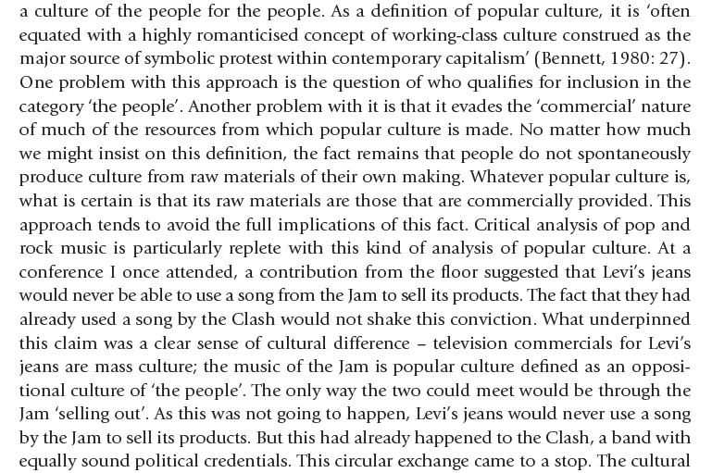
Notes:
Punk: mid-70s. anti-establishment. music of resistance, of protest. rebellion. A subculture.

Slide 15
“Toward a Definition of Popular Culture”, Holt N. Parker
Notes:
prole=working class imprimatur=license, accepting that it has good standards

Slide 16
Fifth Definition
A site of struggle between the ‘resistance’ of subordinate groups and the forces of ‘incorporation’ operating in the interests of dominant groups.
ex: using popular genres such as science-fiction for feminist politics
Notes:
feminists thus helped the political issues reach a much wider audience.

Slide 17
Postmodern View
Postmodern culture is a culture that no longer recognizes the distinction between high and popular culture.
Thus the distinction between ‘authentic’ and ‘commercial’ culture is blurred.

Slide 19
“Toward a Definition of Popular Culture”, Holt N. Parker

Slide 20
Examples of Popular Culture
pop music
comics
soap operas
TV programmes
films
clothes
computer games

Slide 21
Popular Literature

Slide 22
Different Genres Of Popular Fiction
crime fiction: spy/detective stories
science-fiction
fantasy
horror
thriller
romance
best-sellers (remember the question about sales numbers when defining what is “popular”)

Slide 23
Popular Fiction is defined by “what it is not.”
What it is not
What it is
not high literature
not serious literature
not ”real” literature
simple and formulaic because commercial
low culture=low literature
inferior
subculture
popular culture=working class culture/mass culture/folk culture

Slide 24
Literary Canon (The Classics)
Literature that is assumed to be
good literature
high literature
authentic
worth preserving
worth teaching
worth criticizing
Who decides?

Slide 25
Scholars and Critics

Slide 26
The New Debate
Popular fiction deserves its own field as a unique medium, just like film and television.
It is worthy of attention from scholars and critics studying in different fields such as philology, cultural studies, communication.
They reflect the current social context.

Slide 27
First Academic Approaches to Popular Literature
Feminist criticism of romance novels:
pacified
deceived
manipulated female readers.
mass-produced fantasies
Other scholars disagreed, supported popular fiction and explored its politics. Thus, they have approached popular fiction as a distinct field for the first time. They included crime and detective fiction in their studies as well.
The literary canon was patriarchal.

Slide 28
Intertextuality
Based on works of “high literature”: Mary Shelley, H. G. Wells, Orwell, Huxley, Chesterton, Swift…
Based on mythology: Homer’s epics, King Arthur legends, Norse mythology
Direct references to those works
References to one another

Slide 30
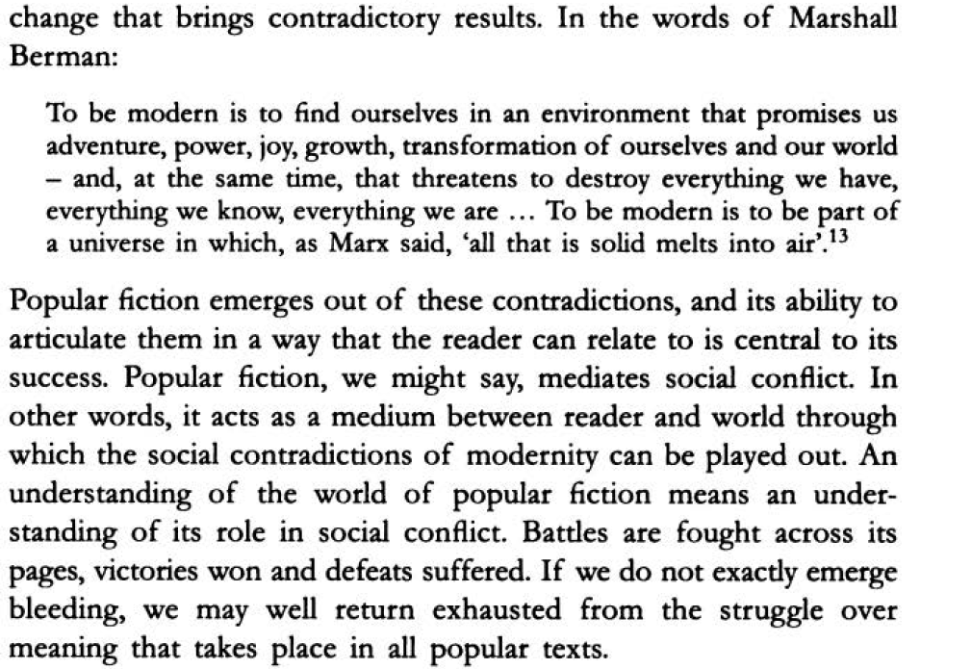
Pulp: Reading Popular Fiction, Scott McCracken

Slide 31
What Are We Doing?
Together we will take a close look at examples from different genres of popular literature
and
a) explore the reasons for their inclusion in the popular literature field
b) establish their literary value.

Slide 32
Genres
Epic
Lyric
Dramatic
Novel
Poetry
Drama

Slide 33
The Novel
Romance
Gothic
Adventure
Bildungsroman
Epistolary
Realist
Magical Realist
Historical
Sentimental
Modernist
Postmodern
Notes:
Some of these are popular fiction genres. How come we read them in the classroom? Thanks to the efforts of feminist scholars. Charlotte Brontë for instance. Her works were included in the canon much later and at the time they were written they were taken seriously only because they were published under a male name. So we might say that works produced by women belonged to the category of popular fiction by default up until the twentieth century (with some exceptions of course).

Slide 34
Why Genres?

Slide 35
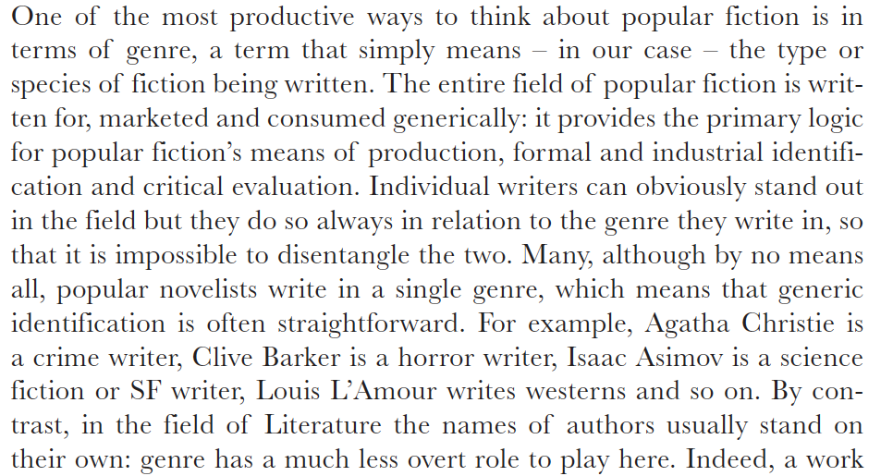
Ken Gelder, Popular Fiction

Slide 36
Consider your own experience
Why do you read popular literature?
What does it provide for you?
How do you feel when you read them?
What kind of an experience is it?

Slide 37
Addiction
Victoria Nelson explains the experience of reading popular literature as “addiction” – devouring book after book.
Do you agree?
Why is it addictive?

Slide 38
A Sense of Belonging
Each genre has its own community.
Each of these communities share a common culture.
They have many other cultural interests in common: movies, music, language, hobbies, clothes
Through literature they find a means to share all this with others.
Notes:
Example: My relationship with Terry Pratchett. When and why I read his works. If a person likes him, he/she must be a nice person, someone I can talk to, someone who speaks the same language as I do, someone who shares a similar view of life. Is this stereotyping and discrimination? Maybe. But when you look at it from the group member’s perspective, we all feel this need to be included in a community of people “just like us.” Whether it is right or wrong is another debate. I personally believe it works the other way around: people who appreciate such a sense of community develop a tendency to be more inclusive. It is not a coincidence that a majority of scholars who study posthumanism are s/f readers.

Slide 39
Which Genres?
Science-fiction
Fantasy
Horror/Thriller
Crime/Detective
Humour
Flash Fiction / Micro Fiction / Fan Fiction
Graphic Novel

