Slide 1
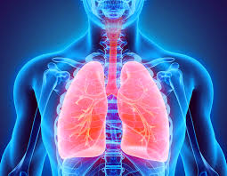
RESPIRATORY SYSTEM WEEK 3
Assoc. Prof. Dr. Yasemin SALGIRLI DEMİRBAŞ

Slide 2
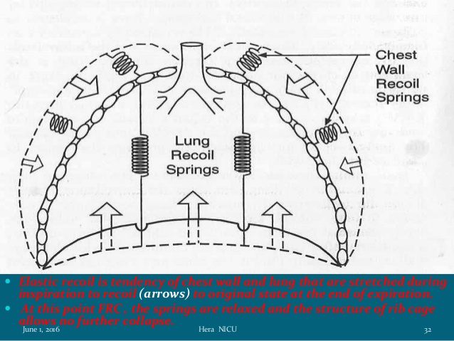
Recoil tendency of lungs
There is a constant tendency for the lungs to collapse, and in doing so they recoil inward from the thoracic wall.
Lung compliance: measure of the lung’s abillity to stretch and expand.
There are two major determinants of lung compliance.
stretchability of the lung tissues, particularly their elastic connective tissues. *Thus a thickening of the lung tissues decreases lung compliance.
An equally important determinant of lung compliance is surface tension at the air-water interfaces within the alveoli.

Slide 3
Determinants of Lung Compliance
The surface of the alveolar cells is moist
The alveoli can be pictured as air-filled sacs lined with water.
At an air-water interface, the attractive forces between the water molecules, known as surface tension,
Thus, expansion of the lung requires energy not only to stretch the connective tissue of the lung but also to overcome the surface tension of the water layer lining the alveoli.

Slide 4
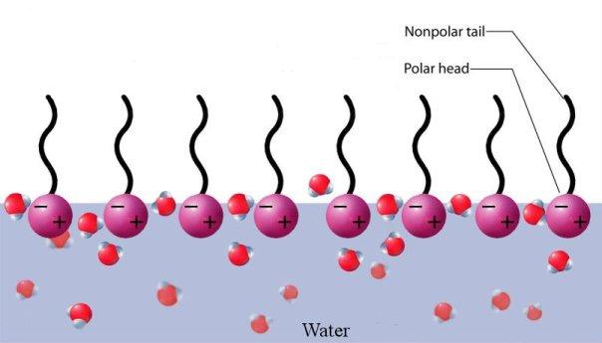
SURFACTANT
Type II alveolar cells secrete a detergent-like substance known as pulmonary surfactant,
*Pulmonary surfactant is a mixture of phospholipids and protein.
Surfactant: markedly reduces the cohesive forces between water molecules on the alveolar surface.
Therefore, surfactant lowers the surface tension, which increases lung compliance and makes it easier to expand the lungs.
A deep breath increases its secretion (by stretching the type II cells).

Slide 6
Ventilation terminology
Total ventilation: is the volume of gas moved in or out of the airways and alveoli over a certain period of time.
Minute ventilation :is the total volume of gas moved in or out of the airways and alveoli in 1 min.
Minute ventilation is also referred to as the minute respiratory volume (MRV).
Normoventilation refers to normal ventilation in which a PaCO2 of about 40 mmHg is maintained.
Hyperventilation refers to alveolar ventilation increased beyond the metabolic needs and a PaCO2 below 40 mmHg. Hyperventilation causes respiratory alkalosis.
Hypoventilation is alveolar ventilation decreased below metabolic needs and a PaCO2 above 40 mmHg. Acute hypoventilation causes respiratory acidosis.
Respiratory alkalosis and respiratory acidosis are disturbances of acid–base equilibrium where the pH of blood [H+] is increased or decreased, respectively, from normal.
Hydrogen ion concentration is influenced by CO2 according to the hydration reaction whereby the combination of CO2 with water yields H2CO3, which dissociates to H+ and HCO3–:

Slide 7
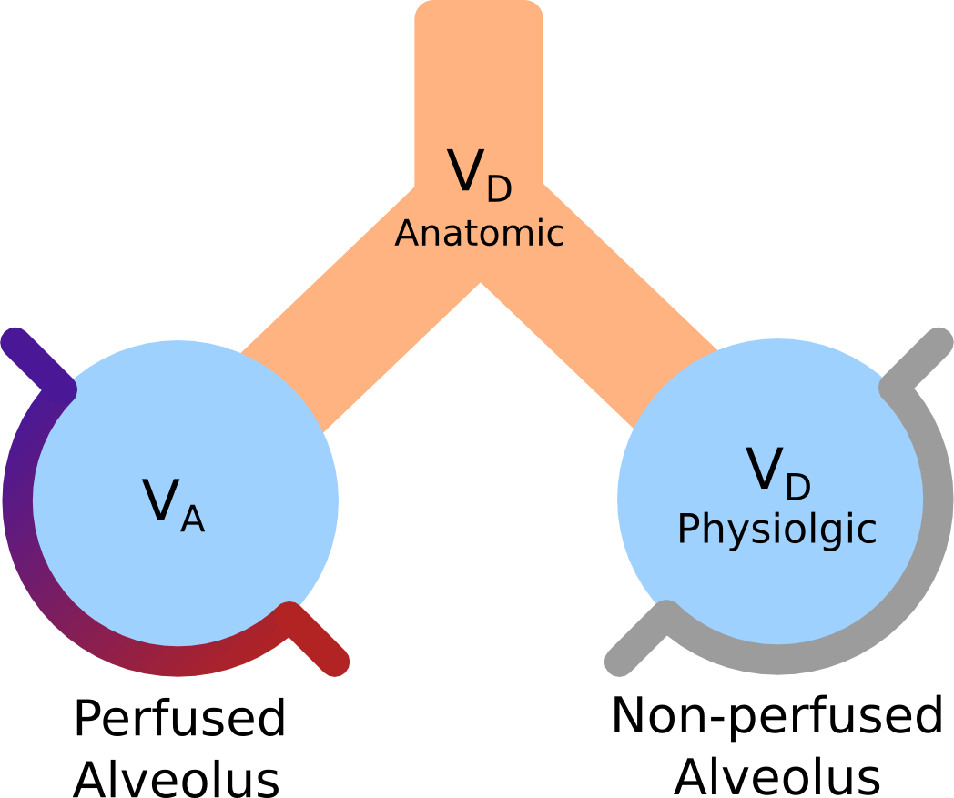
Dead Space Ventilation
The tidal volume is used to ventilate not only the alveoli, but also the airways leading to the alveoli.
Because there is little or no diffusion of oxygen and carbon dioxide through the membranes of most of the airways, they compose part of what is called dead space ventilation.
The other part of dead space ventilation is made up of alveoli with diminished capillary perfusion.
Ventilating these alveoli is ineffective in producing changes in blood gases.
Ventilation of nonperfused alveoli and the airways, (some of anatomic and alveolar dead space) is referred to as physiologic dead space.

Slide 8
Ventilation and perfusion relationships
The partial pressures of oxygen and carbon dioxide in the blood are related not only to alveolar ventilation but also to the amount of blood that perfuses the alveoli.
The relationship of these two factors to each other is referred to as the ventilation/perfusion ratio
Alveolar ventilation brings oxygen into the lung and removes carbon dioxide from it.
Similarly, the mixed venous blood brings carbon dioxide into the lung and takes up alveolar oxygen.
The PO2 and CO2 are thus determined by the relationship between alveolar ventilation and pulmonary capillary perfusion.
A normal ventilation/perfusion ratio implies that there is a balance between ventilation and perfusion of the alveoli, so that exchange of oxygen and carbon dioxide between the alveoli and blood is optimal.
Deviations from normal are known as a mismatching of ventilation and blood flow within the lung.

Slide 9
General scheme of oxygen transport
The transport of oxygen from alveoli to hemoglobin and from hemoglobin to tissues occurs via diffusion gradients.
When oxygen‐poor blood arrives at the lungs, the process of diffusion is from alveoli to erythrocytes.
Reversal of the process occurs when oxygen‐rich blood arrives at the tissues.
The process of oxygen uptake by hemoglobin proceeds as follows:
oxygen passes from air in the alveolus to successive solution in interstitial fluid
plasma
erythrocyte fluid
finally to combination with hemoglobin

Slide 10
Alveolar Gas Pressures
Normal alveolar gas pressures are:
PO2: 105 mmHg and PCO2: 40 mmHg.
Compare these values with the gas pressures in the air being breathed:
PO2: 160 mmHg and PCO2: 0.3 mmHg
The alveolar PO2 is lower than atmospheric PO2 because some of the oxygen in the air entering the alveoli leaves them to enter the pulmonary capillaries.
Alveolar PCO2 is higher than atmospheric PCO2 because carbon dioxide enters the alveoli from the pulmonary capillaries.

Slide 11
Alveolar Gas Pressures
The factors that determine the precise value of alveolar PO2 are
(1) the PO2 of atmospheric air,
(2) the rate of alveolar ventilation, and (3) the rate of total body oxygen consumption.

Slide 12
Transport of Oxygen in Blood
The oxygen is present in two forms: (1) dissolved in the plasma and erythrocyte water and (2) reversibly combined with hemoglobin molecules in the erythrocytes.
Each liter normally contains the number of oxygen molecules equivalent to 200 ml of pure gaseous oxygen at atmospheric pressure.
Because oxygen is relatively insoluble in water, only 3 ml can be dissolved in 1 L of blood at the normal arterial PO2 of 100 mmHg.
The other 197 ml of oxygen in a liter of arterial blood, more than 98 percent of the oxygen content in the liter, is transported in the erythrocytes reversibly combined with hemoglobin.

Slide 13
The oxygen–hemoglobin dissociation curve
1. The amount of oxygen associated with hemoglobin is related, but is not directly proportional, to the pressure of dissolved oxygen in the water of the red blood cell and plasma.
2. Before the combination of oxygen with hemoglobin, there must be oxygen in solution; similarly, after its removal from hemoglobin, oxygen is again in solution so that it may diffuse to the consuming cells (the oxygen unloads because Po2 in solution is lowered)
Hb SATURATION:

Slide 14
Effect of PO2 on Hemoglobin Saturation
Raising the blood PO2 should increase the combination of oxygen with hemoglobin - oxygen-hemoglobin dissociation curve
The curve is S-shaped because each hemoglobin molecule contains four subunits; each subunit can combine with one molecule of oxygen, and the reactions of the four subunits occur sequentially, with each combination facilitating the next one.
Note that the curve has a steep slope between 10 and 60 mmHg PO2 and a relatively flat portion (or plateau) between 70 and 100 mmHg PO2.

Slide 15
Effect of PO2 on Hemoglobin Saturation
The importance of this plateau at higher PO2 values:
Many situations, including high altitude and pulmonary disease, are characterized by a moderate reduction in alveolar and therefore arterial PO2.
Even if the PO2 fell from the normal value of 100 to 60 mmHg, the total quantity of oxygen carried by hemoglobin would decrease by only 10 percent since hemoglobin saturation is still close to 90 percent at a PO2of 60 mmHg.
The plateau therefore provides an excellent safety factor in the supply of oxygen to the tissues.

Slide 16
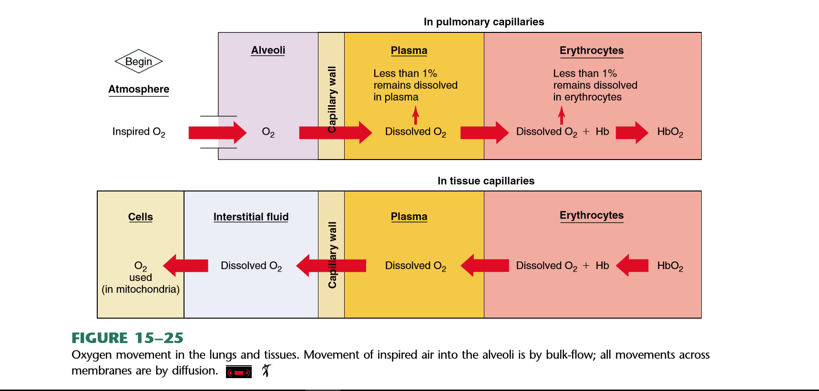

Slide 17
Effects of Blood PCO2, H Concentration, Temperature, and DPG Concentration on Hemoglobin Saturation
At any given PO2, a variety of other factors influence the degree of hemoglobin saturation:
blood PCO2,
H+ concentration,
temperature,
2,3-diphosphoglycerate (DPG) (also known as bisphosphoglycerate, BPG)—produced by the erythrocytes.
Increase in any of these factors causes the dissociation curve to shift to the right, which means that, at any given PO2, hemoglobin has less affinity for oxygen.
In contrast, a decrease in any of these factors causes the dissociation curve to shift to the left, which means that, at any given PO2, hemoglobin has a greater affinity for oxygen.

Slide 18
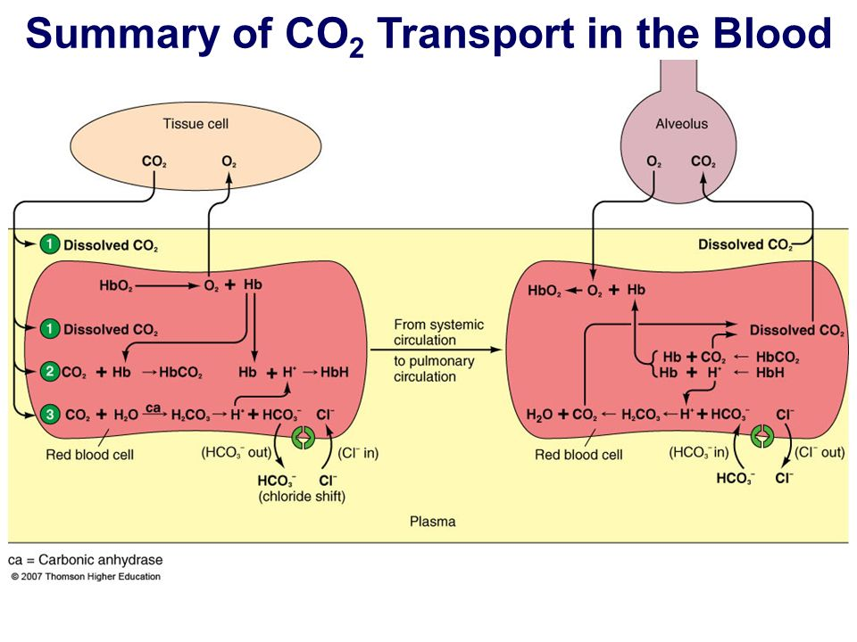
Transport of Carbon Dioxide in Blood
In a resting person, metabolism generates about 200 ml of carbon dioxide per minute.
When arterial blood flows through tissue capillaries, this volume of carbon dioxide diffuses from the tissues into the blood .
Carbon dioxide is much more soluble in water than is oxygen = more dissolved carbon dioxide than dissolved oxygen is carried in blood.
Even so, only a relatively small amount of blood carbon dioxide is transported in this way; only 10 percent of the carbon dioxide entering the blood remains physically dissolved in the plasma and erythrocytes

Slide 19
Transport of Carbon Dioxide in Blood
Another 30 percent of the carbon dioxide molecules entering the blood reacts reversibly with the amino groups of hemoglobin to form carbamino hemoglobin.
The remaining 60 percent of the carbon dioxide molecules entering the blood in the tissues is converted to bicarbonate:

Slide 21
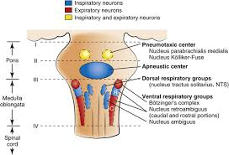
Control of Respiration
The rhythmic pattern of breathing and the adjustments are integrated within portions of the brainstem known as the respiratory center.
Four specific regions have been identified: (i) the dorsal respiratory group (DRG) in the dorsal medulla, (ii) the ventral respiratory group (VRG) in the ventral medulla, (iii) the pneumotaxic center (PC) in the rostral portion of the pons, and (iv) the apneustic center in the caudal pons.

Slide 22
Control of Respiration
Neurons of the DRG are associated with inspiratory activity and generate the basic rhythm of breathing.
Operates on «ramp signal». Begins weakly, increases steadily for about 2 sec,ceases abruptly for next 3 seconds –Pacemaker activity
Inspiration is initiated by a burst of action potentials in the nerves to the inspiratory muscles.
Then the action potentials cease, the inspiratory muscles relax, and expiration occurs as the elastic lungs recoil.
Output from the DRG is relayed via the phrenic nerve to the diaphragm to provide for its contraction
Input to the DRG is relayed via the vagal and glossopharyngeal nerves.

Slide 23
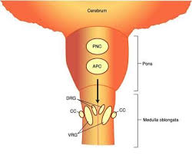
Control of Respiration
The VRG has neurons that are associated with both inspiratory and expiratory activity but it is primarily responsible for expiration.
If expiration is considered to be passive during normal quiet breathing, the expiratory neurons are not active;
During exercise, when expiration becomes an active process, the expiratory neurons are active.
But, it is likely that the inspiratory neurons of the VRG are also more active during exercise.

Slide 24
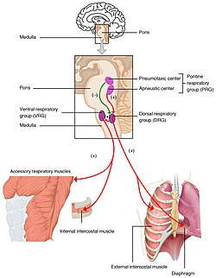
Control of Respiration
The PC inhibits inspiration and therefore regulates inspiratory volume and respiratory rate.
The primary function of the PC is to limit inspiration, thereby controlling the duration of the filling phase of the respiratory cycle.
The pneumotaxic signal that controls the filling phase may be strong or weak.
*The effect of a strong signal is to increase the respiratory rate whereby both inspiration and expiration are shortened and which are coupled with a lesser tidal volume. The converse is true for a weak PC signal.
The apneustic center is the least understood of all the regions of the respiratory center; consequently, there is no consensus as to its role. Whereas the PC is concerned with the termination of inspiration, the apneustic center is believed to be associated with deep inspirations (apneusis).
Perhaps complementary breaths (sighs) are manifestations of apneustic center activity

Slide 25
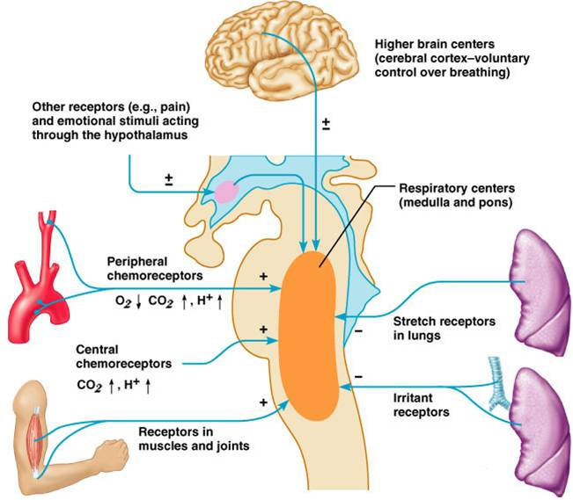
Neural control of ventilation
Hering–Breuer reflexes
The basic rhythm of respiration may be modified so that the breathing rate, depth, or both are changed.
The reason for the modification is to change the rate of ventilation in response to body needs.
Afferent impulses to the respiratory center from several receptor sources have been identified.
The most noteworthy of these among many of the animals are the Hering–Breuer reflexes.
The receptors for these reflexes are located in the lung and particularly in the bronchi and bronchioles.

Slide 26
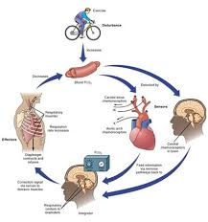
Neural control of ventilation
There are two components to the Hering–Breuer reflexes:
(i) the inspiratory‐inhibitory or inflation reflex and
(ii) the inspiratory or deflation reflex.
The nerve impulses generated by the receptors of the Hering–Breuer reflexes are transmitted by fibers in the vagus nerves to the respiratory center.
The effect of inflation‐receptor stimulation is to inhibit further inspiration (stimulation of neurons in the DRG) and to stimulate expiratory nerves in the VRG.
The inspiratory or deflation reflex component is activated at some particular point of deflation.
Deflation reflex receptor stimulation can be elicited in anesthetized dogs by manual compression of the thorax, which is followed immediately by inspiration.
Practical use of this reflex is appropriate for respiratory depressed or unresponsive animals to promote more adequate ventilation in the former or to initiate ventilation in the latter.
During exercise when tidal volume and frequency are increased, it would appear that the deflation reflex is more active in order to hasten the beginning of the next inspiration.

Slide 27
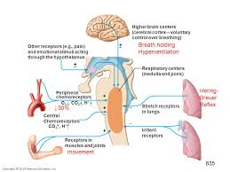
Neural control of ventilation
There are other peripherally located receptors that assist in modifying the basic rhythm.
Stimulation of receptors in the skin is excitatory to the respiratory center.
Advantage is taken of these receptors when stimulation of breathing is desired in newborn animals: Rubbing the skin with a rough cloth often starts the breathing cycles.
An assist to ventilation needed during muscle activity is obtained from receptors located in tendons and joints.
They will be stimulated when muscle contraction causes movement.
It is also believed that when impulses are directed to skeletal muscles from the cerebral cortex, collateral impulses go to the brainstem and stimulate the respiratory center to increase alveolar ventilation.
This mechanism might account for increases in ventilation that are not explainable by mere observation of changes in carbon dioxide, oxygen, and hydrogen ion concentration in the blood.

Slide 28
Upper air passage reflexes
Stimulation of the mucous membrane in these regions causes reflex inhibition of respiration.
A striking example of this reflex is the inhibition of respiration that occurs during swallowing.
Stimulation of the mucous membrane of the larynx in the unanesthetized animal causes not only inhibition of respiration but, usually, also powerful expiratory efforts (coughing).
Similarly, stimulation of the nasal mucous membrane frequently leads to sneezing.
The function of all these reflexes is to protect the delicate respiratory passages and the depths of the lungs from harmful substances (irritating gases, dust, food particles) that otherwise might be inspired.

Slide 29
Baroreceptor modification of respiration
The principal function of afferent impulses from baroreceptors in the carotid and aortic sinuses is to regulate the circulation.
However, the same receptors are also able to modify respiration.
The receptors are constantly generating impulses that increase in frequency when blood pressure increases and which decrease in frequency when blood pressure decreases.
These impulses to the respiratory center are inhibitory in nature, and respiratory frequency decreases when impulse frequency increases.
It is believed that the function of this response is to modify the return of blood to the heart.
For example, when blood pressure is reduced, respiration increases and flow of blood to the heart is facilitated.

Slide 30
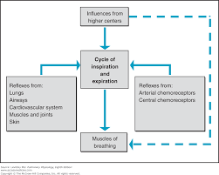
Voluntary control of respiration
Ordinary respirations proceed quite involuntarily.
However, it is a matter of everyday experience that they may be altered voluntarily within wide limits; they may be hastened, slowed, or stopped altogether for a while.
If respirations are entirely inhibited voluntarily, there soon comes a time when one must breathe again; the cells of the respiratory center escape from the inhibition.

Slide 31
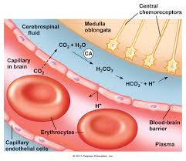
Central chemoreception
Chemosensitive areas near the ventral surface of the medulla are highly sensitive to changes in hydrogen ion concentration of the interstitial fluid of the brain.
The chemoreceptors in these areas are excitatory to the respiratory center, causing increases in tidal volume and in frequency.
Whereas hydrogen ions diffuse poorly through the blood–cerebrospinal fluid barrier
Whenever the PaCO2 increases, the PCO2 of both the interstitial fluid of the medulla and the cerebrospinal fluid increases, forming hydrogen ions through hydration.
Because of the barriers to hydrogen ion diffusion, the respiratory center response to respiratory acidosis (increased Paco2) is greater than the response to metabolic acidosis (increased hydrogen ion concentration).

Slide 32
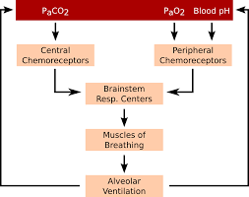
Peripheral chemoreception
The anatomical entities known as the carotid and aortic bodies, found in the region of the bifurcation of the carotid arteries and the arch of the aorta, respectively, are chemoreceptors.
They detect changes in the partial pressures of carbon dioxide, oxygen and hydrogen ion concentration and affect the respiratory center by transmission of impulses in afferent nerve fibers of the glossopharyngeal nerves (from the carotid bodies) and vagus nerves (from the aortic arch).
Although the medulla is the principal location for detection of changes in carbon dioxide and hydrogen ion concentrations, it has been shown that the carotid and aortic body chemoreceptors supply about 50% of the ventilator drive in response to changes in PaCO2.
Carotid and aortic body chemoreceptors, however, are the only places where the partial pressure of oxygen is detected.
These small organs are highly perfused with blood, and the oxygen needed for baseline activity is obtained from the oxygen in solution.

Slide 33
Peripheral chemoreception
Nerve impulse transmission by the carotid and aortic bodies to the respiratory center varies with the Po2 perfusing them, as mentioned above.
The impulse discharge rate is increased most significantly in the Po2 range 20–60 mmHg and declines rapidly after 60 mmHg.
The oxygen–hemoglobin dissociation curve shows that hemoglobin is still about 90% saturated with oxygen at a partial pressure of 60 mmHg.
Therefore, no serious oxygen lack is present and little change in ventilation occurs.

