Slide 1
RISK CALCULATION
Relative risk;
The x2-test is used to determine the relationship between a disease and the hypothesis. This test can not be used to determine the level of the relationship. Therefore, the value determined by this method is considered as relative risk.
Relatif risk (r) = a/(a+b)
c/(c+d)
 | Hastalık var | Hastalık yok
Has a factor | a | b
Hasnt a factor | c | d

Slide 2
Odds ratio=ad/bc
qualIfIable risk

Slide 3
Odds ratio =ad/bc
qualIfIable risk = [a/(a+b)- [c/(c+d) ]

Slide 4
SUBMISSION OF DATA

Slide 5
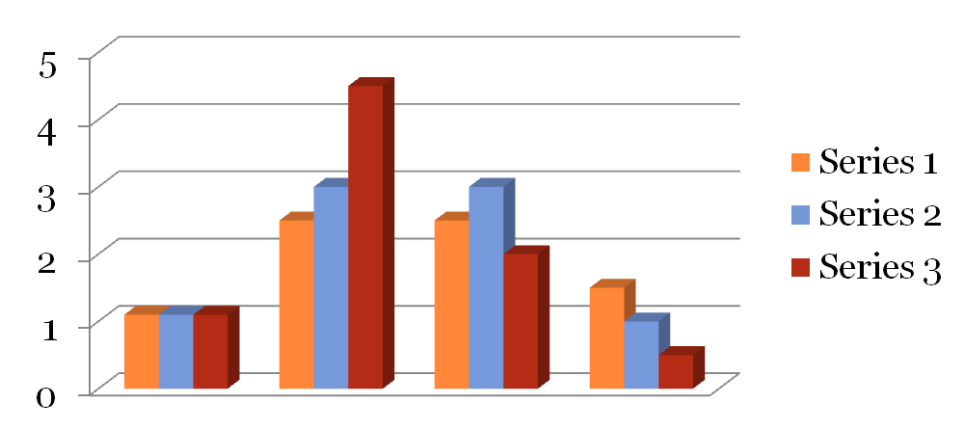
Graphical methods
1-Histogram and frequency polygon

Slide 6
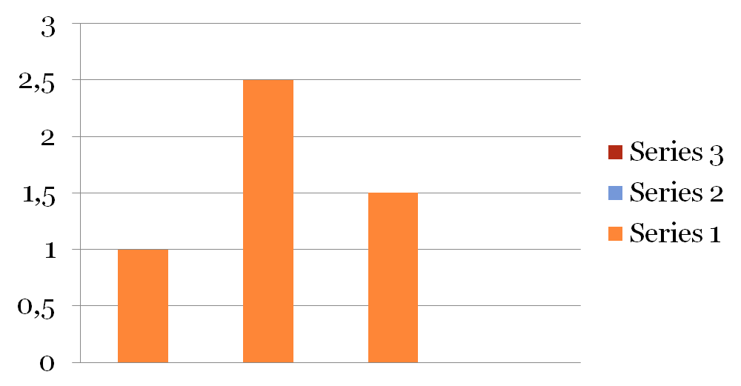
Graphical methods
2- column chart

Slide 7
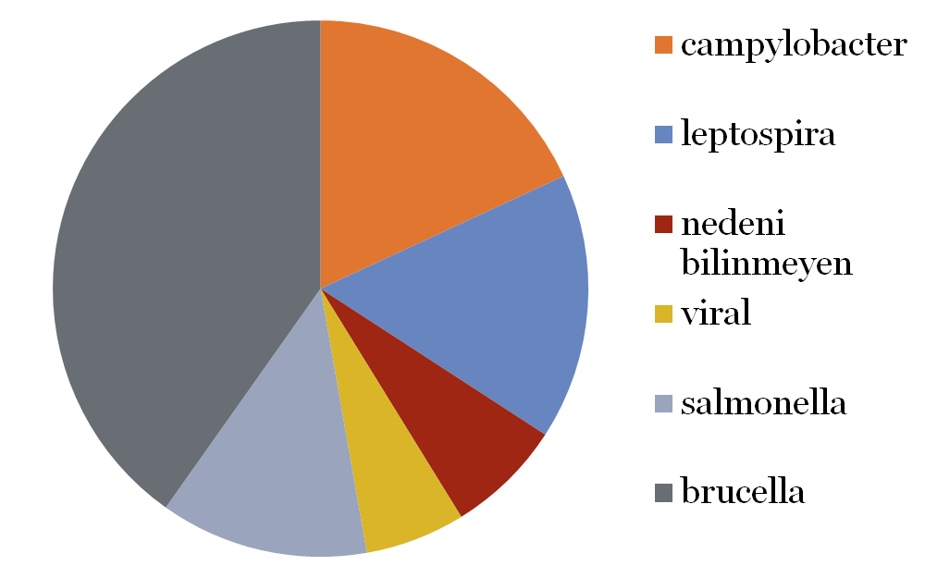
Graphical methods
3- Sliced graphic

Slide 8
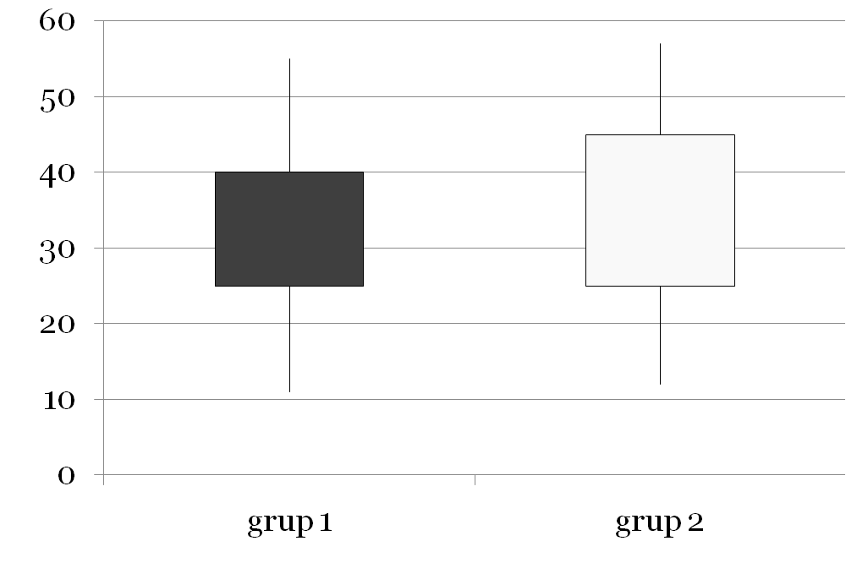
Graphical methods
4-Box and whisker plot

