Slide 1
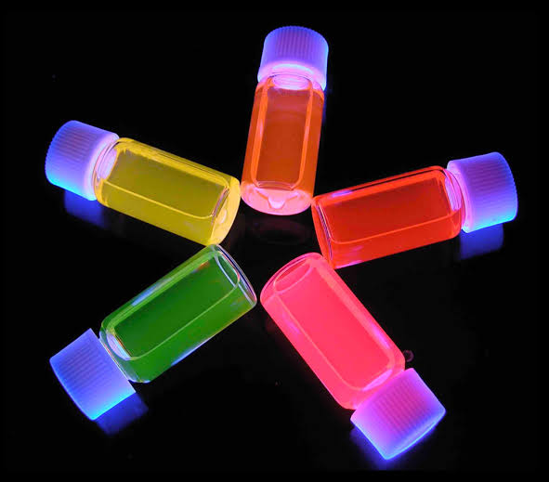
SEMICONDUCTOR QUANTUM DOTS AS FLUORESCENT PROBES FOR IN VITRO AND IN VIVO BIO-MOLECULAR AND CELLULAR IMAGING

Slide 2
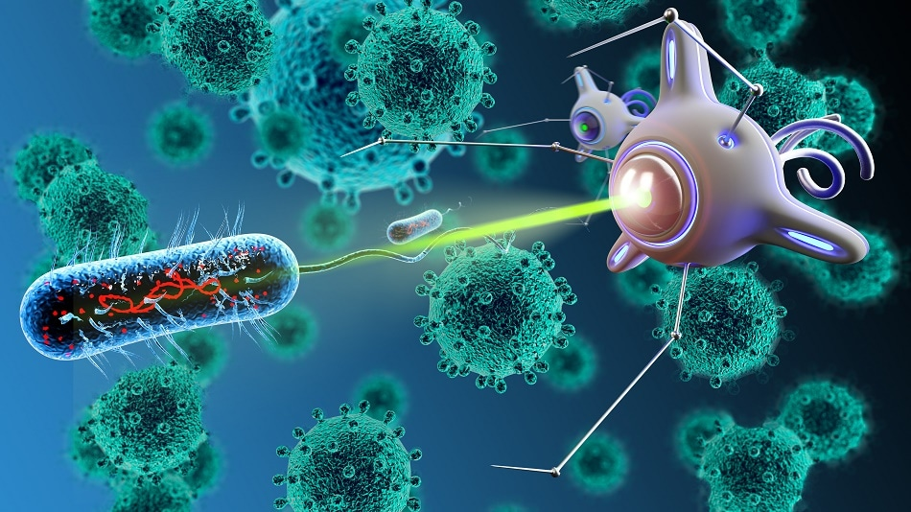
What is Nanotechnology?
Nanotechnology is the manipulation of matter in dimensions <100 nm. It is based on the fact that the physical and chemical properties of matter change considerably at the nanoscale compared to those that they exhibit at the macroscale.

Slide 3
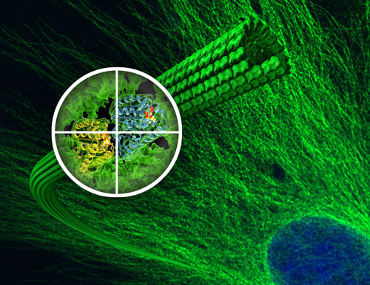
QD in Biomedical Imaging
All over the years biological imagining has seen many advances allowing scientist to unfold many mysteries. The ideal imagining resolutions found in nanometers.
Their potential clinical applications and the limitations that need to be overcome have also been discussed.

Slide 4
Quantum Dots Historical Side
Colloidal semiconductor QDs were first prepared by Professor Louis Brus in 1982 and this marked the birth of a nanoscience building block.
Weller first described the quantum confinement effects of the colloidal semiconductor Q-particles in 1993.
In the same year, Murray and colleagues developed a novel, reproducible method for the synthesis of high quality, monodisperse nanocrystals. QDs were first introduced to biological imaging in 1998.

Slide 5
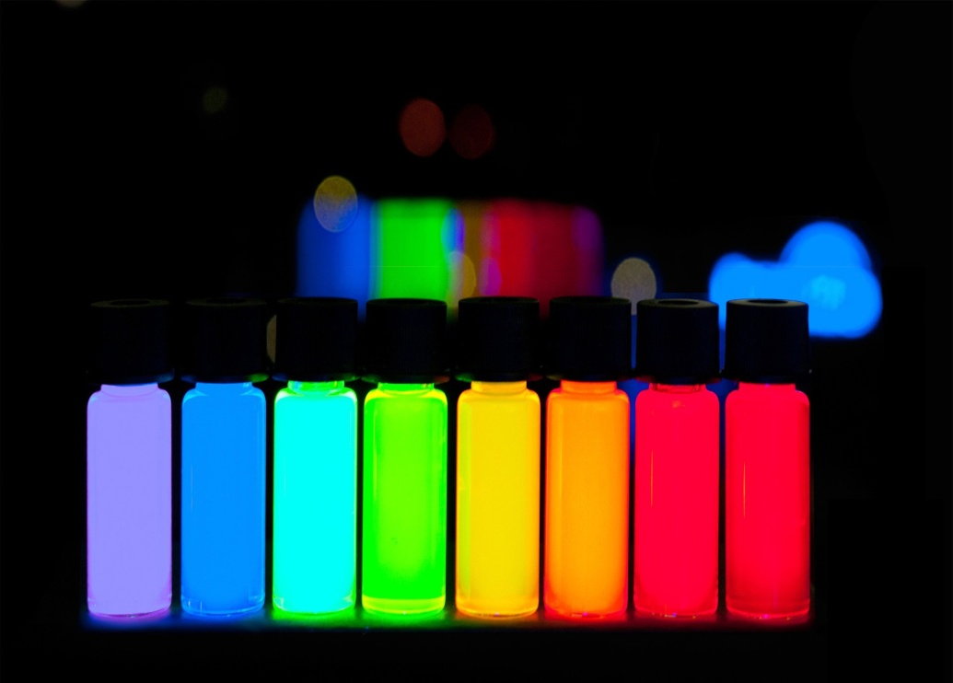
Quantum Dots - Basics
QDs are fluorescent semiconductor nanocrystals, composed of materials from the elements in the periodic groups of II–VI, III–V or IV–VI.
They range in size from 2 to 10 nm in diameter and contain approximately 200–10,000 atoms.
Their emission colour depends on their size, chemical composition and surface chemistry and can be tuned from the ultraviolet to the visible and near-infrared (NIR) wavelengths.

Slide 6
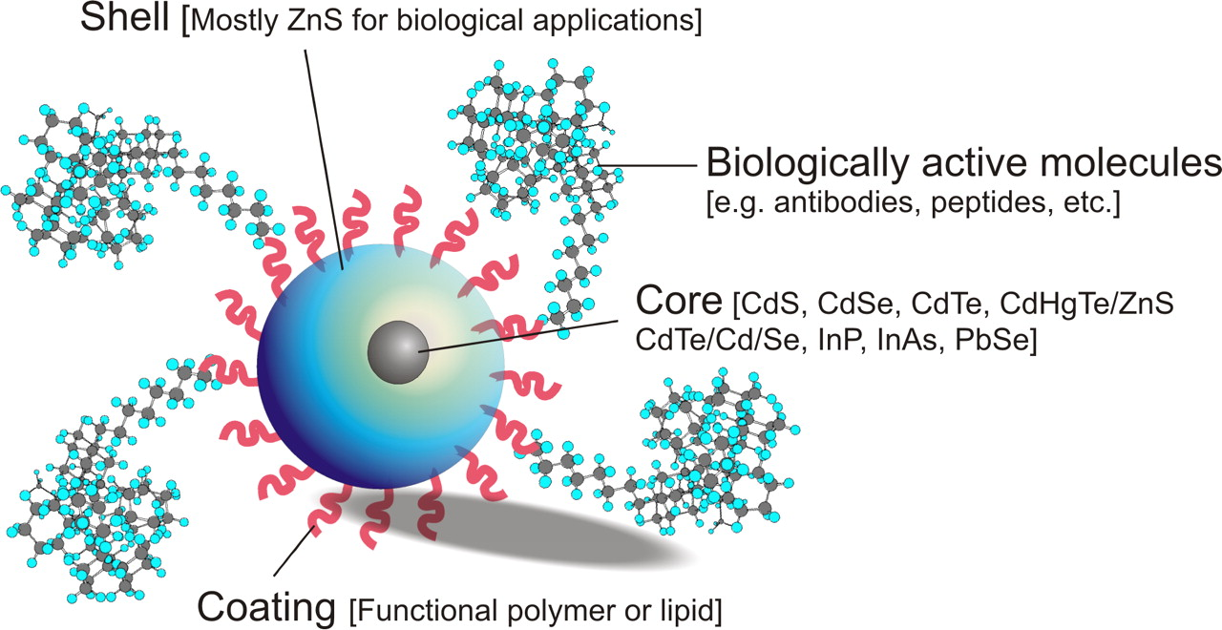
Quantum Dots - Structure

Slide 7
Quantum Dots –Comparison

Slide 8
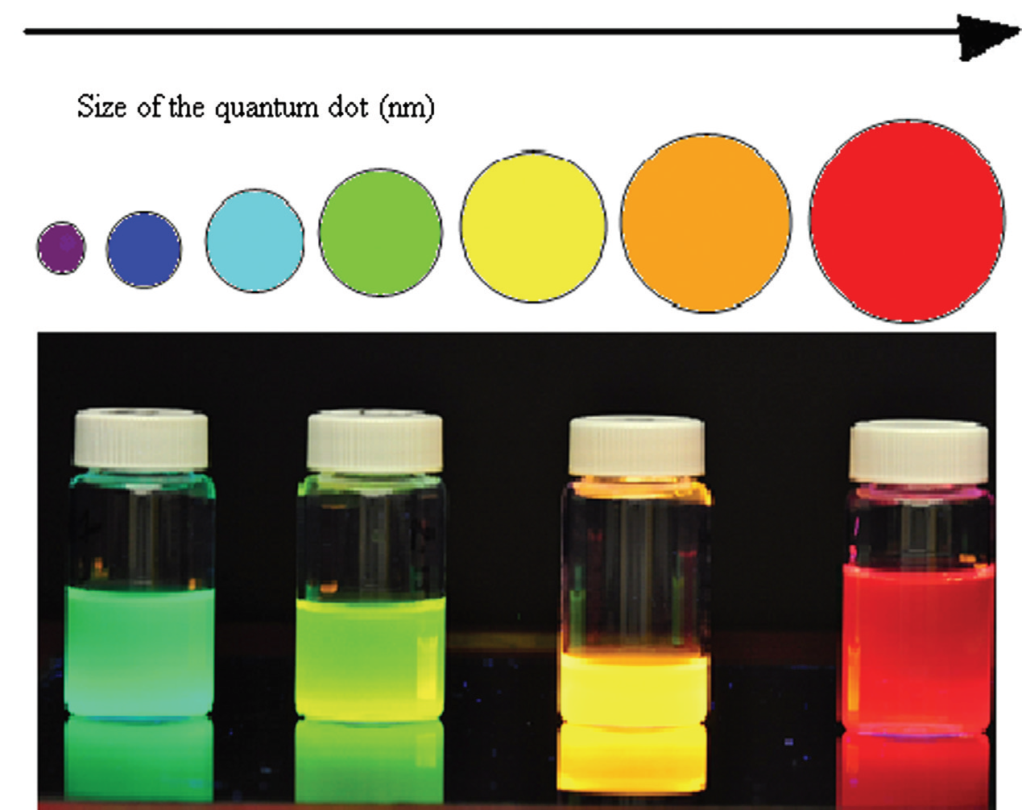
As the size of the quantum dot changes,the color of the light that is emitted changes.
Larger QDs emit (5-6nm ) with colors such as orange or red.
Smaller QDs (2–3 nm) emit colors like blue and green.

Slide 9
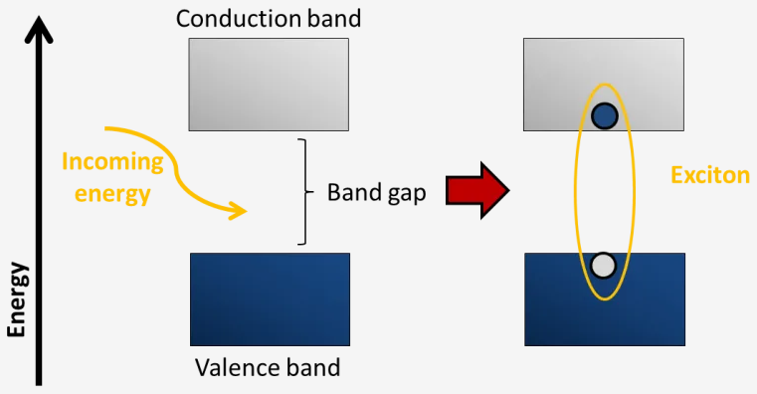
SO,WHAT ARE THE REASONS FOR THESE PROPERTIES of QDs?
It is possible to explain the most important property of QDs by their size.
Exciton: electron-hole pair
Exciton bohr radius: the average physical distance between the electron-hole pair
-different for different materials

Slide 10
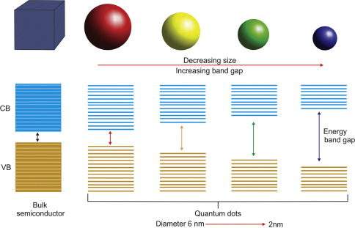
As the size of the semiconductor material approaches the size of its exciton bohr radius, the energy levels become discrete and the nanocrystal is called a QD.
Quantum confinement effect:
Due to the dimension effect, the behavior of electrons in QDs differs from that in the bulk material, this is called the quantum confinement effect.
The smaller the QD, the higher the band gap energy.

Slide 11
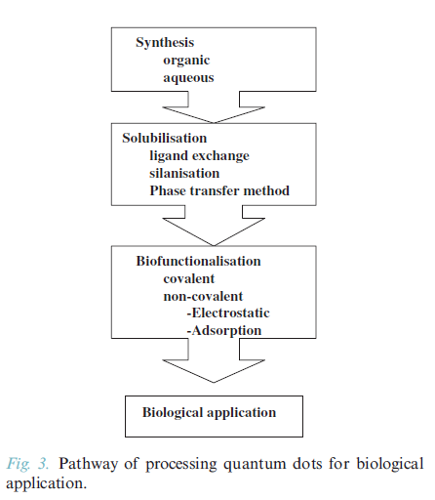
Process of biofunctionalisation ;

Slide 12
Synthesis
ORGANIC
İnvolves:
high temperature
surfactant
-insoluble QDs in aqeous media
AQEOUS
+simpler
+cheaper
+reproducible
+water soluble QDs
-crystallinity
- quantum yields
- FWHM
- reaction times
-preparation is time-consuming
MICROWAVE ASSISTED
based on microwave irradiation with controllable temperatures.
+reduced toxicity
+good reproducibility
+cheap
+good water solubility
+stability
+biocompatibility

Slide 13
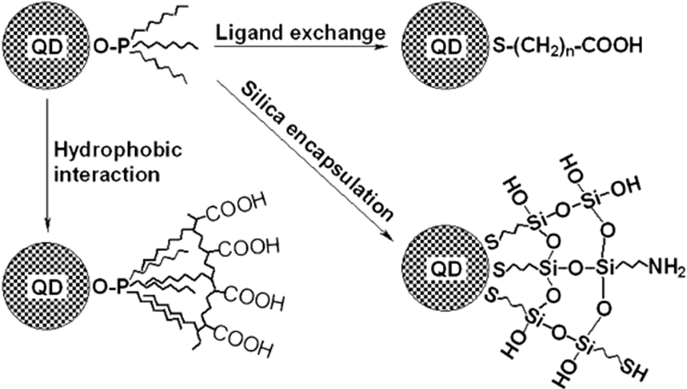
SOLUBILISATION:
As most QDs are synthesized
by theorganic route,
their hydrophobic
surface chemistry makes
them insoluble in aqueous
biological media.

Slide 14
The techniques used to achieve solubilisation include;
Ligand Exchange method:
The ligand exchange method is based on the exchange of the hydrophobic surfactant molecules with bifunctional molecules to bind to the ZnS shell on the QD.
Surface Silanisation:
Surface silanisation involves the growth of a silica shell around the nanocrystal.
The phase transfer method:
Uses amphiphyllic polymers to coat the QD surface.

Slide 15
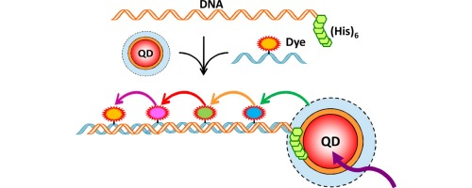
BIOCONJUGATION:
Once solubilisation has been achieved, QDs can be functionalised by conjugation to a number of biological molecules.

Slide 16
Methods of bioconjugation fall into two categories:
NON-COVALENT CONJUGATION:
Noncovalent interactions include adsorption, electrostatic interaction and mercapto exchange.
COVALENT CONJUGATION:
Covalent linkage is the most stable of all the bioconjugation methods
And utilises functional groups on the QD surface, to form a covalent bond with similar groups present on the biomolecules or through the use of crosslinker molecules

