Slide 1
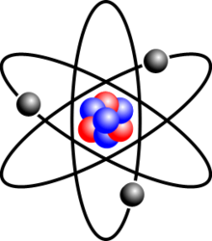
Atomism
Dr. Vural Başaran

Slide 2
If, in some cataclysm, all of scientific knowledge were to be destroyed, and only one sentence passed on to the next generation of creatures, what statement would contain the most information in the fewest words? I believe it is the atomic hypothesis that all things are made of atoms — little particles that move around in perpetual motion, attracting each other when they are a little distance apart, but repelling upon being squeezed into one another. In that one sentence, you will see, there is an enormous amount of information about the world, if just a little imagination and thinking are applied. (Richard Feynman)

Slide 3
Three kind of atomism:
1) Logical Atomism
2) Psychological Atomism
3) Physical Atomism

Slide 4
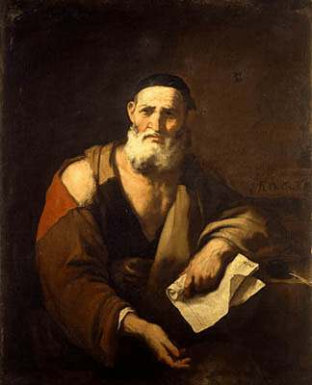
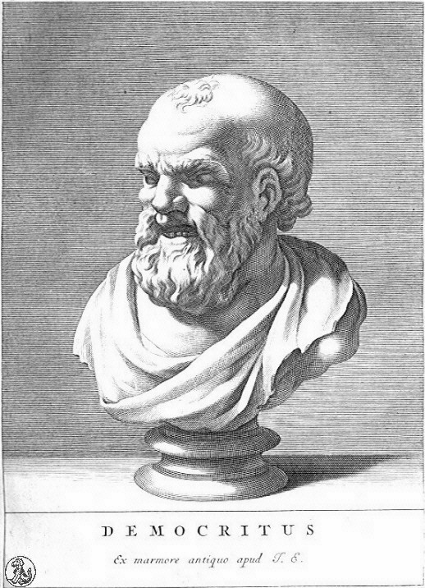
Physical or Ancient Atomism
Leucippus (5th Century B.C.)
Democritus (5th Century B.C.)
Epicurus (341-270 B.C.)
Lucretius (95-55 B.C.)

Slide 5
Leucippus is the founder of the atomist school. However, it is difficult to determine the real owners of the studies when talking about atomist school.
Maybe, Leucippus was founder of the atomist school, but his views was systematized by Democritus.

Slide 6
Democritus was born in Abdera.
He wrote over 60 books.
His the most famous works are on atoms.
The word of atom comes from the Ancient Greece world. It means uncut or indivisible.

Slide 7
According to Compleston, “atomist philosophy” is logical development of Empedocles’ natural philosophy.
For Empedocles, the Universe is formed by different combinations of four elements: earth, water, air and fire.

Slide 8
The Nature of Atoms
What is the nature of qualities?
According to Democritus atoms have no qualities.
So properties or senses is not reality.
Atoms are devoid of all qualities.

Slide 9
Atoms are defined by 3 quantitative measures.
1) Shape
2) Arrangement
3) Position

Slide 10
For Democritus the Atom is the smallest element
The number of atom is actually infinite.
They have all different sizes and shapes.

Slide 11
Nature itself exist independent of human beings. (Physis)
But our senses are not reality. It is artificial human construction and it depends on human being for its existence. (Nomos)

Slide 12
Democritus said that:
By convention sweet is sweet, bitter is bitter, hot is hot, cold is cold, color is color; but in truth there are only atoms and the void.
Atoms are too small to be perceived.
Senses just apparent knowledge.

Slide 13
By supposing that the atoms form the lowest limit to division, the atomist escape from the Zeno’s paradoxes, a total space traversed has only a finite number of parts.

Slide 14
Zeno of Elea
He was the member of Elea school. He is best known for his paradoxes.
Three of the Zeno’s paradoxes the strongest and the most famous.
Achilles and tortoise, dichotomy of argument, arrow in flight.

Slide 15
Atomists are also founder of mechanistic and materialistic philosophy tradition.
They tried to avoid teleological explanation and denied divine intervention.
They formulated their views on ethics, theology, political philosophy and epistemology consistent with this physical system.

Slide 16
Epistemology
How can we get the knowledge or truth.
According to Democritus we must rely on our mind or reason. So he trust method of deduction.
For him we must use our mind to get true knowledge.

Slide 17
Atomic Philosophy influenced both western philosophy and Islamic eastern philosophy.

