Slide 1
NUCLEAR TRANSPORT
Prof. dr. Fulya Tekşen

Slide 2
NUCLEUS
In eucaryotic cells, Nucleus is seperated from the cytoplasm by a two layered membrane, called nuclear envelope.
The inner membrane contains proteins that binds;
- Chromosomes and Nuclear lamina
Outer membrane is continuous with the membrane of Endoplasmic Reticulum and studded with ribosomes

Slide 3
FIGURE 1: Nuclear Membrane

Slide 4
Nuclear Transport;
occurs through the nuclear pores that span the membranes of nuclear envelope.
A typical mammalian cell contains 3000-4000 Nuclear pore complex (NPC)s.
Ex. Glial cell ------- Few hundred NPC
Purjinke neurons --------- 20 000 NPC

Slide 5
A typical NPC– Nuclear Pore Complex ;
Can transport 1000 macromolecules per second and it is BIDIRECTIONAL.

Slide 6
SMALL AND LARGE MOLECULES
Small, water soluble molecules such as 5000 daltons or less, can diffuse easily, but larger proteins OR RİBONUCLEOPROTEİNS (60 000 dalton) first bind to specific receptor proteins and then can be transported.

Slide 7
Which Molecules transport?
From Cytoplasm to Nucleus From Nucleus to Cytoplasm
(Import) (Export)
- Proteins
(Histones- Transcription factors
-RNA Polymerase-DNA Polymerase)
- Ions - mRNP
(messenger ribonuclear particles)
- Small metabolites - tRNA
- ribosomal subunits

Slide 8
During the import of molecules;
The proteins are in folded state.
That is different from the transport from other membranes of the organelles such as; mitochondria, endoplasmic reticulum and chloroplast.

Slide 9
Structure of Nuclear Pore
Nuclear Pore is formed from nuclear pore complex (NPC) that itself is, a protein complex with a mass of 60-80 million Dalton in vertebrates.
The complex contains 30 different kind of proteins called, nucleoporins.
One of them is, FG, nucleoporin that contains multipl copies of FG (Phenylalanine and Guanine) hydrophobic sequences placed in the central transporter channel.
Cytoplasmic filaments ARE ALSO FOUND IN THE nuclear pore and the distal part of these filaments form a nuclear basket in the nucleoplasm.
The membrane embedded portion of NBC İS ALSO ATTACHED DIRECTLY TO THE NUCLEAR LAMINA (Intermediate filaments).

Slide 10
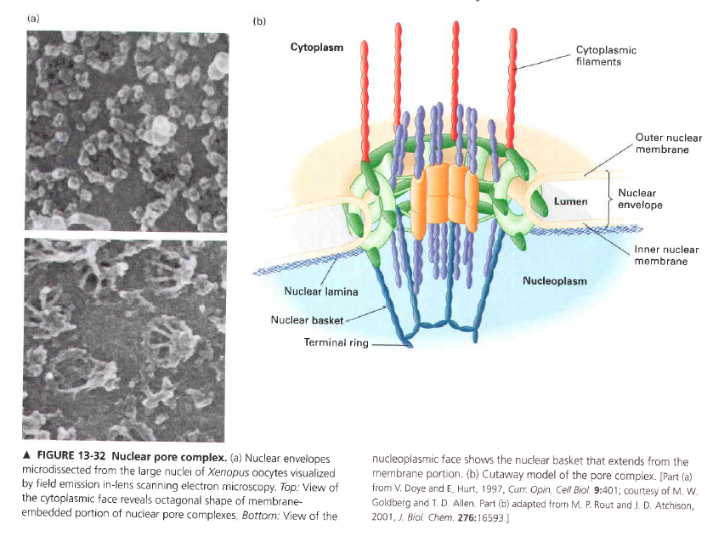
FIGURE 2: NUCLEAR PORE COMPLEX

Slide 11
NUCLEAR LOCALIZATION SIGNALS
These sorting signals direct nuclear proteins in and out of the NUCLEUS and they are responsible for the selectivity in active nuclear transport.
In fact, they are short sequences of amino acids that are rich in the positively charged amino acids lysine and arginine.
Experimentally it is also shown that; when the nuclear proteins were extracted and introduced to cytosol, they return back and accumulate again in the nucleus.

Slide 12
Nuclear IMPORT (IMPORTIN) and EXPORT receptors (EXPORTINS)
They are coded by the same gene family called, karyopherins.
They are soluble cytosolic proteins in structure.
They bind BOTH with the signal sequence (NLS) of the KARGO PROTEIN (Protein that will be transported) and the phenylalanine-glycine (FG)repeatsin the channel nucleoporins which are located in the central pore.
In some cases, additional ADAPTOR proteins can take place between the import receptors and nuclear localization signals on the proteins that will be transported (KARGO Proteins).

Slide 13
IMPORTINS
These are the proteins that contain Nuclear-Localization Signals, THAT direct the molecules into the NUCLEUS.
The importation process is important, as essential molecules such as,
- Histones
- Transcription factors
- DNA Polymerase
- RNA Polymerase
are synthesized in the Cytoplasm and then transported to the Nucleus.

Slide 14
FIGURE 3: Nuclear Import

Slide 15
In the transfer of molecules;
Diffusion is the basic way so the concentration gradients play important role and it is unidirectional.
The passage of molecules bigger than 20-40 kDa through nuclear pore needs PROTEINS.
Proteins imported to or exported from the nucleus contain specific aminoacid (aa) sequences that function as nuclear- localization signal (NLS) or nuclear-export signal (NES).
These signalling parts (NLS or NES) bind specifically to receptor proteins (exportin or importin) that belong to a family of proteins called KARYOPHERINS.
In both Import and Export Processes, Ran molecule can be used, which is a monomeric G protein that shows different conformations when bound to GTP (Guanosin tri phosphate) or GDP (Guanosin di phosphate).
After the ‘CARGO’ complex reaches it’s destination it dissociates, the ‘cargo protein’ becomes free, and the other molecules go to the opposite direction to transport other molecules.

Slide 16
Nuclear Export
- Proteins
- tRNA
- Ribosomal subunits
are transported from nucleus to cytoplasm.
Mechanism is similar with the importation.

Slide 17
Nuclear Export
Can be done by Ran-dependent or Ran-Independent Mechanism

Slide 18
By Ran-dependent Way;
Ran Molecules are used .

Slide 19
FIGURE 4: Nuclear Export

Slide 20
Most mRNA molecules are exported by Ran-Independent Mechanism
As shown in the figure; The heterodimeric TAP (nuclear export factor 1)/Nxt 1 (Nuclear export transporter 1) Complex binds to mRNA- protein complex in the nucleus.
Then, the association of this complex to NPC ( Nuclear pore centre) direct the mRNP to the central channel of the pore.
At this stage, a helicase( Dbp5) located on the cytoplasmic side of NPC is thought to provide a driving force for the passage and dissociation of TAP and Nxt1 proteins from mRNA.

Slide 21
Export of mRNA;
is a critical step in eukaryotic gene expression as;
During transcription and processing, mRNA molecules are assembled into messenger ribonucleoparticles (mRNPs) and then these molecules are exported through nuclear pore complexes (NPCs).

Slide 22
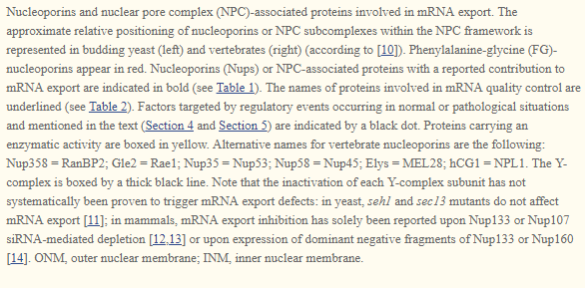
FIGURE 5: Conservation of Nuclear Pore Complex (NPC)in Vertebrate and Yeast

Slide 23
Also importantly;
Changes in mRNA export have been associated with post-translational modifications of nucleoporins or changes in NPC composition, depending on;
- cell cycle progression
- development
OR
- exposure to stress

Slide 24
Nucleoporin Modifications that affect mRNA EXPORT are;
- Change in protein level
- Delocalization from NPC
- Modification at NPC such as PHOSPHORYLATION, CLEAVAGE or altered OLIGOMERIZATION

Slide 25
DISEASE ASSOCIATION
NPC (Nuclear pore complex) modifications also affect the cellular mRNA export in pathological conditions; such as genetic diseases, cancers and viral infections.
For example; mutation of a scaffold nucleoporin, Nup155 was reported to be associated with a cardiac disorder, atrial fibrillation.

Slide 26
References
Bruce Alberts, Alexander Johnson, Julian Lewis, David Morgan, Martin Raff, Keith Roberts, Peter Walter-Molecular Biology of the Cell-Garland Science (2015)
Geoffrey M. Cooper & Robert E. Hausman-The Cell. A Molecular Approach-Sinauer Associates (2007)
Harvey Lodish, Arnold Berk, Chris A. Kaiser, Monty Krieger, Matthew P. Scott, Anthony Bretscher, Hidde Ploegh, Paul Matsudaira-Molecular Cell Biology (Lodish, Sixth Edition)-W. H. Freeman (2007)
Amandine Bonnet and Benoit Palancade* Regulation of mRNA Trafficking by Nuclear Pore Complexes. Genes (Basel). 2014 Sep; 5(3): 767–791.

