Slide 1
Chicken Breeds and Varieties
Chicken exist in many colors, sizes and shapes. There are more than 200 chicken breeds.
They are classified as pure breed and hybrids

Slide 2
Although standard pure breeds have left their place in hybrids for commercial breeding, pure breeds are still important.
Hybrid breeding and breeding facilities have been developed by breeding and breeding enterprises. In parallel with the expansion of the production system, modern chicken breeds may gain importance again.

Slide 3
Classification of chicken breeds
Classification according to regions
American breeds (New Hampshire,Rhod Island Red, Plymouth Rock)
Asian breeds (Brahma,Cochin,Langshan)
English breeds (Cornish,Orpington,Sussex)
Mediterranean breeds (Leghorn,Minorca,Endülüs)

Slide 4
Classification according to yield aspects;
Egg type (Leghorn,Ankona,Minorca)
Meat type (Brahma,Cochin,Cornish,Dorking,Langshan)
Meat-Egg or Egg-Meat type(Australop,New Hampshire,Plymouth-Rock)

Slide 5
According to body structure
Heavy Breeds (Brahma, Cornish, Orpington)
Medium Breeds (New Hampshire)
Light Breeds (Leghorn, Minorca)

Slide 6
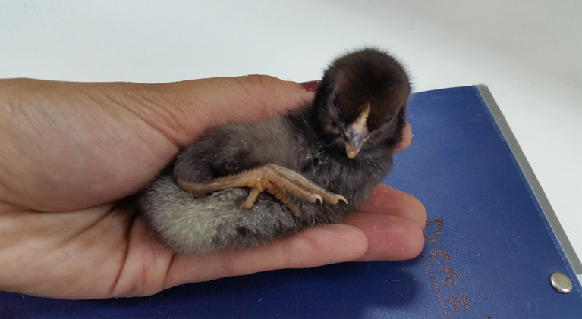
Native Breeds
Denizli

Slide 7
Gerze

Slide 8
Sultan

Slide 9
Commercial hybrids
Hybrid production provide the material for commercial breeding.
Genetic structure is different from each other obtained by parental lines.

