Slide 1
ANKARA UNIVERSITY DEPARTMENT OF ENERGY ENGINEERING NUMERICAL METHODS
INSTRUCTOR
DR. ÖZGÜR SELİMOĞLU

Slide 2
CONTENTS
Interpolations and Curve Fitting
a) Polynomial Interpolation

Slide 3
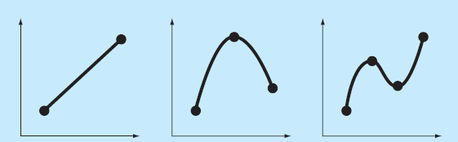
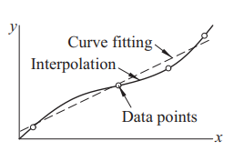
INTERPOLATION AND CURVE FITTING
Discrete data sets, or tables of the form
x₀ | x₁ | x₂ | ……. | x_{n}
y₀ | y₁ | y₂ | ……. | y_{n}
is widely used in technical calculations. The source of the data may be experimental observations or numerical calculations. There is a distinction between interpolation and curve fitting.
We create a curve from data points in interpolation.
Curve fitting is generally applied to data that contains scattering (noise) caused by measurement errors. Here, in a sense, we want to find a smooth curve that approaches the data. Thus, the curve does not necessarily hit the data points. The difference between interpolation and curve fitting is shown in Figure.

Slide 4
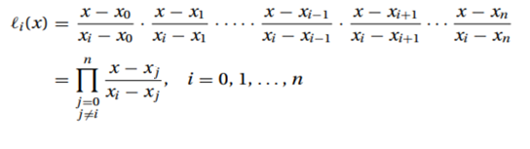
POLYNOMIAL INTERPOLATION
Lagrange’s Method
The simplest form of an interpolant is a polynomial. It is always possible to construct a unique polynomial of degree n that passes through n + 1 distinct data points. One means of obtaining this polynomial is the formula of Lagrange,
(1)
where the subscript n denotes the degree of the polynomial and
(2)
are called the cardinal functions.

Slide 5
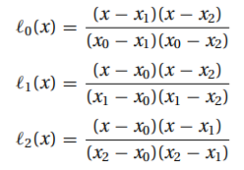
For example, if n = 1, the interpolant is the straight line P₁(x) = y₀ ℓ₀(x) + y₁ ℓ₁(x), where
With n = 2, interpolation is parabolic: P₂(x) = y₀ ℓ₀(x) + y₁ ℓ₁(x) + y₂ ℓ₂(x), where now
The cardinal functions are polynomials of degree n and have the property
(3)

Slide 6
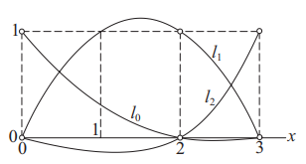
where δ_{ij} is the Kronecker delta. This property is illustrated in Figure for three point interpolation (n = 2) with x₀ = 0,
x₁ = 2, and x₂ = 3.
To prove that the interpolating polynomial passes through the data points, we substitute x = x _{j} into Eq. (1) and then use
Eq. (3). The result is;
It can be shown that the error in polynomial interpolation is
where ξ lies somewhere in the interval (x₀, x_{n}); its value is otherwise unknown. It is instructive to note that the further than a
data point is from x, the more it contributes to the error at x.

Slide 7
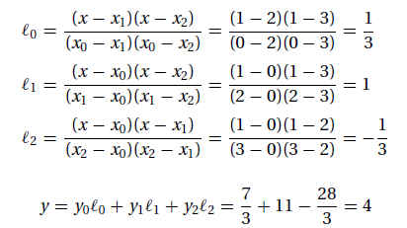
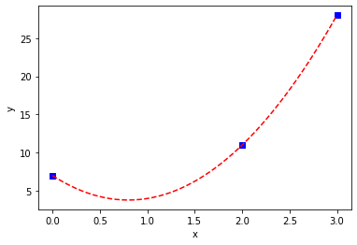
Example: Given the data points
use Lagrange’s method to determine y at x = 1.
Solution:
P₂(1)= ?

Slide 8
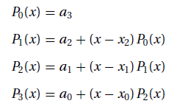
Newton’s Method
A better calculation procedure is obtained with the Newton method, in which the interpolating polynomial is written in the form.
This polynomial gives itself to an efficient evaluation procedure. Consider, for example, four data points (n = 3). Here the interpolating polynomial is
which can be evaluated backward with the following recurrence relations:
For arbitrary n we have

Slide 9
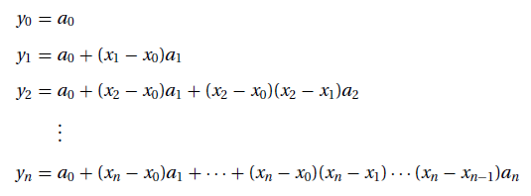
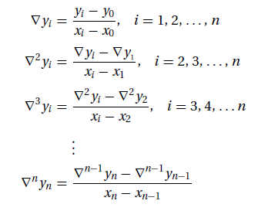
The coefficients of P_{n} are determined by forcing the polynomial to pass through each data point: y_{i} = P_{n}(x_{i} ), i = 0, 1, . . . , n. This yields these simultaneous equations:
(1)
Introducing the divided differences
the solution of Eqs. (1) is

Slide 10
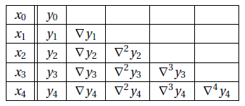
If the coefficients are computed by hand, it is convenient to work with the format in Table (shown for n = 4).
The diagonal terms (y₀, ∇y₁, ∇²y₂, ∇³y₃, and ∇⁴y₄) in the table are the coefficients of the polynomial. If the data points are listed in a different order, the entries in the table will change, but the resultant polynomial will be the same—recall that a polynomial of degree n interpolating n + 1 distinct data points is unique.
Initially, a contains the y-coordinates of the data, so that it is identical to the second column in Table . Each pass through the outer loop generates the entries in the next column, which overwrite the corresponding elements of a. Therefore, a ends up containing the diagonal terms of Table (i.e., the coefficients of the polynomial).

Slide 11
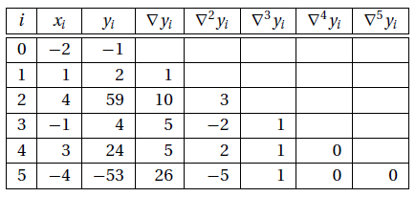
Example: Analyze the data using the Newton method.
Determine the degree of this polynomial by constructing a divided difference table, similar to Table.
Solution:
Here are a few sample calculations used in arriving at the figures in the table:
$∇y1=\frac{y1−y0}{x1−x0}$=$\frac{2−(−1)}{1−(−2)}$=$\frac{3}{3}$=1
$∇y2=\frac{y2−y0}{x2−x0}$=$\frac{59−(−1)}{4−(−2)}$=$\frac{60}{6}$=10
$∇y3=\frac{y3−y0}{x3−x0}$=$\frac{4−(−1)}{−1−(−2)}$= $\frac{5}{1}$ =5
$∇y4=\frac{y4−y0}{x4−x0}$=$\frac{24−(−1)}{3−(−2)}$=$\frac{25}{5}$=5
$∇y5=\frac{y5−y0}{x5−x0}$=$\frac{−53−(−1)}{−4−(−2)}$=$\frac{−52}{−2}$=26

Slide 12
$∇2y2=\frac{∇y2−∇y1}{x2−x1}$=$\frac{10−(1)}{4−(1)}$=$\frac{9}{3}$=3
$∇2y3=\frac{∇y3−∇y1}{x3−x1}$=$\frac{5−(1)}{−1−(1)}$= $\frac{4}{−2}$ =-2
$∇2y4=\frac{∇y4−∇y1}{x4−x1}$=$\frac{5−(1)}{3−(1)}$=$\frac{4}{2}$=2
$∇2y5=\frac{∇y5−∇y1}{x5−x1}$=$\frac{26−(1)}{−4−(1)}$=$\frac{25}{−5}$=-5
$∇3y3=\frac{∇2y3−∇2y2}{x3−x2}$=$\frac{−2−(3)}{−1−(4)}$= $\frac{−5}{−5}$ =1
$∇3y4=\frac{∇2y4−∇2y2}{x4−x2}$=$\frac{2−(3)}{3−(4)}$=$\frac{−1}{−1}$=1
$∇3y5=\frac{∇2y5−∇2y2}{x5−x2}$=$\frac{−5−(3)}{−4−(4)}$=$\frac{−8}{−8}$=1
$∇4y4=\frac{∇3y4−∇3y3}{x4−x3}$=$\frac{1−(1)}{3−(−1)}$=$\frac{0}{4}$=0
$∇4y5=\frac{∇3y5−∇3y3}{x5−x3}$=$\frac{1−(1)}{−4−(−1)}$=$\frac{0}{−3}$=0
$∇5y5=\frac{∇4y5−∇4y4}{x5−x4}$=$\frac{0−(0)}{−4−(3)}$=$\frac{0}{−7}$=0
From the table we see that the last nonzero coefficient (last nonzero diagonal term) of Newton’s polynomial is ∇³y₃, which is the coefficient of the cubic term. Hence the polynomial is a cubic.

Slide 13
Neville’s Method
Newton’s method of interpolation involved two steps: computation of the coefficients, followed by evaluation of the polynomial. It works well if the interpolation is carried out repeatedly at different values of x using the same polynomial. If only one point is to be interpolated, a method that calculates the interpolant in a single step like Neville's algorithm is a more appropriate choice.
P _{k} [x _{i} , x _{i+1}, . . . , x _{i+k} ] denote the polynomial of degree k that passes through the k +1 data points
(x _{i} , y _{i} ), (x _{i+1}, y _{i+1}), . . . , (x _{i+k} , y _{i+k} ). For a single data point, we have
The interpolant based on two data points is
It is easily verified that P₁[x_{i} , x_{i+1}] passes through the two data points; that is, P₁[x_{i} , x_{i+1}] = y_{i} when x = x_{i}, and
P₁[x_{i} , x_{i+1}] = y_{i+1} when x = x_{i+1}.
The three-point interpolant is
Notes:
*****************Pek kullanışlı bir yöntem değil.**************

Slide 14
To show that this interpolant does intersect the data points, we first substitute x= x_{i} , obtaining
Similarly, x = x_{i+2} yields
so that
Having established the pattern, we can now deduce the general recursive formula:
Given the value of x, the computations can be carried out in the following tabular format (shown for four data points):

Slide 15
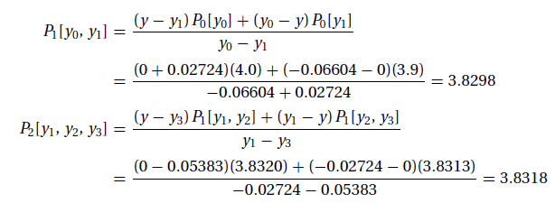
Example: Given the data points
determine the root of y(x) = 0 by Neville’s method.
Solution: This is an example of inverse interpolation, in which the roles of x and y are interchanged. Instead of computing y at a given x, we
are finding x that corresponds to a given y (in this case, y = 0). Employing the format of Neville’s Table (with x and y interchanged, of
course), we obtain
The following are sample computations used in the table:
All the P’s in the table are estimates of the root resulting from different orders of interpolation involving different data points. For example,
P1[y0, y1] is the root obtained from linear interpolation based on the first two points, and P2[y1, y2, y3] is the result from quadratic
interpolation using the last three points. The root obtained from cubic interpolation over all four data points is x = P3[y0, y1, y2, y3] = 3.8317.

Slide 16
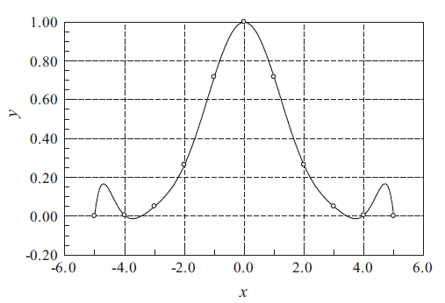
Limitations of Polynomial Interpolation
Polynomial interpolation should be carried out with the fewest feasible number of data points. Linear interpolation, using the nearest two points, is often sufficient if the data points are closely spaced. Three to six nearest-neighbor points good results in most cases. An interpolant intersecting more than six points may be mistake.
Figure 1:Polynomial interpolant displaying oscillations.
The danger of using too many points is illustrated in Figure 1 . The 11 equally spaced data points are represented by the circles. The solid line is the interpolant, a polynomial of degree 10, that intersects all the points. As seen in the figure, a polynomial of such a high degree has a tendency to oscillate excessively between the data points. A much smoother result would be obtained by using a cubic interpolant spanning four nearest-neighbor points.
The fifth-degree interpolating polynomial is represented by the solid line. The interpolant looks fine within the range of data points, but drastically departs from the obvious trend when x > 12. Extrapolating y at x = 14, for example, would be meaningless in this case.
If extrapolation cannot be avoided, the following measures can be useful:
• Plot the data and visually verify that the extrapolated value makes sense.
• Use a low-order polynomial based on nearest-neighbor data points. A linear or quadratic interpolant, for example, would yield a reasonable estimate of y(14) for the data in Figure 1.

Slide 17
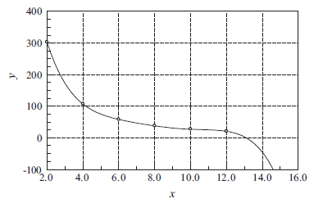
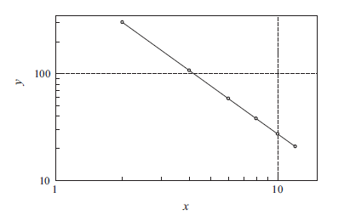
Figure 2: Extra polation may not follow the trend of data.
Work with a plot of log x vs. log y, which is usually much smoother than the x-y curve and thus safer to extrapolate. Frequently this plot is almost a straight line. This is illustrated in Figure 3, which represents the logarithmic plot of the data in Figure 2.
Figure 3 : Logarithmic plot of the data in Figure 2.

Slide 18
Rational Function Interpolation
Some data are better interpolated by rational functions rather than polynomials. A rational function R(x) is the quotient of two polynomials:
Because R(x) is a ratio, it can be scaled so that one of the coefficients (usually b_{n+1}) is unity. That leaves (m + n + 1) undetermined coefficients that must be computed by forcing R(x) through (m+n +1) data points. A popular version of R(x) is the so-called diagonal rational function, where the degree of the numerator is equal to that of the denominator (m = n) if (m+n) is even, or less by one (m = n − 1) if (m+n) is odd. The recursive formula that is the basis of the algorithm is due
Where
R[x_{i} , x_{i+1}, . . . , x_{i+k} ] denotes the diagonal rational function that passes through the data points (x_{i} , y_{i} ), (x_{i+1}, y_{i+1}), . . , (x_{i+k} , y_{i+k} ). It is also understood that R[x_{i} , x_{i+1}, . . . , x_{i−1}] = 0 (corresponding to the case k = −1) and R[x_{i} ] = y_{i} (the case k = 0).
The computations can be carried out in a tableau, similar to Table used for Neville’s method. We start by filling the column
k = −1 with zeros and entering the values of y_{i} in the column k = 0.

Slide 19
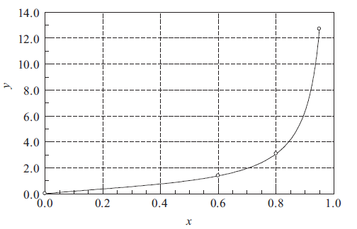
Example:Given the data
determine y(0.5) by the diagonal rational function interpolation.
Solution:The plot of the data points indicates that y may have a pole at around x = 1. Such a function is a very poor candidate for polynomial interpolation, but can be readily represented by a rational function.
We set up our work in the format of Table. After completing the computations, the table looks like this:
Notes:
Python’da Çözemedim.

Slide 20
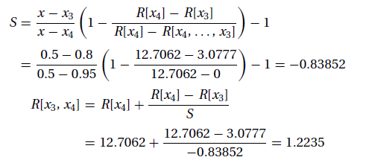
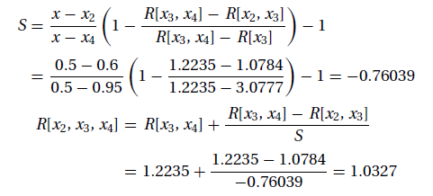
Let us now look at a few sample computations. We obtain, for example, R[x₃, x₄] by substituting i = 3, k = 1 into Eqs.
The entry R[x₂, x₃, x₄] is obtained with i = 2, k = 2. The result is
The interpolant at x = 0.5 based on all four data points is R[x₁, x₂, x₃, x₄] = 1.0131.

Slide 21
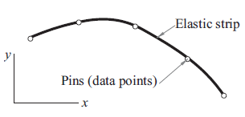
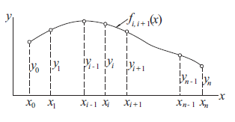
Interpolation with Cubic Spline
If there are more than a few data points, a cubic spline is hard to beat as a global interpolant. It is considerably “stiffer” than a polynomial in the sense that it has less tendency to oscillate between data points.
Figure 1: Mechanical model of a natural cubic spline.
The mechanical model of a cubic spline is as in Figure 1. The pins (i.e., the data points) are called the knots of the spline. At the pins, the slope and bending moment (and hence the second derivative) are continuous. There is no bending moment at the two end pins; consequently, the second derivative of the spline is zero at the end points. Because these end conditions occur naturally in the beam model, the resulting curve is known as the natural cubic spline.
Figure 2: A cubic spline.

Slide 22
Figure 2 shows a cubic spline that spans n + 1 knots. We use the notation f_{i,i+1}(x) for the cubic polynomial that spans the segment between knots i and i + 1. Note that the spline is a piecewise cubic curve, put together from the n cubics f_{0,1}(x), f_{1,2}(x), . . . , f_{n−1},n(x), all of which have different coefficients.
Denoting the second derivative of the spline at knot i by k_{i} , continuity of second derivatives requires that
(1)
At this stage, each k is unknown, except for
The starting point for computing the coefficients of f_{i,i+1}(x) is the expression for f _{i,i+1}(x), which we know to be linear. Using Lagrange’s two point interpolation, we can write
Where
Therefore,
(2)

Slide 23
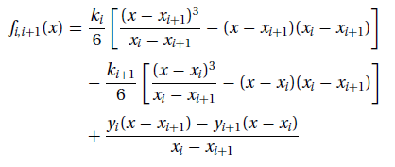
Integrating twice with respect to x, we obtain
(3)
where A and B are constants of integration. The terms arising from the integration would usually be written as C_{x} + D. By letting C = A − B and D = −A_{xi+1} + B_{xi}, we end up with the last two terms of Eq. (3), which are more convenient to use in the computations that follow.
Imposing the condition f _{i,i+1}(x_{i} ) = y_{i}, we get from Eq. (3)
(4)
Therefore,
(5)
Similarly, f _{i,i+1}( x_{i+1}) = y_{i+1} yields
(6)
Substituting Eqs. (4) and (5) into Eq. (3) results in
(6.a)

Slide 24
The second derivatives k_{i} of the spline at the interior knots are obtained from the slope continuity conditions
f _{i−1,i} (x_{i} ) = _{f i,i+1}(x_{i} ), where i = 1, 2, . . . , n − 1. After a little algebra, this results in the simultaneous equations
(7)
If the data points are evenly spaced at intervals h, then x_{i−1} − x_{i} = x_{i} − x_{i+1} = −h, and the Eqs. (7) simplify to
(8)

Slide 25
Example: Use a natural cubic spline to determine y at x = 1.5. The data points are
Solution: The five knots are equally spaced at h = 1. Recalling that the second derivative of a natural spline is zero at the first and last knot, we have k₀ = k₄ = 0. The second derivatives at the other knots are obtained from Eq. (8).Using i = 1, 2, 3 results in the simultaneous equations
The solution is k₁ = k₃ = −30/7, k2 = 36/7.
The point x = 1.5 lies in the segment between knots 0 and 1. The corresponding interpolant is obtained from Eq. (6.a) by setting i = 0.With x_{i} − x_{i+1} = −h= −1, we obtain from Eq. (6.a)

Slide 26
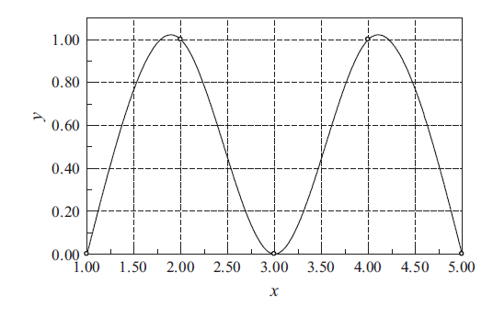
Therefore,
The plot of the interpolant, which in this case is made up of four cubic segments, is shown in the figure.

Slide 27
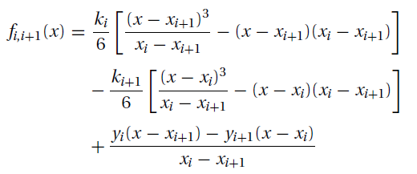
Example: Sometimes it is preferable to replace one or both of the end conditions of the cubic spline with something other than the natural conditions. Use the end condition f _{0,1}(0) = 0 (zero slope), rather than f _{0,1}(0) = 0 (zero curvature), to determine the cubic spline interpolant at x = 2.6, given the data points.
Solution: We must first modify Eqs. (a) to account for the new end condition. Setting i = 0 in Eq. (b) and differentiating, we get
Eqs. (a) Eq. (b)
Thus the end condition f _{0,1}(x₀) = 0 yields
or

Slide 28
From the given data we see that y₀ = y₁ = 1, so that the last equation becomes
(c)
The other equations in Eq. (a) are unchanged. Knowing that k₃ = 0, they are
(d)
(e)
The solution of Eqs. (c)–(e) is k₀ = 0.4615, k₁ = −0.9231, k₂ = 0.2308.
The interpolant can now be evaluated from Eq. (b). Substituting i = 2 and x_{i} − x_{i+1} = −1, we obtain
Therefore,

Slide 29
REFERENCES
Jaan Kiusalaas, “Numerical Methods in Engineering with Python 3”,3rd Edition, Cambridge, NY, 2013
S.C. Chapra and R.P. Canale, “Numerical Methods for Engineers”, 6th ed., McGraw-Hill,, NY, 2010

