Slide 1
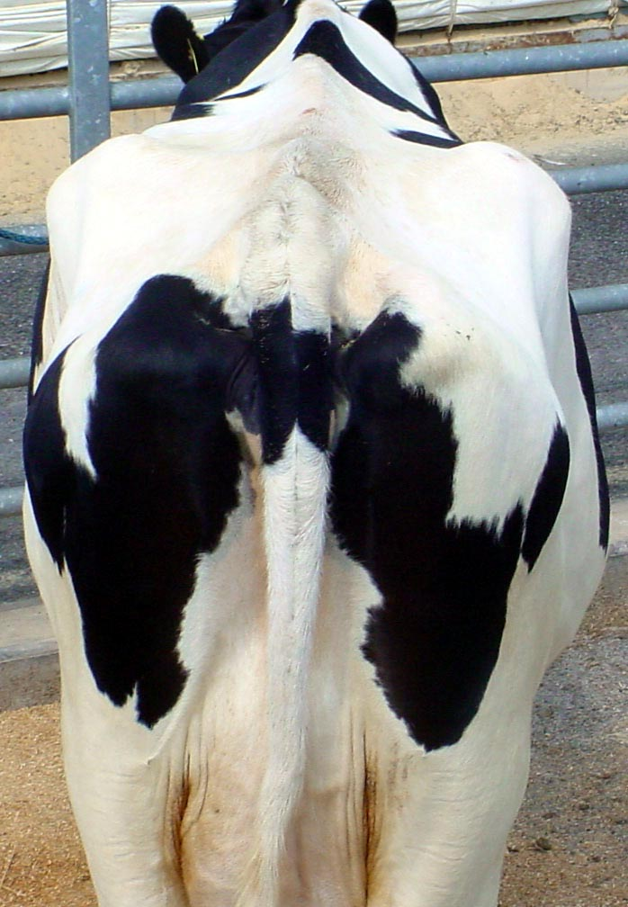
Effects of Body Condition on Performance
Web Presentation
Updated July 2004

Slide 2
Using body condition scoring to fine tune herd nutrition and health management has become a widely accepted practice.
This presentation will examine the influence of body condition on
milk production,
dry matter intake,
reproduction, and
health of cows in your herd

Slide 3
Nutrient and Milk Yield Relationships in the Lactation and Gestation Cycle
Periods
1
2
3
4
5
Body Stores
Used for
Milk Production
Dry Matter Intake
Body Stores
Regained for
Next Lactation
Dry Period
Rumen
Rehab
Milk Production
Body Weight
Freshening
0
1
2
3
4
5
6
7
8
9
10
11
12
Month

Slide 4
BCS and Milk Production
BCS at calving
< 2.75  reduced milk yield
> 3.25  reduced milk yield
Penn State & Cornell research shows cows with a BCS >3.25 at calving produce 5 pounds less milk each day than cows with lower BCS during the first 30 days of lactation
BCS change after calving
Decrease of 1 BCS unit  increase of 930 lb milk in 305-d lactation
Body reserves essential to support milk production
Waltner et al., 1993
Pedron et al., 1993

Slide 5
BCS and Increased Health Risk
Excess Body Condition
Fat Cow Syndrome
Ketosis
Displaced Abomasum
Milk Fever
Metritis
Mastitis
Lameness
Limited Dry Matter Intake
Thin Body Condition
Lameness
Metabolic problems can set the stage for consequences of other nutritional-stress complications, including infections such as mastitis.

Slide 6
BCS and Reproduction
Cows > 3.75 BCS at dry off were 2.8 times more likely than cows with average BCS to experience the following reproductive problems in their next lactation
Dystocia
Retained placenta
Uterine infection
Cystic ovaries
Abortion
Gearhart et al., 1990

Slide 7
Relationship between BCS Loss in First 5 Weeks after Calving and Reproduction
 | Body Condition Loss
Item | < 0.5 | 0.5 to 1.0 | > 1.0
# Cows | 17 | 64 | 12
Days to first ovulation | 27ª | 31ª | 42^{b}
Days to first heat | 48^{ab} | 41ª | 62^{b}
Days to first service | 68ª | 67ª | 79^{b}
First service conception rate, % | 65ª | 53ª | 17^{b}
Services per conception | 1.8 | 2.3 | 2.3
Pregnancy rate, % | 94 | 95 | 100
Means in a row with different superscripts differ P < 0.05
Butler and Smith, 1989

Slide 8
In Summary. . .
BCS changes can cause problems when they are
Too Little
Too Much
Too Rapidly Changed

Slide 9
Managing Body Condition Loss
Avoid over conditioning
If cows are fat at dry off
Do Not allow BCS loss during dry period
Body condition score dry cows to monitor changes
Maximize dry matter intake of close up and fresh cows to limit negative energy balance

Slide 10
BCS Loss in High Producers
High-producing cows can lose between 100 to 150 pounds during the first 60 to 80 days (the equivalent of 1 BCS unit)
Rate of 1 to 2 pounds per day
But weight loss of 3 to 4 pounds per day
May increase the possibility of metabolic disorders such as ketosis
May discourage implantation of the fetus, resulting in cows that are "apparently not conceiving"

Slide 11
More on High Producers
Negative energy balance is common for high-producing cows in early lactation
Mobilized body fat is used to produce milk
1 pound of mobilized fat = 7 pounds of milk
Our goal is to minimize weight loss by encouraging intake of
High quality, highly palatable forage dry matter at 1.8 to 2.0% of body weight daily
Sufficient grain, the quantity being gradually increased over the first few weeks of lactation

Slide 12
Managing Body Condition Gain
Add body condition in late lactation
Efficient storage of energy
Monitor BCS of lactating cows to identify thin and fat cows early, in time to make adjustments before drying off
Avoid changes in BCS during dry period
Very thin cows may benefit from extra feed in the early dry period

Slide 13
More on Body Condition Gain
Cows should start replenishing fat reserves after reaching peak milk
A few cows, 5 to 10%, may never put on much flesh
A similar proportion may be "easy keepers" and tend to be obese most of the time

Slide 14
BCS Changes Over Lactation
Efficient, high producing cows do not experience large changes in body condition
Inefficient, low producing cows increase in BCS over a lactation
Most cows are between these extremes
BCS decreases to about 100 days
Then increases until dry-off

Slide 15
Recommended BCS by Stage of Lactation
 |  |  |  | BCS
Stage of Lactation |  | DIM |  | Goal | Min | Max
Calving |  |  |  | 3.50 | 3.25 | 3.75
Early Lactation |  | 1 to 30 |  | 3.00 | 2.75 | 3.25
Peak Milk |  | 31 to 100 |  | 2.75 | 2.50 | 3.00
Mid Lactation |  | 101 to 200 |  | 3.00 | 2.75 | 3.25
Late Lactation |  | 201 to 300 |  | 3.25 | 3.00 | 3.75
Dry Off |  | > 300 |  | 3.50 | 3.25 | 3.75
Dry |  |  |  | 3.50 | 3.25 | 3.75

Slide 16
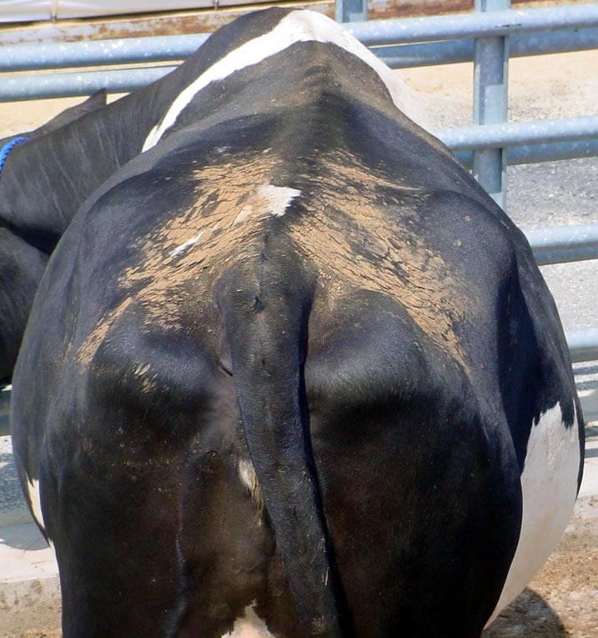
BCS at Calving
Recommended Score: 3.25 to 3.75
Nutritional Objective:
Cows calve with adequate, but not excessive, body-fat reserves

Slide 17
Red Flags – Calving
BCS < 3.25
Too little energy provided in late lactation or dry period
Risk low milk production
Especially if ration is not balanced or not palatable
BCS > 3.75
Too much energy provided in late lactation or dry period
Separate dry cows from milking herd
Feed low-energy ration balanced for protein, minerals, and vitamins
Niacin may help
Reduce ketosis
Increase fat mobilization
Increase appetite

Slide 18
BCS in Early Lactation
Recommended Score: 2.75 to 3.25
Nutritional Objectives:
Maximize intake of a high-energy ration
Minimize body condition loss and offset negative energy balance
Ration must contain enough protein to support high milk production

Slide 19
Red Flags – Early Lactation
BCS < 2.75 and low milk production
Too little energy provided in ration
High producers may drop below 2.75, but condition must be regained to prevent reproductive problems
BCS > 3.25
Too little protein provided in ration to support milk production
Check intake of water, minerals, and vitamins

Slide 20
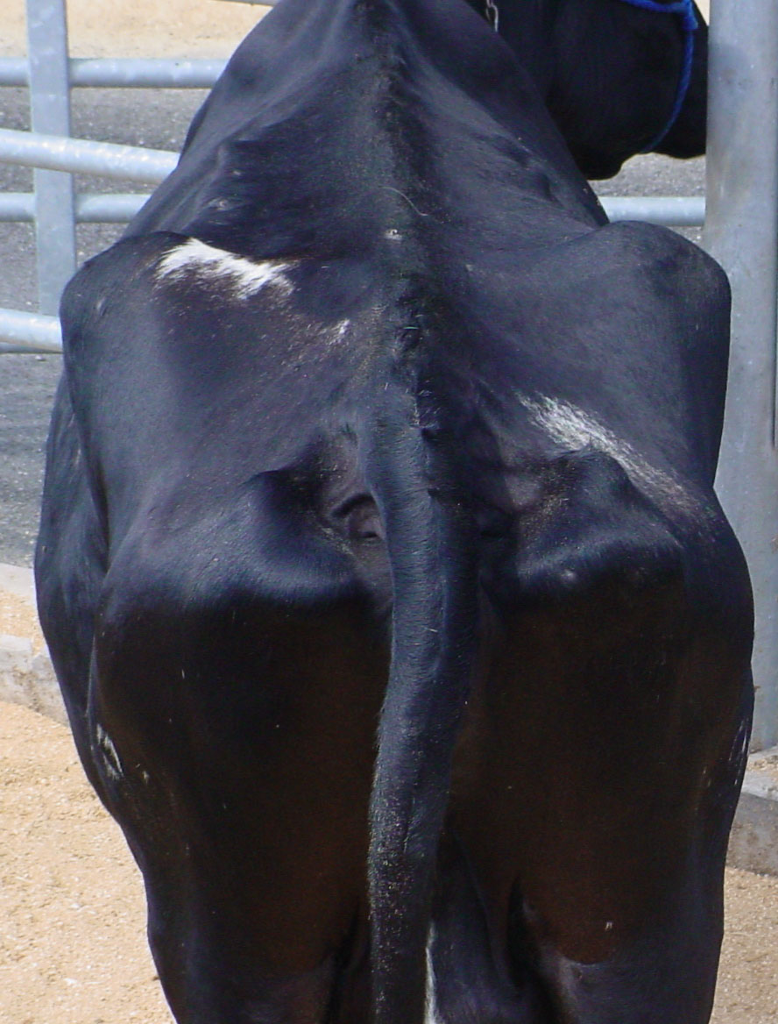
BCS at Peak Milk Yield
Recommended Score: 2.5 to 3.25
Nutritional Objectives:
Maximize intake of a high-energy ration
Minimize body condition loss and offset negative energy balance
Ration must contain enough protein to support high milk production

Slide 21
Red Flags – Peak Milk
BCS < 2.5 and low milk production
Too little energy provided in ration
BCS > 3.25
Too little protein provided in ration
Check intake of water, minerals, and vitamins

Slide 22
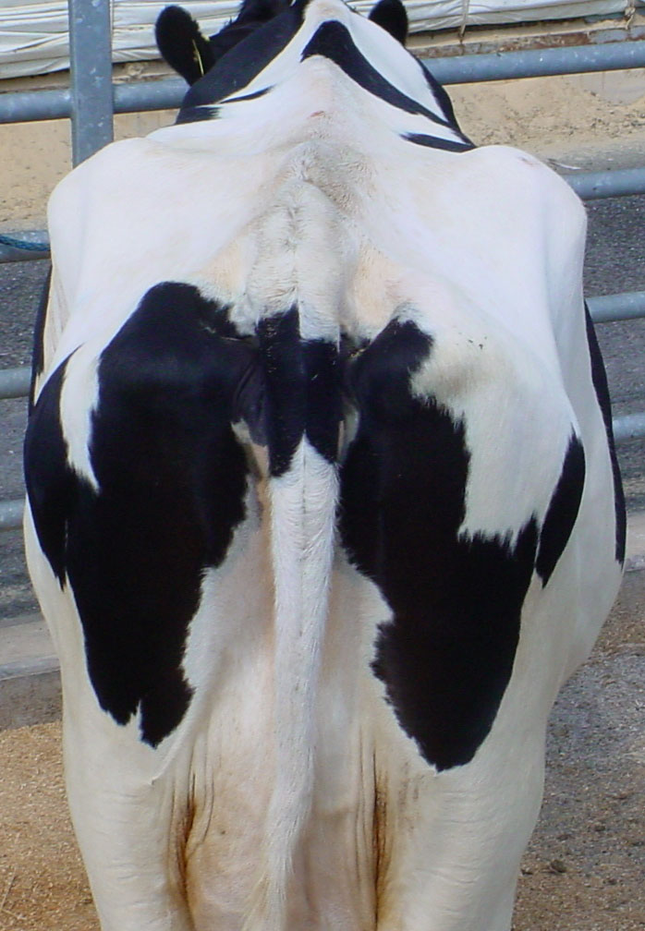
BCS in Mid Lactation
Recommended Score: 2.75 to 3.25
Nutritional Objectives:
Maintain body condition
Begin to gain condition for maximum milk production
Avoid excessive body weight gain

Slide 23
Red Flags – Mid Lactation
BCS < 2.75
Too little energy provided in ration
Problem probably began in early lactation
BCS > 3.25
Reduce energy intake to avoid over conditioning

Slide 24
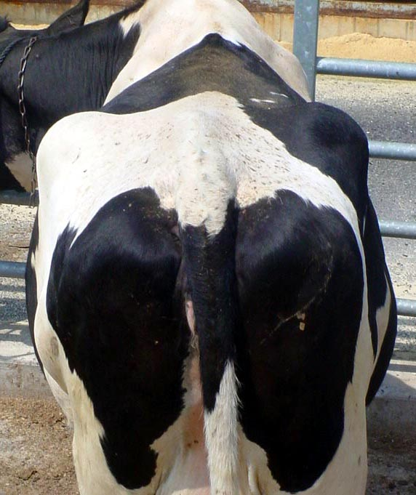
BCS in Late Lactation
Recommended Score: 3.0 to 3.75
Nutritional Objectives:
Replenish body reserves to prepare for next lactation
Avoid over conditioning

Slide 25
Red Flags – Late Lactation
BCS < 3.0
Too little energy provided in ration
Problems likely began earlier in the lactation
BCS > 3.75
Too much energy provided in ration
Also may result from extended calving intervals

Slide 26
BCS at Dry Off
Recommended Score: 3.25 to 3.75
Nutritional Objectives:
Prepare for next lactation
Maintain condition through dry period – do not lose, especially if cows enter dry period fat
Avoid over conditioning by feeding low-energy ration with adequate protein, minerals, and vitamins

Slide 27
Red Flags – Dry Cows
BCS < 3.25
Too little energy provided in ration
Problems likely began earlier in the lactation
BCS > 3.75
Too much energy provided in ration
Also may result from extended calving intervals
Avoid BCS loss in dry period

Slide 28
Summary of Body Condition Score Changes over a Lactation
BCS at calving affects lactation performance
If too thin, peak milk yields will be low and reproduction will be delayed
If too fat, metabolic diseases are very likely
Early lactation – BCS lost
Used to support milk production
Extreme loss hurts reproductive activity

Slide 29
By 80 to 120 days into the lactation
Weight loss should be minimal
Cows should begin to regain condition
Essential for strong exhibition of estrus (heat) and conception
After 120 days, all cows should be gaining about 0.75 to 1.0 pounds per day

Slide 30
If a cow enters the dry period fat
Maintain body condition – DO NOT LOSE
If a cow enters the dry period thin
May add a little condition early (first 3 weeks)
Section 3 will look at ways to identify and address body condition problems

Slide 31
Charting body condition during a lactation can help troubleshoot herd problems
See extension.psu.edu/dairynutrition to download spreadsheet that plots BCS and compares your animals to ecommendations

Slide 32
Troubleshooting Tips
Indicators of body condition problems
Increase of 5 to 10% in rate of metabolic disease
Cows not able to maintain persistency or peak at expected levels of milk production
Wouldn’t you rather find these problems before cows get sick and milk drops???
Score cows regularly to predict – and address – potential problems before they happen

Slide 33
Suggested BCS Schedule
Calving
30 days after calving
First breeding
Pregnancy check
60 days before dry-off
Dry-off
Possibly mid dry period if cows are having problems at calving or during early lactation

Slide 34
Plan to Address BCS Problems
Nutrition Checklist
Dry Matter Intake – especially of forages
Feeding sequence
Fiber level of rations
Feeding frequency
Ration palatability
Bottom line
Make sure cows are eating enough
Provide at least 45% of DMI from forage sources

Slide 35
If those are adequate…
Check ration to be sure it is properly balanced for
Protein, energy, minerals, and vitamins
Test the forages and balance rations for each group of cows
When feeding hay crop silages, be sure to analyze for bound protein and adjust the ration accordingly
Examine grain and forage quality – focus on
Fineness of chop or grind of the ingredients
Smell, acceptability, and pH
Look at the amounts of bypass protein, soluble protein, starch ingredients, fats, and oils in the ration

Slide 36
How to Achieve High Milk Yields
Feed good-to-excellent quality forages that stimulate eating and enable cows to produce up to their maximum genetic potential

Slide 37
Nutritional Strategies to Manage BCS: Early Lactation
Feed extra energy in early lactation to offset negative energy balance
Added fat from oil seeds – no more than 5% of total ration dry matter
Higher levels upset rumen fermentation and decrease forage digestibility
Additional fat from bypass or protected fats (rumen inert) – an additional 2% of ration dry matter
Total fat in ration should not exceed 7%
When oils and fats are added to the ration
Increase calcium, magnesium, phosphorus 10% on a dry matter basis

Slide 38
Nutritional Strategies to Manage BCS: After Peak Milk
Cows should be gaining 0.75 to 1 lb per day
Balance ration to avoid over conditioning
If cows are getting too heavy
Protein may be limited, energy may be excessive

Slide 39
Nutritional Strategies to Manage BCS: Dry Cows
If cows fat at dry-off
Maintain condition to avoid weight loss
Feed average quality grass forages
Supplement 3 to 4 pounds of grain
Or, minimal amounts of corn silage and a grass hay mixture
If cows are thin at dry-off
Feed good quality grass forages
Supplement 3 to 4 pounds of grain

