Slide 1
ORGANIC ACIDS
Prof.Dr. Pınar Saçaklı
psacakli@ankara.edu.tr

Slide 2
Organic acids
Carboxylix acids including fatty acids and amino acids, which have the chemical structure of R-COOH with acidic properties
Organic Acids are weak Acid & do not disassociate completely in water
Organic acids used in animal diets as feed additives
SCFA
Formic (C1) | Lactic
Acetic (C2) | Malic
Propionic (C3) | Tartaric
Butiric (C4) | Fumaric
 | Citric

Slide 3
Organic acids used in animal nutrition
Preservatives Protect feed against deterioration caused by micro-organisms or their metabolites;
Acidity regulators Adjust the pH of feedingstuffs
Silage additives Improve the production of silage
Zootechnical additives Improve certain zootechnical parameters, when fed to the animals

Slide 4
Organic acids as Zootechnical Feed Additive
Antibiotic growth promoters (AGPs) have been widely used in poultry diets for years
AGPs usage as feed additives banned in 2006 in EU and Turkey
-Public concerns about possible residual problem
-Development of antibiotic resistant bacteria

Slide 5
Mode of Action
Decreased pH in diets and the GIT
2.Improved nutrient utilization in diets by increasing nutrient retention and activating enzyme secretion
3.Inhibition of pathogenic bacterial growth

Slide 6
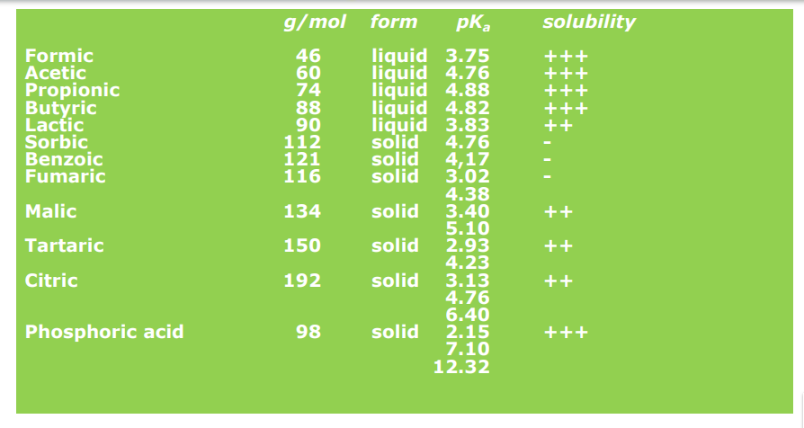
Effects on pH reduction in GIT
pH reduction in diets and GIT depend on pKa values of the organic acid and pH conditions of the GIT

Slide 7
Effects on Nutrient Utilization
Reduced pH in the upper part of the GIT may increase nutrient digestibility and nutrient utilization
In the stomach a reduction in gastric pH activates pepsinogen and other zymogens *******improves digestion of protein
Acidic digesta may decrease gastric emptying

Slide 8
Effects on Pathogenic Bacteria
Organic acids can easily penetrate bacteria cell wall and disrupt normal cellular functions, including replication and protein synthesis of bacteria
Once inside the microbial cell, the acid releases its proton (H+) in the more alkaline environment of the cytoplasm, resulting in a decrease of bacterial intracellular pH.

Slide 10
5. Coccidiostats and Histomonostats
Against coccidiosis -To prevent disease an to minimize economic loss
Prophylactic------- over treatment
*Most of the damage occurs before clinical signs become apparent
*Drugs cannot completly stop outbreak

Slide 11
Anticoccidials
1-Ionophors
-Salinomycin
-Monensin
-Narasin
-Maduramicin
-Semduramicin
-Lasalocid
2-Chemicals
-Robenidin
-Diclazuril
-Nicarbazin+Narasin
-Decoquinate
Nicarbazin

