Slide 1
ENE102-7
FLOWCHART EXAMPLES

Slide 2
FLOWCHART Examples
Example 1: Finding the sum of two numbers.
Variables:
A: First Number
B: Second Number
C: Sum (A+B)
Algorithm:
Step 1 – Start
Step 2 – Input A
Step 3 – Input B
Step 4 – Calculate C = A + B
Step 5 – Output C
Step 6 – Stop

Slide 3
FLOWCHART EXAMPLES
Start
Read
A
Read
B
C = A + B
Print C
Stop

Slide 4
FLOWCHART EXAMPLES
Example 2: Find the difference and the division of two numbers and display the results.
Variables:
N1: First number
N2: Second number
D : Difference
V : Division
-- Algorithm:
Step 1: Start
Step 2: Input N1
Step 3: Input N2
Step 4: D = N1 – N2
Step 5: V = N1 / N2
Step 6: Output D
Step 7: Output V
Step 8: Stop

Slide 5
FLOWCHART EXAMPLES
Start
Read
N1
Read
N2
D = N1 – N2
V = N1 / N2
Print D
Print V
Stop

Slide 6
FLOWCHART EXAMPLES
Example 3: A car starts to move, accelerates during 10 minutes and its speed becomes 60 km/hr. Then, it continues with this speed during 15 minutes and finally slows down during 10 minutes and stops. What is the speed of the car at time T?

Slide 7
FLOWCHART EXAMPLES
In this problem, during the first 10 minutes the speed of the car is found by V = a.T
a is the acceleration rate at the unit time. The car speeds up to 60 km/hr during 10 minutes. So a = (60/10)
Between minutes 10 and 25, the speed is the same.
Between minutes 25 and 35, the car slows down and the speed is: V_{last} = V_{first} – aT (Substitute
(T-25) for T since slowing down starts at 25th min.

Slide 8
FLOWCHART EXAMPLES
Variables:
T: Time(minutes)
V: The speed at an instant.
Algorithm:
Step 1: Start
Step 2: Input T
Step 3: If T<10 go to step 4, otherwise go to step 5
Step 4: V = (60/10)*T (and go to step 8)
Step 5: If T<25 go to step 6, otherwise go to step 7
Step 6: V = 60 (and go to step 8)
– Step 7: V = 60-(T-25)*(60/10)
Step 8: Output V
Step 9: Stop

Slide 9
FLOWCHART EXAMPLES
Start
Read
T
1
T < 10
0
1
0
V = (60/10)*T
T < 25
V = 60
V=60-(60/10)*(T-25)
Print V
Stop

Slide 10
FLOWCHART EXAMPLES
Example 4: Work on the algorithm and flowchart which examines an ABC triangle according to its sides whose sides are entered as input.
Variables:
A: Length of the first side
B: Length of the second side
C: Length of the third side

Slide 11
FLOWCHART EXAMPLES
Algorithm:
Step 1: Start
Step 2: Input A, B and C values
Step 3: If A=B go to step 4, otherwise go to step 5
Step 4: If B=C go to step 6, otherwise go to step 8
Step 5: If A=C go to step 8, otherwise go to step 7
Step 6: “Triangle is equilateral (eşkenar)”. Go to step 11
Step 7: “If B=C go to step 10, otherwise go to step 9
Step 8: “Triangle is isosceles (ikizkenar)”. Go to step 11
Step 9: “Triangle is multilateral (çeşitkenar)”. Go to 11
Step 10: “Triangle is isosceles (ikizkenar)”. Go to step 11
Step 11: Stop

Slide 12
FLOWCHART EXAMPLES
Start
Read
A,B,C
0
A = B
1
0
A = C
1
0
B = C
1
B = C
1
0
“İkizkenar”
“Çeşitkenar”
“Eşkenar”
Stop

Slide 13
FLOWCHART EXAMPLES
Example 5: Work on the algorithm and the flowchart of the problem of calculating the roots of the equation Ax² + Bx + C = 0
Variables:
A: Coefficient of X²
B: Coefficient of X
C: Constant term
delta: Discriminant of the equation
X1: First root of the equation
X2: Second root of the equation

Slide 14
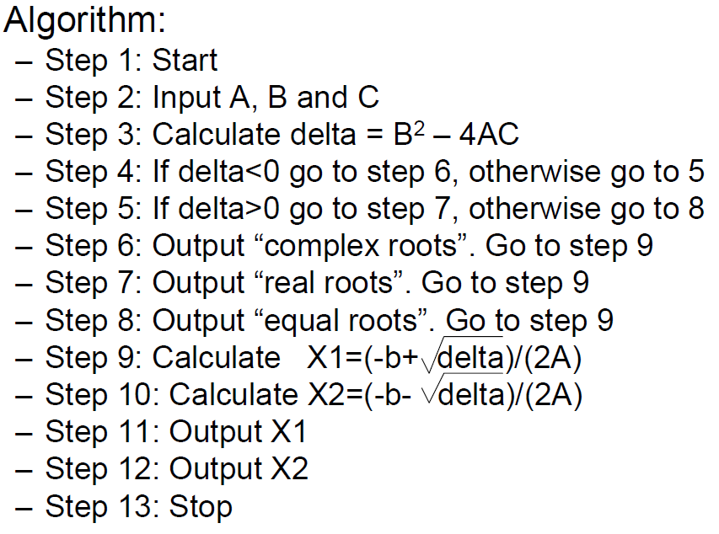
FLOWCHART EXAMPLES

Slide 15
FLOWCHART EXAMPLES
Start
Read
A,B,C
Delta=B^2-4*A*C
1
Delta<0
0
“Complex roots”
1
0
Delta>0
“Real roots”
“Equal roots”
X1=(-b+ delta)/(2*A)
X2=(-b- delta)/(2*A)
Print X1
Print X2
Stop

Slide 16
FLOWCHART EXAMPLES
Example 6: In a classroom of 10 students the ages of the students varies between 18-20. Work on the algorithm and flowchart claculating the the number of students at the ages 18, 19 and 20
Variables:
A: Age
S18: Number of 18 year old stuents
S19: Number of 19 year old students
S20: Number of 20 year old students
– X: Counter for students

Slide 17
FLOWCHART EXAMPLES
Algorithm:
Step 1: Start
Step 2: Initialize S18, S19 and S20 and X to 0.
Step 3: If X>=10 go to step 13 otherwise continue
Step 4: Input a student age A
Step 5: If A=18, go to step 9
Step 6: If A=19, go to step 10
Step 7: If A=20 go to step 11
Step 8: Output “age error” and go to step 4
Step 9: Calculate S18 = S18 + 1, go to step 12
Step 10: Calculate S19 = S19 + 1, go to step 12
Step 11: Calculate S20 = S20 + 1
Step 12: Increment the student counter X and go to step 3
Step 13: Output S18, S19 and S20
– Step 14: Stop

Slide 18
FLOWCHART EXAMPLES
Start
S18=S19=S20=X=0
Input Age A
1
X>=10
0
Print “Age Error”
0
A = 18
0
A = 19
0
A = 20
1
1
1
S18 = S18 + 1
S19 = S19 + 1
S20 = S20 + 1
X = X +1
Print S18, S19, S20
Stop

Slide 19
FLOWCHART EXAMPLES
Example 7: Work on an algorithm and flowchart that calculates the factorial of N (N is input).
Variables:
N: The number whose factorial will be calculated
counter: A counter varying between 1 and N
Nfac: Factorial of N
Algorithm:
Step 1: Start
Step 2: Input N
Step 3: Initialize the counter and factorial to 1
Step 4: If counter > N go to step 7
Step 5: Calculate Nfac = Nfac * counter
Step 6: Increment counter and go to step 4
Step 7: Output Nfac
Step 8: Stop

Slide 20
FLOWCHART EXAMPLES
Start
Read
N
Set counter = 1
Set Nfac = 1
1
counter<N
Nfac = Nfac * counter
0
Print Nfac
counter = counter + 1
Stop

