Slide 1
Moisture and total solids analysis
Assoc Prof. ÖZGE ŞAKIYAN DEMİRKOL
08.03.2021

Slide 2
Importance of moisture assays
One of the most fundamental and important analytical procedures that can be performed on a food product is an assay for the amount of moisture, referred to as the moisture or water content of the food.
It is the water activity, more so than the moisture content, that influences microbial growth, physical properties, and chemical and enzymatic reactions in foods.
Additionally, it is differences in water activity, not moisture content, that drive moisture migration between different food components (such as between a crust and a filling) or between a food and the environment. Water molecules move from regions of high water activity to regions of low water activity until equilibrium water activity is reached.

Slide 3
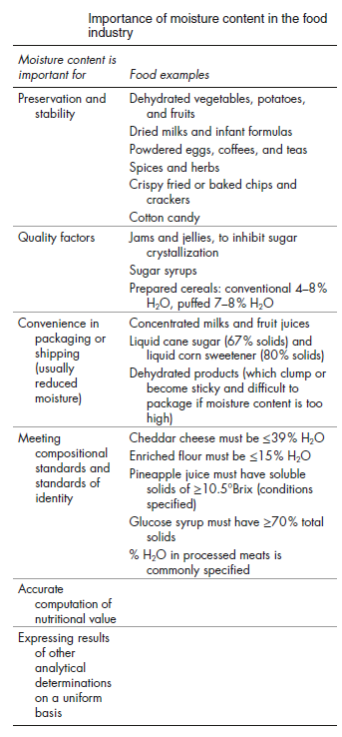
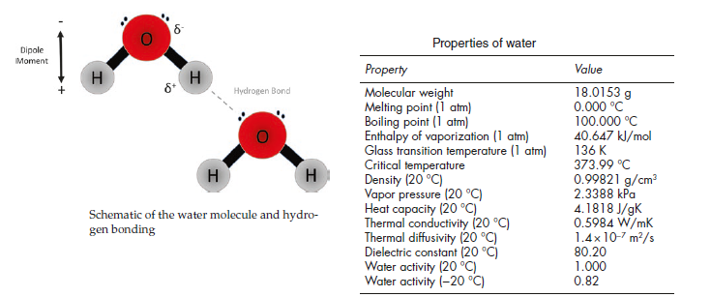

Slide 4
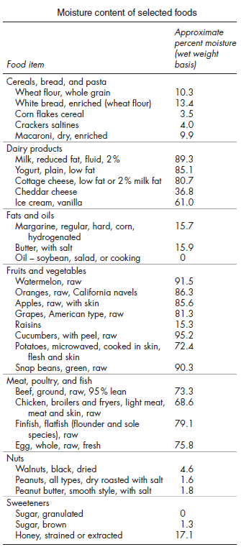

Slide 5
How to determine the correct method for moisture determination?
The properties of food
The volitile components, fat content and heat stability of food
The speed and duration of analysis
The accuracy and reproducibility of the method
The cost and the required equipments

Slide 6
Moisture determination methods
The moisture determination methods which are dependent on weight loss or water removal determination
The moisture determination methods depend on some physical properties of food material
The moisture determination methods depend on chemical reactions of water

Slide 7
The moisture determination methods which are dependent on weight loss or water removal determination
Drying in incubator
Drying in vacuum incubator
Hot plate tecnique
Drying in desiccator
Freeze drying (lyophilization)

Slide 8
The moisture determination methods depend on some physical properties of food material
Specific gravity
Vapor pressure
Electrical conductivity
Refractometric and polarimetric methods
NMR (nuclear magnetic resonance)
Spectroscopic methods (IR)
Cryoscpic techniques
Chromatographic techniques

Slide 9
The moisture determination methods depend on chemical reactions of water
Color change of iodine in Karl Fischer solutions
Color change of cobalt chloride
Measurement of heat released as a result of reaction between water and sulphuric acid
Detection of acetylene due to reaction between water and calcium carbide
Detection of hydrogen from calcium hyroxide
Formation of HCl from α- naphtoxide chlorophosphine

Slide 10
Thanks!!!!
osakiyan@ankara.edu.tr

