Slide 1
Diversity And Classification of Flowering Plants: Commelinid Monocots

Slide 2
Commelinid Monocots

Slide 3
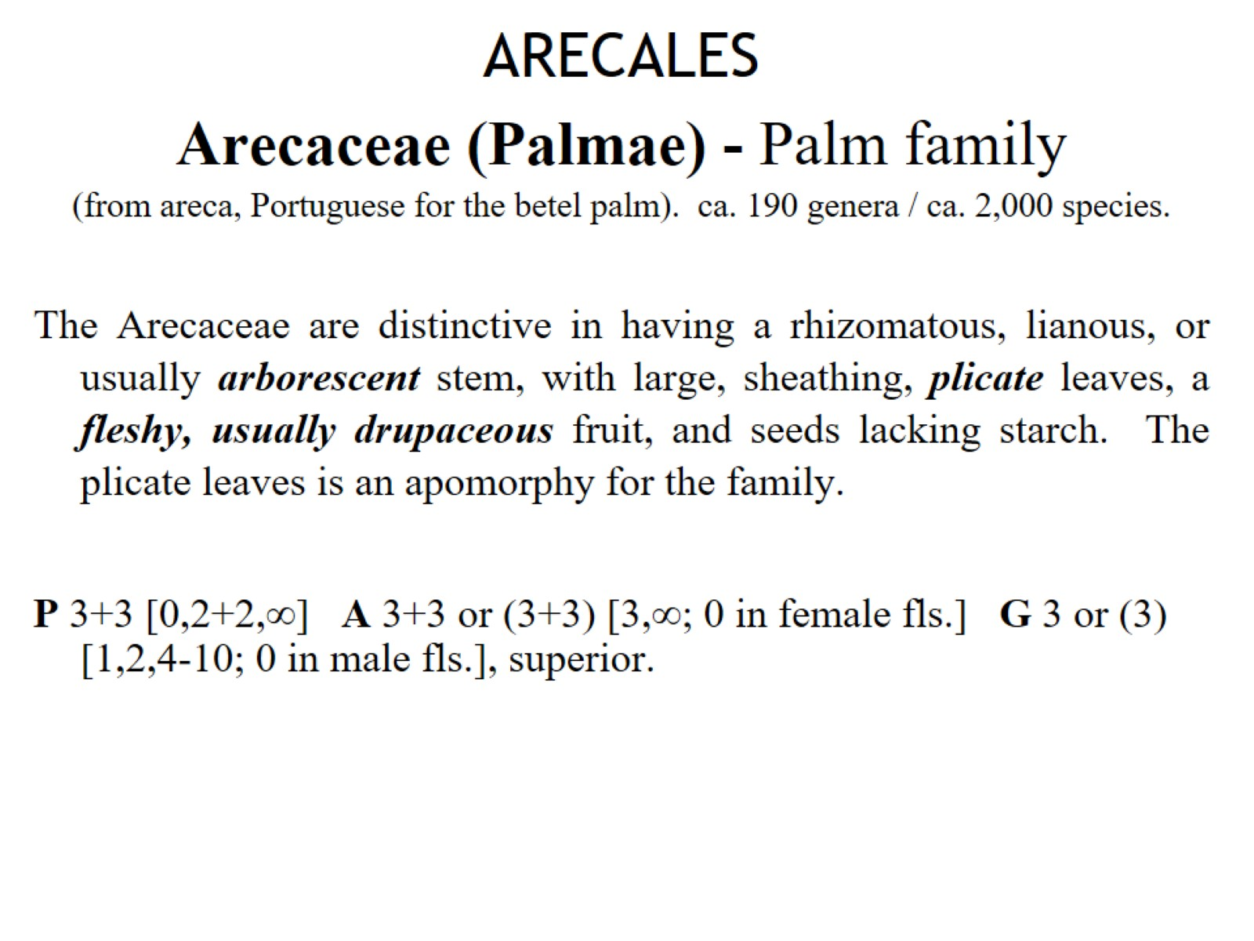
ARECALES Arecaceae (Palmae) - Palm family (from areca, Portuguese for the betel palm). ca. 190 genera / ca. 2,000 species.

Slide 4
ZINGIBERALES - Ginger Group

Slide 5
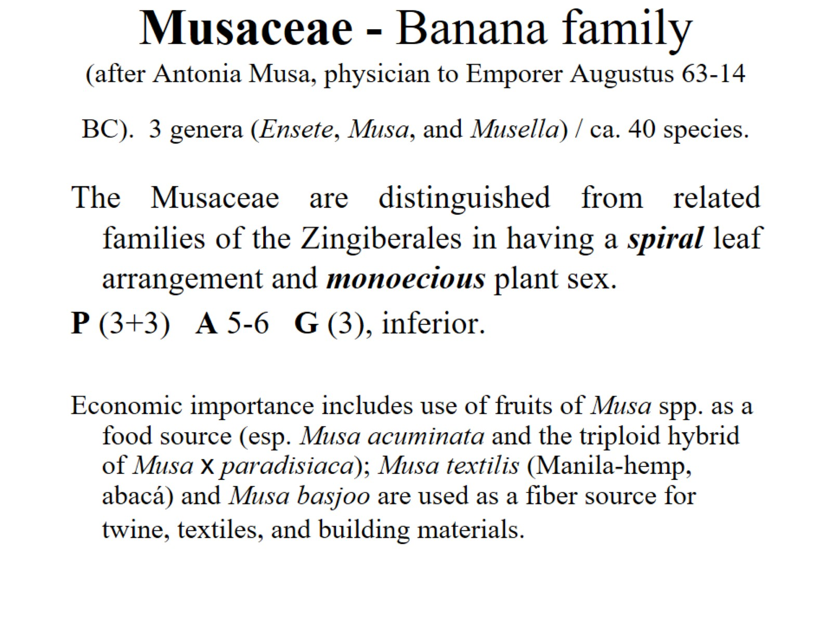
Musaceae - Banana family (after Antonia Musa, physician to Emporer Augustus 63-14 BC). 3 genera (Ensete, Musa, and Musella) / ca. 40 species.

Slide 6
Zingiberaceae - Ginger family (from a pre-Gr. name, possibly from India). 50 genera / 1,200 species

Slide 7
Zingiberaceae - Ginger family (from a pre-Gr. name, possibly from India). 50 genera / 1,200 species

Slide 8
Commelinaceae—Spiderwort family (after Caspar Commelijn, Dutch botanist, 1667–1731) 39 genera/640 species.

Slide 9
Cyperaceae - Sedge family (Gr. for several species of Cyperus). 98 genera / 4,350 species

Slide 10
Cyperaceae - Sedge family (Gr. for several species of Cyperus). 98 genera / 4,350 species

Slide 11
Juncaceae - Rush family (L. for binder, in reference to use in weaving and basketry). 7 genera / 430 species

Slide 12
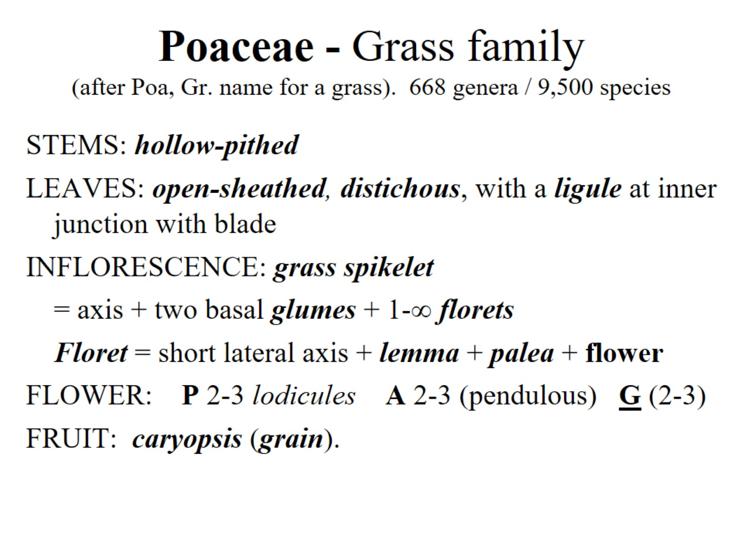
Poaceae - Grass family (after Poa, Gr. name for a grass). 668 genera / 9,500 species

Slide 13
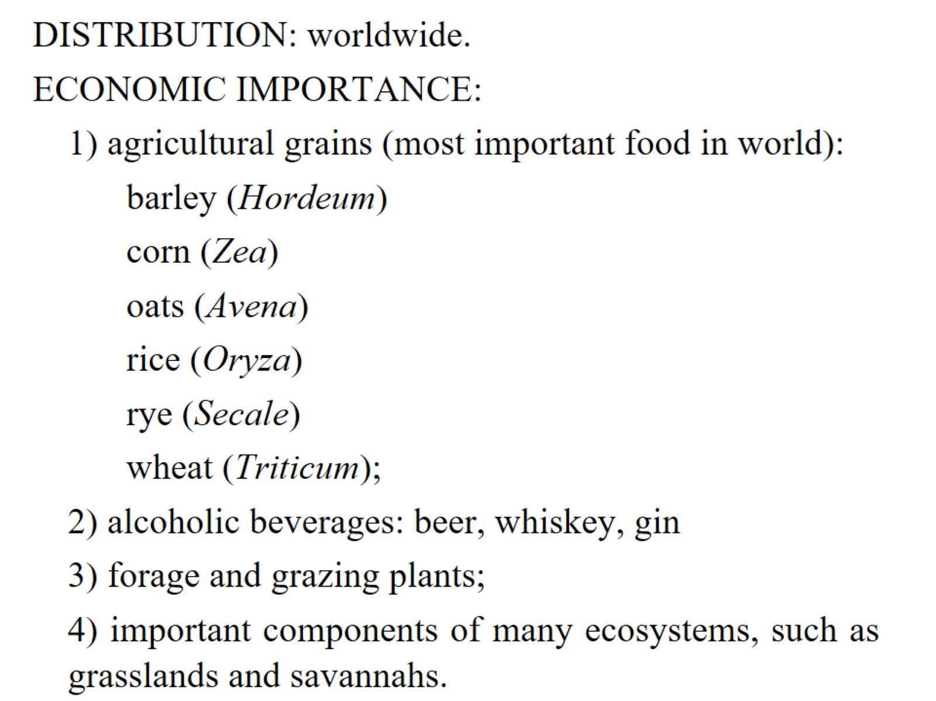

Slide 14
Diversity And Classification of Flowering Plants: Eudicots ca. 75% of all angiosperms!

Slide 15
Eudicots

Slide 16
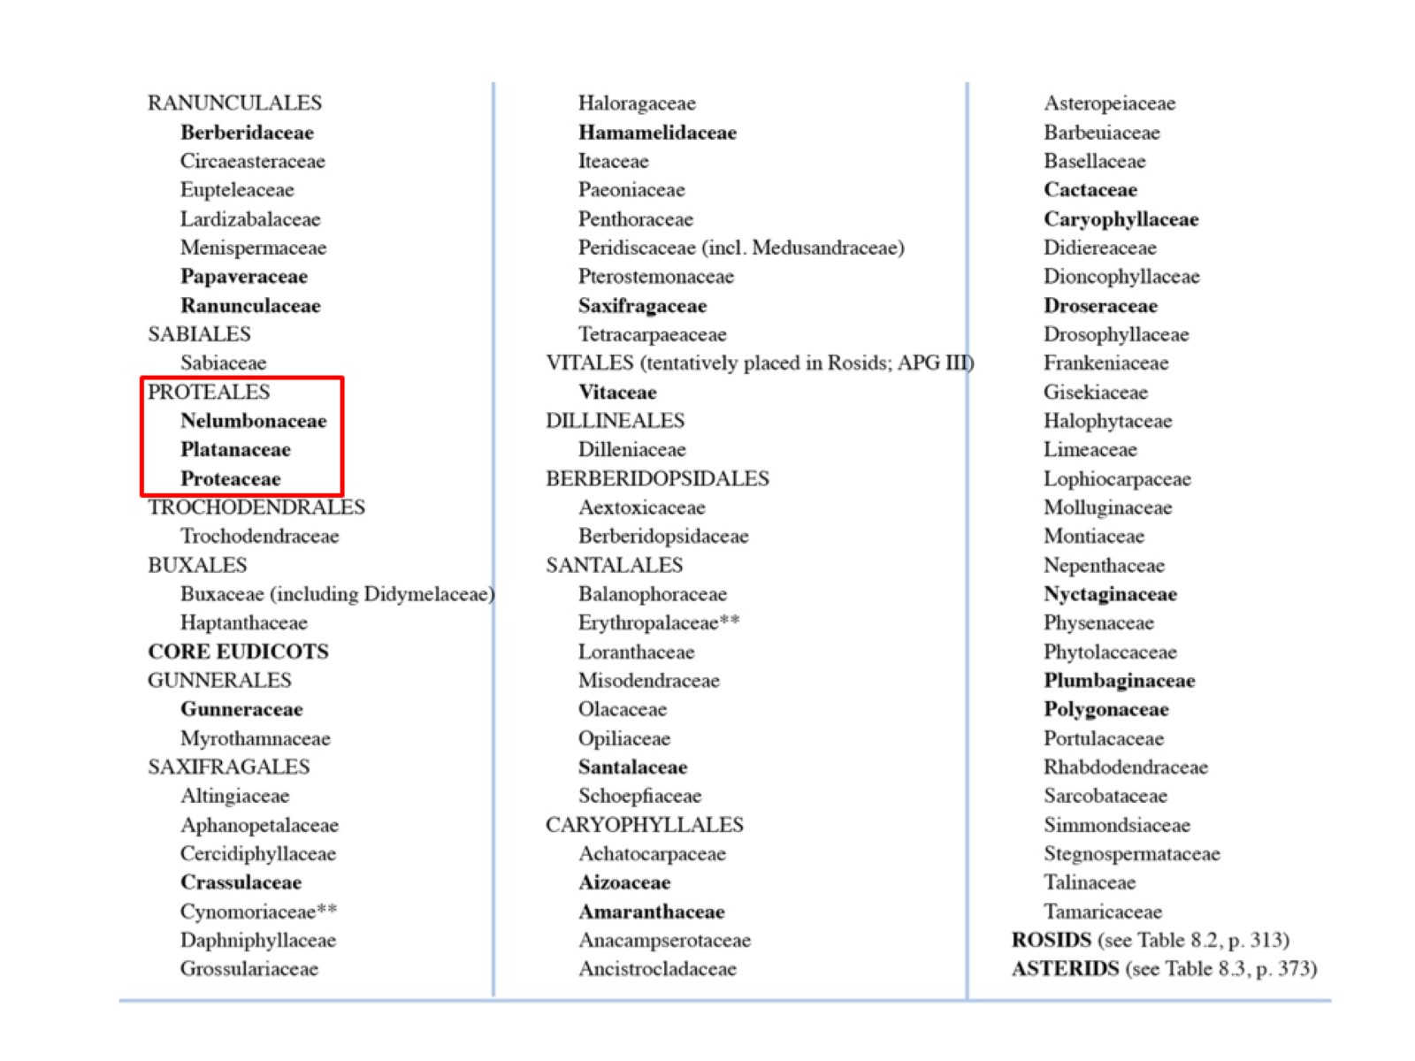

Slide 17
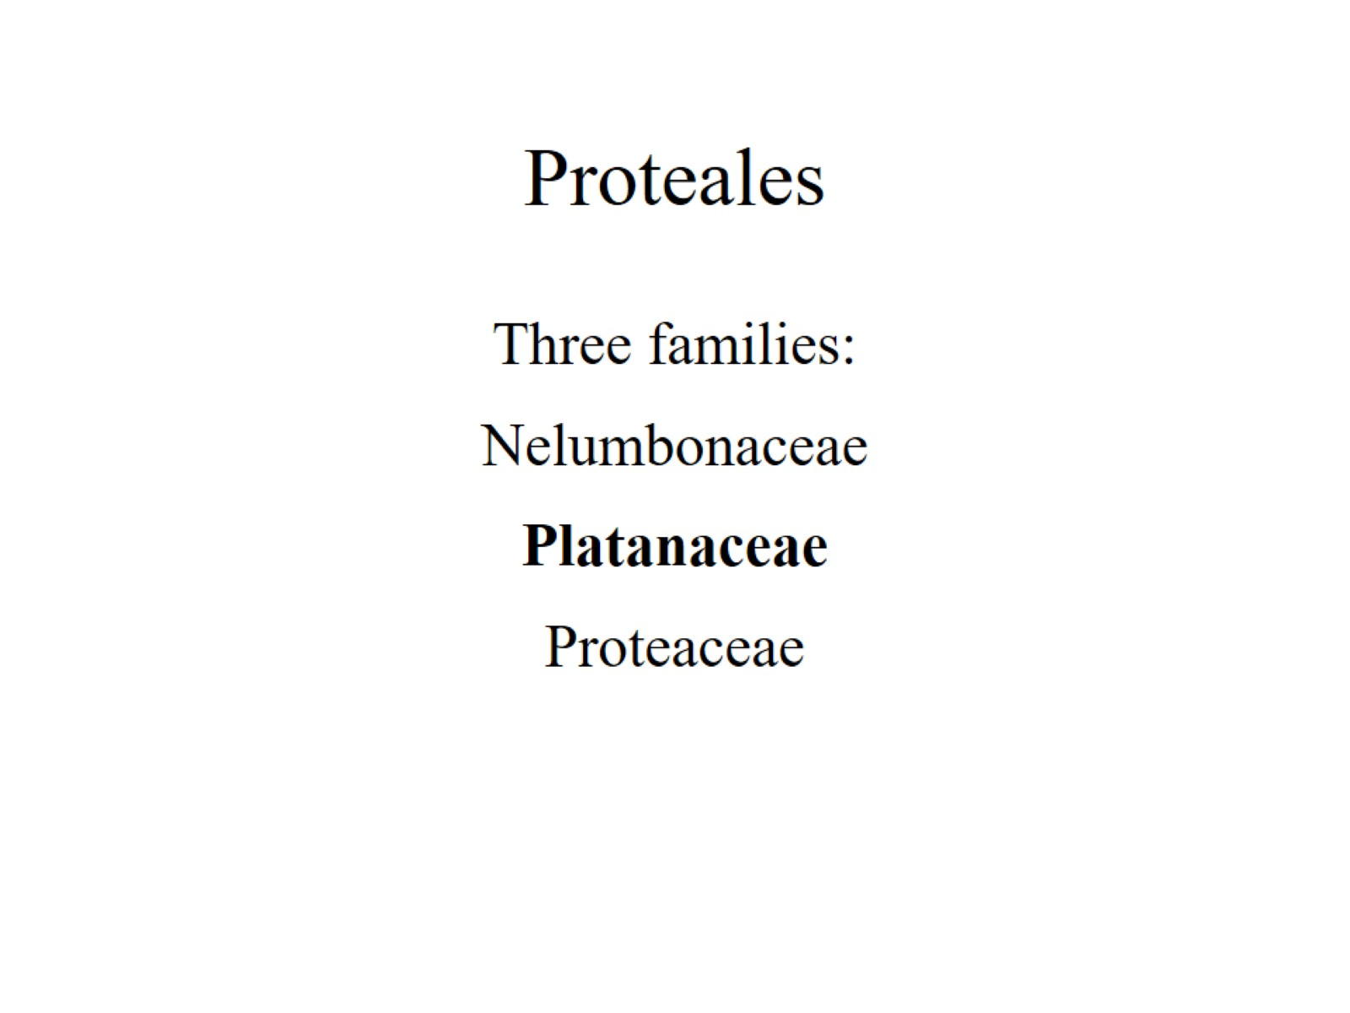
Proteales

Slide 18
Platanaceae Plane Tree / Sycamore family (Greek Platanus, broad leaf). 1 genus (Platanus) / 7 species.

Slide 19
encircling stipules

Slide 20
infrapetiolar buds

Slide 21
palmately lobed and veined

Slide 23
RANUNCULALES

Slide 24
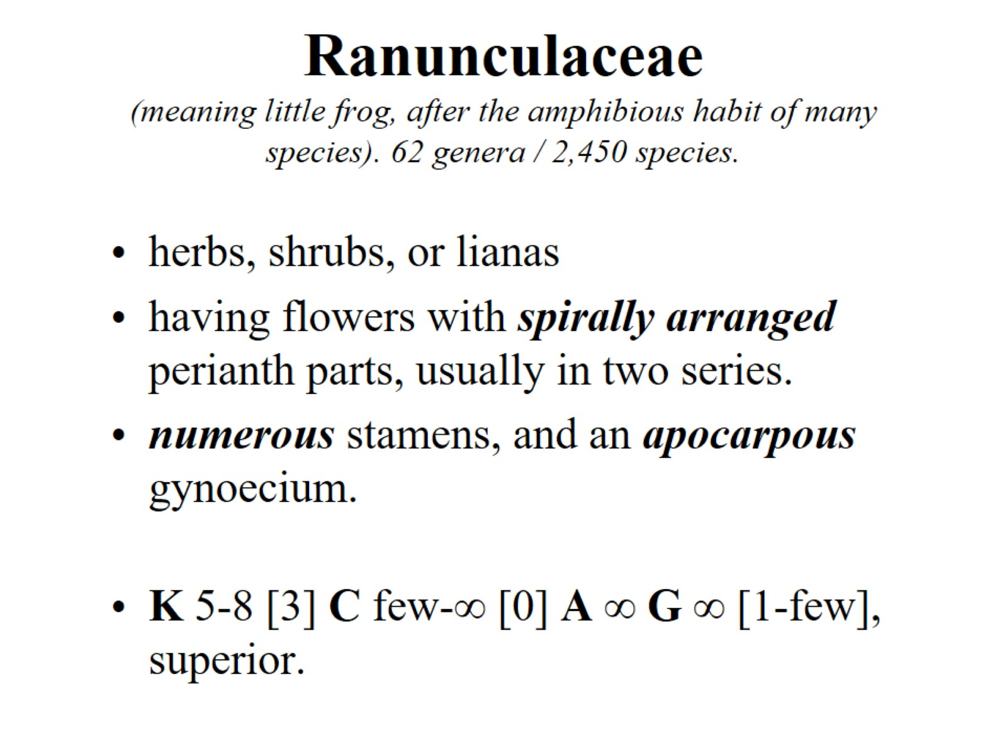
Ranunculaceae (meaning little frog, after the amphibious habit of many species). 62 genera / 2,450 species.

Slide 25
Flower in longitudinal section

Slide 26
Follicles

Slide 27
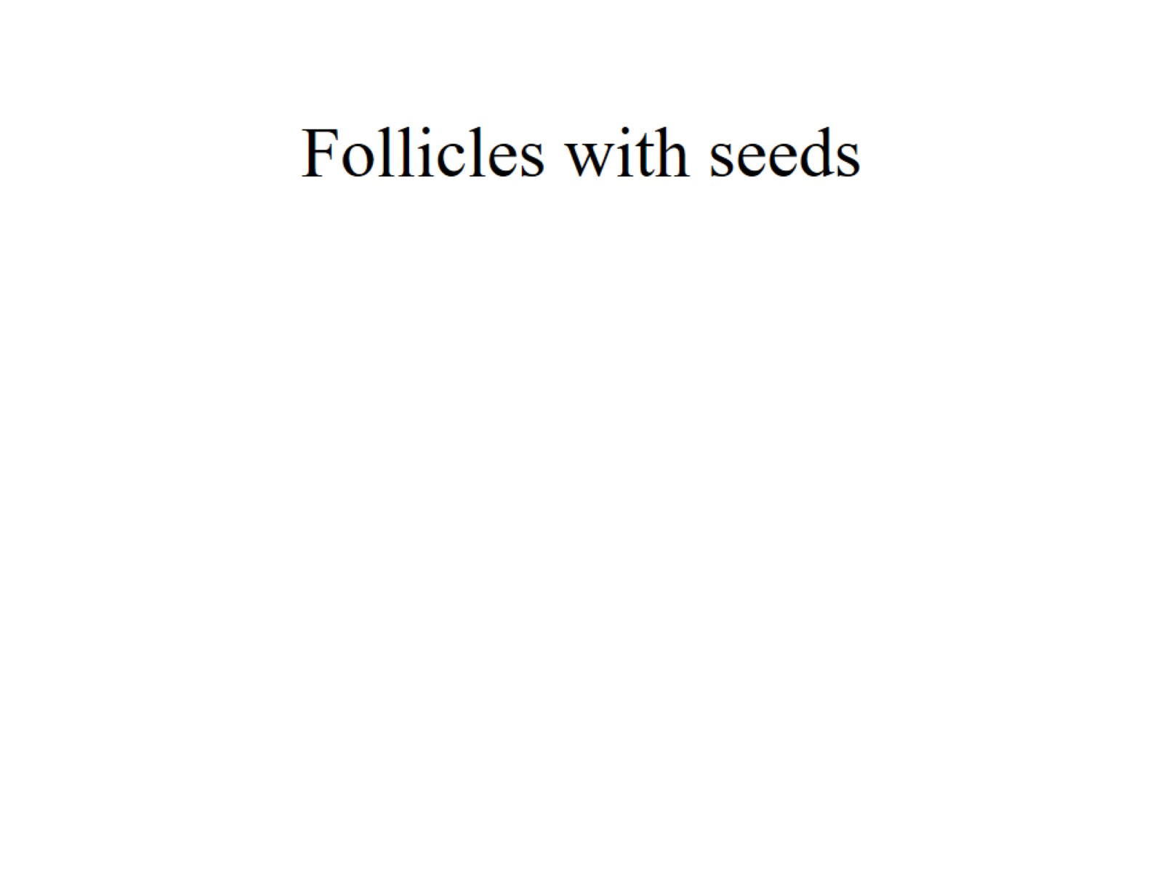
Follicles with seeds

Slide 28
Ranunculus trichophyllus

Slide 29
Clematis sp.

Slide 30
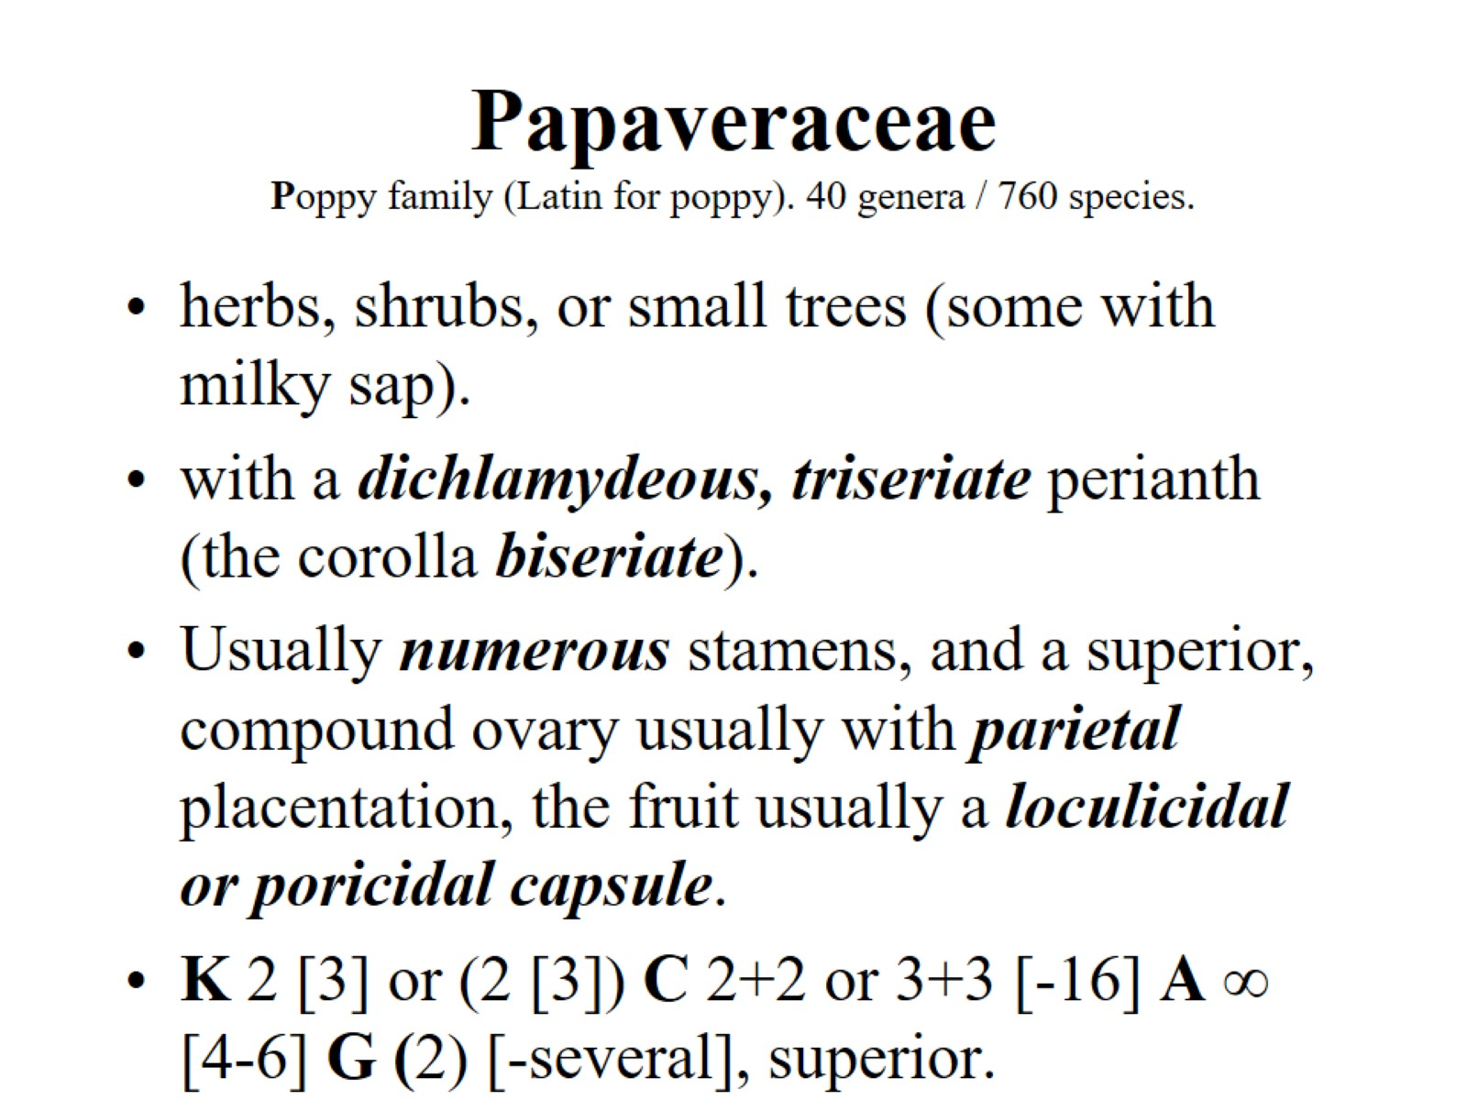
Papaveraceae Poppy family (Latin for poppy). 40 genera / 760 species.

Slide 31
poricidal capsule

Slide 32
parietal placentae

Slide 33
Papaver somniferum

Slide 34
Hypecoum sp.

Slide 35
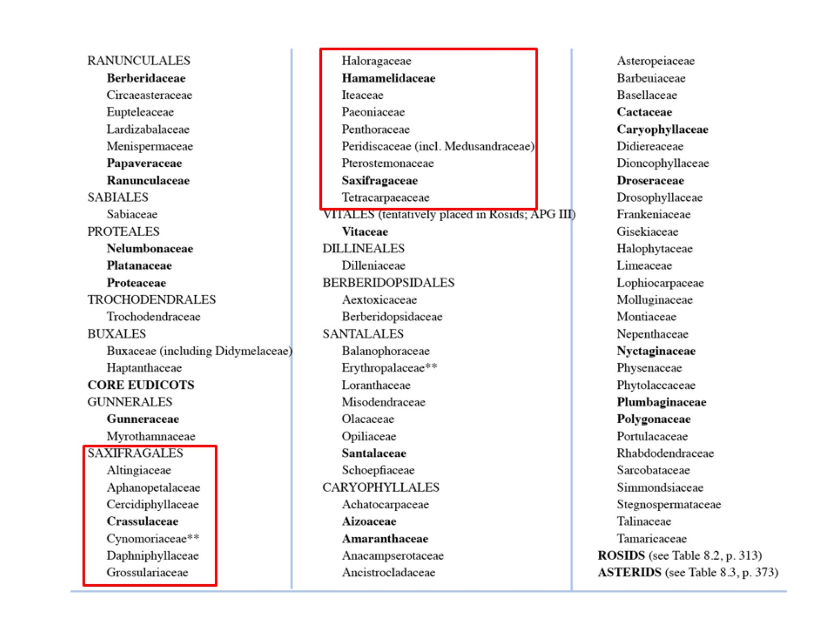

Slide 36
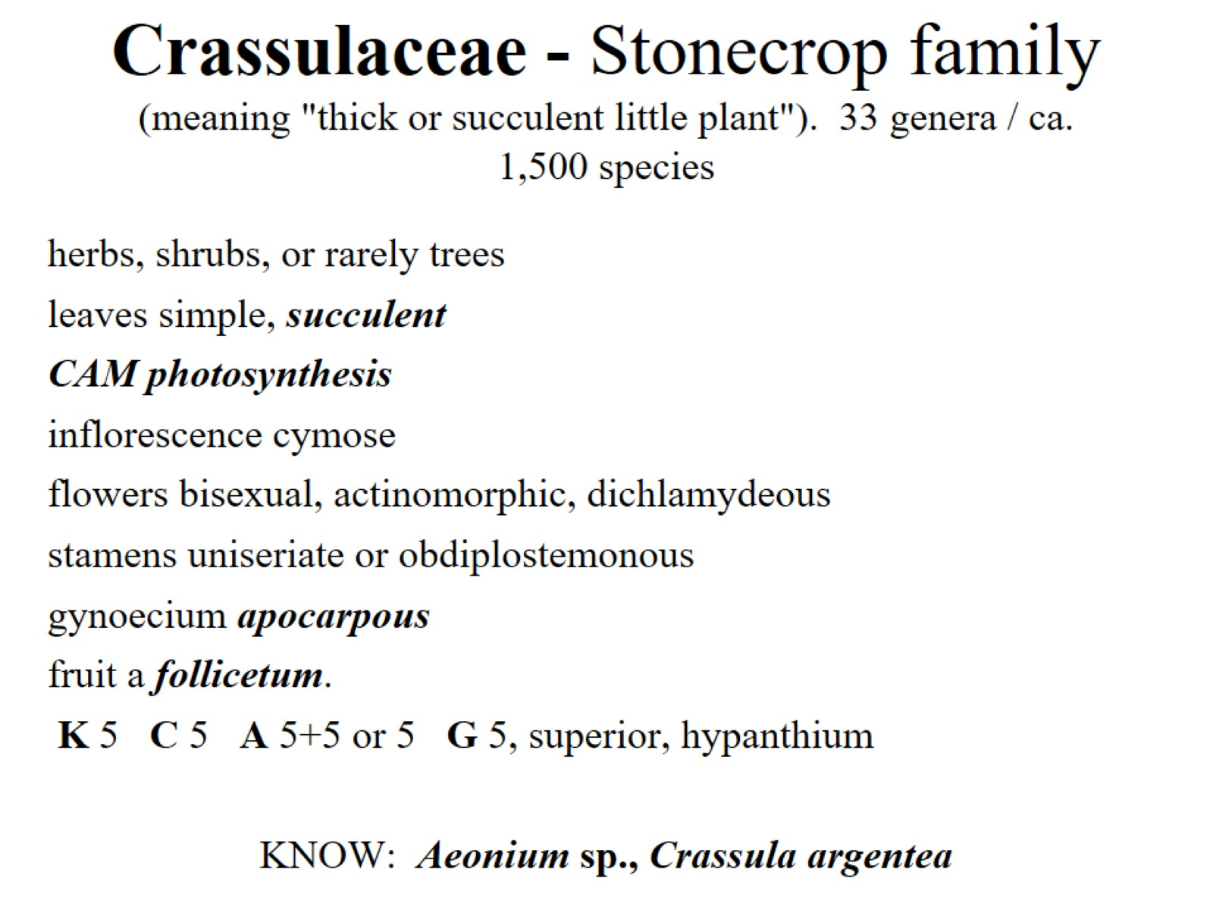
Crassulaceae - Stonecrop family (meaning "thick or succulent little plant"). 33 genera / ca. 1,500 species

Slide 37
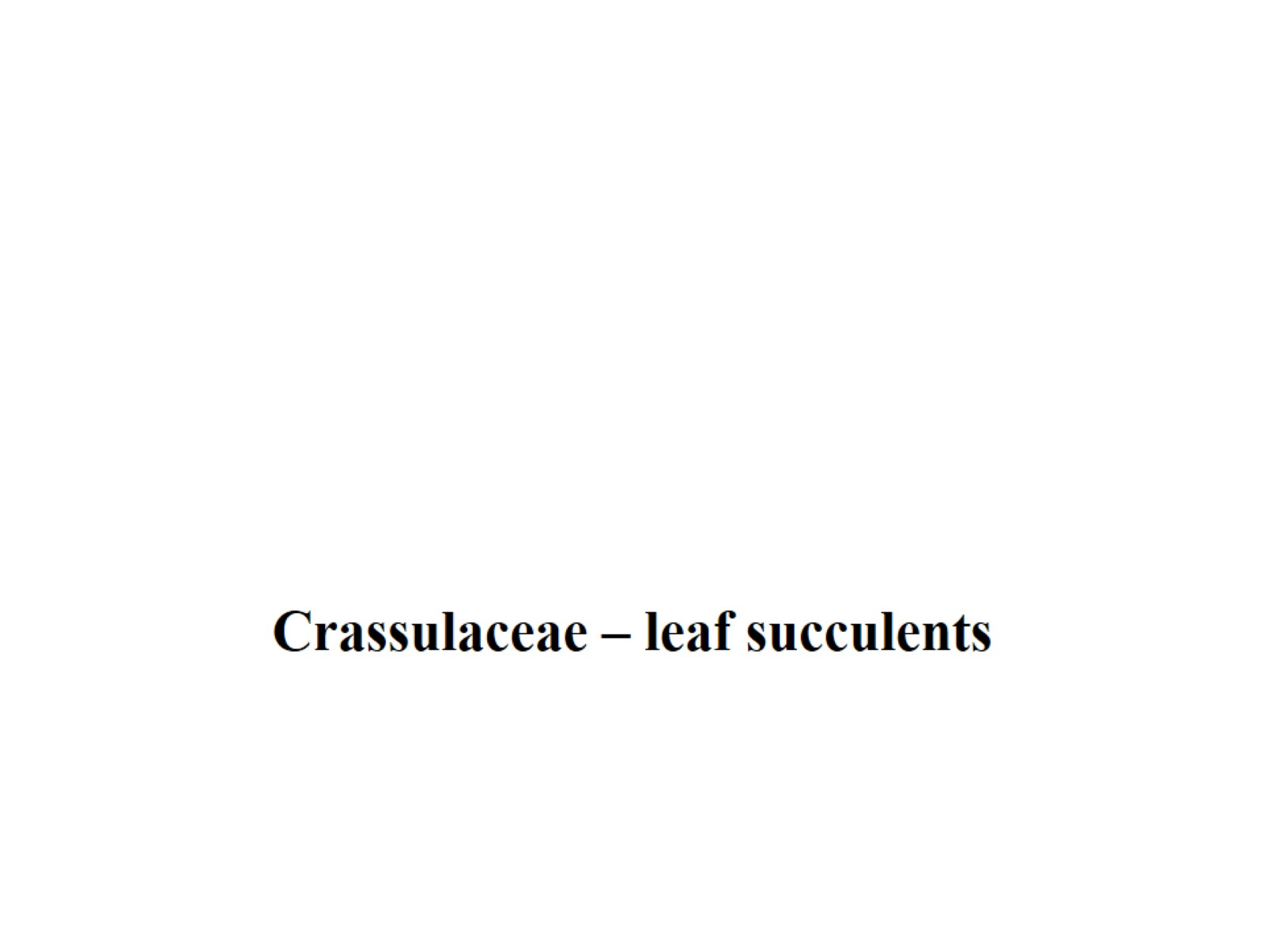

Slide 38
fruit a follicetum.

Slide 40
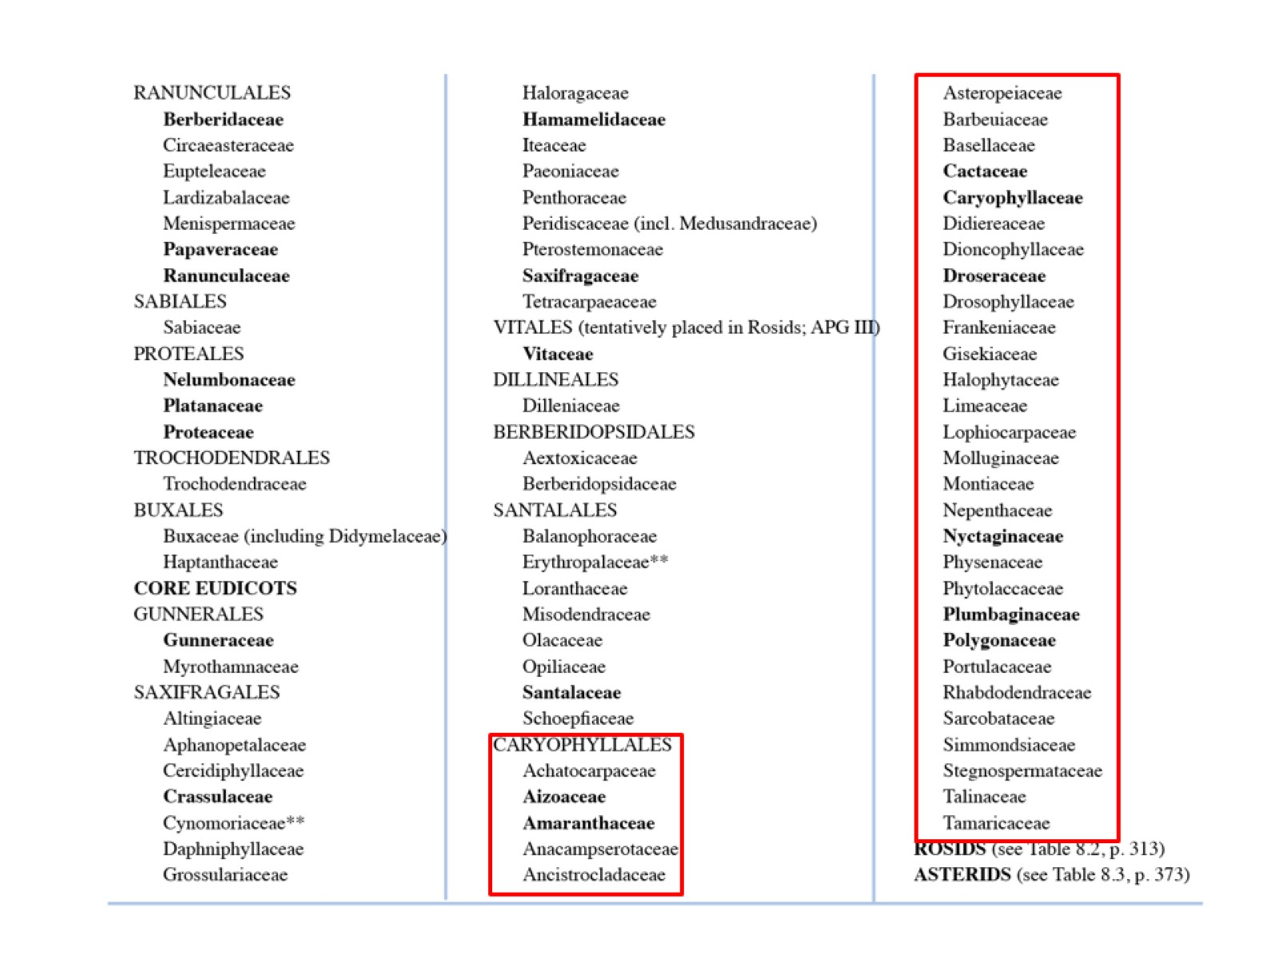

Slide 41
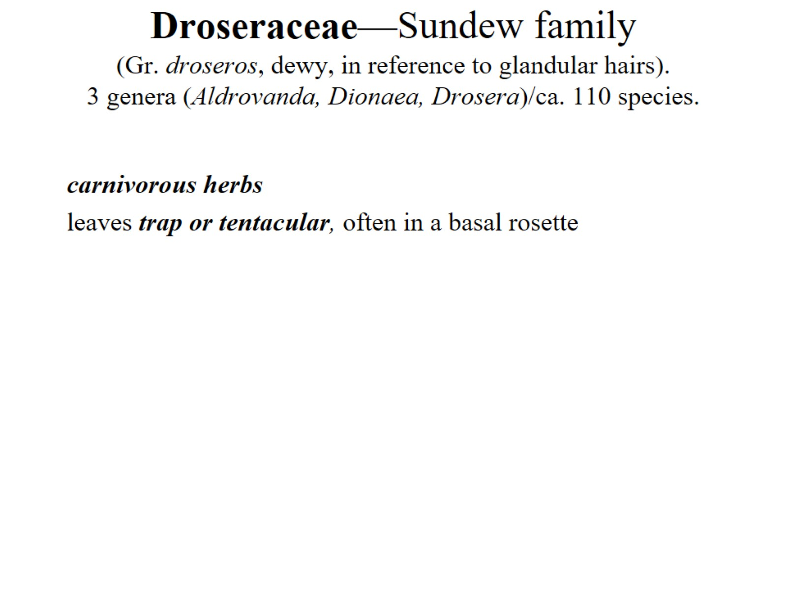
Droseraceae—Sundew family (Gr. droseros, dewy, in reference to glandular hairs). 3 genera (Aldrovanda, Dionaea, Drosera)/ca. 110 species.

Slide 42
Droseraceae—Sundew family (Gr. droseros, dewy, in reference to glandular hairs). 3 genera (Aldrovanda, Dionaea, Drosera)/ca. 110 species.

Slide 43
Core Caryophyllales

Slide 48
Amaranthaceae (including Chenopodiaceae) 174 genera / 2050 species

Slide 49
Reduced leaf

Slide 50
Succulent leaves

Slide 51
uniseriate perianth of mostly sepals

Slide 52
periant

Slide 53
Curved embryo

Slide 54
Microcnemum sp.

Slide 55
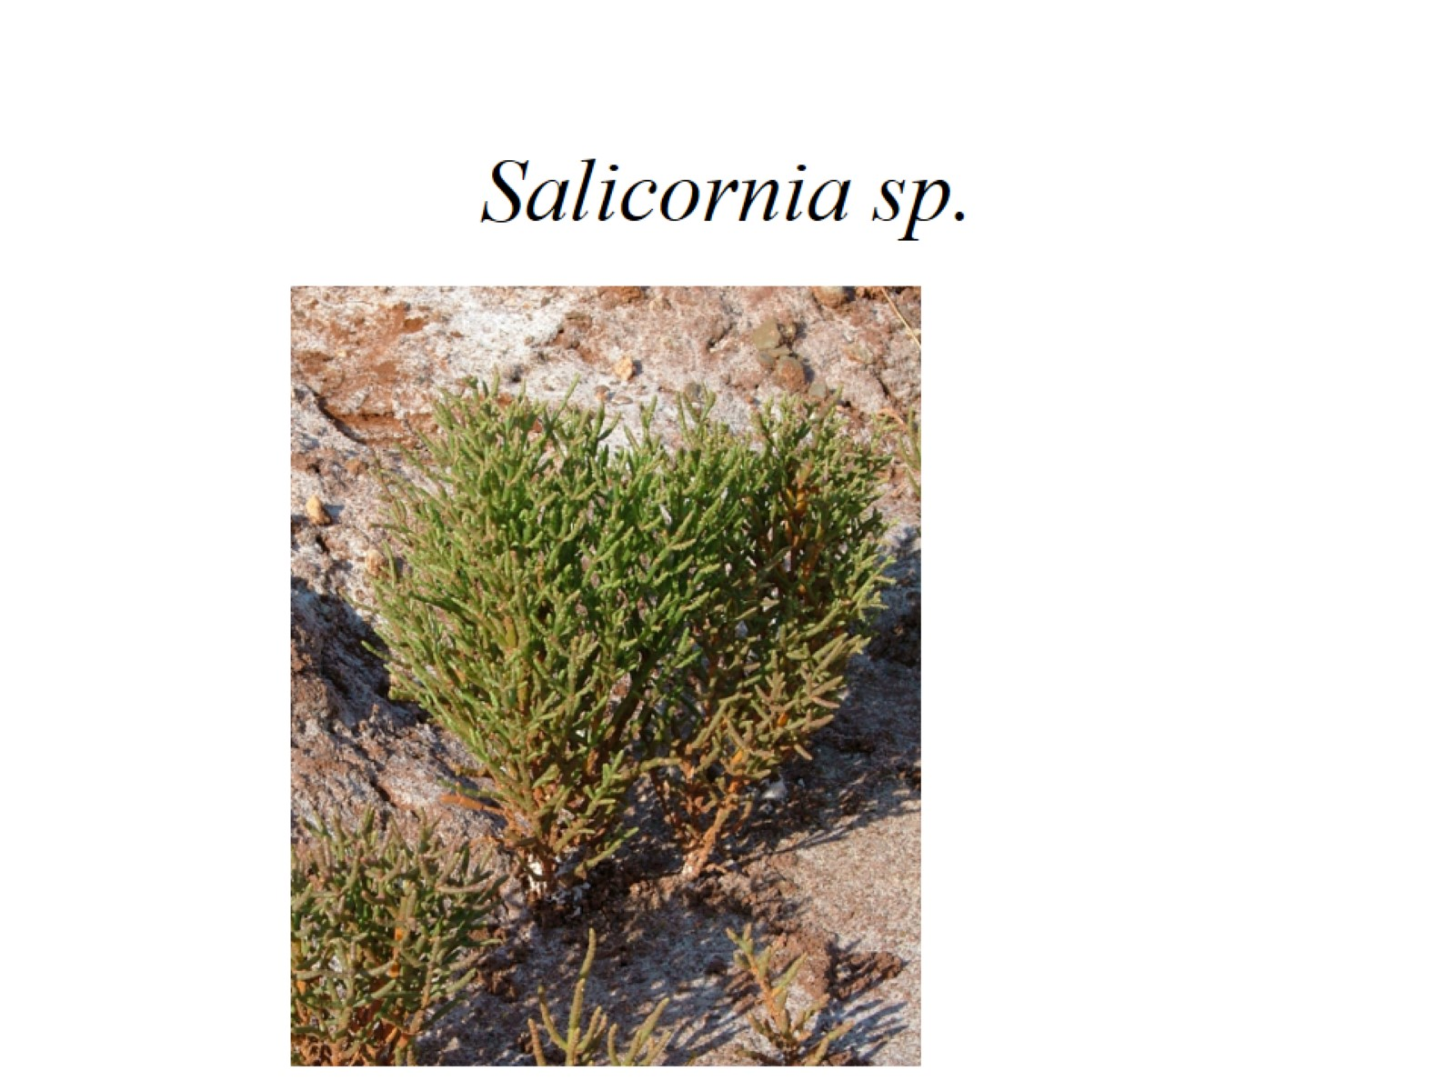
Salicornia sp.

Slide 56
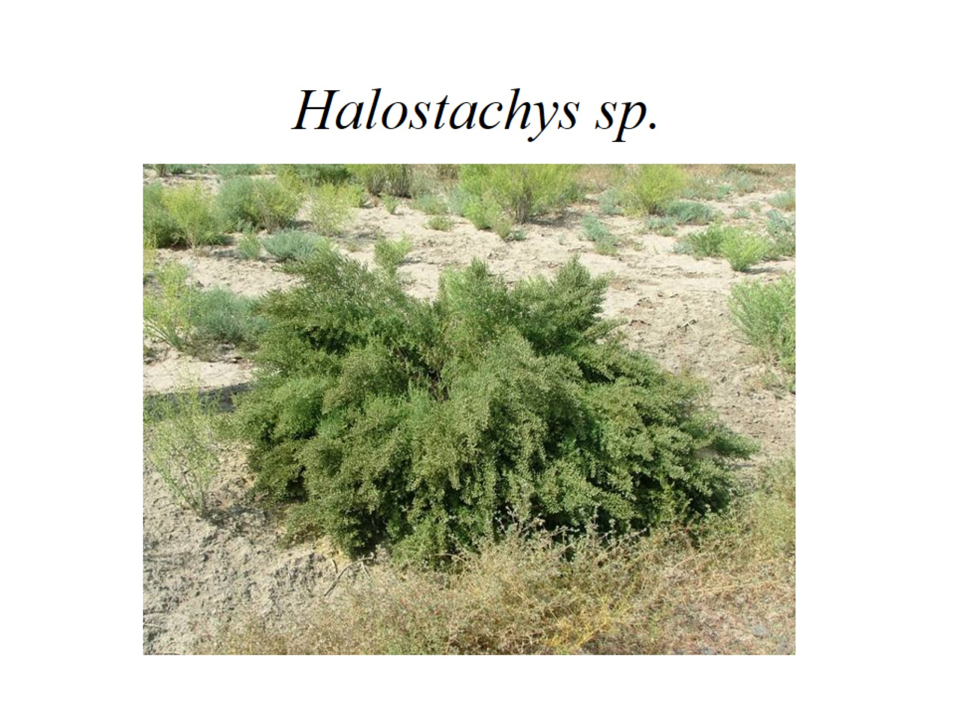
Halostachys sp.

Slide 57
Salsola grandis

Slide 58
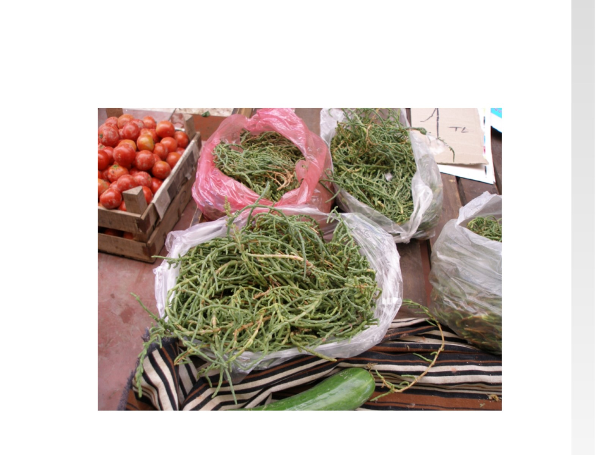

Slide 59
Caryophyllaceae 87 genera / 2300 species

Slide 60
Swollen nodes

Slide 61
Cyme inflorescence

Slide 62
flower in longitudinal section

Slide 63
flower in exploded view

Slide 64
Denticidal capsule

Slide 65
free-central placentation

Slide 66
curved (peripheral) embryo around the perisperm.

Slide 67
Stellaria

Slide 68
Silene sp.

Slide 69
Dianthus sp.

Slide 70
Cactaceae - Cactus family (Greek for a spiny plant). 97 genera / 1,400 species

