Slide 1
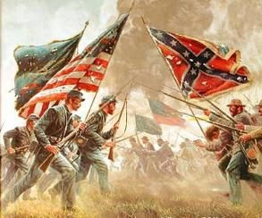
The American Civil War
AKE 117 American History I
Dr. Gamze Katı Gümüş

Slide 2
William T. sherman
Notes:
Pic from https://www.reddit.com/r/ColorizedHistory/comments/hkjztp/william_tecumseh_sherman/

Slide 3
uNION SYSTEM OF COMMAND
Commander in Chief: President Abraham Lincoln
General in Chief: Ulysses S. Grant
The Chief of Staff: Henry W. Halleck
Secretary of War: Edwin M. Stanton

Slide 4
CONFEDERATE SYSTEM OF COMMAND
Commander of the Eastern theater: General Robert E. Lee
Commander of the mountains and the Mississippi River theater: Joseph E. Johnston
Commander of the the trans-Mississippi theater: Edmund Kirby-Smith

Slide 5
The Process
The North was in a disadvantaged position during the first two years of the war, as it lost confidence under the rule of indecisive generals.
With the new command system and the able command of Grant and Sherman, the Northern forces started to gain the upper hand in the war.

Slide 6
The wartime economy
Both the Confederacy and the Union farmers opted to produce grain.
The South was compelled to change its produce from cotton and tobacco to grain since the Northern markets as well as the European markets were now closed to them.
The North started to resort to the use of machinery in farming because of the labor shortage cause by the enlisting of farmhands.
The Southern and Northern industries both profited from the war.

Slide 7
The wartime Economy
Both economies suffered from inflation.
The Homestead Act (1862), [promising 160-acres of land to five years of continuous residence on the land] and the discovery of oil in Pennsylvania led to an economic boom for some Northerners.
However, workers lost many of their wages, and women were in a more disadvantageous position since the employers would cut the wages of women laborers.
Hunger and starvation was a common sight in the South, as their economy was influenced much worse than the Northern economy.

Slide 8
CONSCRIPTION IN THE SOUTH
1862
In 1862, all able-bodied white males between the ages of eighteen and thirty-five were eligible for military service, with large-plantation owners and some state job holders except from the Act.
1864
In 1864, with a need for manpower, the conscription made all white males between the ages seventeen and fifty subject to the draft. Now, small planters (w/ 15 slaves) were exempted one farmer or overseer from the draft.

Slide 9
Draft in the north
In 1863, the Draft Act declared that all able-bodied males between the ages of twenty and forty-five were liable to military service.
Except for:
The only sons of widows and of infirm parents
Certain high governmental officials
People who could hire a substitute
People who could buy exemption at a price of $300

Slide 10
Draft riots of 1863
Notes:
https://www.baruch.cuny.edu/nycdata/disasters/riots-draft.html

Slide 11
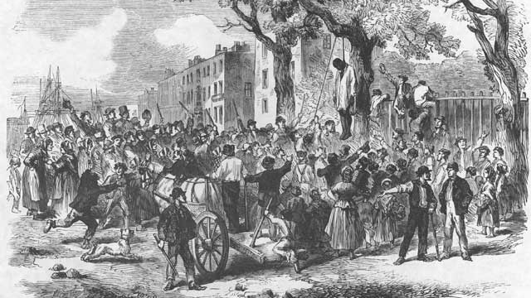
Notes:
https://virtualny.ashp.cuny.edu/Search/search_res_image67d3.html?id=288

Slide 12
“How to escape the draft” 1863, Harper’s weekly
Notes:
https://aaregistry.org/story/the-new-york-civil-war-draft-riots-occur/

Slide 13
Black soldiers
Southerners and Northerners, who were threatened with the draft because of the shortage of soldiers, started to consider the black involvement in the war.

Slide 14
BLACK SOLDIERS
Although the white population of the North and the South was skeptical about arming and emancipating the black population, blacks were already working at nonmilitary jobs in both armies.
The Confederate Congress had the right to seize slaves initially with the consent of the owner, and eventually without the owner’s consent.
Run-away slaves joined the ranks of the Union army to fight against the Confederacy.

Slide 15
BLACK SOLDIERS
1862
North
1865
South

Slide 16
The question of Emancipation
Although emancipation was a highly debated issue, the Union did not want to lose the Border States with a proclamation.
A migration which would follow the emancipation was a scary issue for white laborers, who were afraid to lose their jobs to the cheap black labor force.

Slide 17
PRELIMINARY EMANCIPATION PROCLAMATION (sEPTEMBER 1862)
That it is my purpose, upon the next meeting of Congress to again recommend the adoption of a practical measure tendering pecuniary aid to the free acceptance or rejection of all slave States, so called, the people whereof may not then be in rebellion against the United States and which States may then have voluntarily adopted, or thereafter may voluntarily adopt, immediate or gradual abolishment of slavery within their respective limits; and that the effort to colonize persons of African descent, with their consent, upon this continent, or elsewhere, with the previously obtained consent of the Governments existing there, will be continued.
That on the first day of January in the year of our Lord, one thousand eight hundred and sixty-three, all persons held as slaves within any State, or designated part of a State, the people whereof shall then be in rebellion against the United States shall be then, thenceforward, and forever free; and the executive government of the United States, including the military and naval authority thereof, will recognize and maintain the freedom of such persons, and will do no act or acts to repress such persons, or any of them, in any efforts they may make for their actual freedom.
Notes:
https://www.archives.gov/exhibits/american_originals_iv/sections/transcript_preliminary_emancipation.html

Slide 18
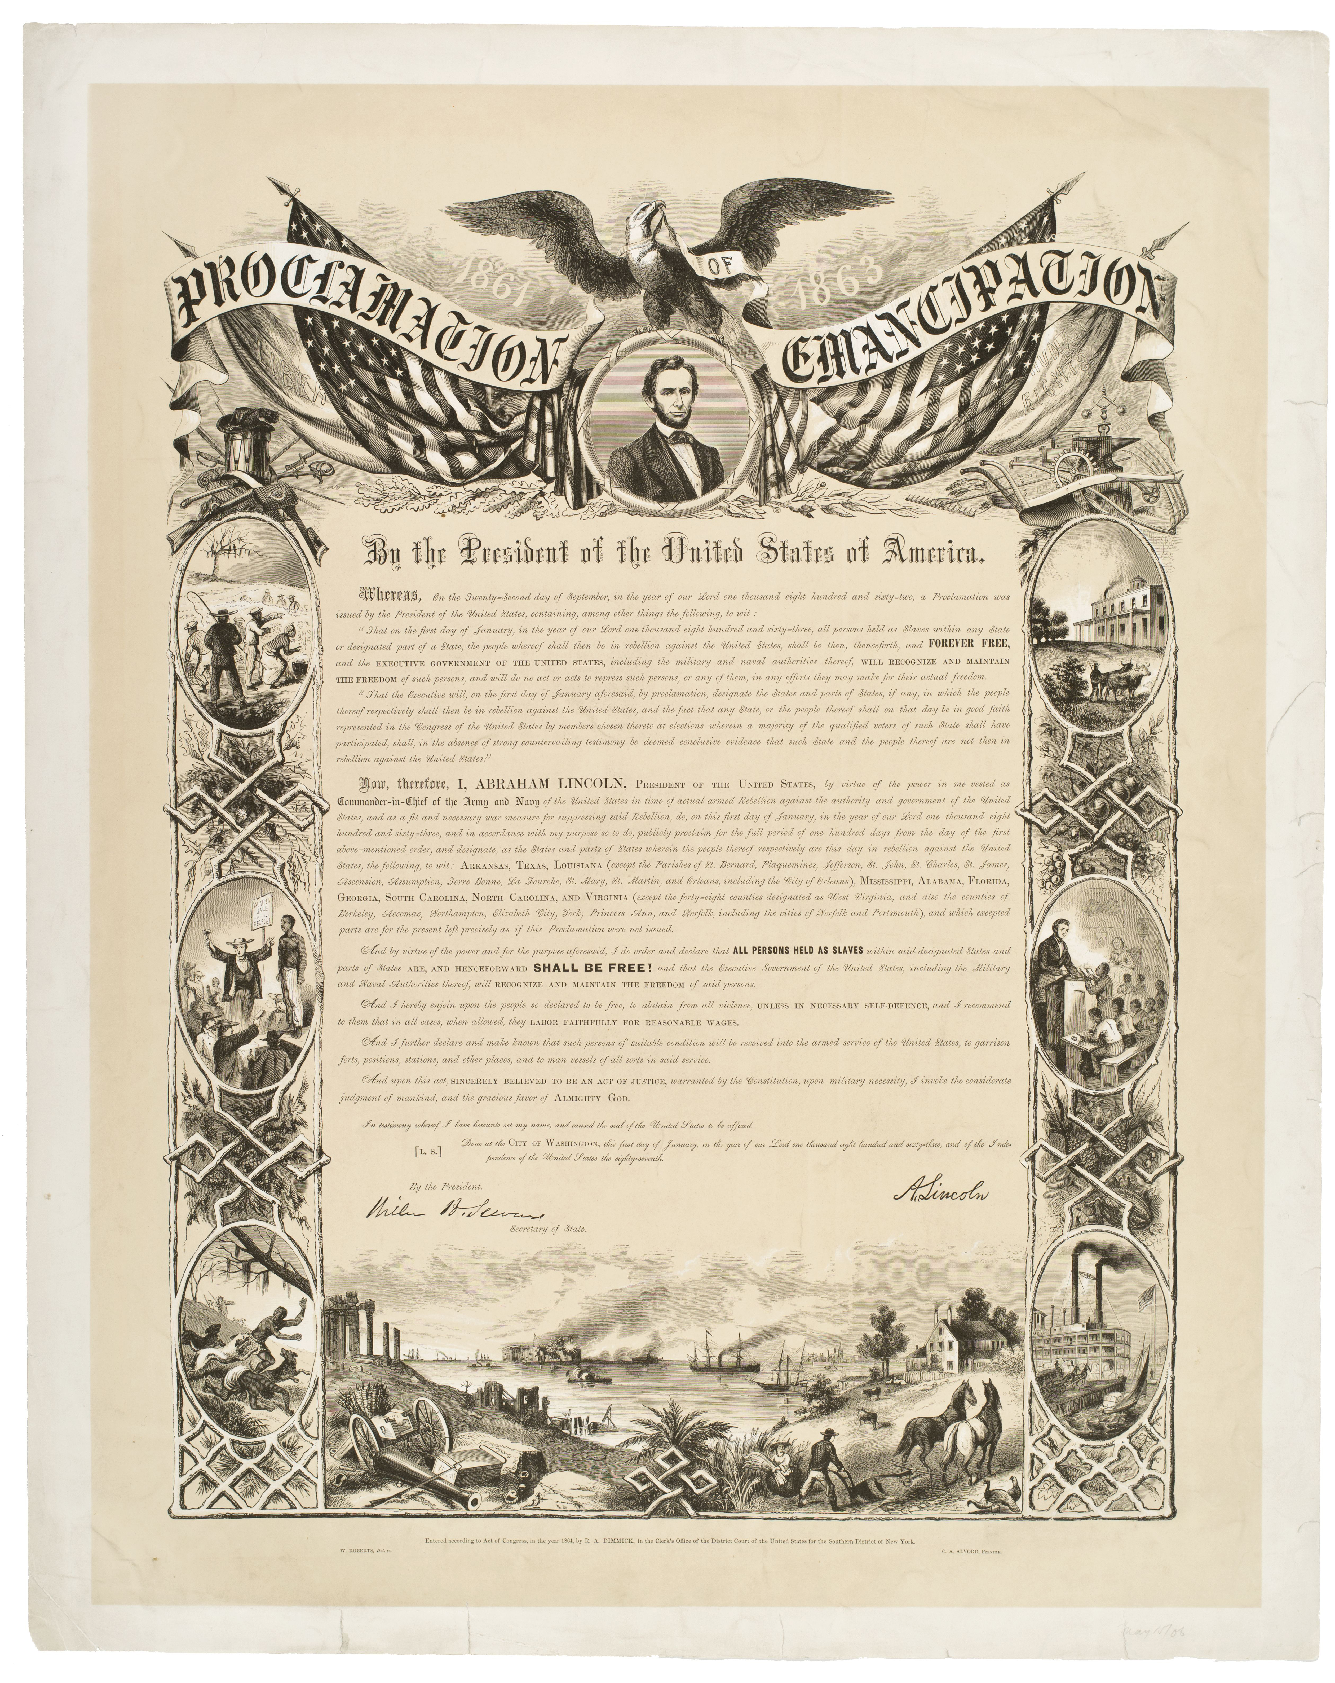
Notes:
http://historydetectives.nyhistory.org/2019/01/who-was-freed-today-in-1863-how-to-read-the-emancipation-proclamation-with-kids/

Slide 19
BLACK SOLDIERS
The recruitment of black soldiers in the Union Army challenged the Northern stereotypes about the racial inferiority of blacks, since black troops came to be recognized by their bravery.
As the North made use of black troops, the South that was in immediate need of manpower, were seeking a resolution.
General Patrick R. Cleburne proposed to recruit black slaves with the promise of emancipation at an unknown future; President Davis on the other hand, discussed the Confederacy’s possibility of purchasing the impressed slaves.
The black troops were recruited by March 1865; however, the war was about to come to an end, end thus they were not able to fight.

Slide 20
WARTIME POLITICS: THE SOUTH
Southerners started to lose faith and trust in President Davis as some started to view him as a dictator striving for imperial power.
The Confederate Congress was another opponent of the President.

Slide 21
WARTIME POLITICS: THE NORTH
Lincoln, was accepted as a dictator by some Americans as well, because of the Emancipation Proclamation and the limitations on the freedom of press.
The abolitionist turn of the war displeased a lot of Northerners, and Lincoln’s Republican Party lost many of its votes to the Democratic Party.
Even though there was a tremendous opposition against Lincoln, he was reelected in the election of 1864.

Slide 22
NORTHERN VICTORY
9 Apr.
On April 9 General Lee surrendered to Grant, and on April 18 General Johnston surrendered to Sherman.
9 May 1865
On May 9, 1865 the Civil War officially came to an end.

Slide 23
Why the North won the war
Economic and industrial superiority of the North
Illness and starvation prevailed in the Confederate Army
Immigrants and blacks acted as additional manpower for the Union Army
The one-party system of the South weakened Davis
The two-party system of the North enabled Lincoln to experiment

Slide 24
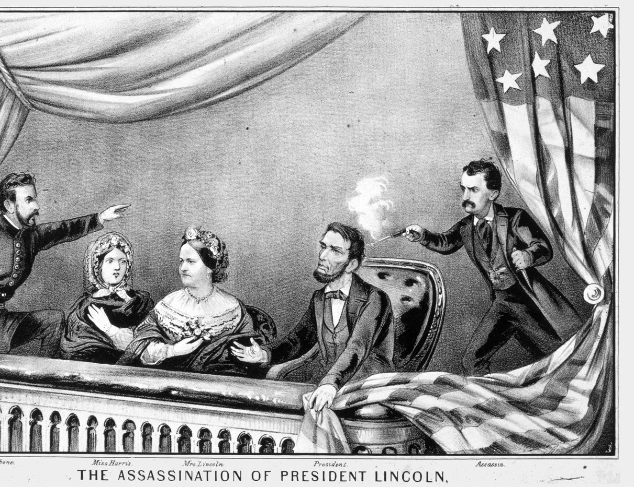
THE ASSASSINATION OF ABRAHAM Lincoln
John Wilkes Booth, an American actor, and his co-conspirators planned to abduct Lincoln and bring him to the Confederate capital, Richmond.
But when General Lee surrendered, Booth changed the plan and decided that he and his co-conspirators should assassinate Lincoln, Vice President Johnson and Secretary of State William H. Seward.
The Lincolns went to the Ford Theatre to watch “Our American Cousin,” where Booth shot the president in the back of his head.
The manhunt for Booth ended with the death of the assassin.
Notes:
https://www.history.com/topics/american-civil-war/abraham-lincoln-assassination

Slide 25
Jefferson Davis
Davis was imprisoned in Fort Monroe for two years until he was released on bail in 1867.
Notes:
https://www.history.com/this-day-in-history/jefferson-davis-captured

Slide 26
CHRONOLOGY
1863
Final Emancipation Proclamation
1863
Drat riots in the North
1864
Lincoln is reelected president
1865
Lee, Johnston and Kirby-Smith surrender
1865
Lincoln is assassinated
1865
Andrew Johnson becomes president

