Slide 1
Religious Education at Home

Slide 2
The family is the first social environment for a child. The child’s character constitutes in this first social atmosphere. According to researchers, the first experience that a child gained in the family is the basis of the later experience and knowledge (Dam, 2014).

Slide 3
It is a responsibility for families that to provide a healthy atmosphere for children in the families, even psychological or physical. Spiritual and moral developments have to be provided for families, too.

Slide 4
Especially in early childhood period, it is extremely important to be as role models for parents. Since children would imitate their parents, parents have to control their attitudes in the family.

Slide 5
There are two main theories on moral development (Kizilabdullah, 2015):
Piaget Moral Development Theory
Kohlberg Moral Theory

Slide 6
Piaget’s theory is based on his cognitive development theory. According to him, Children have three main moral development stage (Karaca, 2007):
The first one is between 0-6 which he describes as «stage before morality»
The second stage is between 6-12 which he describes as «heteronom stage»
The third one is 12+ which he describes as «otonom stage»

Slide 7
According to Kohlberg there are 3 level and 6 stages (Siegal, 1980) in moral development. But in some resources there two more stages (See Karaca, 2007). Those are as follows:
Pre-conventional
Conventional
Post-conventional

Slide 8
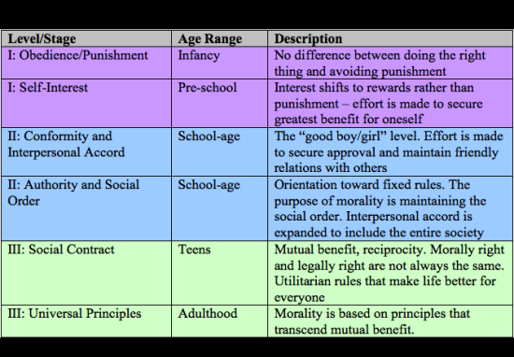
https://www.psychologynoteshq.com/kohlbergstheory/

Slide 9
What are the principles of Religious Education at home?
Being a role model
Consistency
Values Education
Learning and interactive atmosphere
Educational games

Slide 10
Cited Researches
Kizilabdullah, Y. (2015). Ahlak Öğretiminde Aile: “Vicdan” Örneğinde Bir Model Denemesi. Geçmisten Gelecege Ahlak. Bartın.
Dam, H. (2014). Çocukluk Dönemi Din Eğitimi. Gelişimsel Basamaklara Göre Din Eğitimi. Ed. By Mustafa Köylü &Nurullah Altas. Nobel: Ankara.
Karaca, F. (2007). Dini Gelisim Teorileri. Istanbul.
Siegal, M. (1980). Kohlberg Versus Piaget: to What Extent Has One Theory Eclipsed the Other? Merrill-Palmer Quarterly of Behavior and Development, Vol. 26, No. 4. pp. 285-297
https://www.psychologynoteshq.com/kohlbergstheory/

