Slide 1
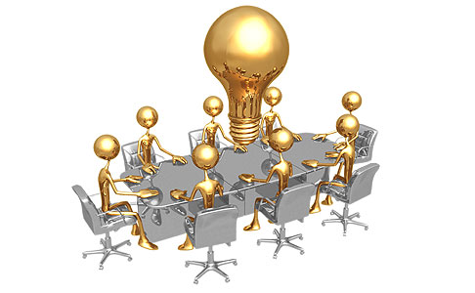
Introduction to Systems Thinking

Slide 2
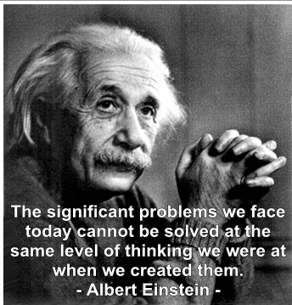

Slide 3
The World’s Biggest Problems
Food Safety & Security
The Energy Crisis
Environmental
Disasters
Climate Change
Carbon Trade
Pandemic
Land Use
Biodiversity
Water Shortage
Business
Profitability
Poverty
Human Health
Animal Health
Globalisation
Sustainability
Job Losses
Resource

Slide 4
Why Do These Problems Persist?
Schools Have Not Prepared Students to Solve Them
What is a system?

Slide 5
Definition of a System
“A system is an interconnected set of elements that is coherently organized in a way that achieves something.
…a system must consist of three kinds of things:
elements,
interconnections and
function or purpose.”
Examples: a business, football team; digestive system; school; faculty, city; corporation; animal; tree; etc.

Slide 6
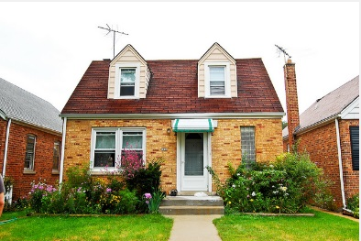
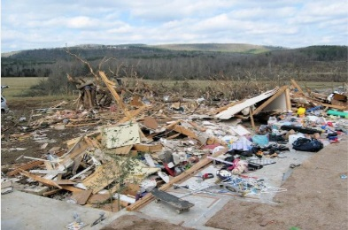
System or Heap?
Imagine a house.
A house is a system, made up of many parts that interact together to provide shelter and other services like electricity and plumbing.
But if an eartquake hits the house and it’s destroyed, it can no longer serve these functions. All the materials and parts may still be there, but the relationships between those parts have been broken and now lie in a purposeless heap.

