Slide 1
BASIC GENETIC TERMS-VII
DVM. Nüket BİLGEN,PhD
A. U. Vet. Med.

Slide 2
Non-Mendelian Genetics
Why non-mendelian genetics?
Some characters don’t follow Mendel’s law.
In those cases where Mendel's proposals are not valid and the expected phenotype rates differ.

Slide 3
Inheritance patterns are not-distributed in accordance with Mendel's rules.
The expected phenotype ratio in these cases where Mendel's proposals are not applicable:
Multiple alleles
Lethal genotypes
Incomplete dominance
Codominance
Penetrance
Expressivity
Pleiotropy
Epistasis

Slide 4
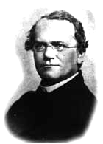
Mendel’s law

Slide 5
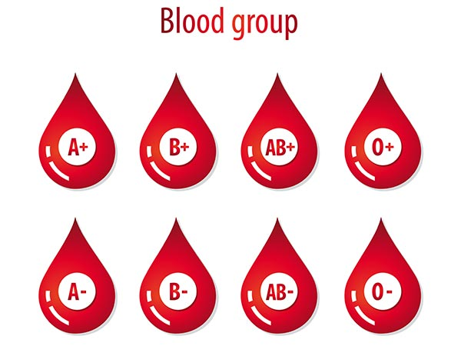
Multiple alleles
Multiple alleles: having more than two alleles that are possible to code for any one characteristic.

Slide 6
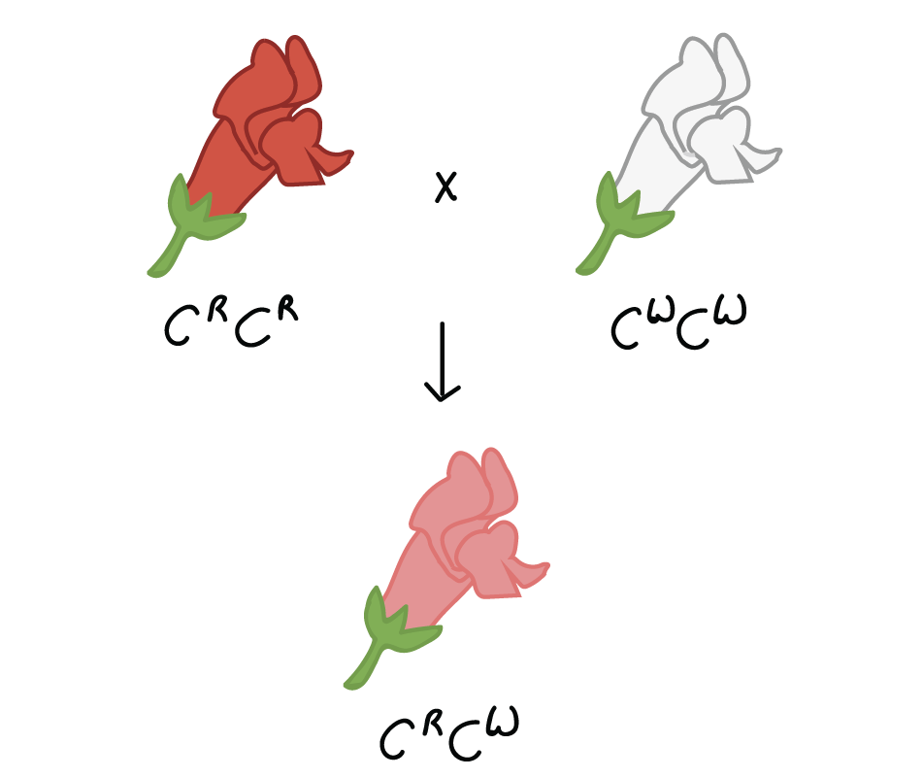
Incomplete Dominance
Incomplete dominance is the blending of traits expressed by the alleles that combine for any given characteristic.

Slide 7
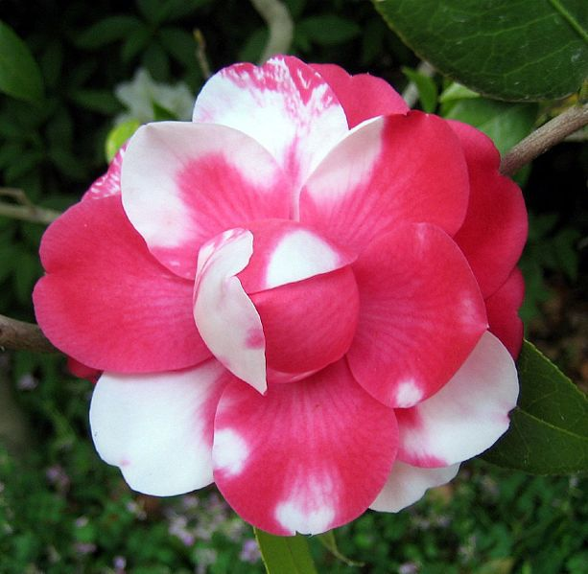
Co-dominance
Instead of creating a new feature, in co-dominance, both alleles are equally expressed and their features are both seen in the phenotype.

Slide 8
Lethal genotypes
Dominant lethal genes?
Recessive lethal genes?
Which can be detected in the population???
Examples: Yellow Mouse, PKD in cats.

Slide 9
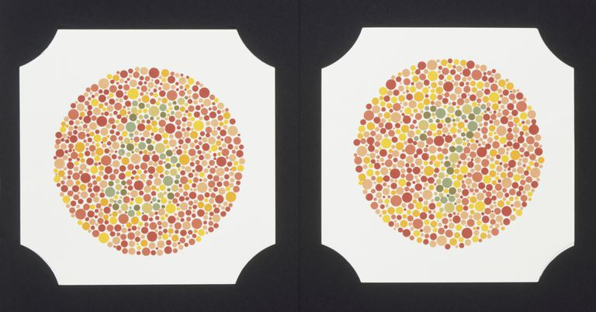
Sex-linked Traits
Sex-linked traits are found on the sex chromosomes of the species and are passed down in that manner.

Slide 10
Sex-limited Traits
Sex-limited genes are genes that are present in both sexes of sexually reproducing species but are expressed in only one sex and remain 'turned off' in the other. In other words, sex-limited genes cause the two sexes to show different traits or phenotypes, despite having the same genotype.
These traits are carried on outosomal chromosomes.
Milk production, and reproductive traits.

Slide 11
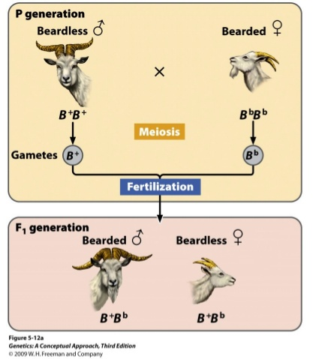
Sex-influenced Traits
These characters are expressed differently in males and females.

Slide 12
Penetrance and Expresivity
Penetrance = the percent of individuals who have a certain genotype and show the expected phenotype.
Some genes are not have %100 penetrance…
The terms penetrance and expressivity quantify the modification of gene expression by varying environment and genetic background; they measure respectively the percentage of cases in which the gene is expressed and the level of expression.

Slide 13
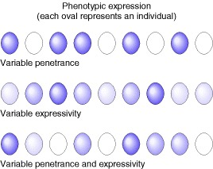
Penetrance and Expresivity
The effects of penetrance and expressivity through a hypothetical character “pigment intensity.” In each row, all individuals have the same allele—say, P—giving them the same “potential to produce pigment.” However, effects deriving from the rest of the genome and from the environment may suppress or modify pigment production in an individual.

Slide 14
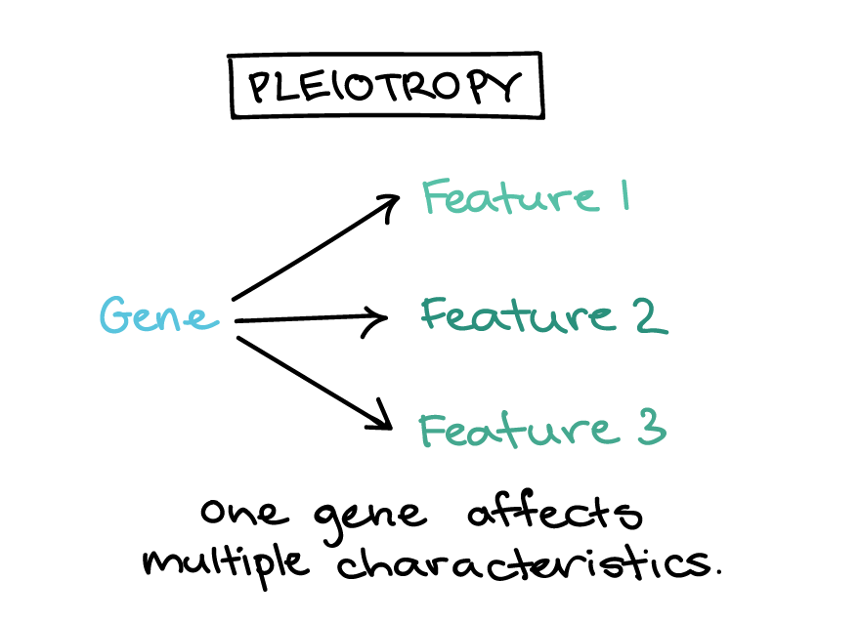
Pleiotropy
Pleiotropy occurs when one gene influences two or more seemingly unrelated phenotypic traits. Therefore, a mutation in a pleiotropic gene may have an effect on several traits

Slide 15
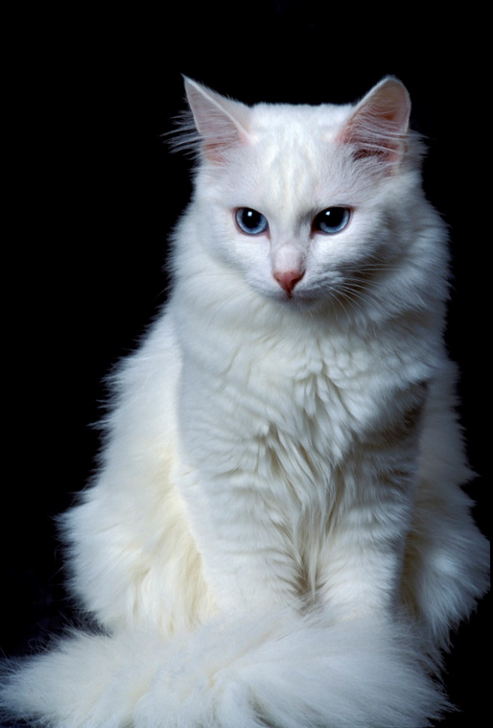
Pleiotropy
White cat fur and blue eyed cats are 40% deaf.
The gene affecting fur and eye color alseo lead to deafness.

