Slide 1
PACKAGING of meat and meat products
Instructor
Assist. Prof. Dr. Eda Demirok Soncu
E-mail: edemirok@eng.ankara.edu.tr
Phone: +90312 203 3300 (3639 ext.)
Office: 2nd floor #212
Fde 216 food packagıng

Slide 2
PACKAGING OF FRESH RED MEAT AND POULTRY MEAT

Slide 3
Quality factors for fresh red/poultry meat
Quality factors that determine the shelf life of fresh red meats and poultry meats are
Color
Odor
Flavor
Tenderness
Exudate (Drip loss)
Bacterial spoilage

Slide 4
Importance of color
For fresh red meat, bright red muscle and white fat color are desirable properties
For poultry meat, the general preference is flesh and skin that are white and bright
Myoglobin can comprise more than 90% of the total pigments in fresh red meat
Myoglobin is able to bind and store O₂; therefore, the effects of various conditions of myoglobin on meat color is important

Slide 5
Various conditions of myoglobin
CO: Carbon monoxide
OCR: Oxygen consumption rate
MRA: Methmyoglobin reduction activity

Slide 6
Various conditions of myoglobin
In the absence of O₂, myoglobin is present in muscle tissue as deoxymyoglobin, which is a dull, purple color. On exposure to O₂, myoglobin is oxygenated to form bright red oxymyoglobin. The interconversion of deoxy- and oxymyoglobin is rapid and reversible, and dependent on the partial pressure of O₂ to which myoglobin is exposed
When the atmosphere contains carbon monoxide, stable, cherry red carboxymyoglobin is formed from deoxymyoglobin

Slide 7
Various conditions of myoglobin
The heme iron of myoglobin can be oxidized from the ferrous to the ferric state, with the formation of physiologically inactive, brown metmyoglobin. Oxymyoglobin is more resistant to oxidation than is deoxymyoglobin. Consequently, metmyoglobin is formed more rapidly at low concentrations of O₂, at which deoxymyoglobin predominates, than at high O₂ concentrations

Slide 8
How color affect the acceptability of fresh meats?
The accumulation of metmyoglobin reduces the acceptability of red meats as it dulls and darkens muscle tissues and cut bone surfaces. The display life of such meats is usually terminated by extensive brown discoloration of exposed muscle tissue surfaces
There is little change in the color of poultry meat during storage. Consequently, the storage life of poultry meat is not usually terminated by color deterioration

Slide 9
Importance of odor, flavor and tenderness
Oxidation of lipids gives rise to rancid odors and flavors in meats
The susceptibility of muscle tissue lipids to oxidation is highly dependent on their fatty acid compositions, as rates of oxidation increase with greater amounts of unsaturated fatty acids and the degree to which those acids are unsaturated
Ferrous iron, which is present in the centre of myoglobin, is an important catalizor of lipid oxidation
Thus, lipid oxidation is accelerated by grinding or other treatments that disrupt muscle tissue and release these compounds
Therefore, discoloration of muscle tissue and lipid oxidation are closely linked

Slide 10
Importance of tenderness
Most consumers consider tenderness to be the main factor determining the eating quality of meat
However, the rate of tenderization declines exponentially with time
Storage under modified atmosphere rich in O₂ may lead to toughening of the meat because of oxidation and cross-linking of muscle structural proteins

Slide 11
Importance of exudate (drip loss)
Loss of exudate from meat is unavoidable
Exudate in retail packs is undesirable because of its adverse effects on the appearance of the packed product
Exudates depends on pH value of meat. Exudate losses are lower from meat of pH > 6 than from meat of lower pH
Exudate losses from all meats are increased by cutting large pieces into smaller ones and by pressure on the product
What is solution ????

Slide 12
Importance of bacterial spoilage
The spoilage flora of chilled meats (stored at refrigerated temperatures under aerobic condition) is composed of psychrotrophic bacteria with minimum temperatures for growth of –3ºC or below
Intact muscle tissue does not usually contain bacteria, and so spoilage bacteria grow only on the surfaces of meats. Surface growth of bacteria affects appearance (formation of slimy surface), odor and flavor of fresh meat

Slide 13
Importance of bacterial spoilage
Aerobic microorganisms are generally responsible from spoilage. Its growth rate is faster under aerobic conditions
Fresh meats stored in air (under aerobic condition) usually develop flora in which species of Pseudomonas predominate
The flora that develop under anaerobic conditions are usually dominated by lactic acid bacteria, which include organisms of the genera Lactobacillus, Carnobacterium and Leuconostoc
The metabolic by-products of the lactic acid bacteria have a low sensory impact as they impart mild acidic or dairy flavors

Slide 14
Principle spoilage bacteria of flesh meat

Slide 15
PACKAGING TYPES OF FRESH MEAT

Slide 16
Packaging of fresh meats
Retail cuts of meat are prepared from carcasses (whole body of animal after slaughtering) or vacuum-packaged primal cuts at butchers’ shops or butchering facilities at retail food stores
Fresh red meat cuts or fresh poultry meat cuts are packaged in different ways such as
Overwrapped trays
Lidded trays (MAP)
Vacuum packaging
The most important factor to preserve the quality during shelf life is temperature. Because, higher temperatures trigger discoloration, microbial spoilage and lipid oxidation

Slide 17
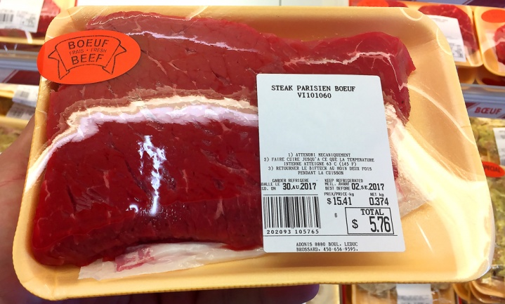
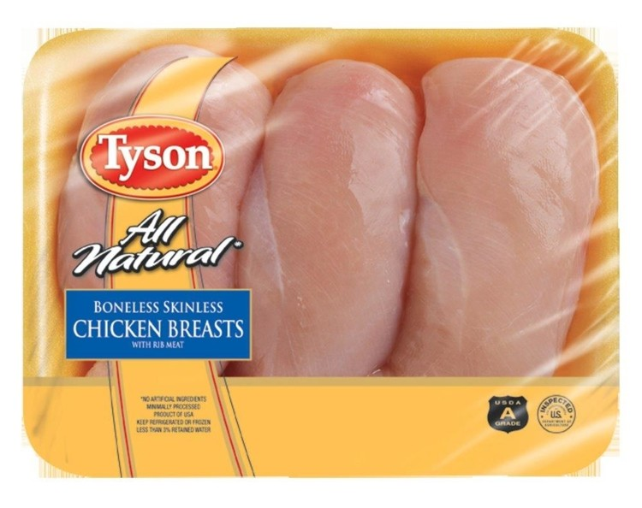
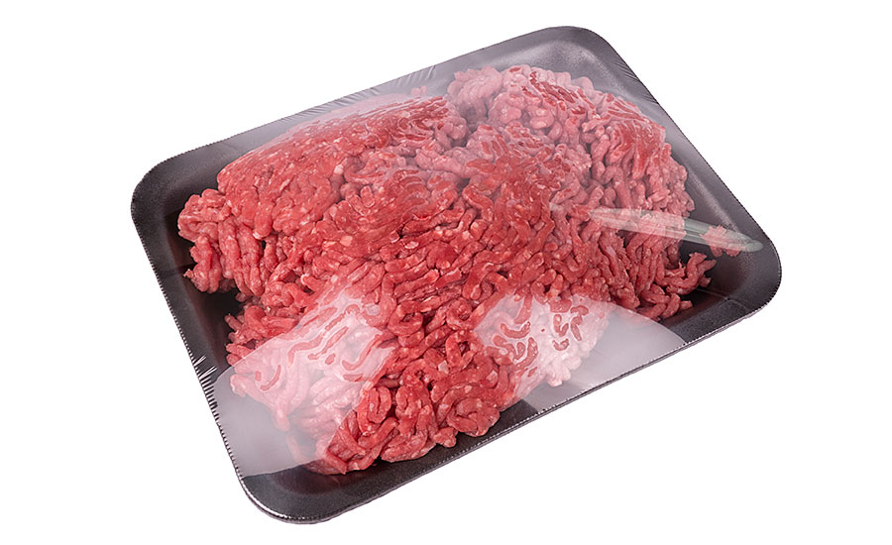
Overwrapped trays
Plastic packaging material used | PS trays overwrapped with a stretchable PVC film The inner surfaces of the trays may have a LDPE or PVC coating
Barrier properties of packaging material | The overwrapping film must have a high O₂ transmission rate. An OTR of about 1700 mL/m² day at 23°C and 50% RH is adequate to provide oxymyoglobin formation

Slide 18
Overwrapped trays
What should be done to extend the shelf life under this packaging condition? | --The use of moisture absorbent pads to remove exudates and improve appearance --Incorporation of CO₂ in absorbent pads to inhibit microbial spoilage (Moistening of the pads by exudate from the meat will then generate a CO₂-enriched atmosphere within the pack). CO₂-enriched pads are especially used for fresh poultry meats. It is not practical for red meats because meats become unsalable due to discoloration before microbial spoilage
What are the factors that limit shelf life? | Discoloration (main factor), aerobic bacteria spoilage and lipid oxidation

Slide 19
Lidded trays (modified atmosphere packaging)
Plastic packaging material used | Trays may be composed of PS, PP or PVC laminated with a film having good gas barrier properties, such as one containing an EVOH. Input gas mixtures used with lidded trays are typically composed of 60–70% O₂, 20–30% CO₂, and 10–20% N₂ or 30% CO₂ and 70% N₂ without or with 0.3–0.5% CO Poultry meats are packaged in lidded trays using mixtures of CO₂ and N₂ without O₂
Barrier properties of packaging material | The OTRs of trays and lidding films can be expected to be less than 0.42 and less than 4.2 mL /m² day, respectively, although negligible OTRs are technically possible The OTR of lidding films for poultry meats should be very low, since oxygen is not used in the pack atmosphere

Slide 20
Lidded trays (modified atmosphere packaging)
What should be done to extend the shelf life under this packaging condition? | High level of O₂ is used to enhance and maintain a desirable color. However, discoloration of the muscle tissue and blackening of the cut surfaces of bones in bone-in cuts is inevitable The growth of aerobic spoilage flora is inhibited by the CO₂ N₂ is included in the atmosphere to guard against pack collapse because of absorption of CO_{2,} which is highly soluble in both muscle and fat tissues
What are the factors that limit shelf life? | Discoloration, changing of pack gas atmosphere due to CO₂ dissolution, O₂ consumption by muscle tissue and bacteria, gas exchange across the lidding film

Slide 21
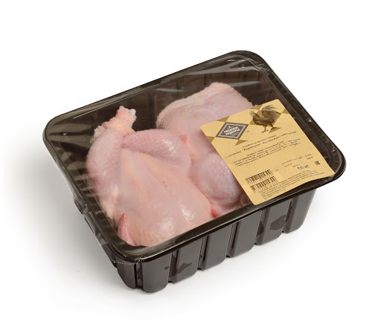
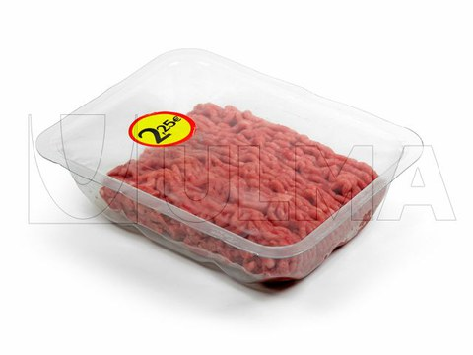
Lidded trays (modified atmosphere packaging)

Slide 22
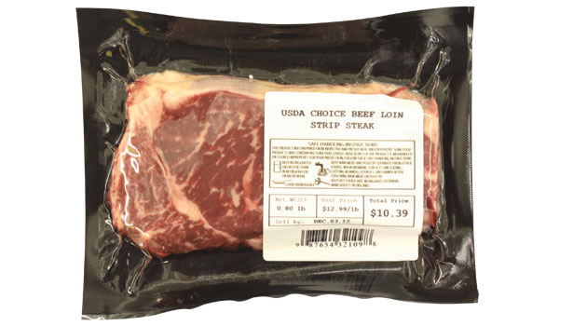
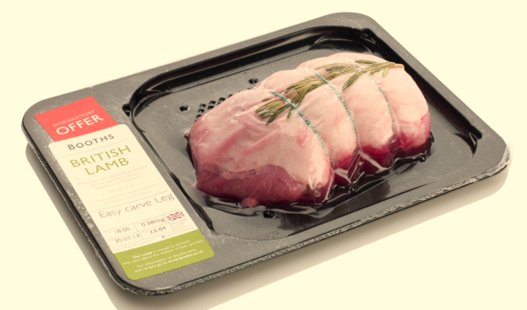
Vacuum packaging
Flexible packs | Bottom side | PA-LDPE
Rigid packs | Bottom side | PVC
 |  | PVC-LDPE
 |  | PS-EVOH-LDPE
 | Upper side | OPA-LDPE
 |  | PET-PVDC-LDPE
 |  | OPA-LDPE-EVOH-LDPE
 |  | PET-LDPE-EVOH-LDPE
Flexible vacuum packs
Rigid vacuum packs

Slide 23
Vacuum packaging
Barrier properties of packaging material | Low OTRs (typically less than 2 mL / m² day) can be used to extend the storage life by inhibition of aerobic spoilage flora
Meat color under this pack condition | Vacuum-packaged beef and pork primal cuts with dull, purple colors imparted by deoxymyoglobin. Bone marrow in bone-in retail cuts will darken during display, and can become black in cuts. The darkening is due to the formation of methemoglobin from hemoglobin released from red blood cells in the bone marrow
What are the factors that limit shelf life? | Growth of lactic acid bacteria Vacuum-packaged beef can also be spoiled by psychrotolerant clostridia that produce large volumes of gas and cause gross swelling of packs

Slide 24
Dry-fermented sausage as a meat product
Deteriorative factors | Dry-fermented sausages have low moisture content (below 40%), low pH value (max 5.4) and high fat content According to these parameters, it should be note that drying, lipid oxidation and fungi growth on the surface are deteriorative factors that limit the shelf life of sausages
Packaging system should be used | Vacuum packaging Modified atmosphere packaging
Packaging materials used | Plastic packaging materials are used for flexible vacuum packaging. Trays and lidding films, produced from plastic packaging materils, are used for MAP

Slide 25
Dry-fermented sausage as a meat product
Barrier properties of packaging material | Packaging material should have Low WVTR to prevent drying Low OTR to prevent/retard lipid oxidation and fungi growth
What should be done to extend the shelf life? | Dry-fermented sausages has unique flavor. To avoid flavor scalping by plastic materials, plastic packaging material should be coated with another material CO₂ is used to inhibit fungi growth in MAP
What are the factor that limit shelf life under vacuum pack or MAP conditions? | Anaerobic bacteria growth in vacuum pack Lipid oxidation and surface fungi growth are triggered at high O₂ concentration in MAP. Therefore, O₂ concentration should be minimum Package collapse in MAP due to dissolution of CO₂ in fat tissue

Slide 26
PACKAGING of cereals AND SNACK FOODS
Instructor
Assist. Prof. Dr. Eda Demirok Soncu
E-mail: edemirok@eng.ankara.edu.tr
Phone: +90312 203 3300 (3639 ext.)
Office: 2nd floor #212
Fde 216 food packagıng

Slide 27
Examples for cereal and cereal products
Wheat, rice, barley, maize, oats, rye, sorghum, and millets are the primary cereals
Some examples for cereal products are given as
Biscuits
Breakfast cereals
Savory snack
Chips
Pretzels
Rice-based snacks
Snacks with dried fruits

Slide 28
What are the deteriorative reactions of cereal-based products?
Many cereal and snack products are dry and contain lipids
They are stable against microbial growth due to their low water activity (aw < 0.6)
Chemical and enzymatic reactions result in product deterioration
Deteriorative reactions in cereal-based products are
Loss of crispness
Lipid oxidation
Vitamin degradation
Mechanical damage
Changes in aroma/flavor

Slide 29
Deteriorative reactions in cereal-based products
Loss of cripness | Dry food systems can lose their desired crispness during storage or upon opening of the package due to moisture uptake For example; a critical aw for potato chips and corn chips was reported to be 0.4; potato chips became organoleptically unacceptable at aw of 0.5
Lipid oxidation | When cereals and snack foods are dried at low moisture content (e.g., <3%), they become highly susceptible to oxidation. The content and quality of lipids are important factors determining the shelf life of the products. The susceptibility of cereal-based foods to lipid oxidation is associated with the concentration and type of fat used and the number of unsaturated bonds in the fatty acids

Slide 30
Deteriorative reactions in cereal-based products
Vitamin degradation | The major factor influencing vitamin loss in packaged cereal products is storage temperature. The loss of aroma/flavor can be a problem with certain cereal products to which fruit flavors have been added
Mechanical damage | Many snack foods are very fragile. Physical breakage of most cereals and snack foods, especially chips, is unacceptable to consumers.

Slide 31
PACKAGE MATERIALS AND THEIR REQUIREMENTS FOR CEREAL-BASED PRODUCTS

Slide 32
What packaging material is used for cereal-based products?
Paper, paperboard, and printed fiberboard
Most cereals and snack foods are packaged with paper-based materials due to their good strength properties, excellent shock absorbing ability, good aesthetic appearance, environmental advantages, and distinctive print properties
White board is suitable for contact with food
It is often coated with LDPE, PVC or wax

Slide 33
What packaging material is used for cereal-based products?
Plastic films
Flexible plastic films have been used for cereals in single packaging or multiserving size packages with other packaging materials.
Typically, the majority of snacks are in flexible bags
Films are also coated with other polymers or aluminum to improve the barrier properties or to impart heat sealability

Slide 34
What packaging material is used for cereal-based products?
Metal packaging material
Metal containers have been rarely used for cereals and snack foods due to their cost, despite their perfect gas barrier properties and extreme strength
However, composite containers are used for molded chips (such as Pringles)
The body of the container is made of LDPE-coated foil on spirally wound paperboard. The top and bottom ends of the containers may be made of metal or plastic
An aluminum pull-tab top and a reclosable plastic lid on the container form a reclosable canister

Slide 35
What are the requirements of packaging material for cereal-based products?
In order to prevent loss of crispness;
Packaging material should have low water vapor transmission rate (it means high moisture barrier)
Plastic film layer such as PP, laminated PP and Al-metalized PE films can be used to improve moisture barrier properties
Desiccants (which are materials used to absorb moisture) in sachet form can be placed inside the package to scavenge moisture

Slide 36
What are the requirements of packaging material for cereal-based products?
In order to prevent/retard lipid oxidation;
Packaging material should have low oxygen transmission rate
Packaging material should have high light barrier properties. This property is improved by the addition of ink pigment into packaging materials
O₂ should be subtituted with other gas such as N₂ or CO₂
Antioxidants or scavenger should be used in food or packaging material

Slide 37
What are the requirements of packaging material for cereal-based products?
In order to prevent mechanical damage;
The packaging material must be physically strong to withstand the processes of vacuumizing and gas flushing
Printed paperboard or plastic materials should be rigid and resistant against to physical breakage enough for cereal packaging and the compression resistance

Slide 38
What are the requirements of packaging material for cereal-based products?
In order to prevent flavor/aroma loss;
The aroma of dried foods is generated during cooking or baking through chemical, enzymic, and thermal reactions
Additionally, flavor/aroma loss is an important quality problem for cereal-based food with dried fruits
Packaging material should have low gas transmission rate to keep the desirable aroma and flavor in dry foods, and also to prevent external odor absorption
Especially, plastic packaging materials are responsible from flavor scalping

Slide 39
What are the requirements of packaging material for cereal-based products?
In order to prevent other problems;
For fried snacks, an oil barrier film, which has grease-proofness, is required to prevent unsightly staining of the package, smudging of the printing and the feeling of a greasy package
For fruit-based snacks, packaging materials should have low WVTR to prevent the development of stickiness as a result of moisture uptake

Slide 40
References
Robertson, G.L. (2010). Packaging and the shelf life of fresh red and poultry meats (Chapter 14 pages 259-272) In Food Packaging and Shelf Life: A Practical Guide. CRC Press Taylor&Francis Group
Robertson, G.L. (2010). Packaging and the shelf life of cereals and snack foods (Chapter 18 pages 340-350) In Food Packaging and Shelf Life: A Practical Guide. CRC Press Taylor&Francis Group

