Slide 1
Political Geography
Asst. Prof. Merve ALTUNDAL ÖNCÜ

Slide 2
INTERNATIONAL RELATION
International Law
Different approaches to international relations exist. The system approach is one, in which international society is considered as a system with subsystems and fixed rules binding them together and making them behave in particular ways. One major problem with this approach is that international relations are neither systematic nor predictable.
Another view is that international relations are based solely on power: each state acts in accordance with its own perceptions of self-interest, mainly the acquisition and retention of power, and the real decision makers are the most powerful states. But due to the difficulty of defining, measuring and the continuous changes of the components of power; it is preferable to consider international relations among members of a community.

Slide 3
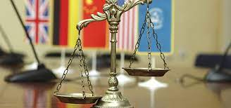
What is International Law?
A complex network of principles, treaties, judicial decisions, customs practices… that are binding on States in their mutual relations, governs it. This, which has been evolving for centuries, is what is called international law.

Slide 4
Unlike domestic law international law is not created by a particular legislature and enforced by an international executive with police powers; nevertheless it is binding.
Because of the fact that international communities recognize their interdependence, they do understand the need for world order, and most of the times do operate according to international law. As in every society there may be intentional deviates; but no state remains a chronic law breaker.

Slide 6
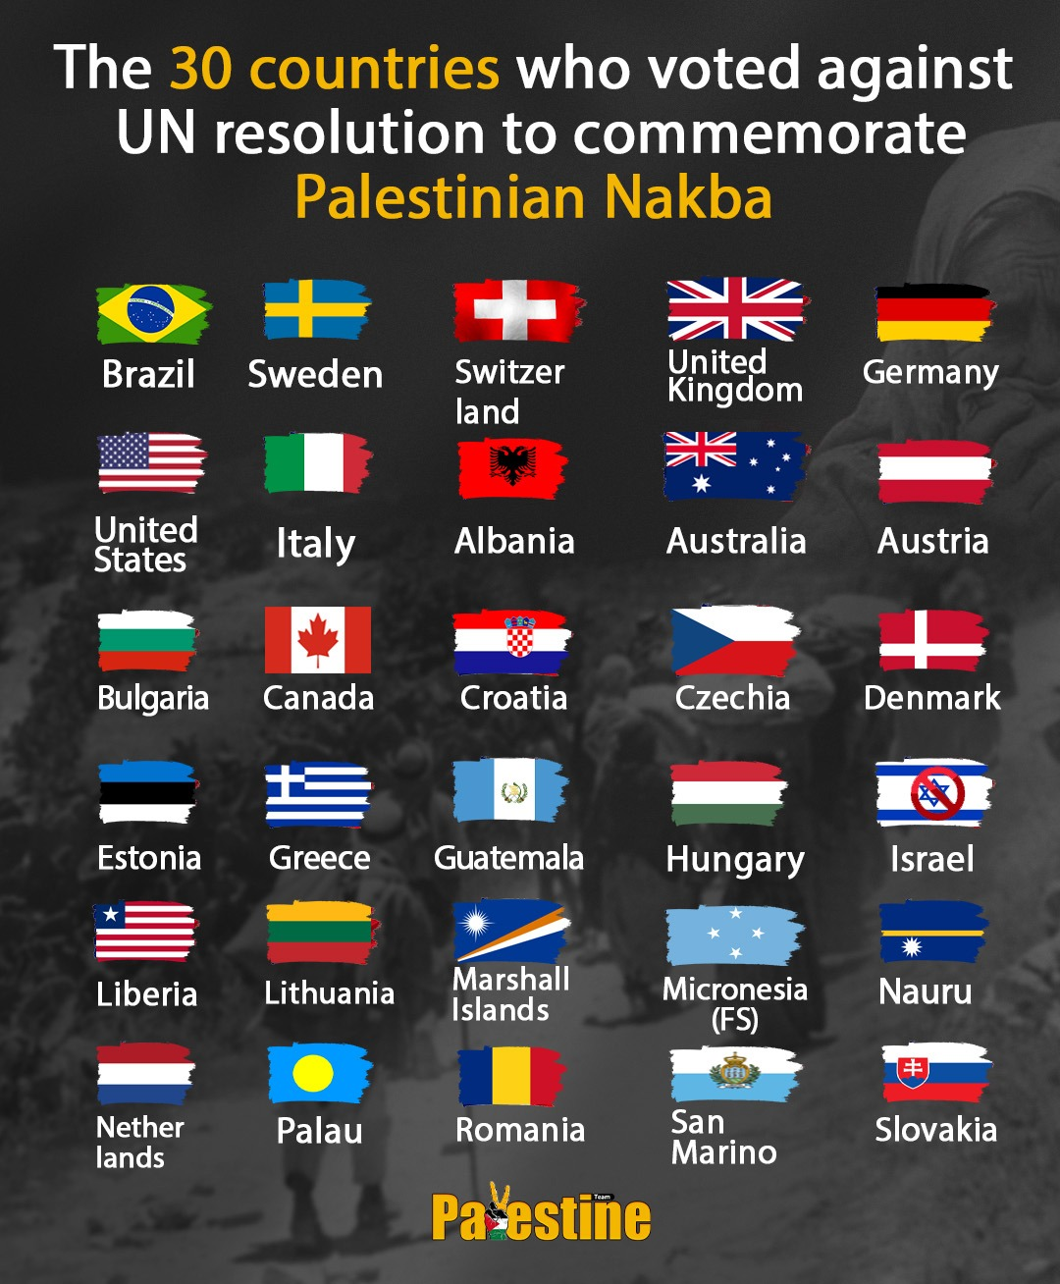
International law although does contain other components of other traditions, “it is basically derived from Roman Law, the Anglo-Saxon common law, and Christian theology.

Slide 7
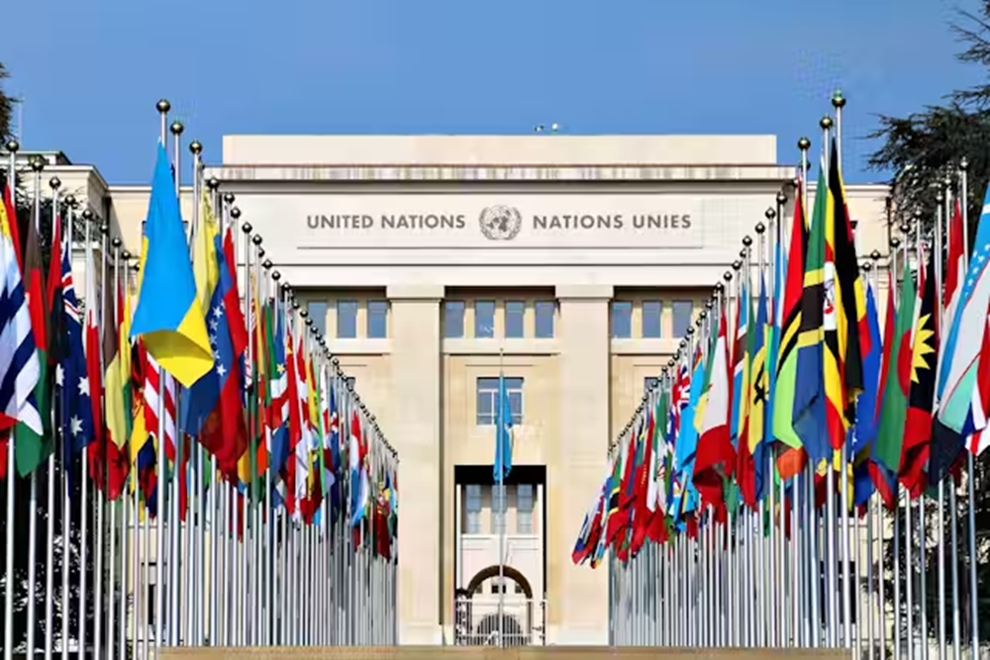
Nowadays international conflicts which are inevitable and international law is needed to resolve it is in the United Nations, in fact, where international law is currently being vigorously developed.

