Slide 1
A User’s Guide to the Sky

Slide 2
The Big Dipper is in the Great Bear or Ursa Major constellation. Look at the two pointer stars at the end of the Dipper, Dubhe and Merak
Northwest
Northeast
North

Slide 3
there is an imaginary line between these two stars and the distance is 1 unit..
Northwest
Northeast
North

Slide 4
Proceed this imaginary line towards Dubhe 5 units…
1 unit…

Slide 5
Proceed this imaginary line towards Dubhe 5 units…
2 units …

Slide 6
Proceed this imaginary line towards Dubhe 5 units…
3 units …

Slide 7
Proceed this imaginary line towards Dubhe 5 units…
4 units..

Slide 8
Proceed this imaginary line towards Dubhe 5 units…
5 units …

Slide 9
There is the North Star (Pole Star, Polaris)…
North Star

Slide 10
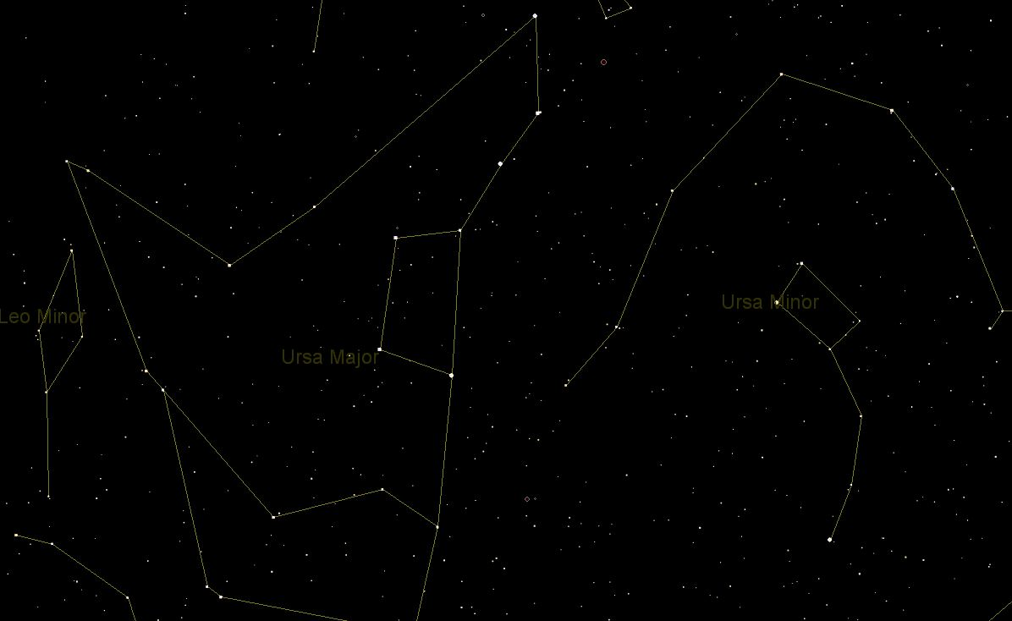
How to Find the North Star
Alkaid
Alcor
Mizar
Alioth
Phecda
Megrez
Merak
Dubhe
1 unit
North Star
(Polaris)

Slide 11
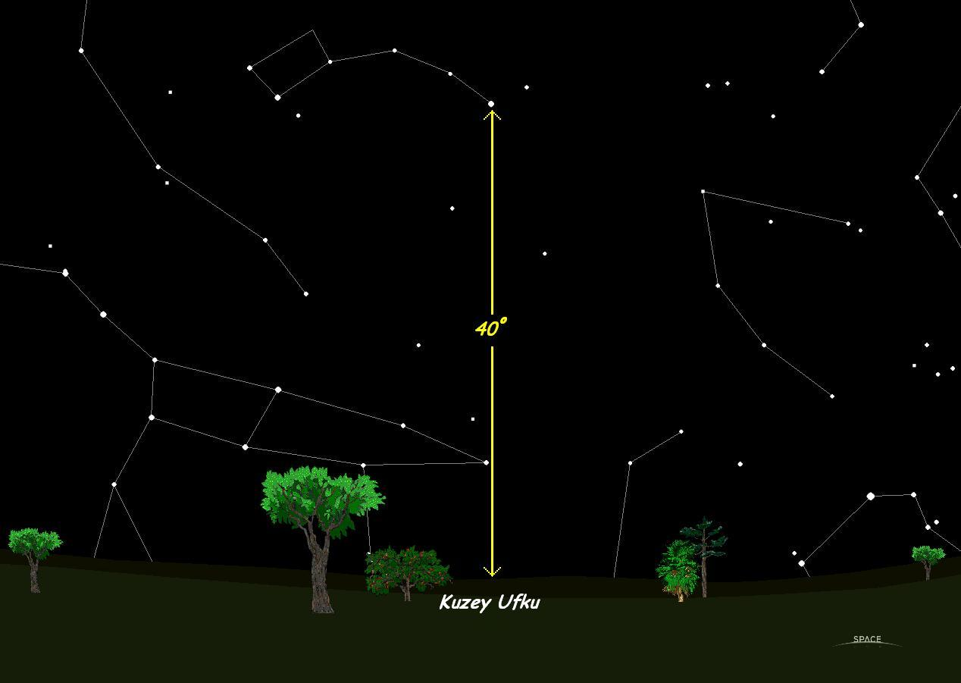
In the northern hemisphere, you can measure the angle from the horizon to the North Star to find the latitude. For Ankara it is 40°
Northern Horizon

Slide 12
If you watch the North Star all night long, you will see that it doesn’t move but the stars move around it.
At 22.00 p.m.

Slide 13
If you watch the North Star all night long, you will see that it doesn’t move but the stars move around it.
At 24.00 p.m.

Slide 14
At 02.00 a.m.

Slide 15
If you watch the North Star all night long, you will see that it doesn’t move but the stars move around it.
At 04.00 a.m.

Slide 16
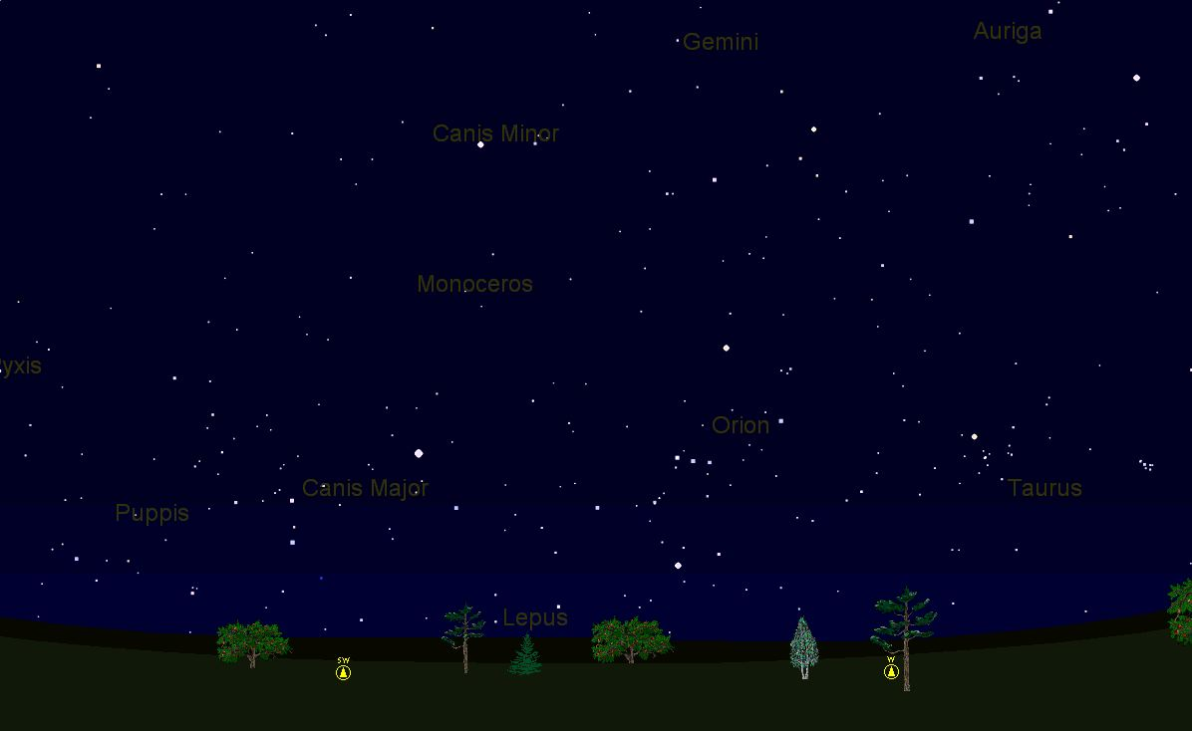
WINTER TRIANGLE 25.04.2006 21:00 West Sky

Slide 17
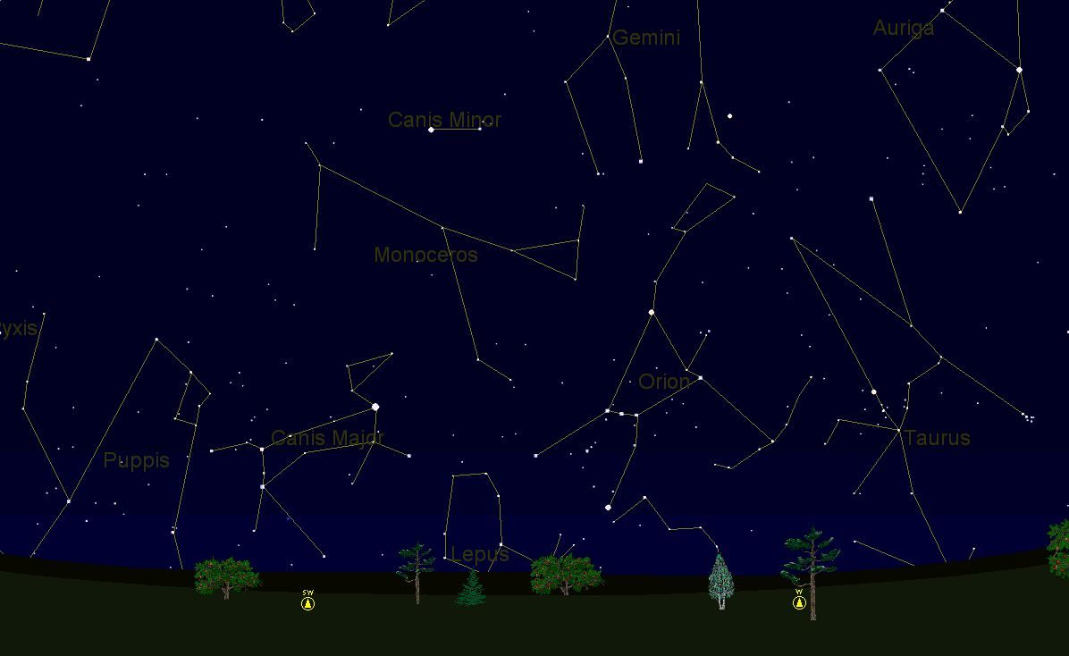
WINTER TRIANGLE 25.04.2006 21:00 West Sky
Canis Minor→Procyon star, Orion→Betelgeuse star, Canis Major→Sirius star
Procyon
Betelgeuse
Sirius

Slide 18
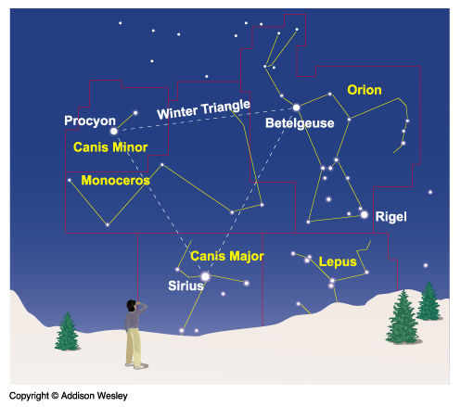

Slide 19
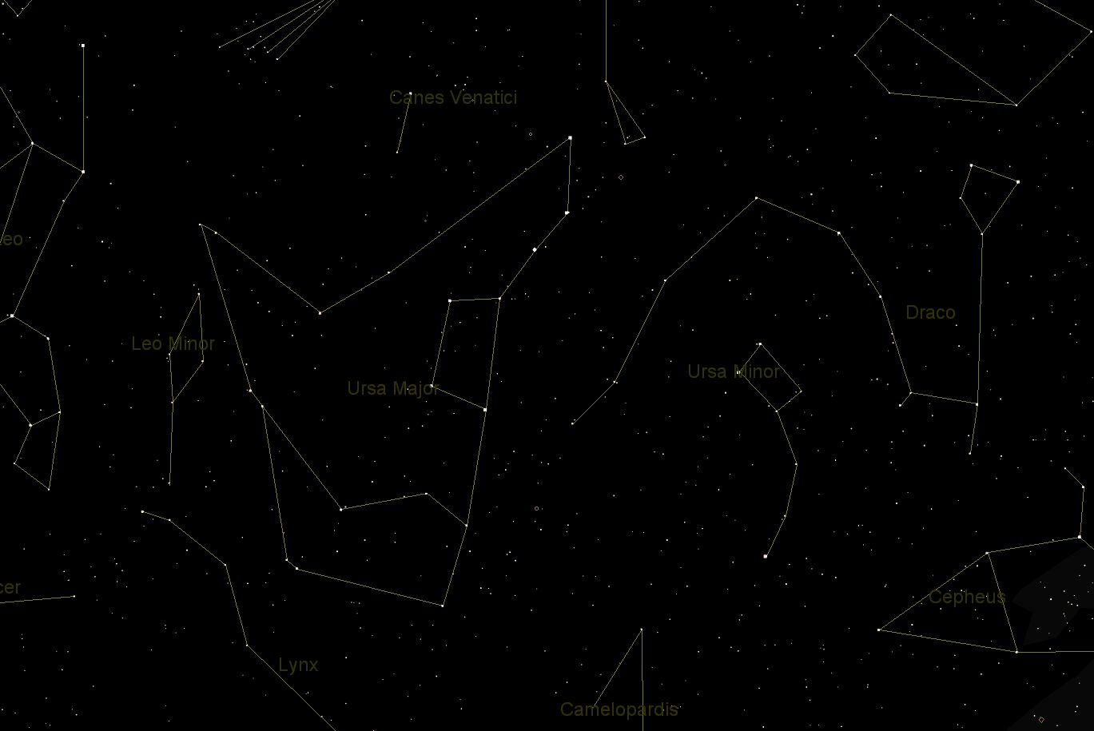
Big Bear (Ursa Major)

Slide 20
The latitude of a place can be found from the altitude of the North Star.
Example; for Ankara it is 40°.

Slide 21
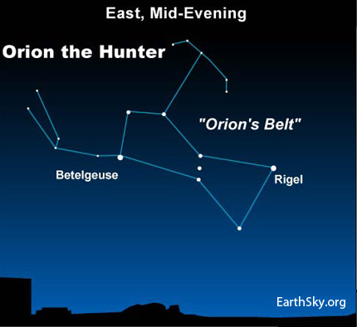

Slide 22
Constellations
How to find Sirius in the Sky
Sirius is the brightest star in the sky.
We use the Orion’s to find Sirius.
Orion
8 unit
1 unit
Sirius

Slide 23
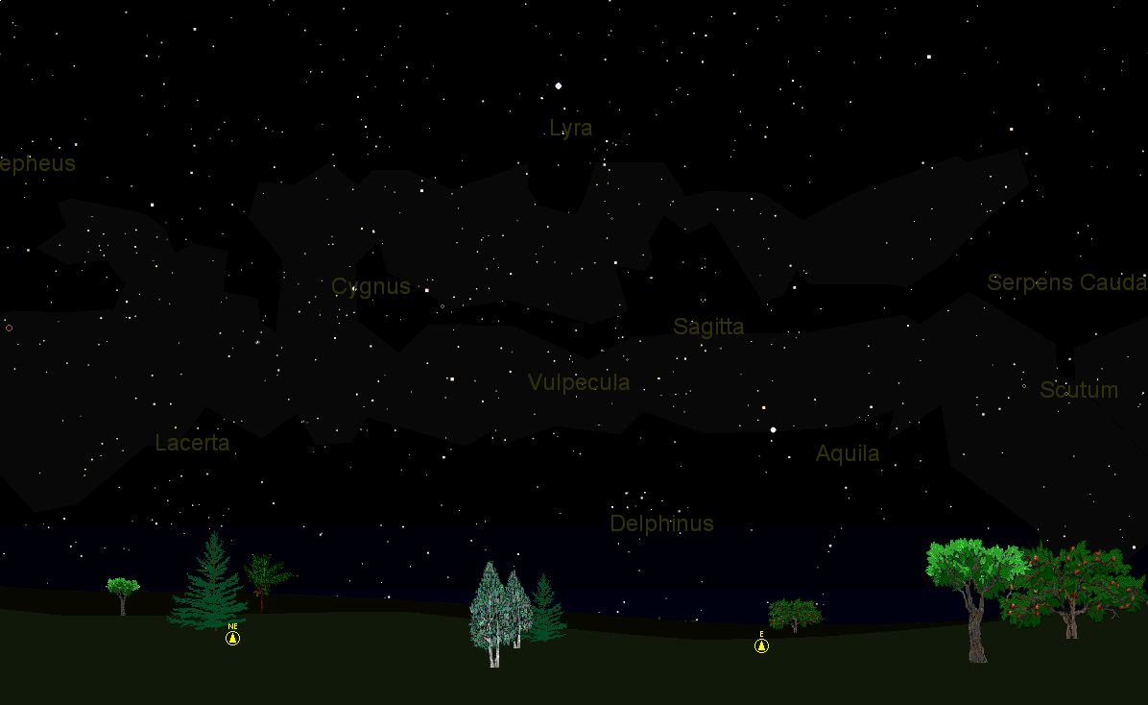
SUMMER TRIANGLE 25.04.2006 1:15 A.M. East Sky

Slide 24
SUMMER TRIANGLE 25.04.2006 1:15 A.M. East Sky
Lyra→Vega star, Aquila→Altair star, Cygnus →Deneb star
Vega
Deneb
Altair

