Slide 1
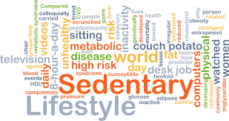
HEALTHY LIFE STYLE
Assist. Prof. Dr.
Gülsen Ceyhun Peker

Slide 2
Case Presentation

Slide 3
Case Presentation
50 years old female patient
Her husband died in a car accident 2 years ago
3 children
DM, HT
Smoking
Always tired, sleep deprivation
Irregular menses, hot flashes
Non compliance with medications

Slide 4
IS SHE HEALTHY?

Slide 5
What the anamnesIs tell US?

Slide 6
WhICH questIONS shall we ask?

Slide 7
WHICH TESTS OR QUESTIONNAIRES WILL YOU ORDER?

Slide 8
Problem list
DM
HT
Depression?
Nicotine addiction
Obesity
Immobility
Menapouse?

Slide 9
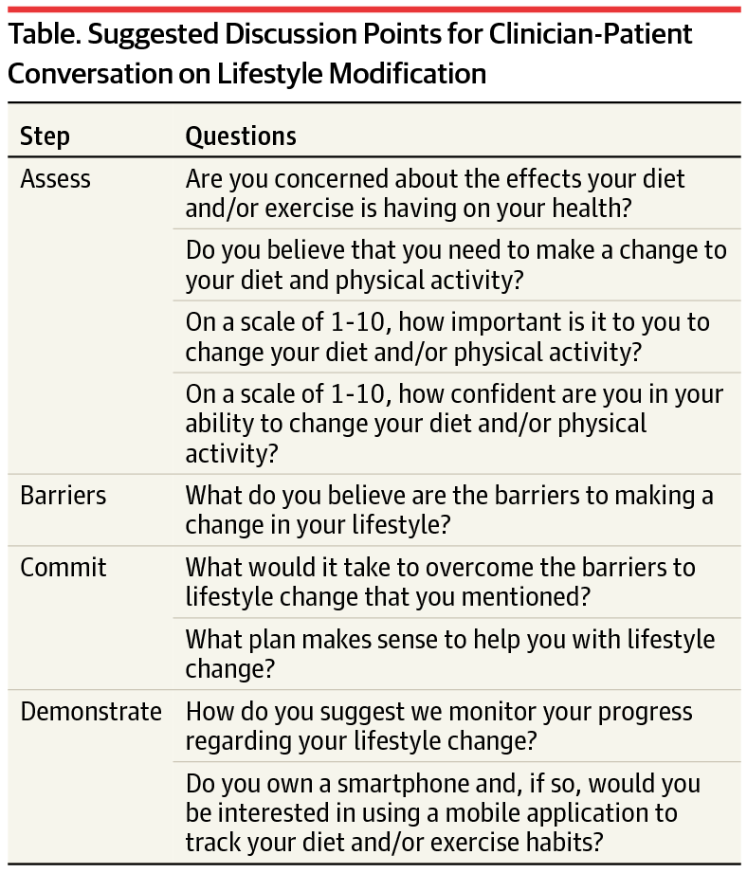

Slide 10
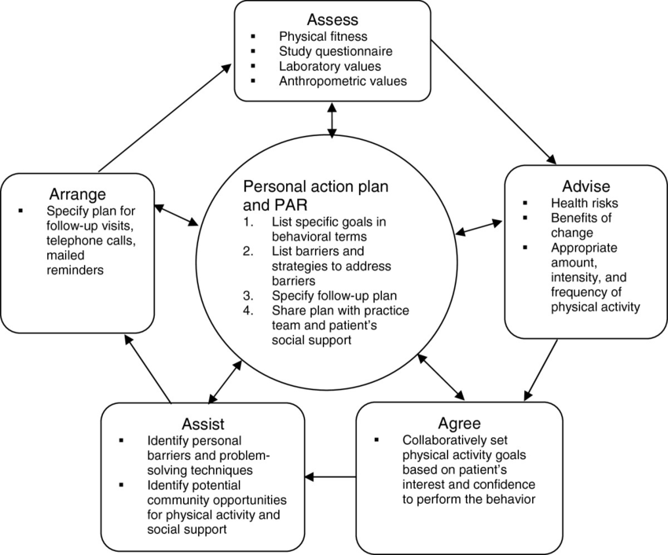

Slide 11
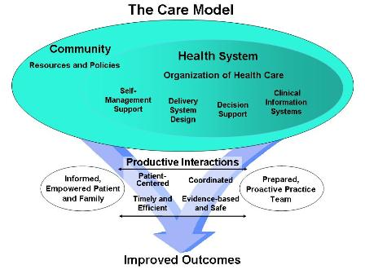

Slide 12
