Slide 1
MSC Therapy

Slide 2
MSC
Mesenchymal stem cells
Adipose or bone marrow origin
Multipotent character

Slide 3
In the last year, the promising features of mesenchymal stem cells (MSCs), including their regenerative properties and ability to differentiate into diverse cell lineages, have generated great interest among researchers whose work has offered intriguing perspectives on cell-based therapies for various diseases.

Slide 4
Characteristics
Currently the most commonly used adult stem cells in regenerative medicine, due to their unique characteristics:
can be isolated from several tissues,
exhibit a strong capacity for replication in vitro, and
can differentiate into osteoblasts, chondrocytes, and adipocytes.
Though the nature and functions of MSCs remain unclear, nonclonal stromal cultures obtained from bone marrow and other tissues currently serve as sources of putative MSCs for therapeutic purposes, and several findings underscore their effectiveness in treating different diseases.

Slide 5
Clinical trials
More than 400 MSC-based clinical trials in the database of the US National Institutes of Health
In particular, clinical trials using MSCs for representative diseases, including hematological disease, graft-versus-host disease, organ transplantation, diabetes, inflammatory diseases, and diseases in the liver, kidney, and lung, as well as cardiovascular, bone and cartilage, neurological, and autoimmune diseases.

Slide 6
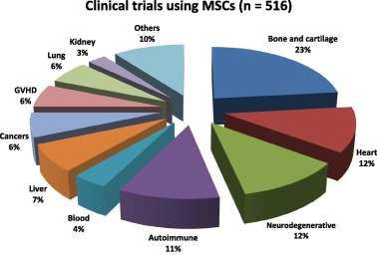
Cryobiology. 2015 Oct;71(2):181-97. doi: 10.1016/j.cryobiol.2015.07.003.

Slide 7
References
Cell Transplant. 2016;25(5):829-48. doi: 10.3727/096368915X689622.
Cryobiology. 2015 Oct;71(2):181-97. doi: 10.1016/j.cryobiol.2015.07.003.
NIH, USA

