Slide 1
Presentation Techniques

Slide 2
Body Language
Content →
%10
Voice Tone→
%30
Body Language→
%60

Slide 3
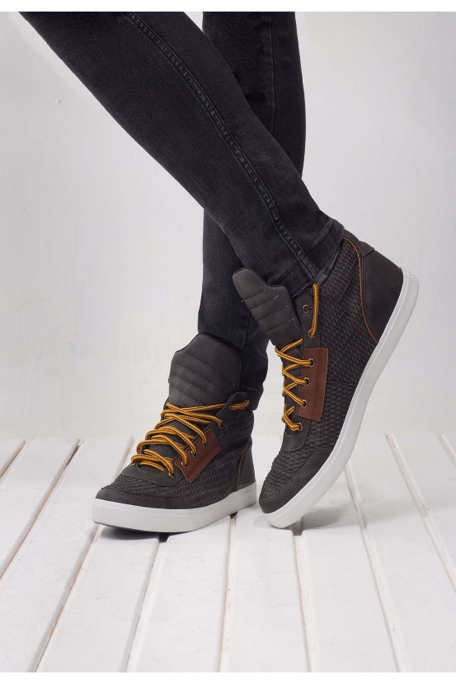
Body Language
Where is the most honest part of the body?

Slide 4
Body Language
If you had committed this crime, would you use a gun?
If you had committed this crime, would you use a knife?
If you had committed this crime, would you use a hammer?

Slide 5
Body Language
Nonverbal language affects what people think about us.
Does it determine what we think about ourselves?

Slide 6
Body Language
Our minds can change our body!
Can our body change our thoughts?

Slide 7
Body Language
Amy Cuddy – Harvard University
Testesteron - Kortizol

