Slide 1
IDEAL GASES AND IDEAL GASE LAWS
Ideal gas law

Slide 2
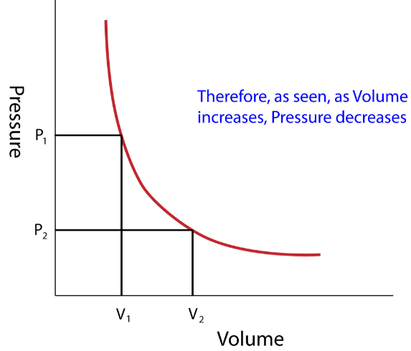
Boyle’s law—at constant temperature and constant amount of substance we have
pV = const , [T, n] .

Slide 3
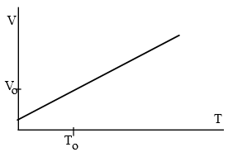
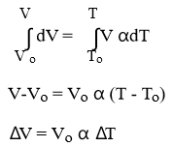
Gay-Lussac’s law—at constant pressure and constant amount of substance, the volume
of a system is proportional to its absolute temperature
V = const T , [p, n] .

Slide 4
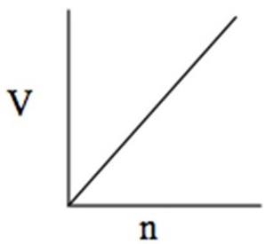
Avogadro’s law—molar volumes of different gases at the same temperature and pressure have the same values.
Vm = const , [p, T]
when the number of moles of gas increases, the volume of the gas will increase as well. Similarly, when the number of moles of gas decreases, the volume of the gas will decrease as well.
Notice that when V increases, the only way for the ratio Vn to be constant is if increases by the same factor as V.

