Slide 1
FMUS1003 Su okuryazarlığı
Dr. Ögr. Üyesi Şeyda Fikirdeşici Ergen

Slide 3
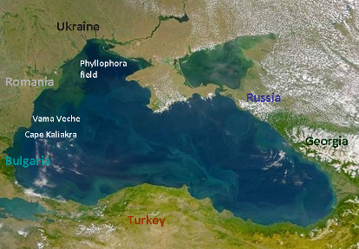
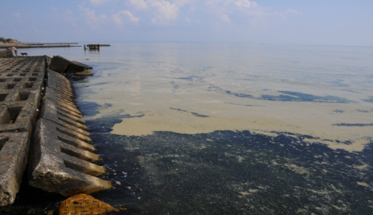
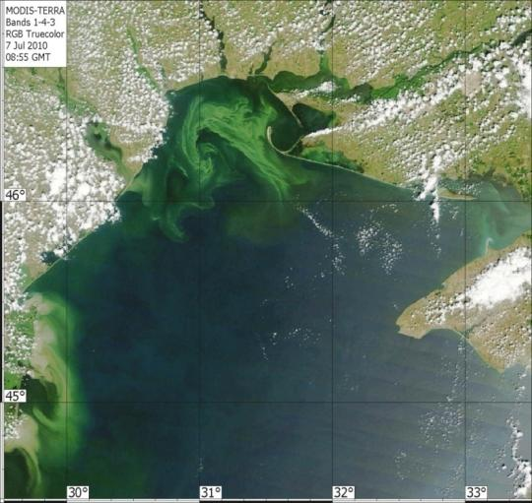
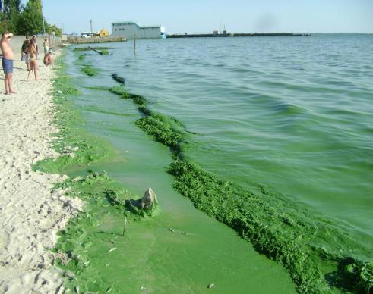
Odessa Bay
Nodularia spumigena – toxic cyanobacter (blue-green algae)
(biomas 8 kg*m⁻³).
Nodularia spumigena
Microcystis aeruginosa
Spirulina laxissima
Dneper-Bug port
Microcystis aeruginosa – cyanobacter (blue-green algae)
Ocak 2011

Slide 4
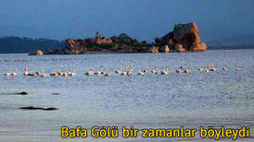
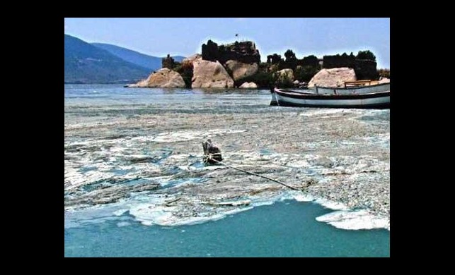
BAFA GÖLÜ

Slide 5
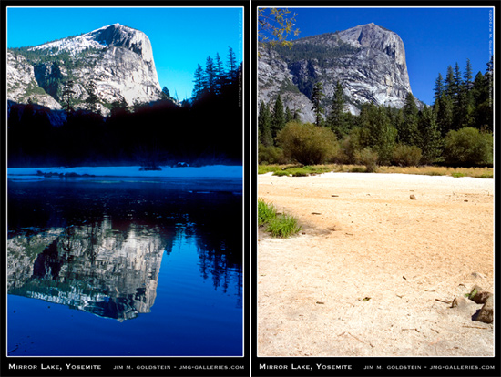
Mirror Gölü, California

Slide 7
Kaynaklar
Chislock, M.F.; Doster, E.; Zitomer, R.A.; Wilson, A.E. (2013). "Eutrophication: Causes, Consequences, and Controls in Aquatic Ecosystems". Nature Education Knowledge. 4 (4): 10. Retrieved 10 March 2018.
Khan, M. Nasir and Mohammad, F. (2014 ) "Eutrophication of Lakes" in A. A. Ansari, S. S. Gill (eds.), Eutrophication: Challenges and Solutions; Volume II of Eutrophication: Causes, Consequences and Control, Springer Science+Business Media Dordrecht. doi:10.1007/978-94-007-7814-6_5. ISBN 978-94-007-7814-6.
Nürnberg, G.K., 2017. Attempted management of cyanobacteria by Phoslock (lanthanum-modified clay) in Canadian lakes: water quality results and predictions. Lake Reserv. Manag. 33, 163–170. doi:10.1080/10402381.2016.1265618
Wetzel 2001. Limnology lake and river ecosystems, New York.
Greeson 1969. Lake eutrophication – A natural process. JAWRA.
Schindler 2006. Recent advances in the understanding and management of eutrophication. Limnol. Oceanogr.
Rast and Holland 1988. Eutrophication of lake reservoirs: A framework for making management decisions. AMBIO.
Vollenweider 1968. Scientific fundamentals of the eutrophication of lakes and flowing waters, with particular reference to nitrogen and phosphorus as factors in eutrophication. OECD Technical Report.
Williamson et al. 2008. Lakes and streams as sentinels of environmental change in terrestrial and atmospheric processes. Front. Ecol. Envriron.
Forbes 1887. The lake as a microcosm. Bull. Peoria Illinois Scientific Association.
Edmonson 1970. Phosphorus, nitrogen, and algae in Lake Washington after diversion of sewage. Science.
Schindler 2006. Recent advances in the understanding and management of eutrophication. Limnol. Oceanogr.
Stockstad 2008. News Focus Article: Canada’s Eperimental Lakes. Science.
RMB Environmental Laboratories. Eutrophication. 2009. Retrieved online at: http://www.rmbel.info/Reports/Static/Eutrophication.aspx

Slide 8
Kaynaklar
Tanyolaç, J. 2000. Limnoloji. Hatiboğlu Yayınevi, Ankara.
Wetzel, G.R. 2017. editor Ergönül, M.B. Limnoloji, Göl ve Nehir Ekosistemleri. 3. baskıdan çeviri. Nobel Yayıncılık, Ankara.
"Nürnberg, G.K., 2017. Attempted management of cyanobacteria by Phoslock (lanthanum-modified clay) in Canadian lakes: water quality results and predictions. Lake Reserv. Manag. 33, 163–170. doi:10.1080/10402381.2016.1265618"
"Pérez-Sirvent, C., Hernández-Pérez, C., Martínez-Sánchez, M.J., García-Lorenzo, M.L. and Bech, J. 2017. Metal uptake by wetland plants: implicationsfor phytoremediation and restoration. J Soils Sediments, 17:1384–1393"
Kometa, S. S., Kimengsi, J. N. And Petiangma, D.M. 2018. Urban Development and its Implications on Wetland Ecosystem Services in Ndop, Cameroon, Environmental Management and Sustainable Development, Vol. 7, No. 1
Phytoremediation - Hinchman, Negri, and Gatliff, 2017. Argonne National Laboratory and Applied Natural Sciences, Inc., Phytoremediation: Using Green Plants to Clean Up Contaminated Soil, Groundwater, and Wastewater
Khan, M. Nasir and Mohammad, F. (2014 ) "Eutrophication of Lakes" in A. A. Ansari, S. S. Gill (eds.), Eutrophication: Challenges and Solutions; Volume II of Eutrophication: Causes, Consequences and Control, Springer Science+Business Media Dordrecht
" Chislock, M.F.; Doster, E.; Zitomer, R.A.; Wilson, A.E. (2013). ""Eutrophication: Causes, Consequences, and Controls in Aquatic Ecosystems"". Nature Education Knowledge. 4 (4): 10. Retrieved 10 March 2018."
"Xie, Zhenglei, Zhang, Hezi, Zhao, Xiaoxiang, Du, Zebing, Xiang, Lixiong, et al. 2016. Assessment of Heavy Metal Contamination and Wetland Management in a Newly Created Coastal NaturalReserve, China Journal of Coastal Research, 32(2) : 374-386."
G. Zhang et al.2016. Heavy metals in wetland soils along a wetland-forming chronosequence in the Yellow River Delta of China: Levels, sources and toxic risks. Ecological Indicators 69 (2016) 331–339
J. Tournebize et al. 2017. Implications for constructed wetlands to mitigate nitrateand pesticide pollution in agricultural drained watershed. Ecological Engineering 103 (2017) 415–425.
Mander, Ü., Tournebize, J., Kasak, K., Mitsch, W.J., 2014. Climate regulation byfree water surface constructed wetlands for wastewater treatment and createdriverine wetlands. Ecol. Eng. 72, 103–115
Fikirdeşici-Ergen, Ş et al. 2018. Bioremediation of heavy metal contaminated medium using Lemna minor, Daphnia magna and their consortium. Chemistry and Ecology. 34(1):43-55
Fikirdeşici-Ergen, Ş and Üçüncü-Tunca, E. 2018. Nanotoxicity Modelling and Removal Efficiencies of ZnONP, International Journal of Phytoremediation 20(1):16-26
Yakup Sedat VELIOGLU, Şeyda FİKİRDEŞİCİ-ERGEN, Pelin AKSU, Ahmet ALTINDAĞ. 2018. Effects of Ozone Treatment on the Degradation and Toxicity of Several Pesticides in Different Groups, Journal of Agricultural Sciences, 24(2):245-255

