Slide 1
SEMICONDUCTOR MATERIALS FOR SOLAR CELLS
ENE 304 Materials in Energy Technologies

Slide 2
Content
Solar cell structure
Semiconductor properties: Atomic structure
Semiconductor properties: Doping
Semiconductor properties: Carrier concentrations

Slide 3
Solar cell structure
In the majority of solar cells today the absorption of photons, resulting in the formation of charge carriers and the separation of produced charge carriers, occur within the semiconductor material.
For this reason, semiconductor layers are the most important parts of a solar cell;
Semiconductor layers form the heart of the solar battery.
There are a wide variety of semiconductor materials suitable for the conversion of the energy of the photons into electrical energy, each of which has advantages and disadvantages.
Crystalline silicon (c-Si) solar cell, now dominant in the PV market, has a simple structure and is a good example of a typical solar cell construction.

Slide 4
Solar cell structure
The first successful solar cell is still the most widely used PV material from c-Si.
For this reason we will use c-Si as an example to explain the semiconductor properties of solar cell operation.
Solar cell operation of c-Si gives us a basic idea of how solar cells based on other semiconductor materials work.
Central semiconductor parameters determining the design and performance of a solar cell are:
i) the concentrations of the doping atoms,
ii) mobility, μ, and diffusion coefficient, D, of charge carriers,
iii) lifetime, τ, and diffusion length, L, of the excess carriers,
iv) band gap energy, EG, absorption coefficient, α, and refractive index.

Slide 5
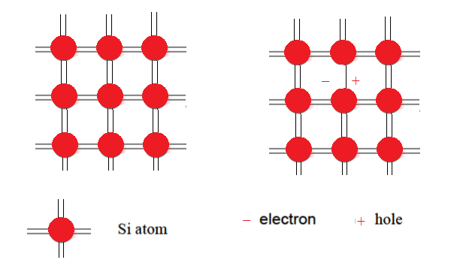
Solar cell structure
Figure 1. The bonding structure of intrinsic c-Si. (a) No bonds are broken. (b) a bond between two Si
atoms is broken resulting in a mobile electron and hole

Slide 6
Semiconductor properties Atomic structure
Silicon atom has an atomic number of 14, which means there are 14 electrons orbiting the nucleus.
Silcom atom has a four valance electrons in ground state configuration.
Stated valence electrons are most important because they form the bonds with other Si atoms in crytalline structure.
To form the crystalline structure, two silicon atoms are bonded together when they share each other’s valence electron.
This is most known covalent bond forming by two electrons.
Silicon can be covalently bonded to four other silicon atoms because Si atom has four valence electrons .

Slide 7
Semiconductor properties Atomic structure
The bonds within the crystalline structure have the same length and the same angles.
The number of bonds that an atom forms with its neighbours in the crystalline structure is called the coordination number or coordination.
Hence, the coordination number for all silicon atoms in a single crystal structure is four; we can also say that each silicon atom has four neighbours in the crystalline structure .
A unit cell can be defined, from which the crystal lattice can be reproduced by duplicating the unit cell and stacking the duplicates next to each other.
Such a regular atomic arrangement is described as a structure with long range order.

Slide 8
Semiconductor properties Doping
Electron and hole concentrations in C-Si can be manipulated by doping.
We understand that atoms of the appropriate elements substitute Si atoms in the crystal lattice during doping crystalline-Si (c-Si).
Substitution must be carried out by three or five valence electron atoms, such as boron or phosphorus, respectively.
The doping effect can be understood with the help of the bonding model, which is shown in Figure 2.
Phosphorus with four valance electrons atom will easily bond to four neighboring Si atoms in the crystalline structure.
The fifth valence electron can not play a role in forming a bond and is bound to the phosphorus atom in a very weak state.

Slide 9
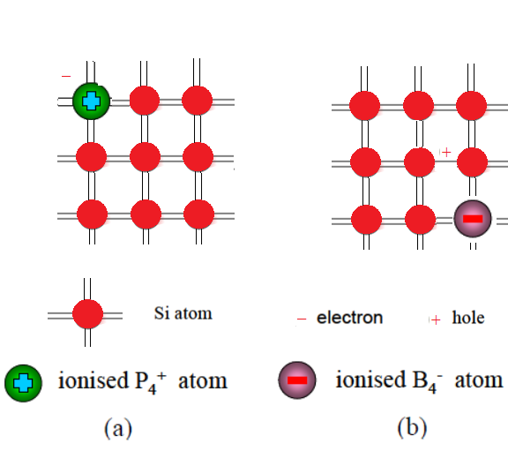
Figure 2. The doping process given with the the bonding model. (a) a phosphorous atom substitutes a Si atom in the lattice resulting in the positively-ionised P atom and a free electron, (b) a boron atom substitutes a Si atom resulting in the negatively ionised B atom and a hole.

Slide 10
Semiconductor properties Carrier concentrations
Any type operation of an ordinary semiconductor device depends on the amount and type of carriers that carry the charge in the semiconductor and cause electrical currents.
It is important to know the exact number of these charge carriers in order to understand the device operation.
The observable parameters of a semiconductor at equilibrium (when no external voltage, magnetic field, lighting, and mechanical stress) do not change over time.
To determine the carrier concentration, it is necessary to know the density of the allowed energy states of the electrons and the occupation function of the allowed energy states.

Slide 11
References
https://ocw.tudelft.nl/wp-content/uploads/Solar-Cells-R3-CH3_Solar_cell_materials.pdf (04.01.2018)
https://courses.edx.org/c4x/DelftX/ET.3034TU/asset/solar_energy_v1.1.pdf (04.01.2018)
http://alan.ece.gatech.edu/ECE4833/Lectures/Lecture3_Introduction2Semiconductors.pdf (04.01.2018)

