Slide 1
Advancing coal conversion technologies
ENE 304 Materials in Energy Technologies

Slide 2
Coal conversion basics Coal gasification processes
The gasification process reacts a carbon-containing material with steam and controlled amounts of oxygen at high pressures and temperatures to form a synthesis gas, which includes mainly carbon monoxide and hydrogen.
C + O2 CO2 ΔH = -283 kJ/mol
H2 + 0.5O2 H2O ΔH = -242 kJ/mol
CO + 0.5O2 CO2 ΔH = -283 kJ/mol
C + CO2 2CO ΔH = 172 kJ/mol
C + H2O CO + H2 ΔH = 131 kJ/mol
C + 2H2 CH4 ΔH = -75 kJ/mol

Slide 3
Coal conversion basics Coal gasification processes
Synthesis gas can be used as fuel for energy production or as a basic chemical building block for the formation of various liquid fuels or other chemical products.
The gasification process of the coal is not a new technology.
Until the 1950s, the city gas (another name for synthesis gas) was used extensively in North America and Europe, and Germany used this process to produce significant quantities of liquid fuel during World War II.
There is renewed interest in gasification in recent years when technology combines fuel and product flexibility, lower emissions of critical pollutants.
Synthesis gas originating from coal gasification often requires removal of particulate matter and gaseous contaminants that may be caused by essential impurities present in the coal.

Slide 4
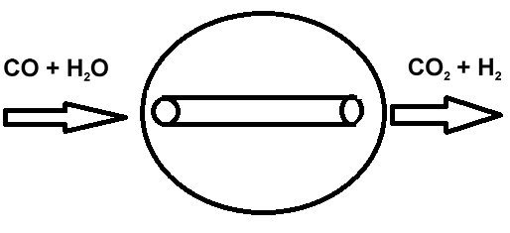
Coal conversion basics Coal gasification processes
Water–gas shift
The water–gas shift (WGS) reaction is used to enhance hydrogen production and to convert all syntesis gas carbon into CO2 for capture.
The water–gas shift reaction is slightly exothermic and is often carried out in multiple catalytic reactors in the presence of Fe or Mo based catalysts and excess steam to minimize unreacted CO.
Figure 1. Water-gas shift reaction

Slide 5
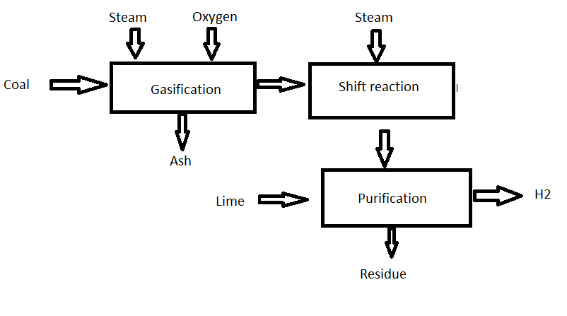
Coal conversion basics Coal gasification processes
Figure 2. Coal Gasification Process

Slide 6
Coal conversion basics Coal gasification processes
Hydrogen production
High-purity H2 can be produced from synthesis gas, which is generated through the gasification process shown in Figure 2.
The shifted synthesis gas, which is composed of CO2 and H2, can be directed through many separation technologies in order to produce pure CO2 and H2 streams.
Figure 2. Coal Gasification Process

Slide 7
Coal conversion basics Coal gasification processes
Coal to liquid fuels
Liquid fuels can be generated from synthesis gas through thermo-catalytic Fischer–Tropsch (FT) synthesis, which generally revolve around the catalytic hydrogenation of carbon monoxide.
Figure 3. Coal to liquid fuel through the Fischer–Tropsch (FT) synthesis process

Slide 8
Coal conversion basics Coal gasification processes
Coal to liquid fuels
The transportation of fuels produced by the thermo-catalytic Fischer–Tropsch (FT) synthesis reaction are low in sulfur, particulate and nitrogen oxides.
South Africa has been producing coal-derived fuels since 1955.
Although it currently produces more than 30% of gasoline and diesel from domestic coal, there is room for improvement, especially in the area of chemical reaction.
In the past, the catalyst systems used in the thermo-catalytic Fischer–Tropsch (FT) synthesis process generally contain iron, cobalt and ruthenium.

Slide 9
Current and future coal utilization technology needs
Advanced gasification
The gasification system requires an effective feedback system that can provide real-time information about process parameters such as reliability and optimization, temperature, pressure and gas composition.
The challenge in the advanced gasification process is the development of sensor materials that are sufficiently sensitive and selective at temperatures greater than 500°C and is robust enough to withstand harsh operating environments, including exposure to flowingslags.
The current research focuses primarily on alumina based materials and optical silica for temperature and gas measurement, and metal oxide based materials for gas detection; However, most concepts are in the research stage and they have not yet been proven.

Slide 10
Current and future coal utilization technology needs
Turbines
In the advanced coal-fired power plant, research is underway to improve efficiency and reduce environmental impact of turbines.
Turbines that can operate with fuel flexibility and temperatures above 1,400°C have the potencial to improve the efficiency by a few percent.
They will be hydrogen turbines that can reliably burn fuels containing a large proportion of hydrogen at high temperatures to maximize efficiency.
It is expected that they will be oxy fuel turbines capable of burning about 100% hydrogen-bearing fuels.
The realization of highly efficient turbines will likely require significant advances in material technology with innovations in heating and cooling management strategies.

Slide 11
References
https://www.princeton.edu/ssp/61-tiger-cub/library/efficiency.pdf
https://water.usgs.gov/edu/wupt-coalplant-diagram.html
Bryan D. Morreale, Cynthia A. Powell and David R. Luebke, Advancing coal conversion technologies: materials challenges, in Fundamentals of Materials for Energy and Environmental Sustainability (Eds. David S. Ginley, David Cahen), Cambridge University Press, 2012.

