Slide 2
How to Write a CV
The CV is the make or break of your job application.
Everything in it tells a potential new employer something about you.
The only information available to the employer is in your application.
People are regularly advised to target every job application with a tailor made CV, and that's why.
The fundamental principles of targeting your CV are pretty simple.
This is a lot easier to do than it might look from that description.
You have the raw material available from your basic CV, and it's quite easy to adapt that material to any job.

Slide 3
Objectives
The objectives part of your CV defines your motivations.
You're telling the employer why you want the job.
Write the objectives section showing a clear reason based on a career track motive like, 'I want to gain direct experience as part of my management studies.'
This will explain why you want a supervisor's job.

Slide 4
Skills
Skills are often keywords in job applications, like essential criteria.
Any job for which you can apply will include a range of skills you can use.
You may not have all of them, but you must include all the required skills as much as possible.
Use exactly the same description of these skills as used in the job ad.

Slide 5
Work History
Your work history needs particular care and good use of terminology.
Explain briefly, but as clearly as possible, your job role and tasks.
Again, use the same terminology as in the job requirements, particularly the essential skills, as the framework for your description.
Spell it out in those terms.
Use multiple examples, and if possible show how your skills developed through your work history, making clear your level of experience.

Slide 6
Achievements
Achievements added on to the work history as part of each job description are a real positive, particularly when you show obvious relevance and value to the employer.
Use examples that are clearly related to the new job application.

Slide 7
Qualifications
Many applications contain a set of required qualifications.
You must provide a list of qualifications that meets those requirements.
Difficulties sometimes arise when you have similar qualifications, but aren't sure if they match the requirements.
Don't guess. Make sure they do, preferably by email, and get a definite yes or no.
Your qualifications also need to be spelled out in detail.
Broad descriptions of qualifications aren't good enough, particularly when all the other applicants will have similar qualifications.
Again, spell it out, so you're obviously qualified for the job.

Slide 8
CV Reference List Tips
CV references are usually straightforward. They're people who can give first hand information relevant to your job applications and testify to your skills, character and experien-ce. Choosing references, however, can be considerably mo-re complex in some cases

Slide 9
Choosing your references
You need a good references who can speak on the same professional level as your new employer.
In principle, the preferred choices of referees are managers or supervisors who can speak to other managers and supervisors on the same level.
This does mean "speaking the same language", in terms of employment prospects, looking at your application from the same perspective.

Slide 10
Although many supervisors and managers will be happy to provide references, you need to consider which of them will make the best impression on a potential new employer.
Some references mean well, but they're not great talkers.
Don't ask a reference for something that's impossible for them to deliver.

Slide 11
The preferred profile for a good referee is:
Articulate, able to express themselves well.
Well spoke, clear speaker easy to understand.
Authoritative, sounds like a boss.
Knowledgeable about your work and personal achievements

Slide 12
Problems with references
Your employment history tells a story.
One of the most common questions about references is "Why no references from this recent employer?"
You may well have a very good reason for that situation, but the gap is still noticeable, and needs filling. In some cases you actually have better references from other sources.
You may never want to see your recent manager again.

Slide 13
Whatever the reason, prepare a response to this inevitable question, so you don't trip over it during an interview.
You may be able to get a reference from the prior employer from another source.
You may want to point out that under the circumstances of your departure from that employer you didn't consider it appropriate to ask for references.
You can then add that one of your other references is a fully qualified person to provide references in relation to the job.

Slide 14
Professional references
Business references: Target your references, using appropriate managers or supervisors in relation to the new job. If you're going for a sales job, you'd use a sales manager as a reference.
Technical jobs references: These jobs really do involve speaking another language, and your reference must be able to deal with any technical questions about your work. Technically qualified managers or highly qualified technical experts are the best references.
Academic references: For postgraduates, academic references in some professions and sciences can be difficult/impossible for those outside the profession. Your reference must be someone who can deal with advanced questions at this level. A former lecturer or a recognized expert in the field is the best reference.

Slide 15
How to Create an Interesting Online CV
DO:
Include all qualifications, experience, and studies. Make it interesting, show some actual achievements.
Drop names of employers, if you can. It's a character reference, and it assures prospective employers that they can check your references.
Include anything unique. Any information that shows value and real ability is priceless, and it's what gets you your job interviews.
Put real effort into designing your text, presentation, and the layout of your CV. Get help if you need it, but make sure all the content is working for you.
Make sure that you include a statement that you have references. It is essential, and looks bad if you don't because it's a basic part.

Slide 16
DON’T
Make any false or possibly misleading claims on your CV. It's a great way to definitely lose a job (This used to be considered 'clever,' for about five seconds, until the world figured it out. Any information you provide which can be shown to be incorrect will be used against you).
Include personal information that could be used for identity theft. Keep your personal security extremely tight. Stick to a single point of contact, preferably through the job site itself.
Include names or contacts of references without their permission. It's not only bad etiquette; it's potentially risky for them

Slide 17
DON’T
Use filler, or drab, uninteresting material. Stick to bare bones, if necessary, but avoid things like 'shop assistant' or 'administration duties' and other uninformative interest killers. Describe skills used rather than job titles, because that's what the employer needs to see.
Use ancient information. Anything older than 5 years can be relegated to the archives, for use only when relevant to a job

Slide 18
Complete contact information
Photo*
Brief biography with personal details, such as age*, date and country of birth*, marital status*, number of children*, religious affiliation*, nationality*, and where you work or hold licenses
Professional, career or research objective
Education
Study abroad
Thesis or dissertation title and advisor
Graduate fieldwork
Awards, honors and patents
Grants and fellowships
Research experience
Work experience
Skills
Publications and presentations
Professional licenses and certifications
Language skills
Professional memberships
Related extracurricular activities**
Interests**
References**

Slide 19
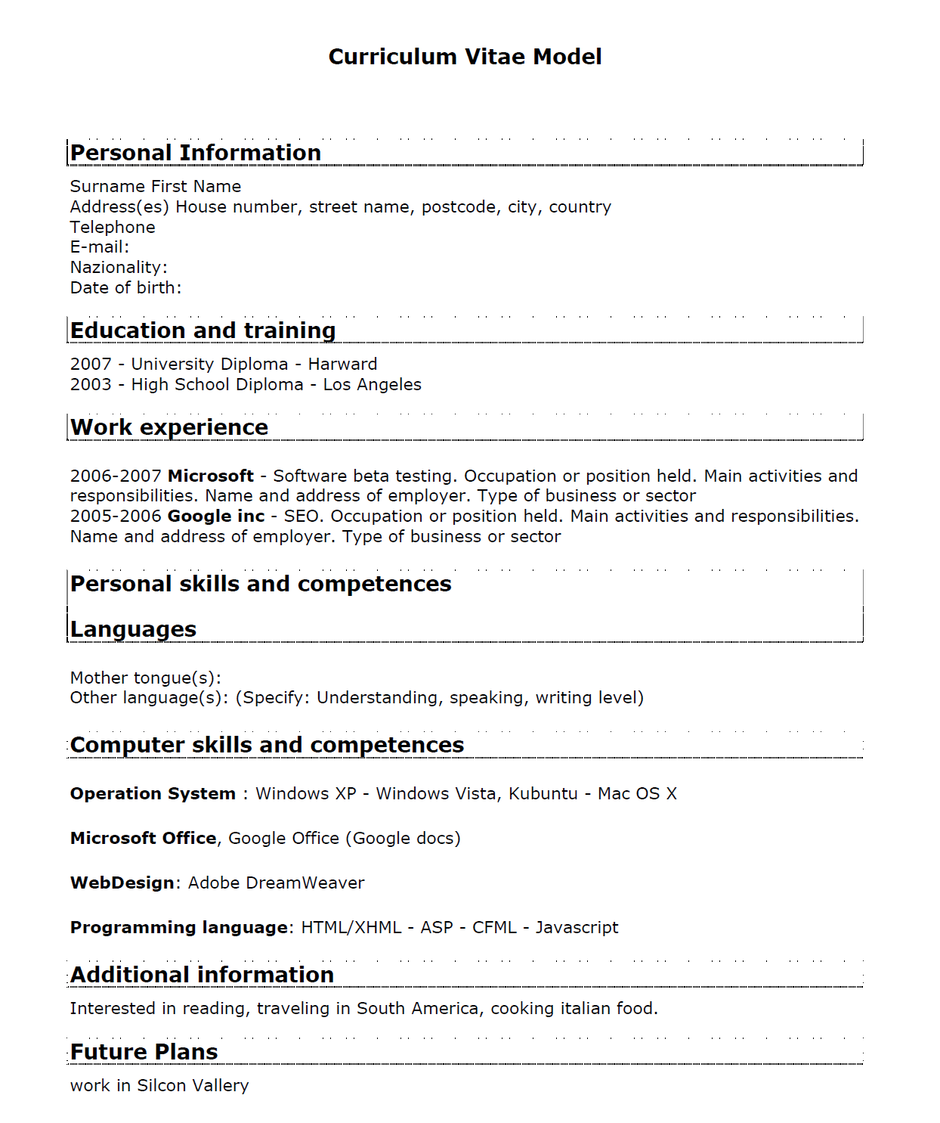

Slide 20
Curriculum Vitae vs Resume - Not The Same Thing
The Curriculum Vitae
The main features of the CV are outlined in brief below:
The Curriculum Vitae is a list of all your achievements until the date you are submitting it, presented in reverse chronological order (i.e. the latest achievements first)
The Curriculum Vitae is ideally two pages in length, though it can sometimes go up to three to five pages
The Curriculum Vitae would include everything that you have done and can be classified as work outside the home - whether paid or unpaid; hence, it is okay if the Curriculum Vitae contains voluntary and honorary positions and work done in such positions
The Curriculum Vitae structure is very systematic and is generally drawn in a specific order
The Curriculum Vitae is normally accompanied by a cover letter, which summarizes what it contains and points out the match of the applicant with the job
A Curriculum Vitae can be written in the following three styles: functional CV, targeted CV and performance CV

Slide 21
The Resume
The main features of the Resume are as under:
A resume is a precise and very brief document representing at-a-glance your key skills and main achievements
A resume should not be longer than one page, unless in rare exceptions
A resume would contain of only what is strictly relevant to the job applied and nothing else - it is more important here to have all the information contained within one page, that representing the information it in totality
The resume would highlight your skills and achievements above all other things
The resume is usually presented without a cover letter because the main reason you are submitting the resume, is fast processing; a cover letter would defeat the purpose
A resume usually can be written in three very different styles - (i) Chronological resume - whereby your skills and main achievements are listed by date starting with the most recent ones first, (ii) Functional resume - whereby your skills and experience are more highlighted than anything else and (iii) a combination of both - whereby both skill and achievements are presented hand-in-hand

Slide 22
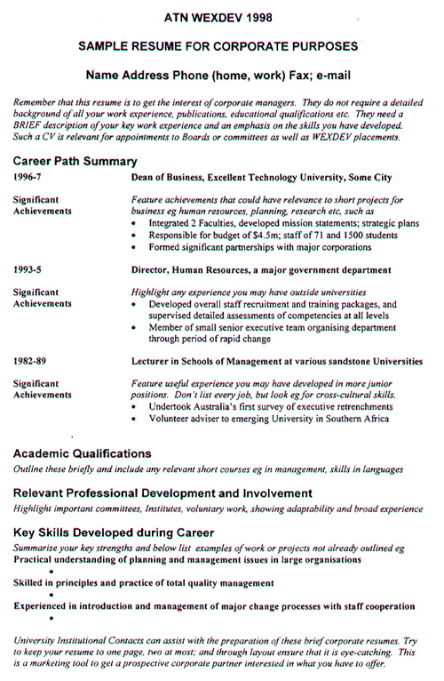

Slide 23
