Slide 1
File-System Interface
These slides are adapted from Operating Systems Concepts textbook, 8th edition,
Silberscatz, Galvin, Gagne.

Slide 2
File Structure
None - sequence of words, bytes
Simple record structure
Lines
Fixed length
Variable length
Complex Structures
Formatted document
Relocatable load file
Can simulate last two with first method by inserting appropriate control characters
Who decides:
Operating system
Program

Slide 3
File Structure
If the OS supports multiple file structures, OS size can be big.
OSs impose a minimal number of file structures
All OSs must support at least executable file structure
Applications include code to interpret input files
Internal File Structure
All disk I/O is performed in units of one physical block
The physical block size may not match the logical record size
Solution: Packing a number of logical records into physical blocks
The packing can be done by OS or by user application program
The larger the block size, the greater the internal fragmentation in last block

Slide 4
File Attributes
Name – only information kept in human-readable form
Identifier – unique tag (number) identifies file within file system
Type – needed for systems that support different types
Location – pointer to file location on device
Size – current file size
Protection – controls who can do reading, writing, executing
Time, date, and user identification – data for protection, security, and usage monitoring
Information about files are kept in the directory structure, which is maintained on the disk

Slide 5
File Operations
File is an abstract data type
Create
Write
Read
Reposition within file
Delete
Truncate
Open(F_{i}) – search the directory structure on disk for entry F_{i}, and move the content of entry to memory
Close (F_{i}) – move the content of entry F_{i} in memory to directory structure on disk

Slide 6
File Operations
create (space in the file system found, entry made in directory)
write (search directory to find file location, maintain a write pointer)
read (search the directory, maintain a read pointer)
reposition (search the directory, reposition the position pointer)
delete (search the directory, release file space, erase in directory)
truncate (file length reset to zero, file space released, attributes remain)
Other common operations
Append, rename, copy, get/set file attributes

Slide 7
File Operations
The OS keeps an open-file table containing info about open files
open() operation copy a directory entry to this table
open() also accepts access mode information
When a file operation is requested the file is specified via an index into this table, so no searching occurs
Entry deleted from table when file is closed
Many processes can open the same file simultaneously
Two tables (one per-process other system wide) are kept

Slide 8
Open Files
Several pieces of data are needed to manage open files:
File pointer: pointer to last read/write location, per process that has the file open
File-open count: counter of number of times a file is open – to allow removal of data from open-file table when last processes closes it
Disk location of the file: cache of data access information
Access rights: per-process access mode information

Slide 9
Open File Locking
Provided by some operating systems and file systems
Mediates access to a file
Shared or exclusive locks
Mandatory or advisory:
Mandatory – access is denied depending on locks held and requested
Advisory – processes can find status of locks and decide what to do
Same precautions as process synchronization
Exclusive locks should be held only while accessing data
Deadlock should be prevented

Slide 10
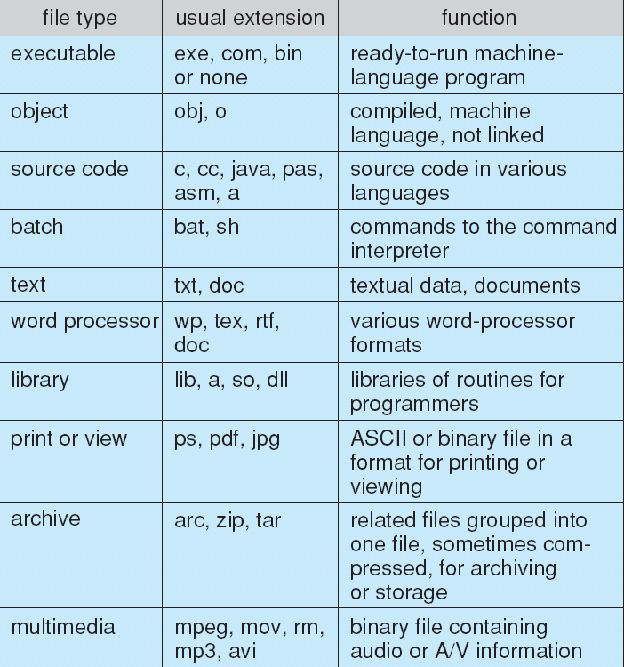
File Types – Name, Extension
If an OS recognizes the type of a file, it can operate on it reasonably.

Slide 11
Access Methods
Sequential Access
read next
write next
reset
no read after last write
(rewrite)
Direct Access
read n
write n
position to n
read next
write next
rewrite n
n = relative block number (relative to the beginning)

Slide 12
Sequential-access File

Slide 13
Simulation of Sequential Access on a Direct-access File

Slide 14
Directory Structure
It might be desirable to place multiple file systems on a disk or to use parts of a disk for a file system and other parts for other things such as swap space or unformatted (raw) disk space.
These parts are known as partitions.
Parts can be combined to form volumes
Each volume that contains a file system must also contain information kept in entries in a device directory or volume table of contents (containing name, size, type....of files on the volume)

Slide 15
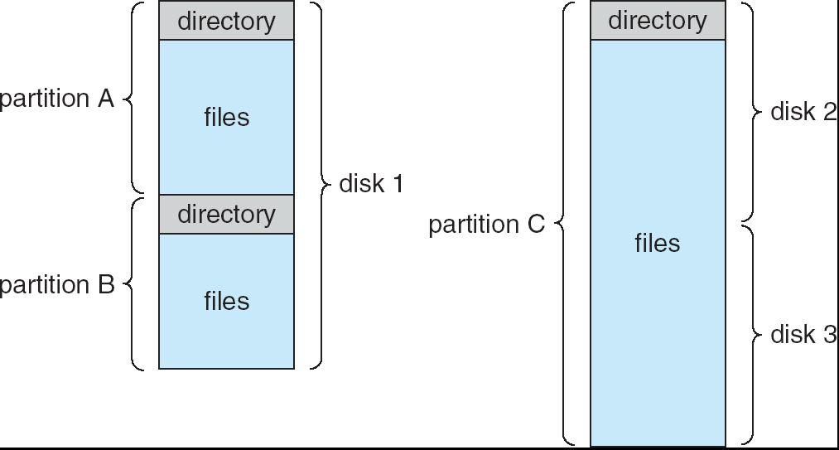
A Typical File-system Organization

Slide 16
Single-Level Directory
A single directory for all users
Naming problem
Grouping problem

Slide 17
Two-Level Directory
Separate directory for each user
Path name
Can have the same file name for different user
Efficient searching
No grouping capability
Special system programs can be used to create UFDs
Additional syntax is needed to specify the volume of a file (C:\usera\test)
Search paths for searching a file (first UFD then a special directory containing system programs)

Slide 18
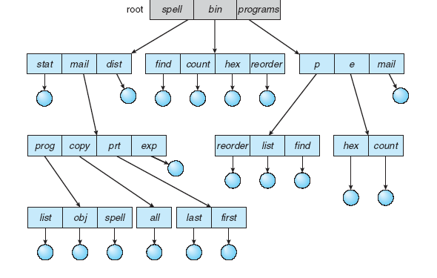
Tree-Structured Directories

Slide 19
Tree-Structured Directories (Cont)
Efficient searching
Grouping Capability
A directory is simply another file
Current directory (working directory)
cd /spell/mail/prog
type list
In an accounting file is a pointer to the user’s initial directory when logged in

Slide 20
Tree-Structured Directories (Cont)
Absolute or relative path name
Creating a new file is done in current directory
Delete a file
rm <file-name>
Creating a new subdirectory is done in current directory
mkdir <dir-name>
Example: if in current directory /mail
mkdir count
Users can be allowed to access the files of other users
mail
prog
copy
prt
exp
count
Deleting “mail” ⇒ deleting the entire subtree rooted by “mail”. But some OSs don’t allow this.

Slide 21
File System Mounting
A file system must be mounted before it can be accessed
A unmounted file system (i.e. Fig. 11-11(b)) is mounted at a mount point
The OS verifies that the device contains a valid file system by asking the device driver to read the device directory and verifying that the directory has the expected format
The OS notes in its directory structure that a file system is mounted at the specified mount point
The recent Windows versions allow a file system to be mounted anywhere in the directory tree, just as UNIX does

Slide 22
File Sharing
Sharing of files on multi-user systems is desirable
Sharing may be done through a protection scheme
On distributed systems, files may be shared across a network
Network File System (NFS) is a common distributed file-sharing method

Slide 23
File Sharing – Multiple Users
User IDs identify users, allowing permissions and protections to be per-user
Group IDs allow users to be in groups, permitting group access rights
The owner and group IDs of a given file (or directory) are stored with the other file attributes.
When a user requests an operation on a file, the user ID can be compared with the owner attribute to determine if the requesting user is the owner of the file. Operation is allowed or denied
Likewise, the group IDs can be compared.

Slide 24
Protection
File owner/creator should be able to control:
what can be done
by whom
Types of access (controlled access)
Read
Write
Execute
Append
Delete
List

Slide 25
Access Lists and Groups
Mode of access: read, write, execute
Three classes of users
RWX
a) owner access 7 ⇒ 1 1 1 RWX
b) group access 6 ⇒ 1 1 0
RWX
c) public access 1 ⇒ 0 0 1
Ask manager to create a group (unique name), say G, and add some users to the group.
For a particular file (say game) or subdirectory, define an appropriate access.
owner
group
public
chmod
761
game
Attach a group to a file chgrp G game

Slide 26
Access Control Lists
The most general scheme to implement identity-dependent access is to associate with each file and directory an access-control list (ACL) specifying user names and the types of access allowed for each user
Enables complex accesses.
Problem is the length of the list. Constructing this list may be tedious and the directory entry must be of variable size.
These problems can be resolved by condensed versions.
Condensed lists involve “owner”, “group”, “universe” idea mentioned in the previous slide
Condensed lists may be combined with ACLs. One of them (usually ACL) may have priority over the other.

Slide 27
Windows XP Access-control List Management

Slide 28
A Sample UNIX Directory Listing

