Slide 1
SOLUTIONS OF THE SECANT METHOD
METHOD EXAMPLES IN PYTHON

Slide 2
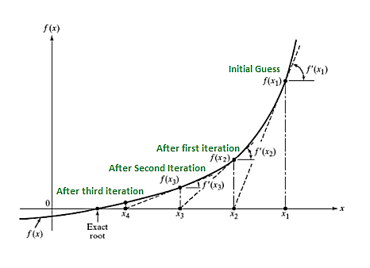
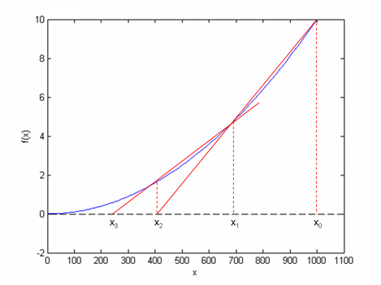
Newton-Raphson Medhod
Secant Method

Slide 4
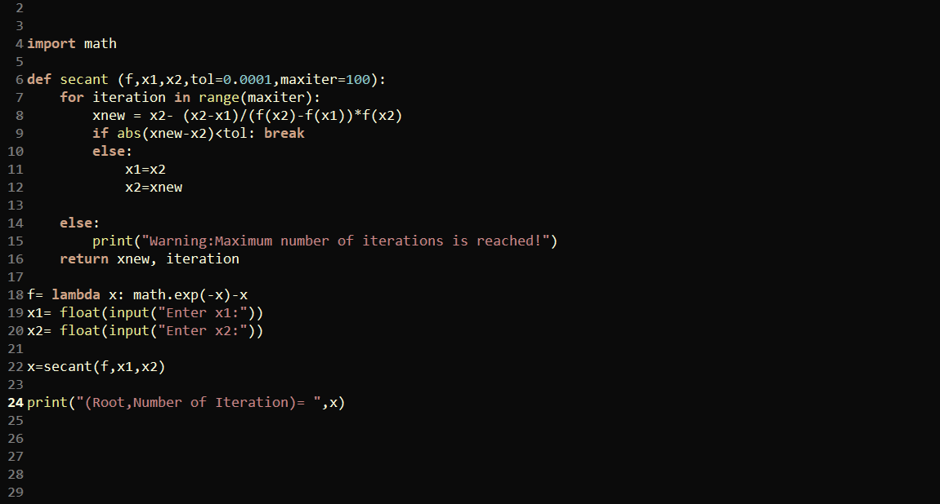

Slide 5
