Slide 1
Seed Plants

Slide 2
Coniferophyta—Conifers

Slide 3
Coniferophyta—Conifers

Slide 4
Coniferophyta—Conifers

Slide 5
Coniferophyta—Conifers

Slide 6
Coniferophyta—Conifers

Slide 7
Coniferophyta—Conifers

Slide 8
Coniferophyta—Conifers

Slide 9
Coniferophyta—Conifers

Slide 10
Coniferophyta—Conifers

Slide 11
Coniferophyta—Conifers

Slide 12
Coniferophyta—Conifers

Slide 13
Coniferophyta—Conifers

Slide 15
Pinaceae

Slide 16
Pinus

Slide 17
Cedrus

Slide 18
Abies

Slide 19
Picea

Slide 23
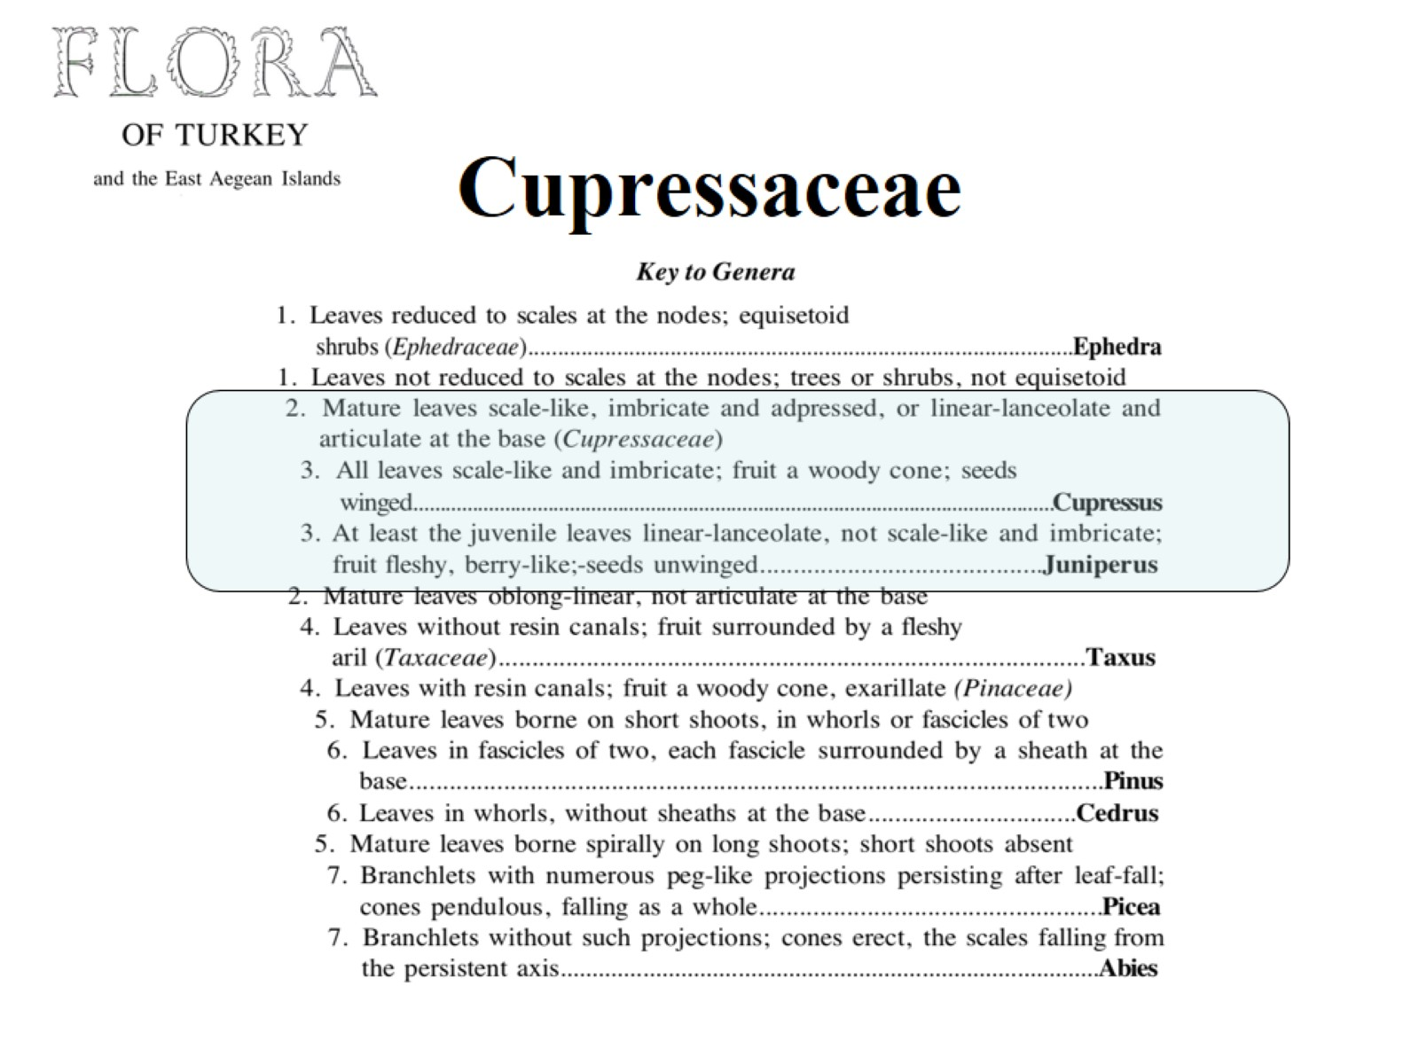
Cupressaceae

Slide 24
Cupressus

Slide 25
Juniperus

Slide 26
Thuja

Slide 29
Taxaceae

Slide 30
Taxus baccata

Slide 31
Coniferae – conifers

Slide 33
Gnetales Ephedraceae One genus: Ephedra (35-45 spp.) Morman Tea E. sinica: ma-huang – Chinese herbal medicine ephedrine – alkaloid weight loss, stimulant now banned.

Slide 34
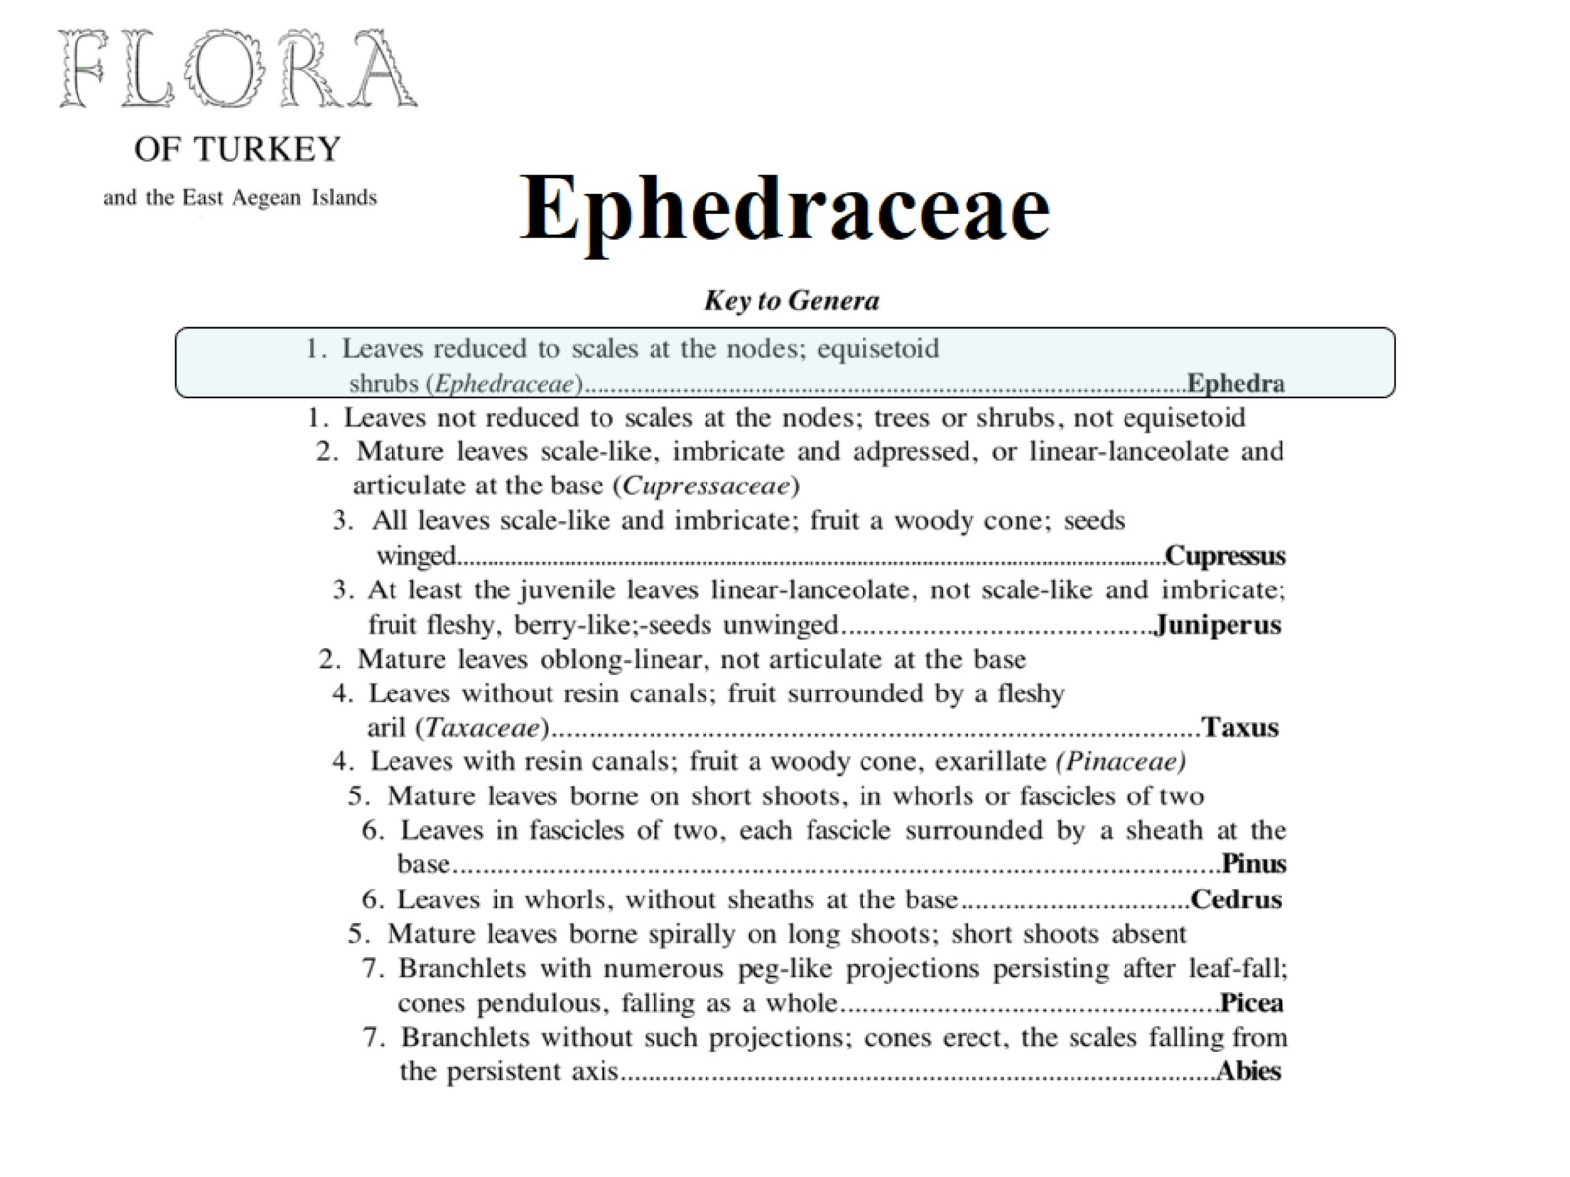
Ephedraceae

