Slide 1
COM258
Chapter 7: Entity-Relationship Model

Slide 2
Outline
Using High-Level Conceptual Data Models for Database Design
A Sample Database Application
Entity Types, Entity Sets, Attributes, and Keys
Relationship Types, Relationship Sets, Roles and Structural Constraints
Weak Entity Types

Slide 3
Using High-Level Conceptual Data Models for Database Design
Entity-Relationship (ER) model
Very popular high level conceptual data model
ER diagrams are used to implement ER model

Slide 4
Using High-Level Conceptual Data Models for Database Design
Requirements collection and analysis
Database designers interview database users to understand data requirements
Result: Data requirements
Functional requirements

Slide 5
Using High-Level Conceptual Data Models for Database Design
Conceptual schema
Description of data requirements
Includes detailed descriptions of the entity types, relationships and constraints
Logical design or data model mapping
A database schema is produced
Physical design phase
Internal storage structures

Slide 6
Using High-Level Conceptual Data Models for Database Design
A Sample Database Application
COMPANY
Employees, departments and projects
Company has a number of departments
Departments controls a number of projects
The dependents of each employee are also kept

Slide 7
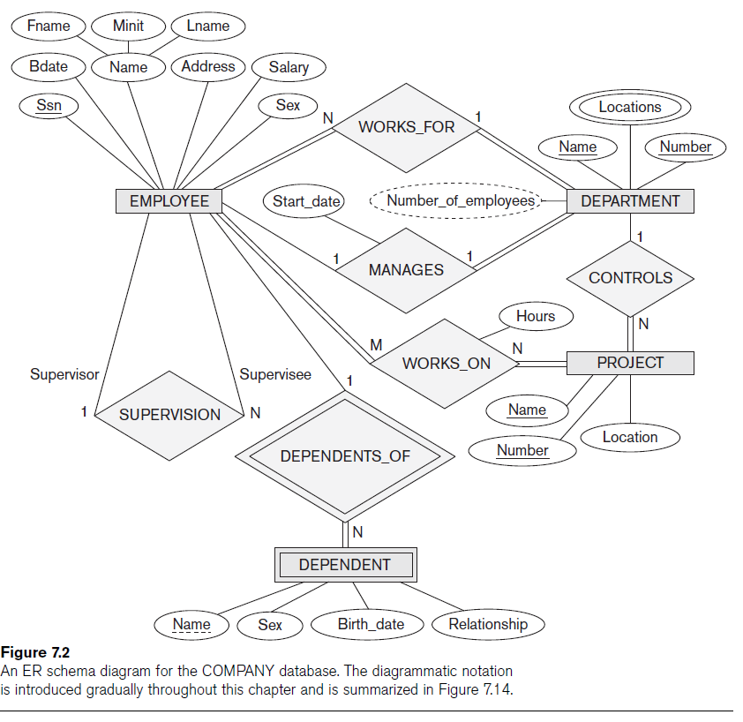
Using High-Level Conceptual Data Models for Database Design

Slide 8
Entity Types, Entity Sets, Attributes, and Keys
ER model describes data using Entities, Relationships and Attributes
Entity is thing in real word with independent existence
Attributes
Composite / simple attributes
Single-valued / multivalued
Stored / derived
NULL values
Complex attributes

Slide 9
Relationship Types, Relationship Sets, Roles and Structural Constraints
Relationship
When an attribute of one entity type refers to another entity type
References are represented as relationships not attributes.
Relationship degree is the number of participating entity types

Slide 10
Relationship Types, Relationship Sets, Roles and Structural Constraints
Constraints on Binary Relationship Types
Cardinality ratio
Specifies maximum number of relationship instances that entity can participate in
Participation constraint
Total
Partial

Slide 11
Relationship Types, Relationship Sets, Roles and Structural Constraints
Attributes of Relationship Types
Attributes of 1:1 relationship type can be migrated to one entity type
Relationship attribute can be migrated only to entity type on N-side for a 1:N relationship type
Attributes must be specified as relationship attributes for M:N relationship types

Slide 12
Weak Entity Types
They do not have key attributes of their own.
Identified by being related to specific entities from another entity type.
Identifying relationship are placed between a weak entity type and its owner.
It always has a total participation.

