Slide 1
NERVOUS SYSTEM WEEK 2
Doç. Dr. Yasemin SALGIRLI DEMİRBAŞ

Slide 2
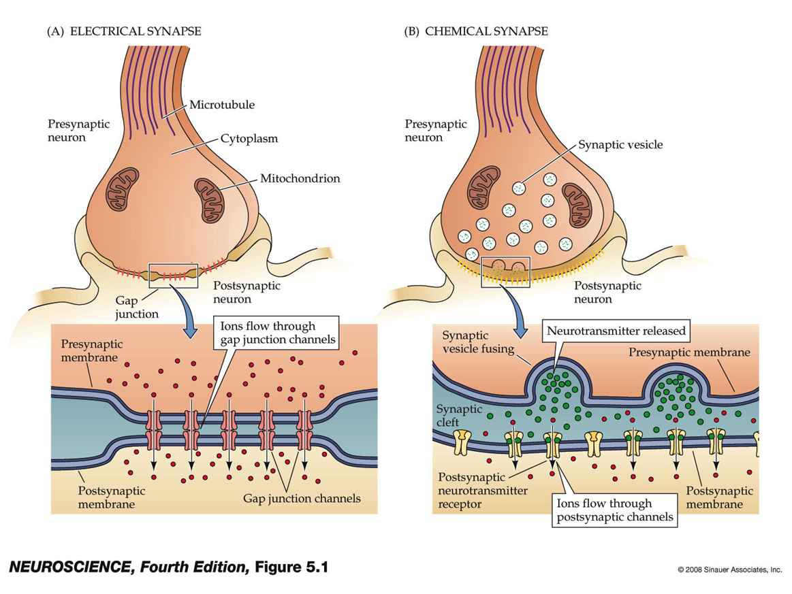
The synapse
A synapse is an anatomically specialized junction between two neurons, at which the electrical activity in one neuron, the presynaptic neuron, influences the electrical (or metabolic) activity in the second, postsynaptic neuron.
Anatomically, synapses include parts of the presynaptic and postsynaptic neurons and the extracellular space between these two cells.

Slide 3
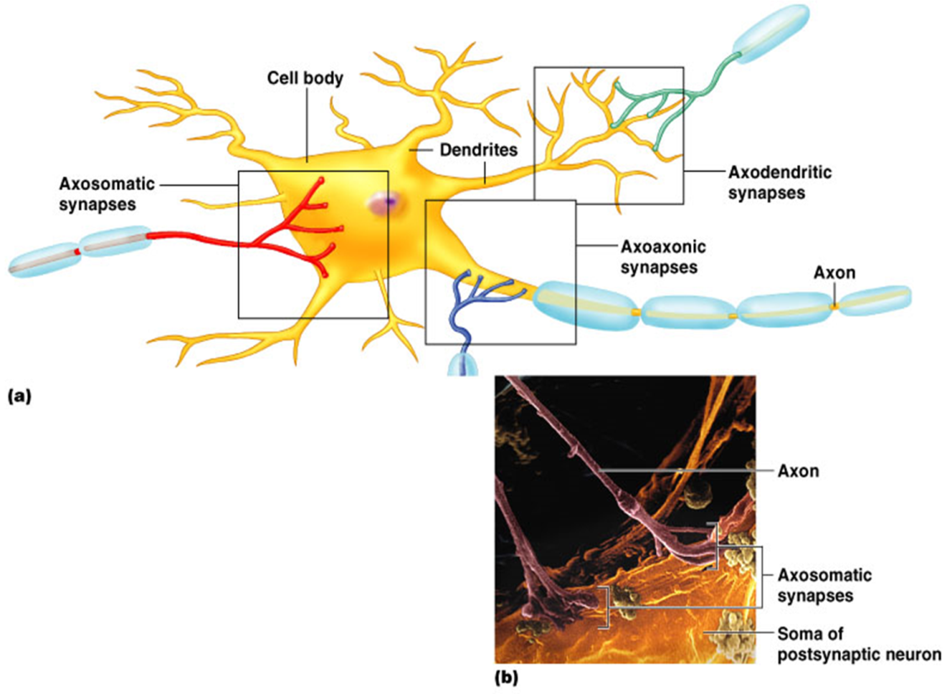
Anatomical Types of Synapses
Axodendritic – synapses between the axon of one neuron and the dendrite of another
Axosomatic – synapses between the axon of one neuron and the soma of another
Other types of synapses include:
Axoaxonic (axon to axon)
Dendrodendritic (dendrite to dendrite)
Dendrosomatic (dendrites to soma)

Slide 4
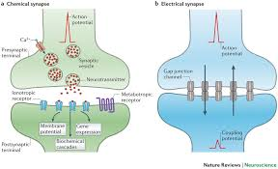
FUNCTIONAL ANATOMY OF SYNAPSES
There are two types of synapses: electrical and chemical.
At electrical synapses, the plasma membranes of the pre- and postsynaptic cells are joined by gap junctions
These allow the local currents resulting from arriving action potentials to flow directly across the junction through the connecting channels in either direction from one neuron to the neuron on the other side of the junction, depolarizing the membrane to threshold and thus initiating an action potential in the second cell.
Electrical synapses are relatively rare in the mammalian nervous system,

Slide 5
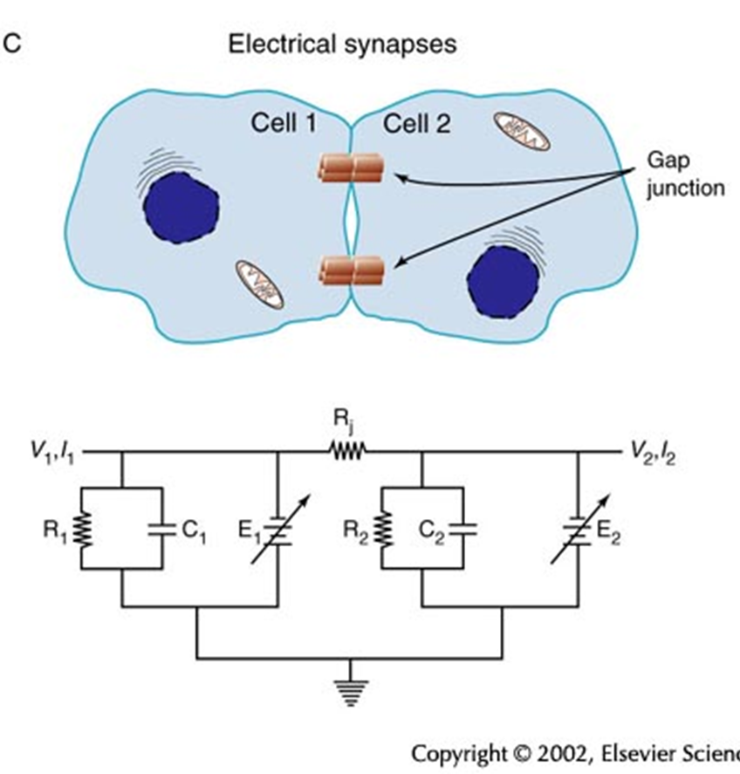
ELECTRICAL SYNAPSES
Electrical synapses transmit signals more rapidly than chemical synapses do.
Some synapses are both electrical and chemical. At these synapses, the electrical response occurs earlier than the chemical response.

Slide 6
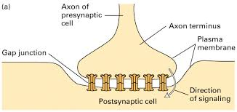
BENEFITS OF ELECTRICAL SYNAPSES
They are fast.
Also, electrical synapses allow for the synchronized activity of groups of cells.
In many cases, they can carry current in both directions so that depolarization of a postsynaptic neuron will lead to depolarization of a presynaptic neuron.
This kind of bends the definitions of presynaptic and postsynaptic!

Slide 7
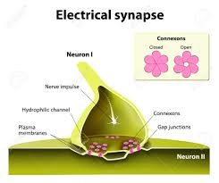
DOWNSIDES OF ELECTRICAL SYNAPSES
Unlike chemical synapses, electrical synapses cannot turn an excitatory signal in one neuron into an inhibitory signal in another.
More broadly, they lack the versatility, flexibility, and capacity for signal modulation that we see in chemical synapses.

Slide 8
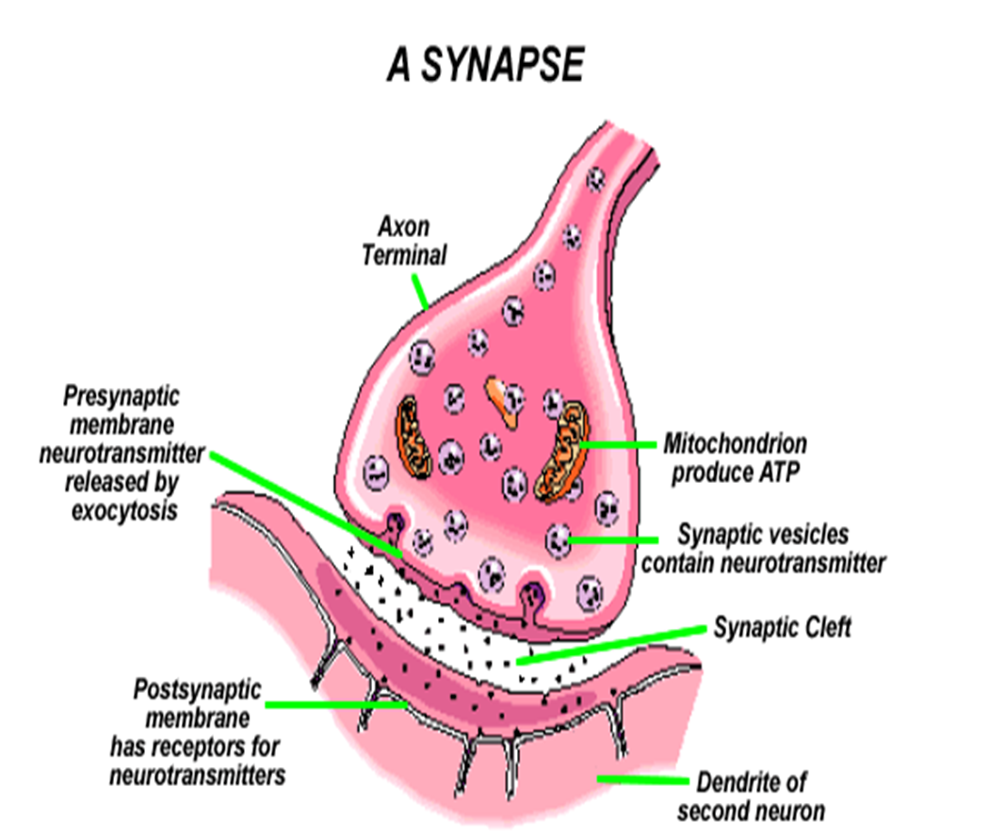
CHEMICAL SYNAPSES
Almost all synapses used for signal transmission in the CNS of human being are chemical synapses.
i.e. first neuron secretes a chemical substance called neurotransmitter at the synapse to act on receptor on the next neuron to excite it, inhibit or modify its sensitivity.
The axon of the presynaptic neuron ends in a slight swelling, the axon terminal, and the postsynaptic membrane under the axon terminal appears denser.

Slide 9
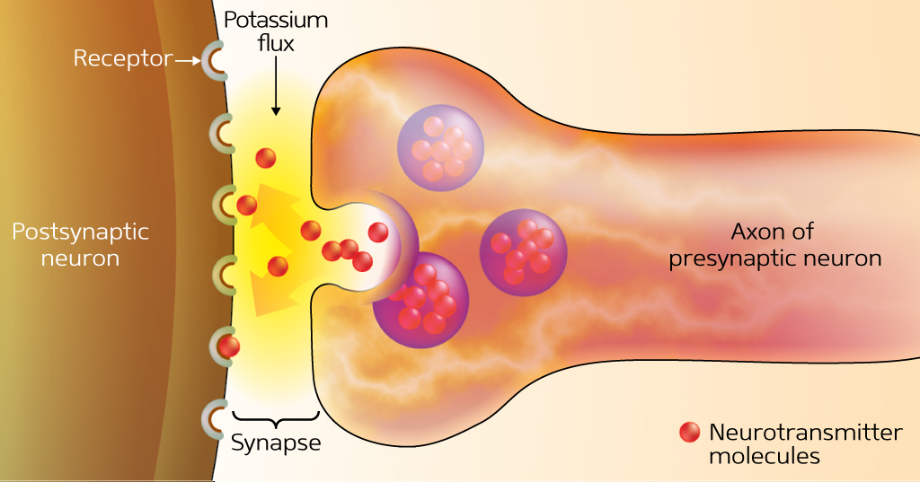
Synaptic Cleft
separates the pre- and postsynaptic neurons and prevents direct propagation of the current from the presynaptic neuron to the postsynaptic cell.
Instead, signals are transmitted across the synaptic cleft by means of a chemical messenger—a neurotransmitter released from the presynaptic axon terminal.

Slide 10
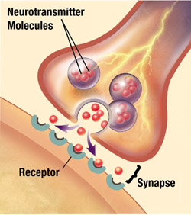
Synaptic Cleft
Sometimes more than one neurotransmitter may be simultaneously released from an axon
the additional neurotransmitter is called a cotransmitter.
These neurotransmitters have different receptors in the postsynaptic cell.

Slide 11
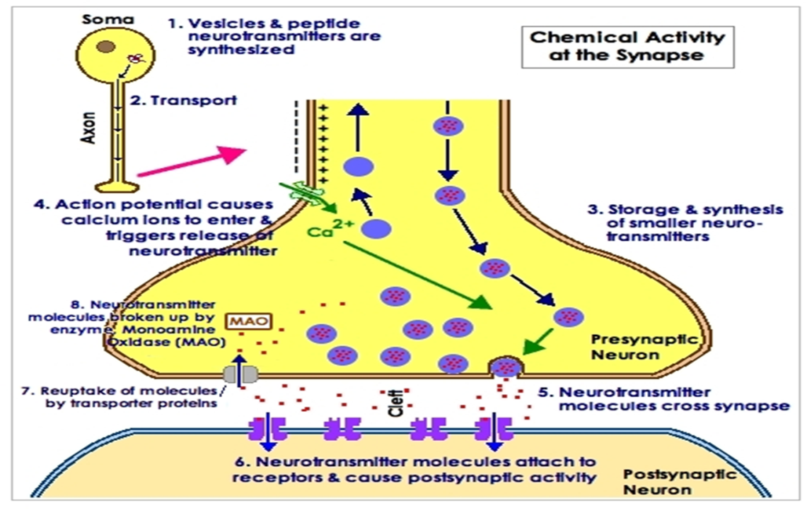
Synaptic Transmission in Summary
Action potential arrives at presynaptic neuron’s axon terminal and opens voltage-gated calcium channels
Calcium enters neuron terminal and causes synaptic vesicle fusion with cell membrane
Neurotransmitter exocytosis occurs
Neurotransmitter diffuses across cleft and binds to receptors on postsynaptic neuron
Ion channels in membrane of post-synaptic cell open, causing excitation or inhibition (graded potential)
Neurotransmitter diffuses away from receptors as it is broken down in the cleft and/or taken back up by pre-synaptic neuron

Slide 12
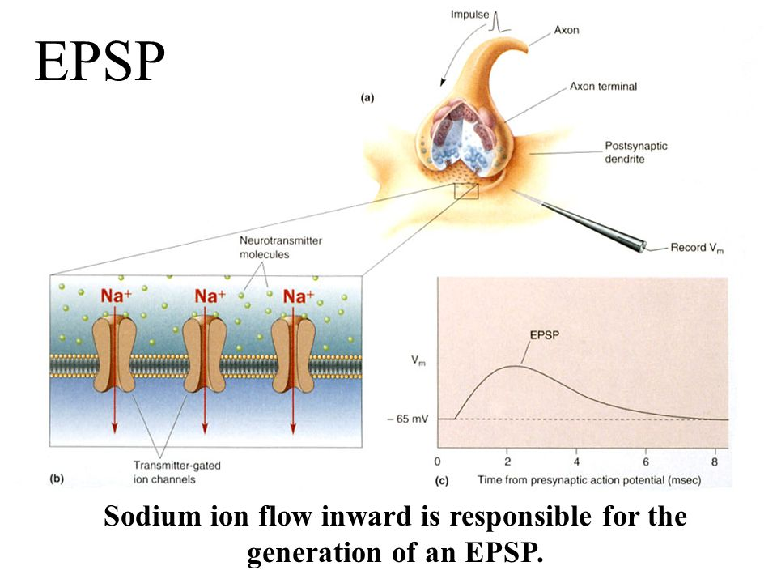
Excitatory postsynaptic potential
When a neurotransmitter binds to its receptor on a receiving cell, it causes ion channels to open or close.
This can produce a localized change in the membrane potential—voltage across the membrane—of the receiving cell.
In some cases, the change makes the target cell more likely to fire its own action potential.
In this case, the shift in membrane potential is called an excitatory postsynaptic potential, or EPSP.

Slide 13
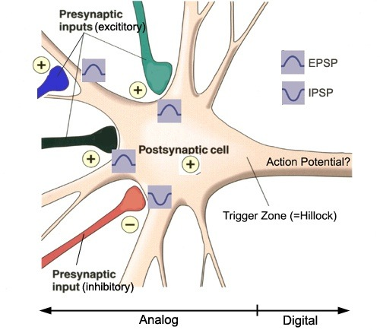
EPSP
An EPSP is depolarizing: it makes the inside of the cell more positive, bringing the membrane potential closer to its threshold for firing an action potential.
Sometimes, a single EPSP isn't large enough bring the neuron to threshold, but it can sum together with other EPSPs to trigger an action potential.
The EPSP is a graded potential that spreads decrementally away from the synapse by local current.
Its only function is to bring the membrane potential of the postsynaptic neuron closer to threshold.

Slide 14
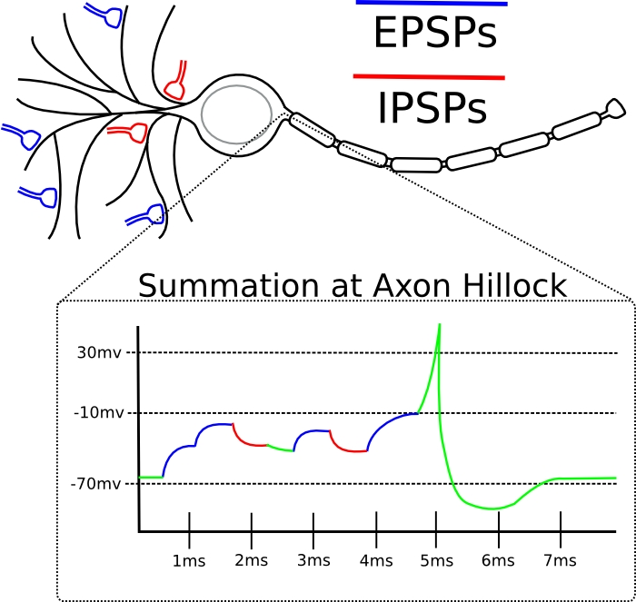
Inhibitory Synapses and IPSPs
Neurotransmitter binds to and opens channels for K+ or Cl–
Causes hyperpolarization (inside of cell becomes more negative)
Reduces the postsynaptic neuron’s ability to produce an action potential

Slide 15
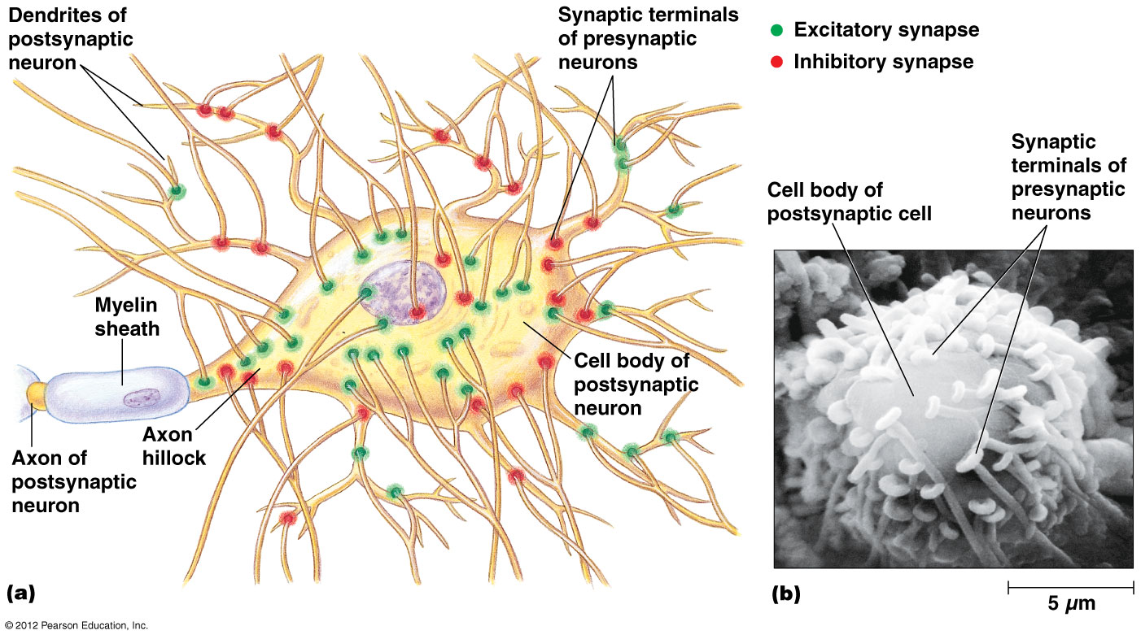
Integration: Summation
One EPSP cannot induce an action potential
EPSPs can sum to reach threshold
IPSPs and EPSPs can cancel each other out

Slide 16
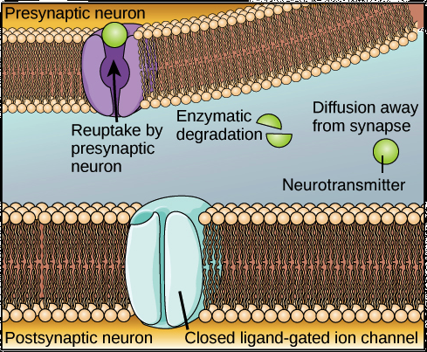
SYNAPTIC TERMINATION
A synapse can only function effectively if there is some way to "turn off" the signal once it's been sent.
Termination of the signal lets the postsynaptic cell return to its normal resting potential, ready for new signals to arrive.
For the signal to end, the synaptic cleft must be cleared of neurotransmitter.
There are a few different ways to get this done:
The neurotransmitter may be broken down by an enzyme,
it may be sucked back up into the presynaptic neuron, or
it may simply diffuse away.
In some cases, neurotransmitter can also be "mopped up" by nearby glial cells.

Slide 17
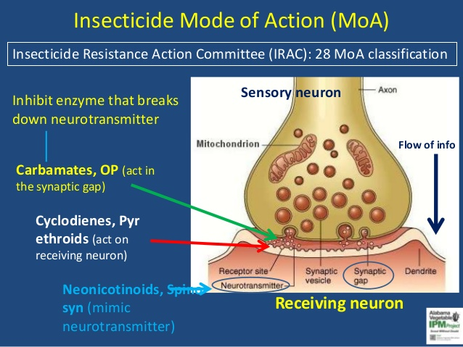
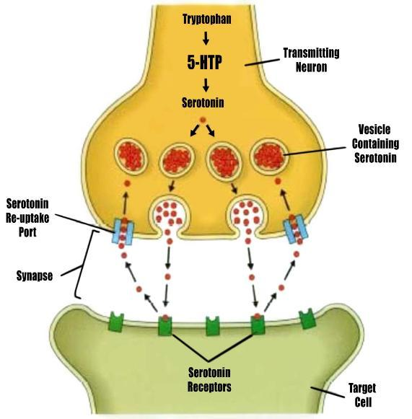
SYNAPTIC TERMINATION
Anything that interferes with the processes that terminate the synaptic signal can have significant physiological effects.
For instance, some insecticides kill insects by inhibiting an enzyme that breaks down the neurotransmitter acetylcholine.
On a more positive note, drugs that interfere with reuptake of the neurotransmitter serotonin in the human brain are used as antidepressants.

Slide 18
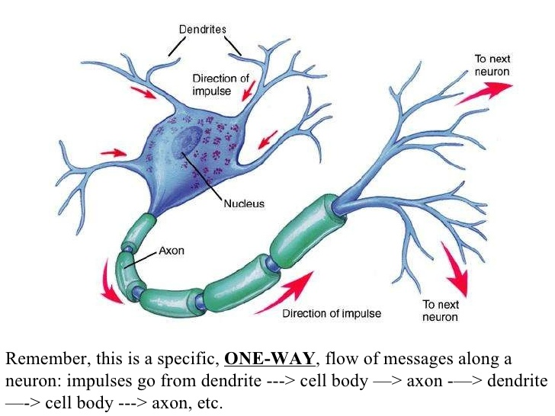
Synaptic properties
1. One-way conduction
Synapses generally permit conduction of impulses in one-way i.e. from pre-synaptic to post-synaptic neuron.

Slide 19
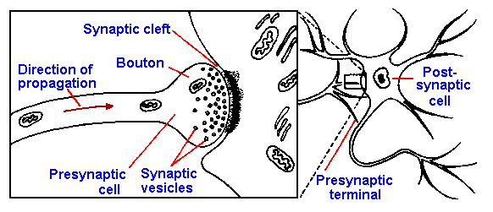
2. Synaptic delay
Is the minimum time required for transmission across the synapse.
This time is taken by
Discharge of transmitter substance by pre-synaptic terminal
Diffusion of transmitter to post-synaptic membrane
Action of transmitter on its receptor
Action of transmitter to ↑ membrane permeability
Increased diffusion of Na+ to ↑ post-synaptic potential

Slide 20
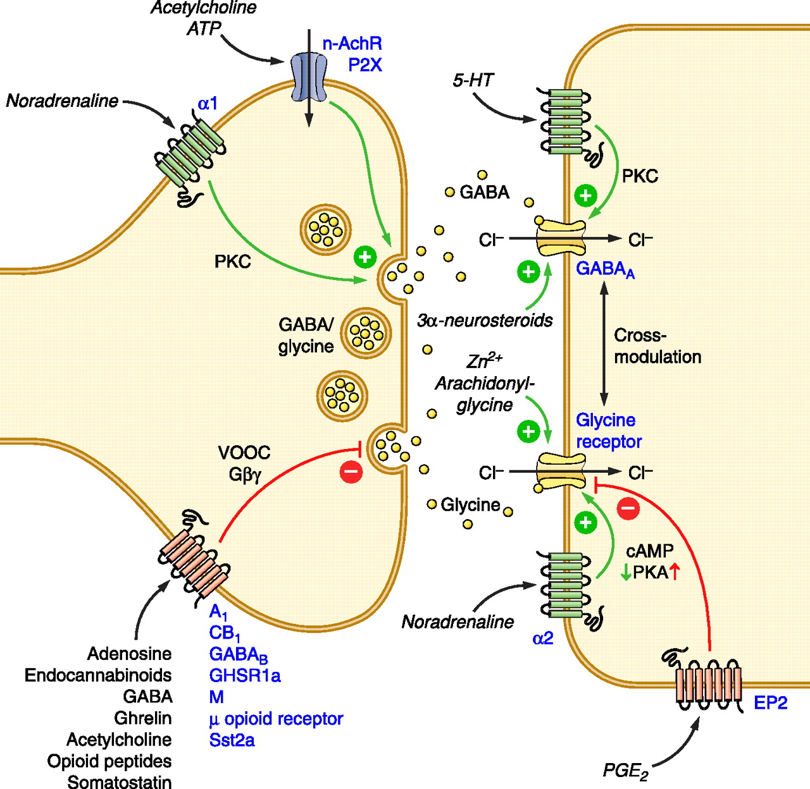
3. Synaptic inhibition
Types:
A. Direct inhibition
B. Indirect inhibition
C. Reciprocal inhibition
D. Inhibitory interneuron
E. Feed forward inhibition
F. Lateral inhibition

Slide 21
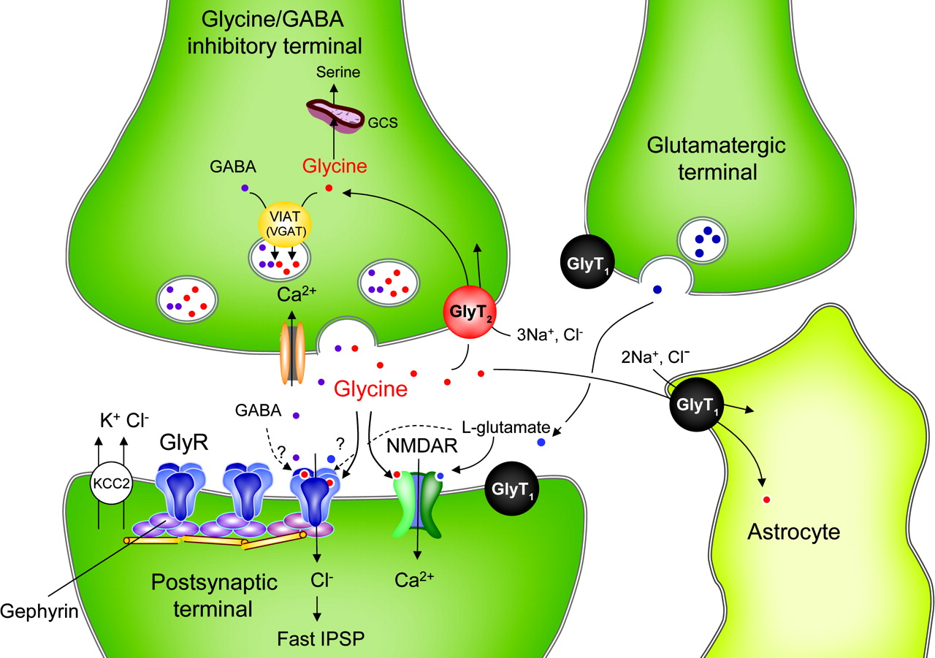
A. Direct inhibition
Post-synaptic inhibition,
e.g. some interneurones in sp. cord that inhibit antagonist muscles. Neurotransmitter secreted is Glycine.
Occurs when an inhibitory neuron (releasing inhibitory substance) act on a post-synaptic neuron leading to → its hyperpolarization due to opening of Cl¯ [IPSPs] and/or K+ channels.

Slide 22
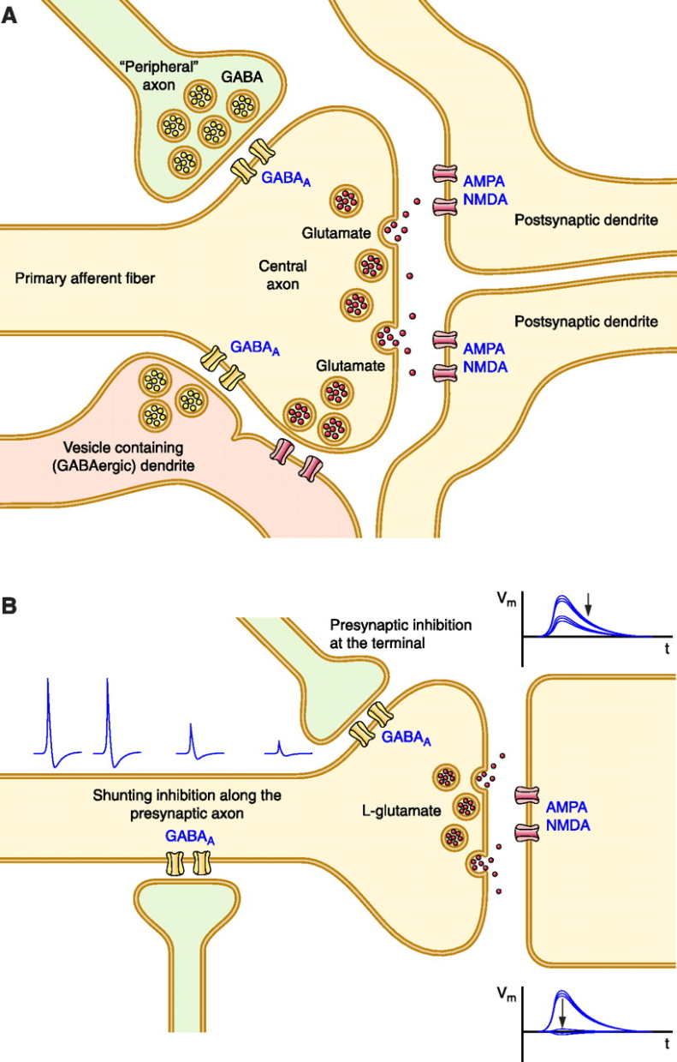
B. Indirect inhibition
Pre-synaptic inhibition.
Presynaptic Inhibition is a mechanism by which the amount of neurotransmitter released by an individual synapse can be reduced, resulting of less excitation of the post-synaptic neurone.
The transmitter released at the inhibitory knob is GABA.
The inhibition is produced by ↑ Cl¯ and ↑ K+. e.g. occurs in dorsal horn → pain gating.

Slide 23
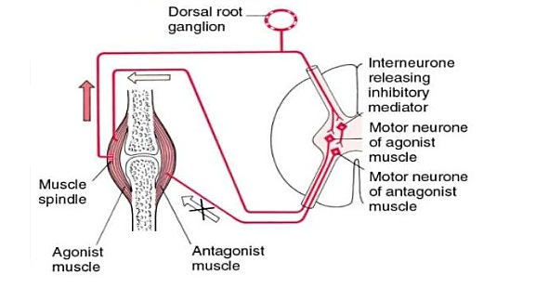
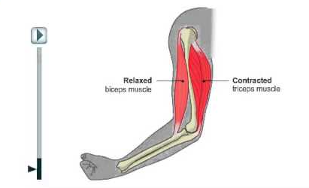
C. Reciprocal inhibition
Inhibition of antagonist activity is initiated in the spindle in the agonist muscle.
Impulses pass directly to the motor neurons supplying the same muscle and via branches to inhibitory interneurones that end on motor neurones of antagonist muscle.

Slide 24
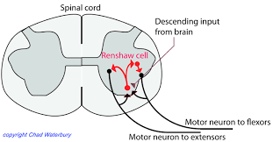
D. Inhibitory interneuron
( Renshaw cells)
The alpha motor neuron axon has a recurrent collateral in the spinal cord that synapses onto the Renshaw cell.
The Renshaw cell directly inhibits the alpha motor neuron using glycine as the neurotransmitter.
This is called recurrent inhibition.
CNS actually inhibits muscle fibers of the same muscle that is contracting.
It provides inhibitory feedback to the pool of alpha motor neurons to prevent excessive output.

Slide 25
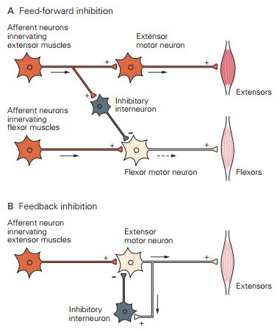
E. Feed forward inhibition
Collateral branches of the excitatory afferent fibers excite inhibitory interneurons that inhibit neurons in the forward direction.
Inhibitory pathways keep down the level of excitation and so suppress discharges from all weakly excited neurons. They also mold and modify the patterns of neuronal responses.
Example: Iα afferent fibers from muscle receptors → spinal motor neurons.

Slide 26
F. Lateral inhibition
Because of lateral inhibition, the lateral pathways are inhibited more strongly.
This happens in pathways utilizing most accurate localization.

Slide 28
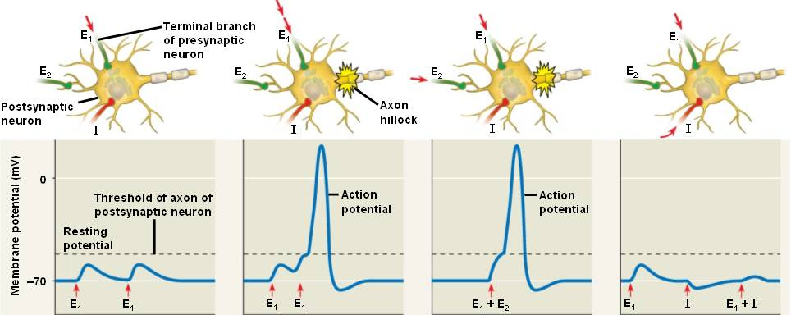
4. Summation
Spatial summation.
When EPSP is in more than one synaptic knob at same time.
Temporal summation.
If EPSP in pre-synaptic knob are successively repeated without significant delay so the effect of the previous stimulus is summated to the next

Slide 29
5. Convergence and divergence
Convergence
When many pre-synaptic neurons converge on any single post-synaptic neuron.
Divergence
Axons of most pre-synaptic neurons divide into many branches that diverge to end on many post-synaptic neuron.

Slide 30
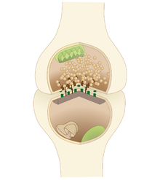
7. Fatigue
Exhaustion of nerve transmitter.
If the pre synaptic neurons are continuously stimulated there may be an exhaustion of the neurotransmitter. Resulting is stoppage of synaptic transmission.
The post synaptic membrane become less sensitive to the neurotransmitter.

Slide 31
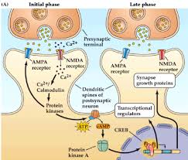
8. Long-term potentiation = LTP
Long-term potentiation (LTP) is a persistent strengthening of synaptic connections induced by a brief period of high-frequency presynaptic activity
Ca++ intracellular in post-synaptic membrane.
Amygdala N-methyl-D-aspartate NMDA receptors.

Slide 32
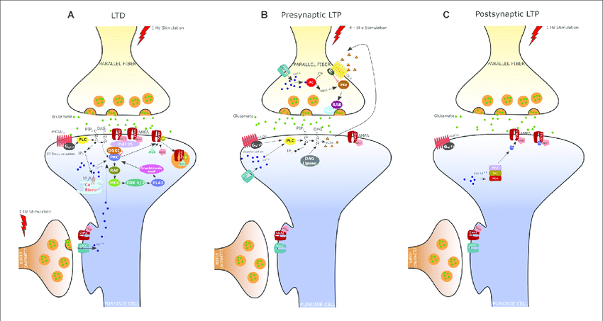
9. Long-term depression
First noted in Hippocampus
Later shown Through brain
Opposite of LTP
↓ synaptic strength
Caused by slower of pre-synaptic neurone
Smaller rise of Ca++
Occure in amino 3 hydroxy -5-methylisoxazole4-propionate AMPA receptors

Slide 33
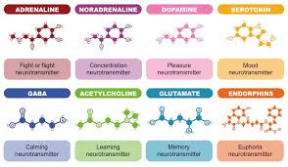
Neurotransmitters
Most neurons make two or more neurotransmitters, which are released at different stimulation frequencies
50 or more neurotransmitters have been identified
Classified by chemical structure and by function

Slide 34
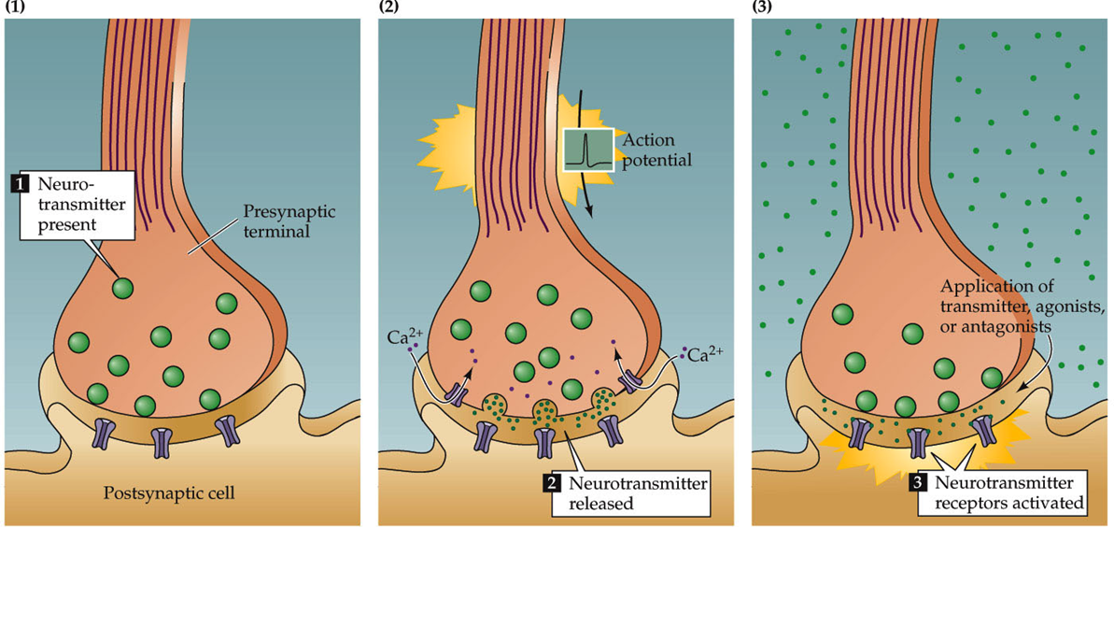
Criteria that define a neurotransmitter:
Must be present at presynaptic terminal
Must be released by depolarization, Ca++-dependent
Specific receptors must be present

Slide 35
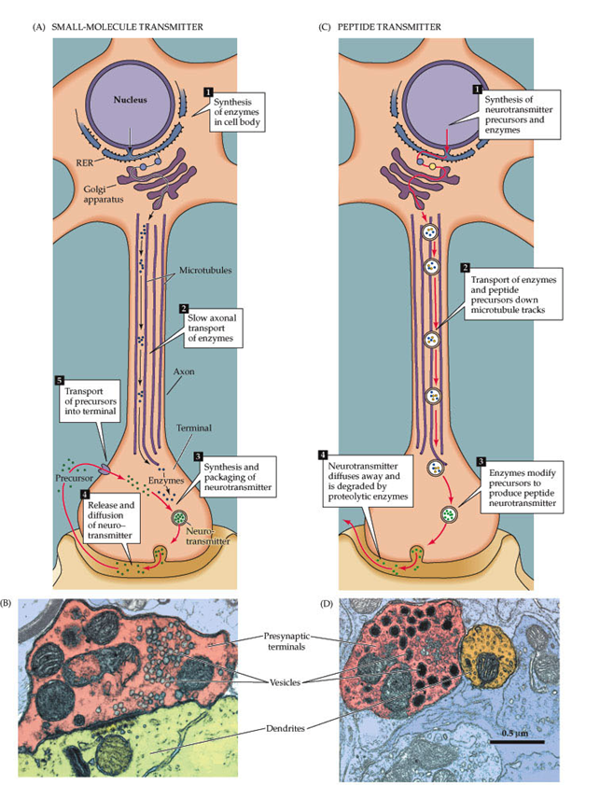
SYNTHESIS OF NTs
Small molecule transmitters are synthesized at terminals, packaged into small clear-core vesicles (often referred to as ‘synaptic vesicles’
Peptides, or neuropeptides are synthesized in the endoplasmic reticulum and transported to the synapse, sometimes they are processed along the way. Neuropeptides are packaged in large dense-core vesicles

Slide 36
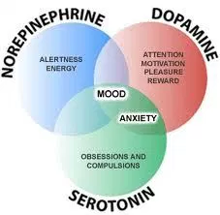
Conventional neurotransmitters
The chemical messengers that act as conventional neurotransmitters share certain basic features.
They are stored in synaptic vesicles, get released when Ca2+ enters the axon terminal in response to an action potential, and act by binding to receptors on the membrane of the postsynaptic cell.

Slide 37
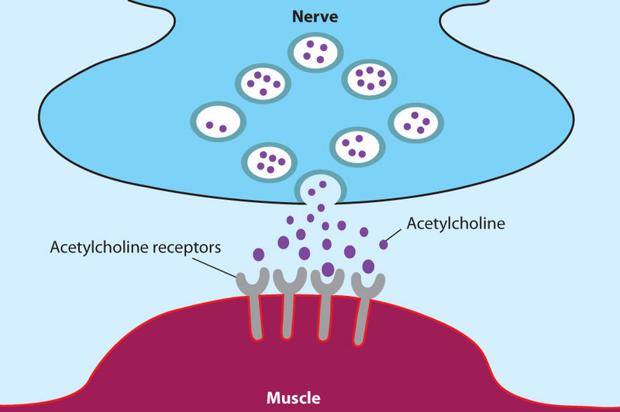
Chemical Classes of Neurotransmitters
Acetylcholine (Ach)
Released at neuromuscular junctions and some autonomic neurons
Synthesized in the pre-synaptic neuron
Degraded by acetylcholinesterase (AChE)

Slide 38
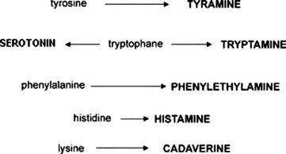
Biogenic amines
Norepinephrine (NE)
Epinephrine
Serotonin
Dopamine
Many others
Broadly distributed in the brain
Play roles in emotional behaviors and the biological clock

Slide 39
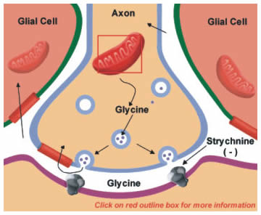
Amino acids
GABA—Gamma (γ)-aminobutyric acid
Glutamate
Glycine
Many others

Slide 40
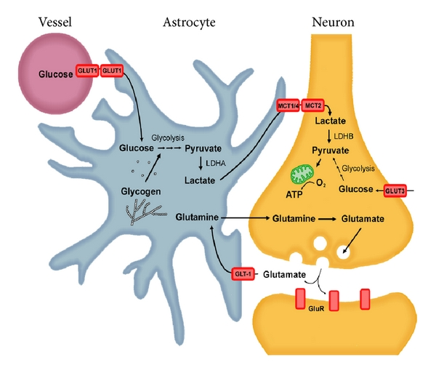
Functional Classification of Neurotransmitters
Excitatory (depolarizing) and/or inhibitory (hyperpol.)
Determined by receptor type on postsynaptic neuron
GABA usually inhibitory
Glutamate, epinephrine usually excitatory
Acetylcholine
Excitatory at neuromuscular junctions in skeletal muscle
Inhibitory in cardiac muscle

Slide 41
Neurotransmitter Actions
Direct action
Neurotransmitter binds to channel-linked receptor and opens ion channels
Promotes rapid responses
Examples: ACh; glutamate and GABA at some of their synapses

Slide 42
Neurotransmitter Actions
Indirect action
Neurotransmitter binds to a G protein-linked receptor and acts through an intracellular second messenger
Promotes long-lasting effects
Examples: Norepinephrine, epinephrine, serotonin; glutamate and GABA at some of their synapses

Slide 43
Unconventional neurotransmitters
All of the neurotransmitters we have discussed so far can be considered “conventional” neurotransmitters.
More recently, several classes of neurotransmitters have been identified that don’t follow all of the usual rules.
These are considered “unconventional” or “nontraditional” neurotransmitters.
Two classes of unconventional transmitters are the endocannabinoids and the gasotransmitters (soluble gases such as NO and CO).

Slide 44
Unconventional neurotransmitters
These molecules are unconventional in that they are not stored in synaptic vesicles and may carry messages from the postsynaptic neuron to the presynaptic neuron.
Also, rather than interacting with receptors on the plasma membrane of their target cells, the gasotransmitters can cross the cell membrane and act directly on molecules inside the cell.

Slide 45
ANY QUESTIONS?

