Slide 1
BÖLÜM 3
YÜZEY KAPLAMA ENDÜSTRİLERİ

Slide 2
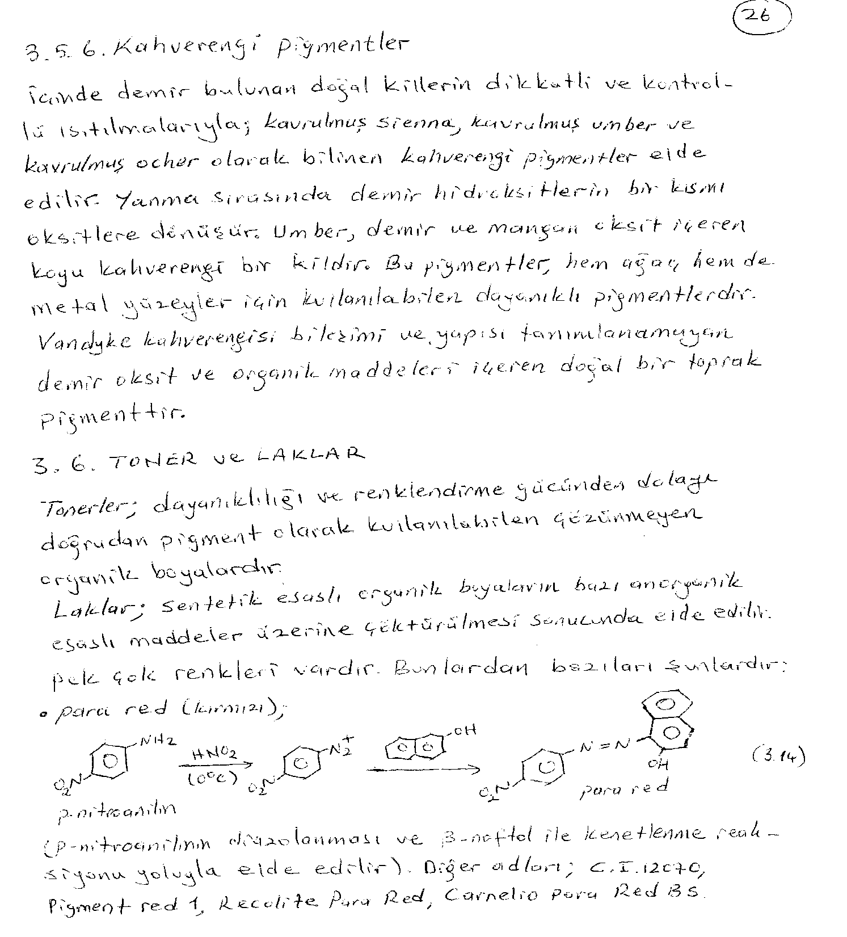

Slide 3
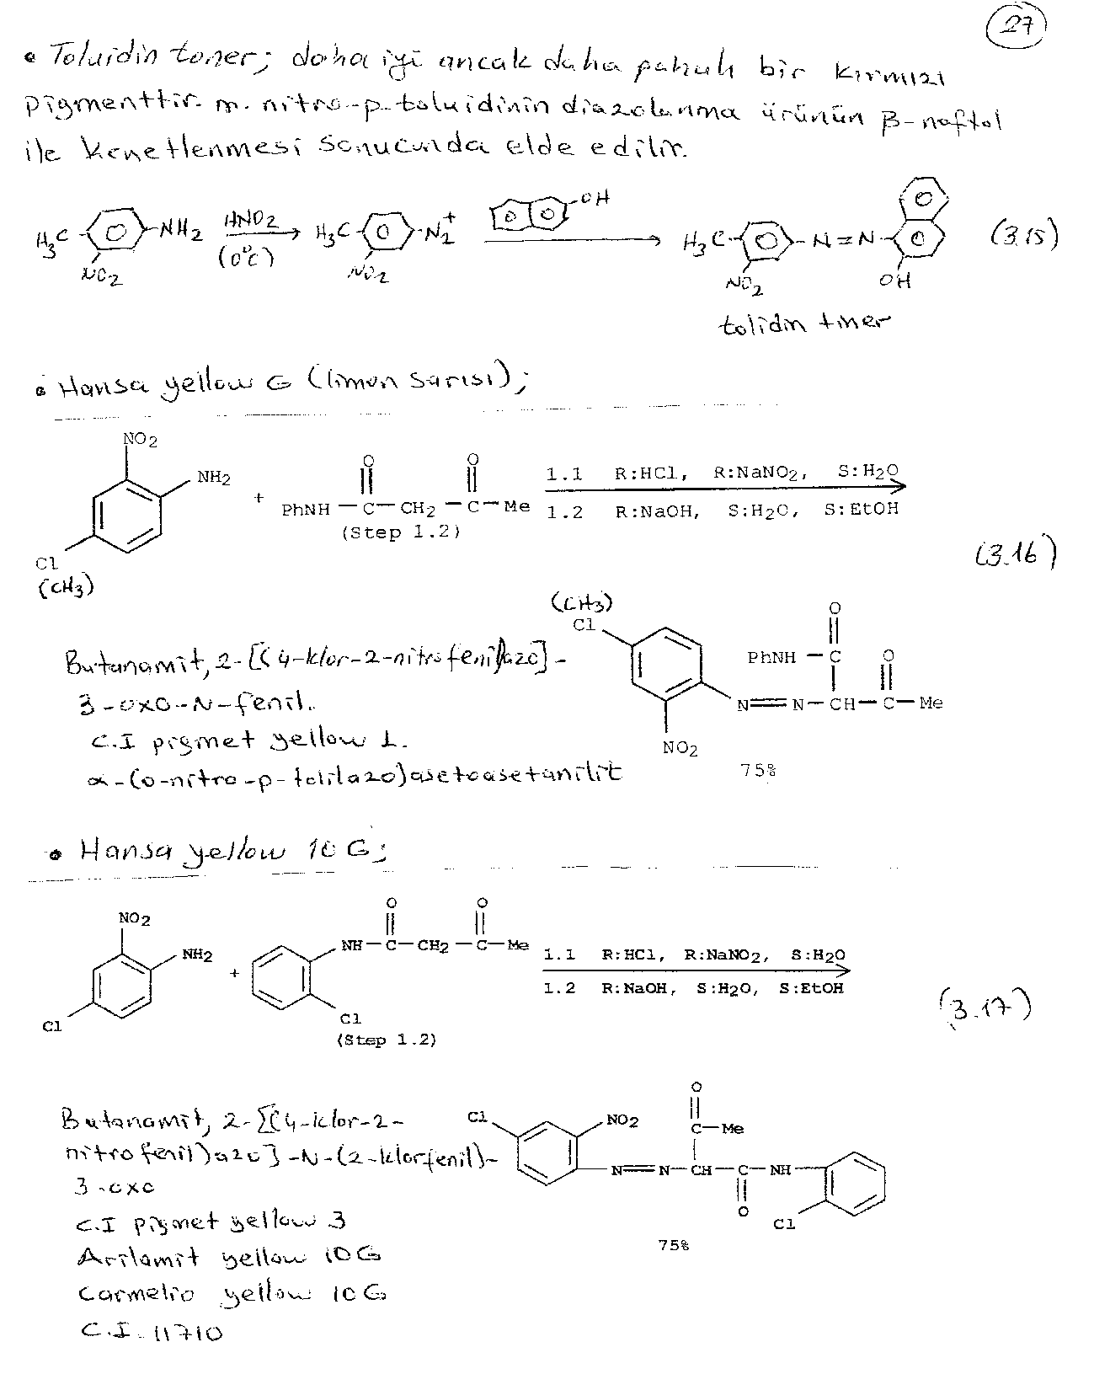

Slide 4
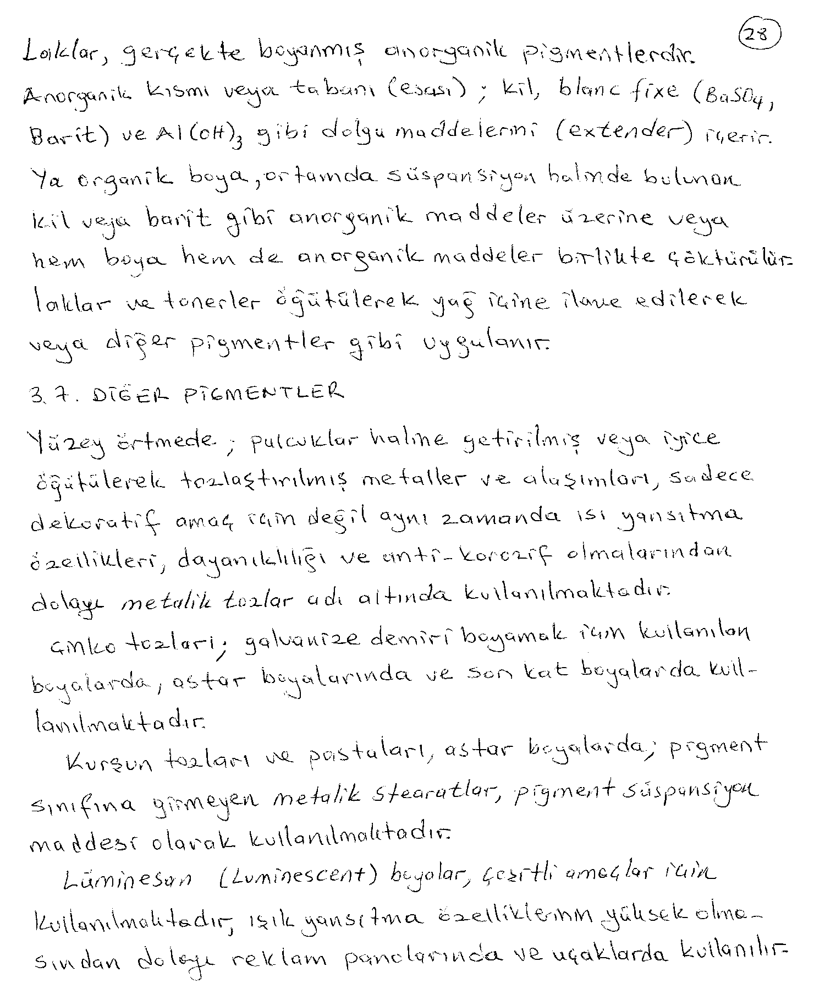

Slide 5
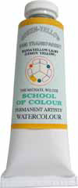
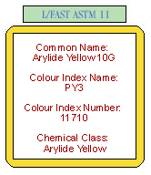
Green-Yellow, Semi-Transparent Hansa Yellow Light is a semi-transparent green-yellow. As such it will give very bright, clear greens with Phthalocyanine Blue, semi opaque bright greens with Cerulean Blue and relatively transparent mid greens with Ultramarine Blue. Blend with Quinacridone Violet for dull but transparent oranges. A versatile, lightfast yellow.
Hansa Yellow Light (Lemon Yellow) 37ml Watercolors
Quantity:(List Price: $16.95)
Our Price: $14.95

Slide 6
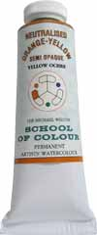
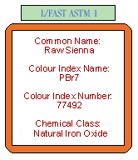
Raw Sienna (37ml Watercolors)
Neutralized Orange-Yellow, Semi-Transparent Raw Sienna has been chosen because it will give even, transparent washes when well diluted. This makes it a very useful color when working in glazes. A neutralised (or dulled) orange-yellow which has a calming effect on other colors. It will give very dull, subtle, clear greens with Ultramarine Blue and soft mid oranges with Cadmium Red Light.
(List Price: $11.95)

Slide 7
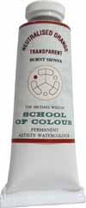
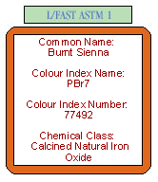
Burnt Sienna (37ml Watercolors
Neutralized Orange, Transparent
Burnt Sienna is valued for its vibrancy and transparency. When mixed with Ultramarine Blue it will provide a wide range of dark browns and dark blues which are superior to 'Paynes Grays' as they do not contain black.The same mix will also give you a range of soft, velvety blacks which are far superior to any black paint. It is absolutely lightfast
Our Price: $9.95

Slide 8
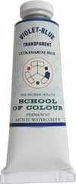
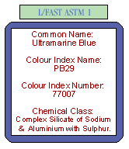
Ultramarine Blue (37ml Watercolors)
Violet-Blue, Transparent
Ultramarine Blue is a transparent violet-blue. As we do not dilute our colors with filler the washes are particularly transparent. Gives very bright violets with our Quinacridone Violet, dull semi opaque greens with Cadmium yellow Light and reasonably transparent mid greens with our Hansa Yellow. It will not fade on exposure.
Our Price: $12.95

Slide 9
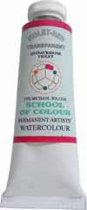
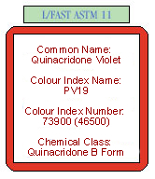
Quinacridone Violet (37ml Watercolors)
Violet-Red, Transparent
Quinacridone Violet is a strong, vibrant, violet-red which is particularly transparent and lightfast. It is the ideal replacement for Alizarin Crimson, an inferior color prone to fading. Quinacridone Violet is also a lot brighter than Alizarin Crimson and will give superior violets when mixed with Ultramarine Blue.

Slide 10
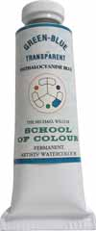
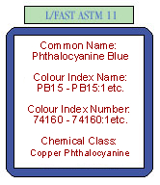
Phthalocyanine Blue (37ml Watercolors)
Green-Blue, Transparent
Phthalocyanine Blue is a powerful, transparent green-blue which needs to be handled with some care. It has been chosen because it will give very bright greens when mixed with our Hansa Yellow and a wide range of transparent blue greens with Phthalocyanine Green. Such clear blue greens cannot be mixed any other way.
(List Price: $16.95

Slide 11
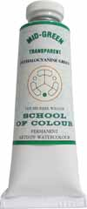
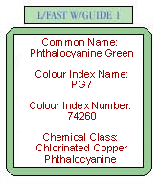
Phthalocyanine Green (37ml Watercolors)
Mid-Green, Transparent
Phthalocyanine Green is a strong, staining colour which needs to be handled with care. It is an important colour in our limited palette because it gives a range of very transparent blue greens when mixed with Phthalo Blue. These are unobtainable any other way. Darkens beautifully with our Quinacridone Violet.
(List Price: $16.95)

Slide 12
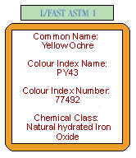
Yellow Ochre (37ml Watercolors
Neutralized Orange-Yellow, Semi-Opaque
Yellow Ochre is a neutralised (or dulled) orange-yellow. It has a soft, calming affect when mixed with other colors. Produces extremely dull greens with Ultramarine Blue, slightly brighter mid greens with Cerulean Blue and subtle oranges with Cadmium Red Light. A semi opaque color, it covers well but will also give clear washes when diluted.
List Price: $11.95)

Slide 13
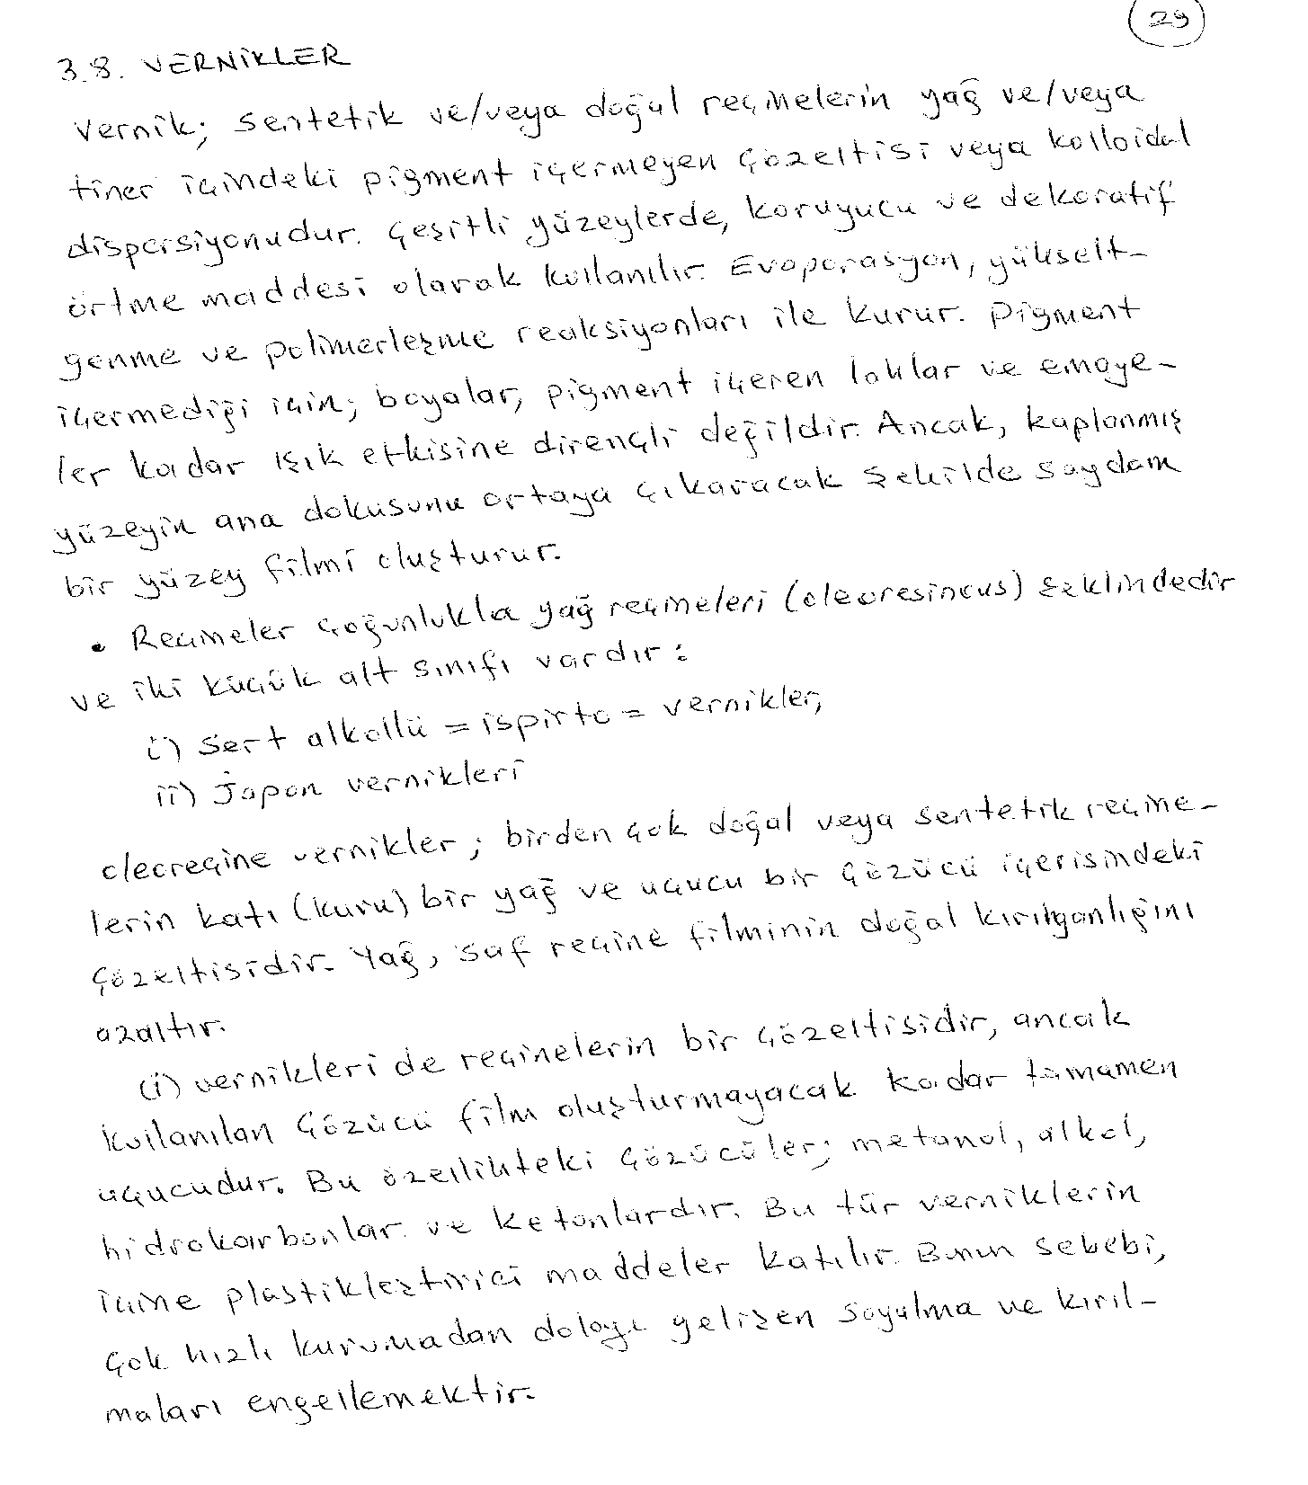

Slide 14
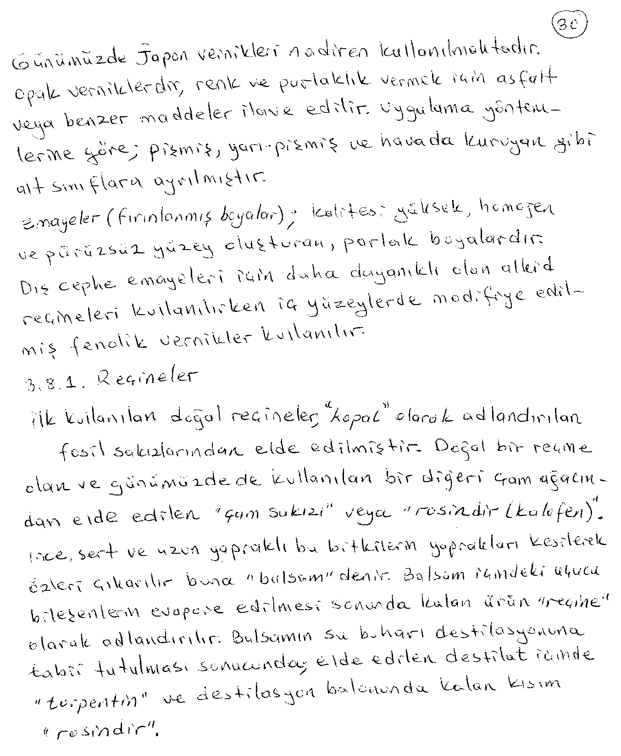

Slide 15
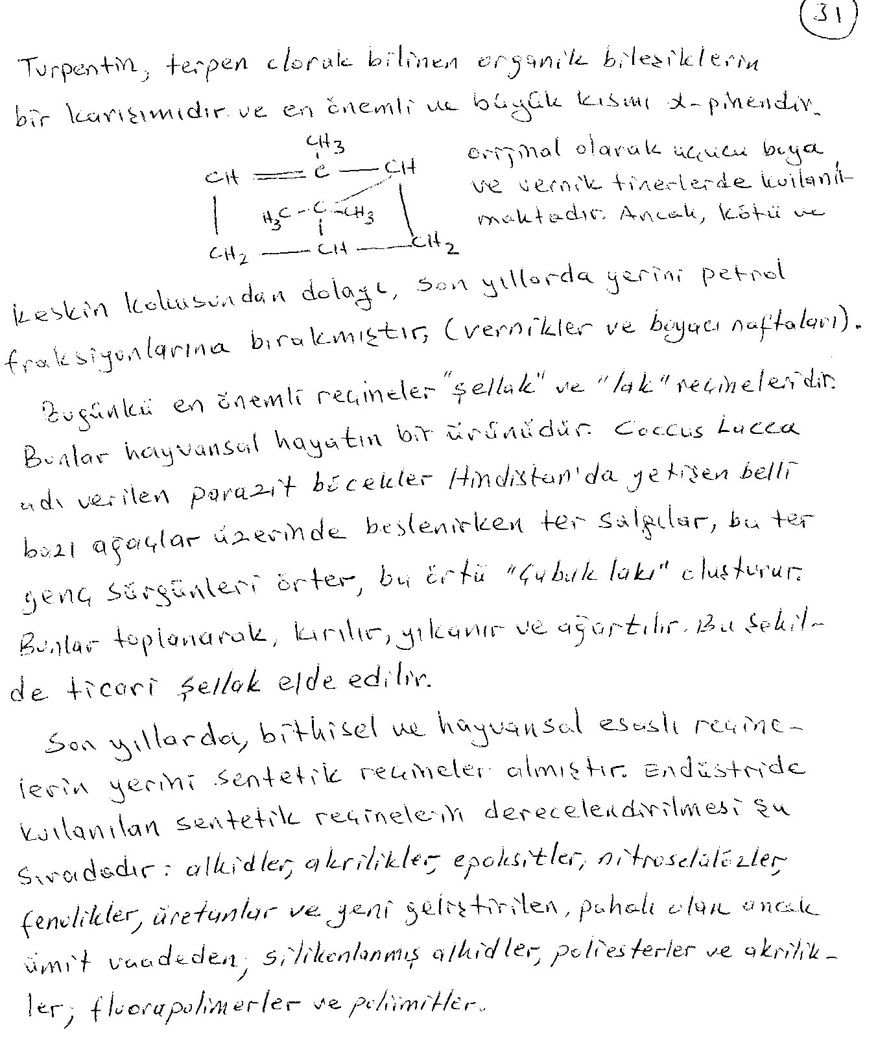

Slide 16
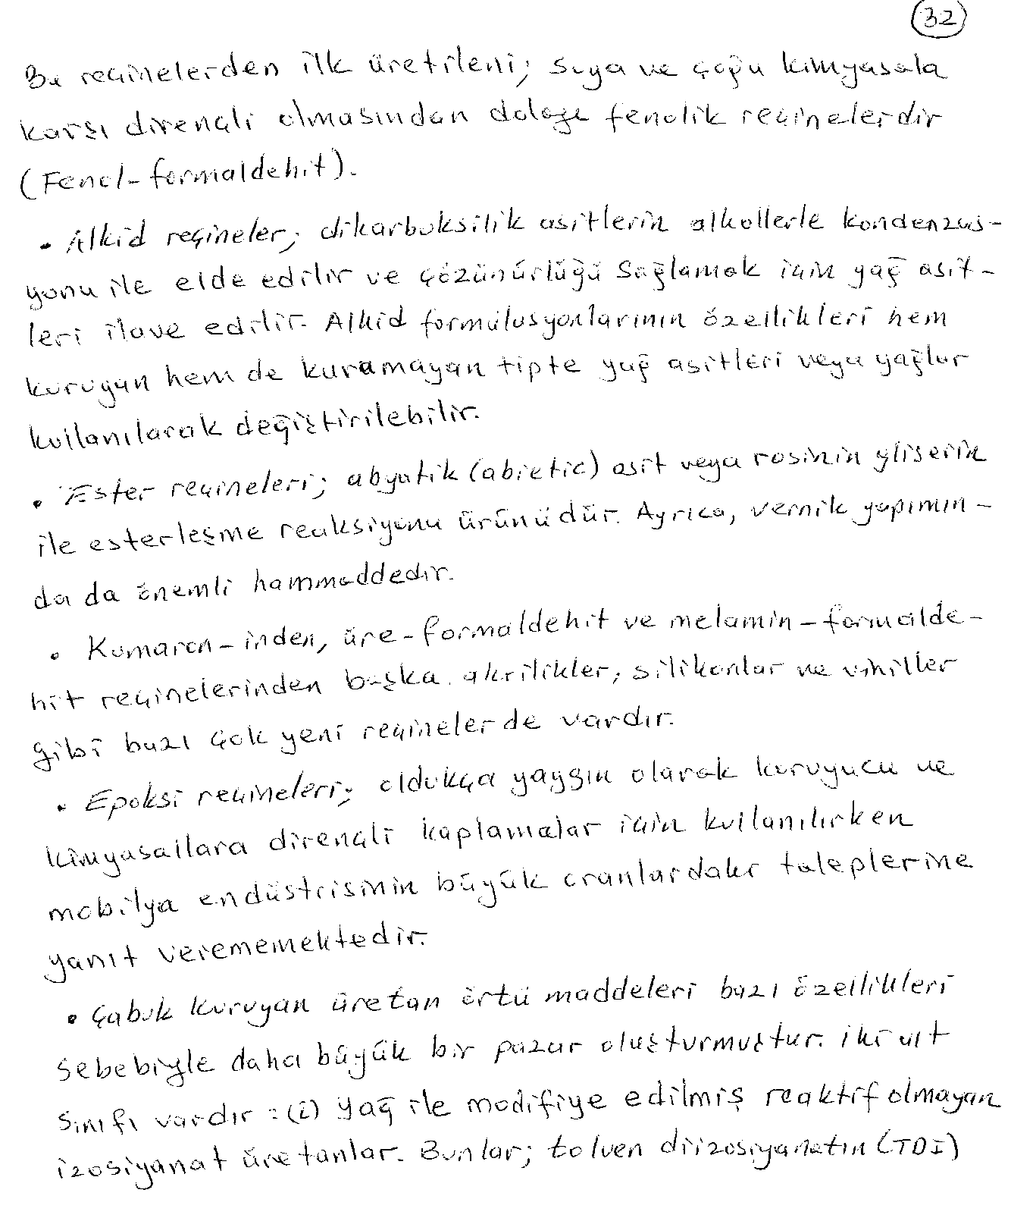

Slide 17
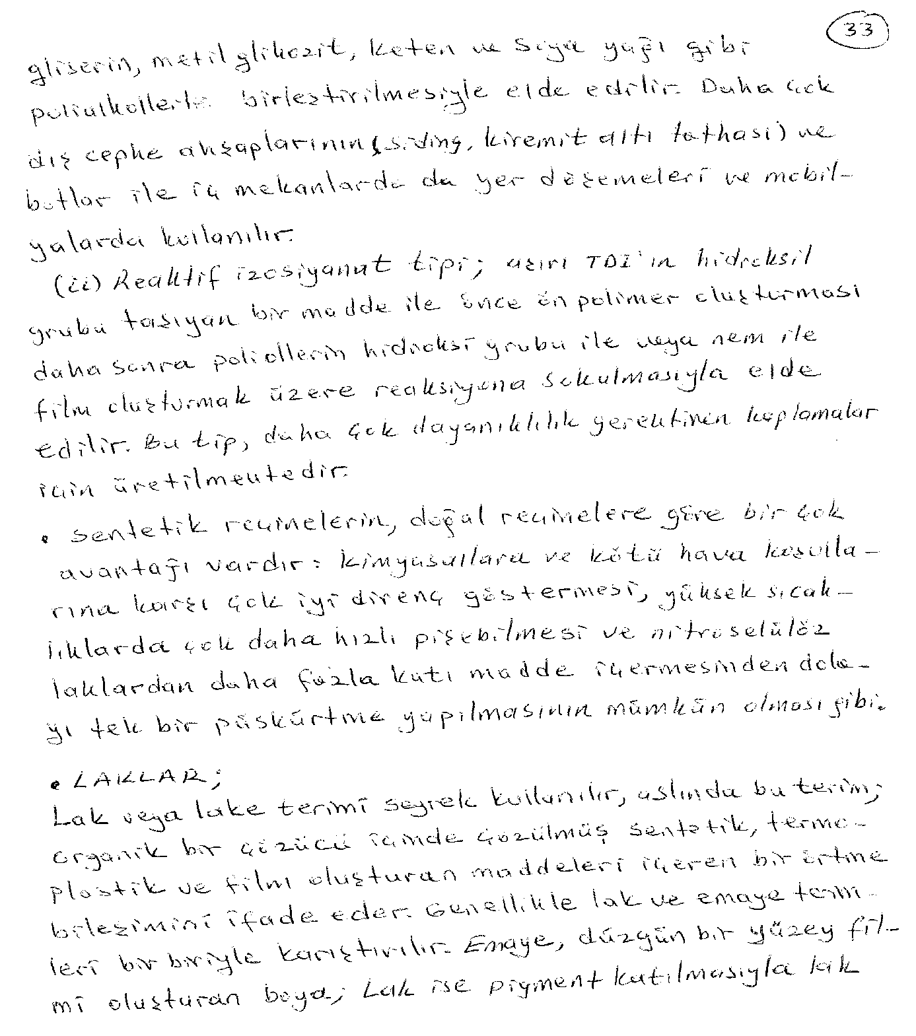

Slide 18
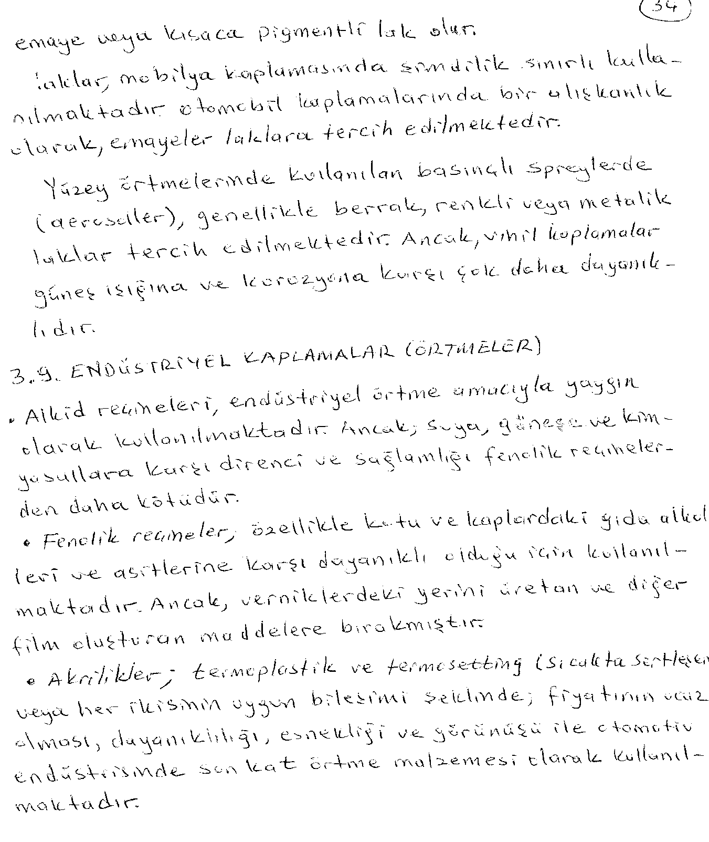

Slide 19
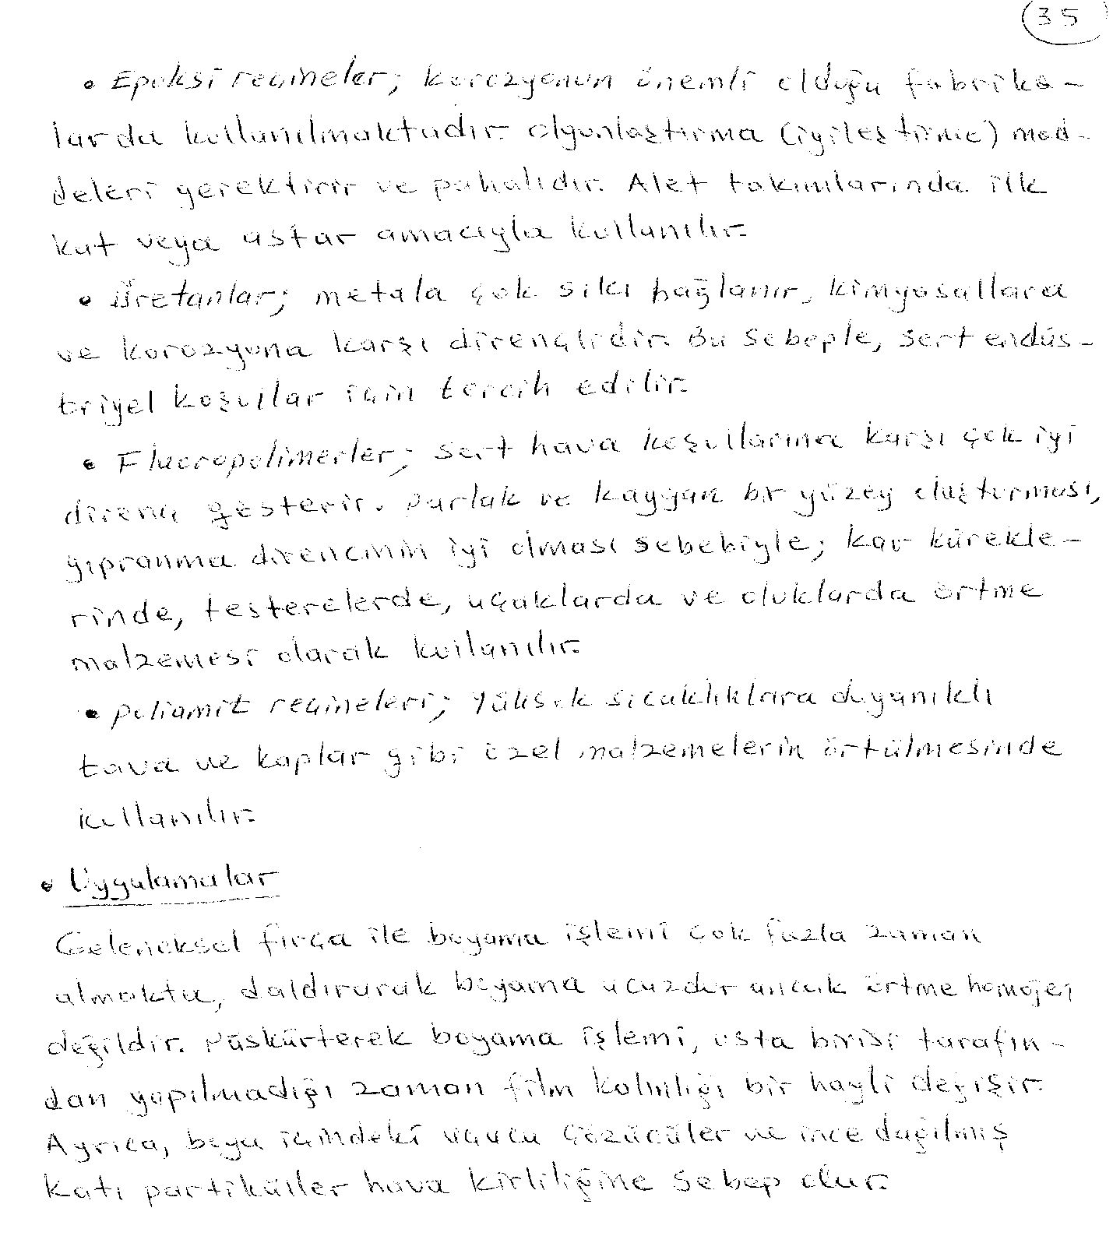

Slide 20
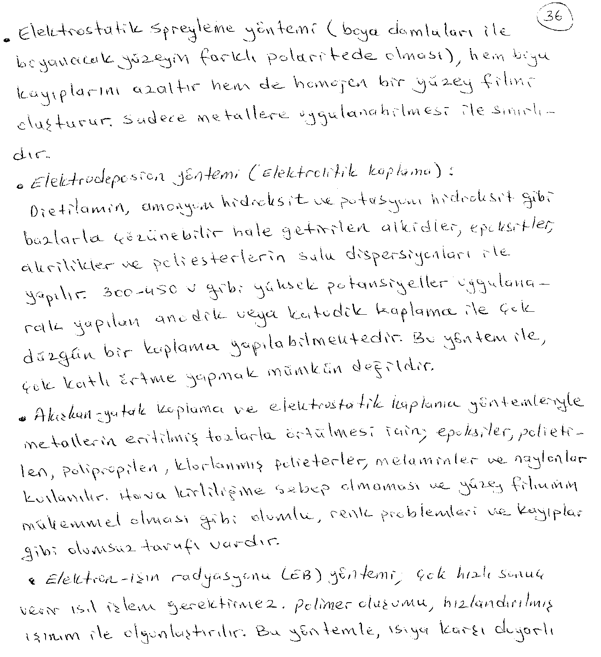

Slide 21
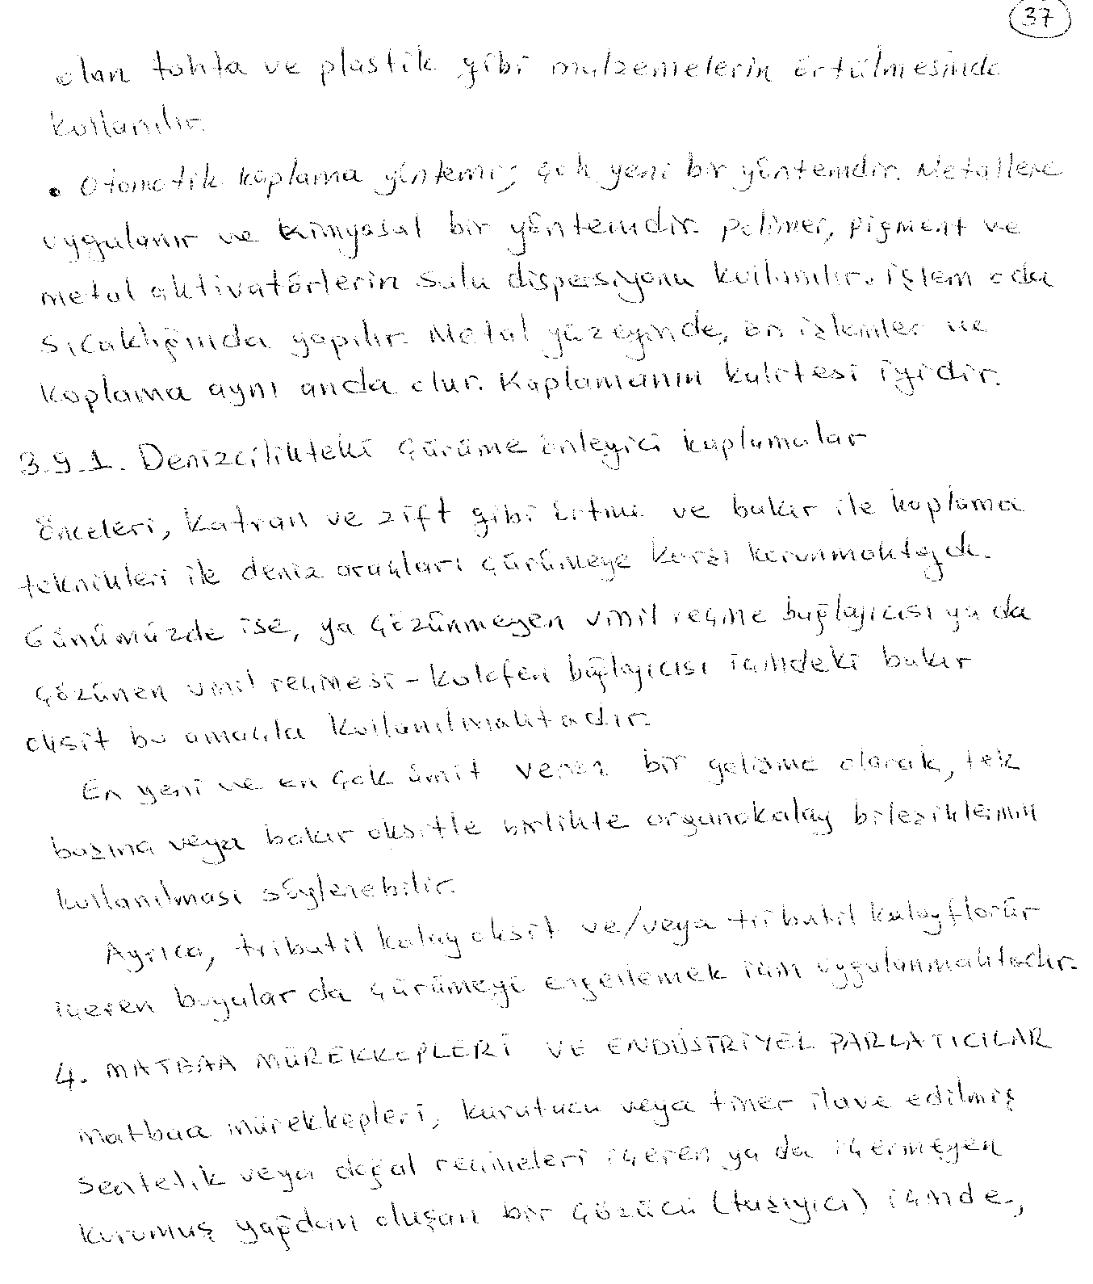

Slide 22
