Slide 1
DRUG INTERACTIONS Finerenone&Erytromycin
Merve Tanrıverdi-15030161

Slide 2
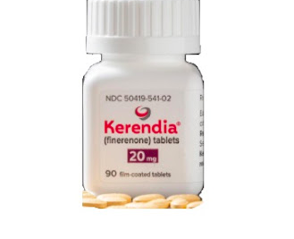
FINERENONE (Brand name: Kerendia)
Finerenone is a third generation, non-steroidal mineralocorticoid receptor antagonist.
It is used to reduce the risk of kidney function decline, kidney failure, cardiovascular death, non-fatal heart attacks, and hospitalization for heart failure in adults with chronic kidney disease associated with type 2 diabetes.

Slide 3
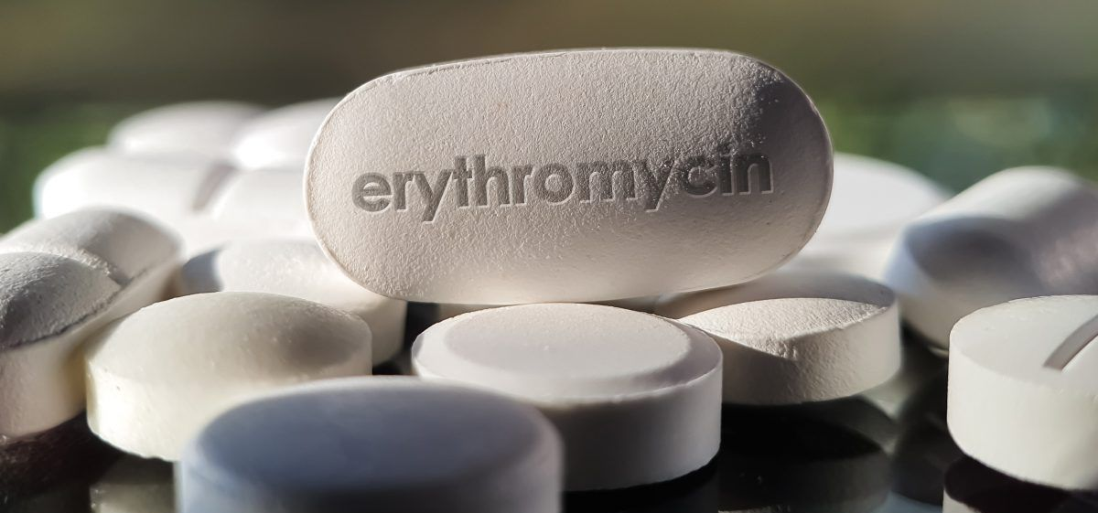
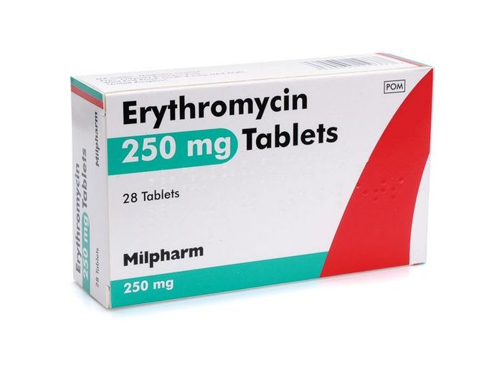
ERYTROMYCIN (Brand name: Erythrocin)
Erythromycin is one of the macrolide antibiotics that metabolized by enzymes of the cytochrome P450 system, in particular, by isozymes of the CYP3A superfamily.
It is used for the treatment of a number of bacterial infections.

Slide 4
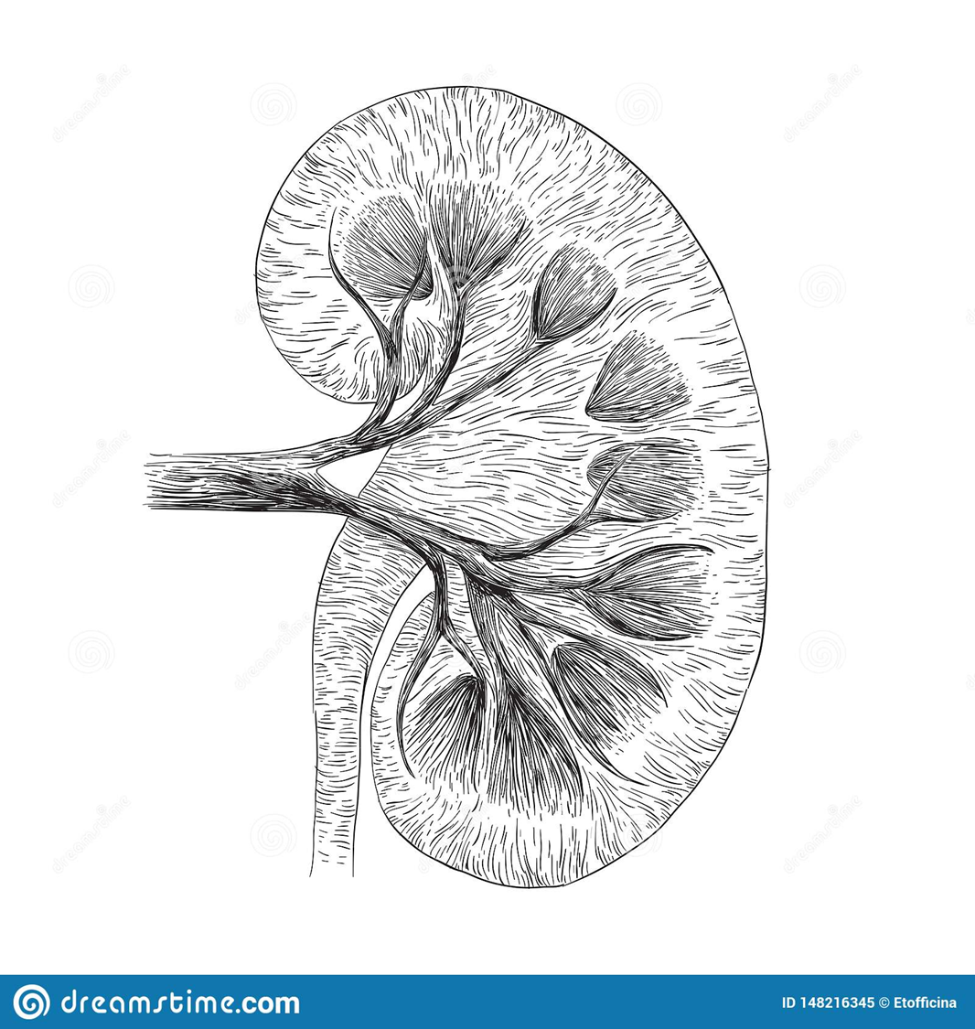
Interaction
Drug interaction studies demonstrated that concomitant use of erythromycin (moderate CYP450 3A4 inhibitor) increased finerenone mean systemic exposure and peak plasma concentration.
High exposure to finerenone may potentiate the risk of hyperkalemia, and the risk may be further increased with decreasing kidney function and higher baseline potassium levels.
Using erytromycin and finerenone together can increase the risk of serious side effects including hyperkalemia (high blood potassium), which in severe cases can lead to kidney failure, muscle paralysis, irregular heart rhythm, and cardiac arrest.

Slide 5
Management
Serum potassium and renal function should be monitored throughout treatment with finerenone, particularly during drug initiation or dosage adjustment of either finerenone or the CYP450 3A4 inhibitor, and the finerenone dosage adjusted as appropriate in accordance with the product label.

Slide 6
References
drugs.com
wikipedia.com
Google scholar
ascpt.onlinelibrary.wiley.com

