Slide 1
REPRODUCTIVE HERD HEALTH
Prof.Dr. Şükrü Küplülü

Slide 2
The Effect of Herd Management on
Fertility in Dairy Cows

Slide 3
The aim of dairy cows is to make a profit
Incomes
Milk production
Breeding production
Outcomes
Establishment of the facility
Animal supply
Equipment
Nutrition costs
Veterinary Medicine
Staff
Depreciation
NOTE: If the income exceeds the expenses, the enterprise may survive!

Slide 4
For success in cattle: herd management is important
Good planning
Animal selection with high genetic capacity
Well-trained staff
Effective health programs (preventive medicine-vaccination)
Recording system (Inputs, cost and especially fertility parameters)
Implementation of fertility control programs (Individual and Collective Approaches)
7. Nutrition (accurate and cheap)

Slide 5
Combined cost
Accountability is important for profitability
(Anonim 6, 2017)

Slide 6
Measures against costs
PRECAUTIONS TAKEN BY THE BREEDER
Selection
* Keeping the animals with high milk yield in the herd
Keeping animals of high genetic capacity in flock
PRECAUTIONS
The use of adipose tissue as an energy source in milk yield
Stop reproductive activities
NOTE: * These two parameters are antagonists of each other.
* NEB

Slide 7
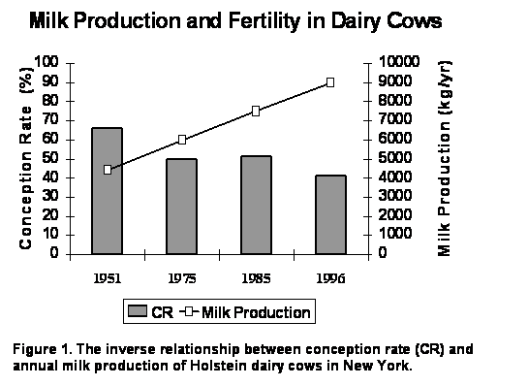
Relationship Between Milk Yield and Fertility (USA)
NOTE: Fertility decreases while milk yield increases.
Heifers have high fertility rate at first insemination

Slide 8
The Relationship Between Milk Yield and Fertility
Cows Survival Rates and Birth Intervals in North-East America in 1957-2002
(Oltenacu ve Broom, 2010)

Slide 9
main purpose in cattle breeding
1 year
Healthy mother
A viable calf

Slide 10
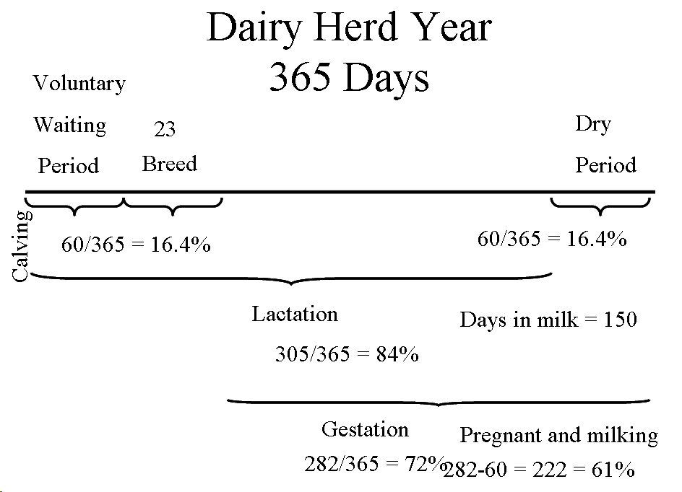
1 YEAR OF MILK COW
Postpartum process
Uterine regeneration
Ovarium activity +
Lactation
Dry period
Milk secretion
Calf growth
Insemination
DOĞUM
Lactation
Pregnancy
Pregnancy and Lactation
282/365 = % 72
282-60=222= % 61

Slide 11
Reproductive parameters
Calving interval | 1 year
Calving-first estrus | 21-24 days
Calving-First insemination | < 60.0-65.0 days
Pregnancy rate in inseminated cows | > % 60-65
Insemination Index (number of pregnancy / insemination) | < 1.6
Calving-conception interval | < 80-82 days
Accepting mating | > 70-80
Determination of oestrus | > % 85-90
NOT: Bu parametreleri yakalamak çoğu zaman zordur

Slide 12
Diseases that need to be strictly monitored for fertility
Brucellosis -
Tuberculosis -
BVD-MD -
IBR -
Neospora caninum -
leucosis -
It is unnecessary to evaluate fertility parameters in herds with these diseases.

Slide 13
Body Condition Score and Fertility
Back, waist and sacrum
subcutaneous fat thickness
 | Target. BCS
Far off | 3- 3,50
Close up | 3,25
Eearly lactation | 3
(Anonim, 2017; Vince ve ark; 2017)

Slide 14
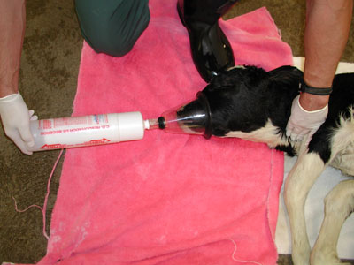
BCS and Immunity
Immunosuppression occurs in fatty cows
CALF SEPTEMIA
Good ones Ig high interferon g high
High BCS I g low interferon g low

Slide 15
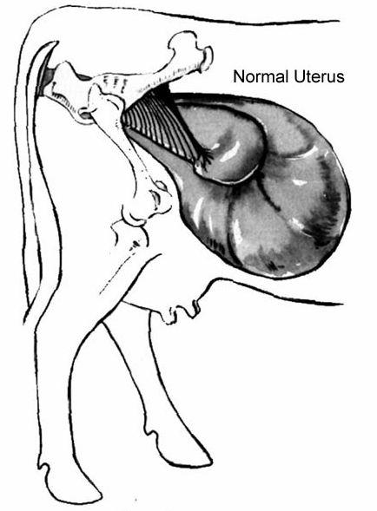
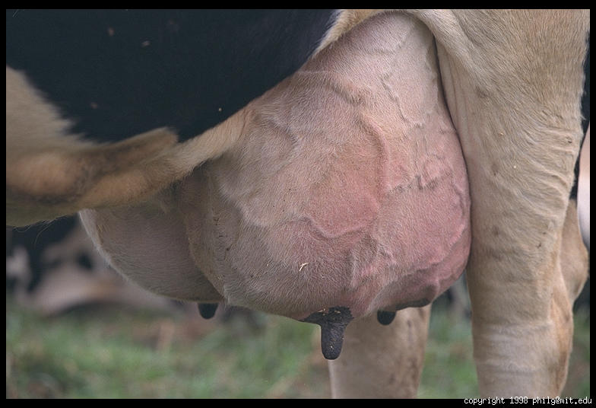
Energy requirement in periparturient period
Parturition
Intrauterin calf growth
BIOLOGICAL ACTIVITIES AND GROWTH
COLOSTRUM
MILK PRODUCTION
2 Weeks
7 Weeks

Slide 16
Body Condition Score and Fertility (Practical Indicator of Energy Balance)
Nutrition is the key to fertility.
The indicator of nutrition is VKS.
Commercial enterprises should have an animal nutritionist.
Nutrition strategy should be established.
(Rodenburg, 2016; Anonim 11, 2015)

Slide 17
PRACTICAL APPROACHES TO FERTILITY CONTROL ON FARM BASE
Check vaccination and antiparasitic applications
Are there any measures to prevent infertility? (Brucellosis, Tuberculosis, IBR etc.)
Check fertility control parameters
Evaluate abortion and cut rates
See the general hygienic structure of the farm
Evaluate Energy Balance and BCS (Grouping by BCS)
7. Check the age distribution of the flock

