Slide 1
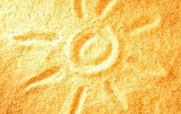
İKLİM TASARIM KENTSEL MİKROKLİMA VE KENTSEL TASARIM
SICAKLIK
Prof. Dr. Şükran Şahin, Ankara Üniversitesi
Mayıs 2022

Slide 2
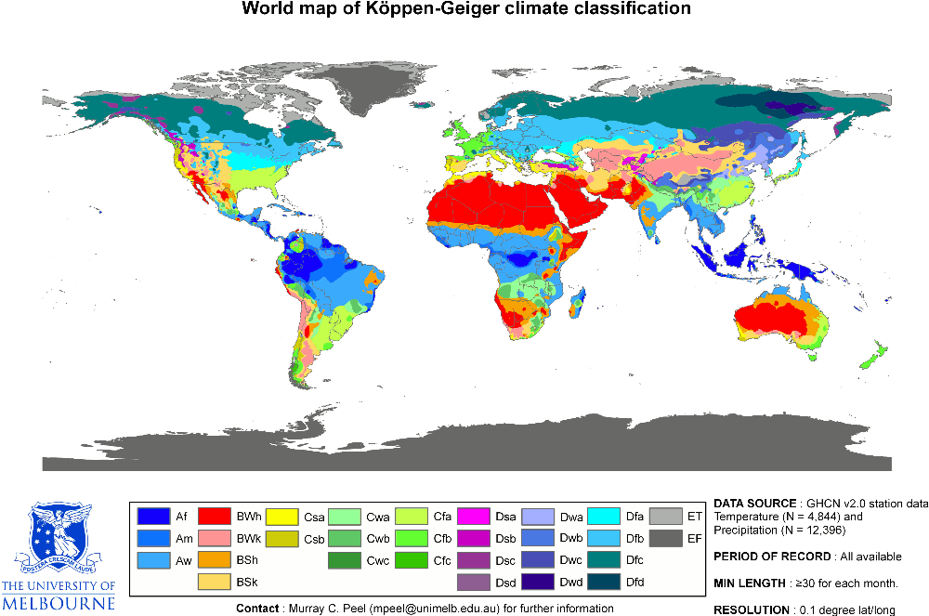
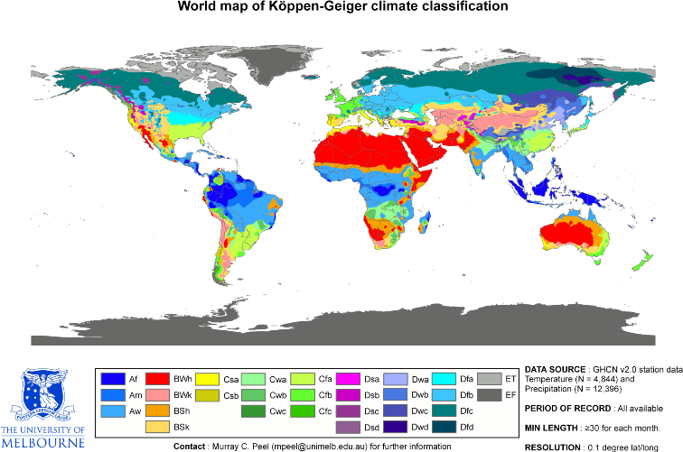

Slide 3
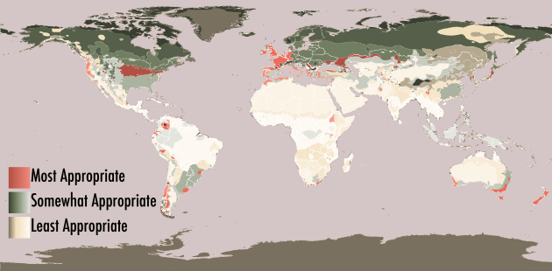
Somewhat appropriate, where we would be comfortable in at least one city within the classification area; and Least Appropriate, where at least one of us would not be comfortable. When broken down into these categories, the map now looks like this:

Slide 4
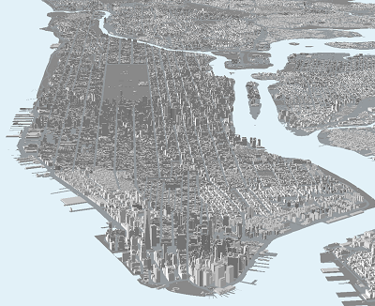
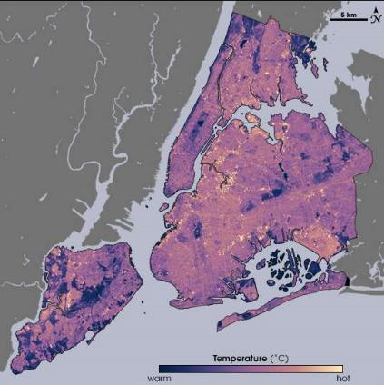
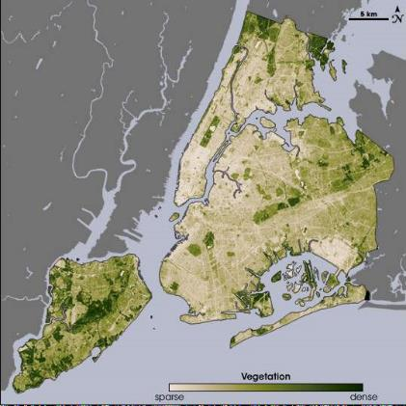
New York Kenti
14 Ağustos 2002
Kentsel bitki örtüsünün serinletici etkisi
Thermal infrared satellite data measured by NASA on one of the hottest days in New York City’s summer NASA Earth Observatory, August 14, 2002.
https://www1.nyc.gov/assets/dep/downloads/pdf/environment/education/10-analyzing-urban-heat-island-effect.pdf
Notes:
Vegetative surfaces perform a service known as evapotranspiration, which helps to cool surrounding areas. “Trees and vegetation absorb water through their roots and emit it through their leaves—this movement of water is called ‘transpiration’... Evaporation, the conversion of water from a liquid to a gas, also occurs from the soil around vegetation and from trees and vegetation as they intercept rainfall on leaves and other surfaces. Together, these processes are referred to as evapotranspiration. Evapotranspiration cools the air by using heat from the air to evaporate water.”
Evapotranspiration, alone or in combination with shading, can help reduce peak summer temperatures by 2–9°F (1–5°C).^{2,3}
2. Huang, J., H. Akbari, and H. Taha. 1990. The Wind-Shielding and Shading Effects of Trees on Residential Heating and Cooling Requirements. ASHRAE Winter Meeting, American Society of Heating, Refrigerating and Air-Conditioning Engineers. Atlanta, Georgia.
3. Kurn, D., S. Bretz, B. Huang, and H. Akbari. 1994. The Potential for Reducing Urban Air Temperatures and Energy Consumption through Vegetative Cooling (PDF)Exit Exit EPA website (31 pp, 1.76MB). ACEEE Summer Study on Energy Efficiency in Buildings, American Council for an Energy Efficient Economy. Pacific Grove, California.

Slide 5
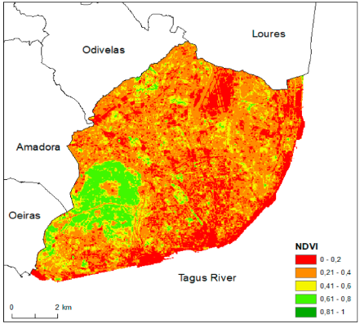
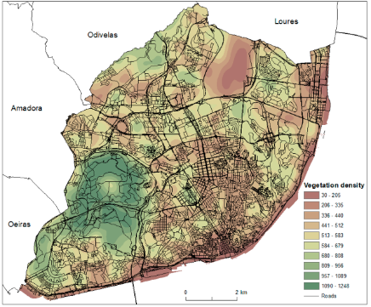
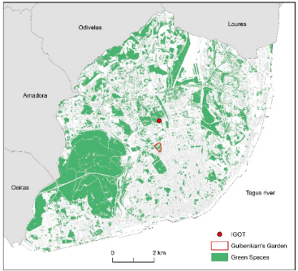
Biyokütle hesabı
Bitki yoğunluğu hesabı
Re,s and Lopez, 2019)

Slide 6
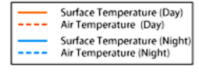
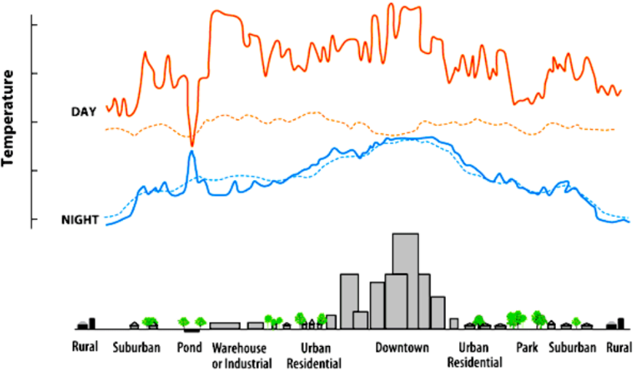
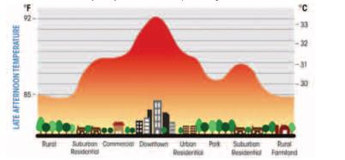
Kentsel Isı Adası Nedir?
Notes:
As urban areas develop, changes occur in their landscape. Buildings, roads, and other infrastructure replace open land and vegetation. Surfaces that were once permeable and moist become impermeable and dry. These changes cause urban regions to become warmer than their rural surroundings, forming an "island" of higher temperatures in the landscape.

Slide 7
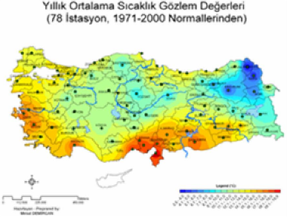
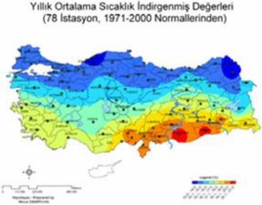
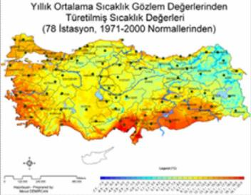
LAPSE RATE YÜKSEKLİK UYARLANMIŞ SICAKLIK HARİTASI
1
T1-(H2-H1)/200
T1: Bilinen yükseklikteki bilinen sıcaklık
H1: Sıcaklık değeribilinen yükseklik
H2: Sıcaklık değeri aranan yükseklik
2

Slide 8
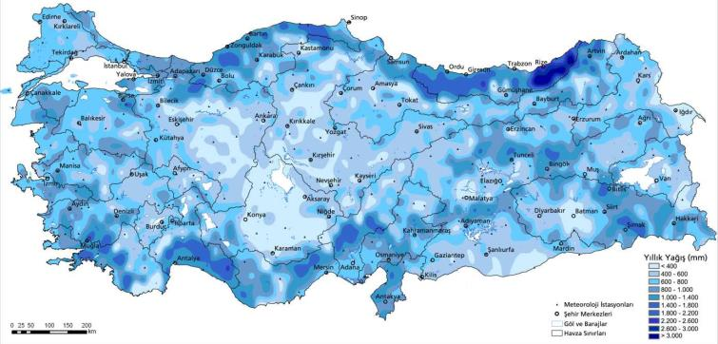
EĞİM UYARLANMIŞ YAĞIŞ HARİTASI

Slide 9
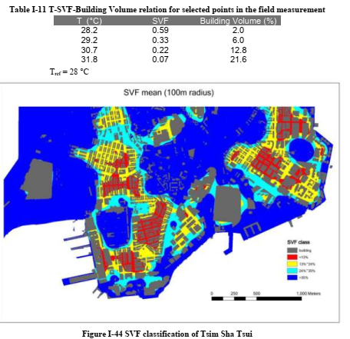
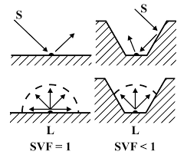
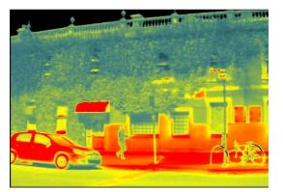
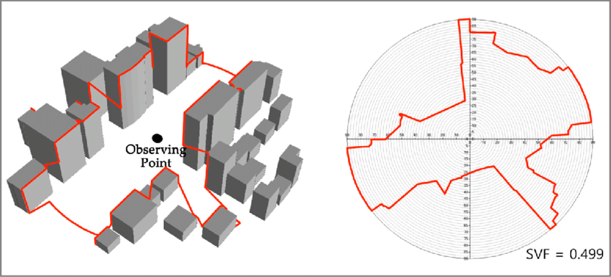
CADDE KANYONUNDA Y/G VE GGF
1
2
https://www.researchgate.net/figure/Skyline-graph-and-sky-view-factor-calculation-in-ArcGIS_fig2_318823667
Notes:
Sky View Factor (SVF) is a measure of the degree to which the sky is obscured by the surroundings for a given point. In urban climatology, it is mainly used to characterise the geometry of urban canyons in urban climatology. Its value is a ratio ranging from zero to one. When obstacles fully block the sky, the factor is zero. When the sky is completely visible, the factor is one.

Slide 10
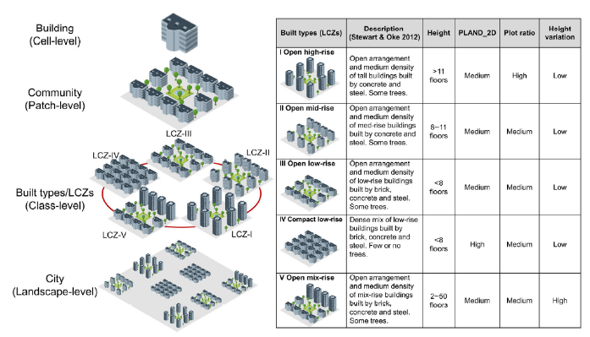
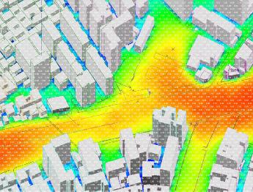
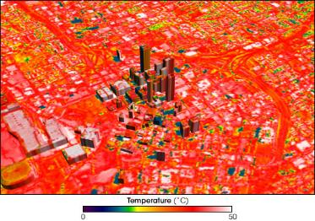
Sıcaklığı etkileyen kentsel peyzaj karakteri
?
http://www.marcuswhite.com.au/cool-city-design-integrating-real-time-urban-canyon-assessment-into-the-design-process-for-chinese-and-australian-cities/
https://earthobservatory.nasa.gov/features/GreenRoof
Notes:
On May 11-12, 1997, NASA used a specially outfitted Lear Jet to collect thermal data on metropolitan Atlanta, Georgia. Nicknamed “Hot-Lanta” by some of its residents, the city saw daytime air temperatures of only about 26.7 degrees Celsius (80 degrees Fahrenheit) on those days, but some of its surface temperatures soared to 47.8 degrees Celsius (118 degrees Fahrenheit). In this image, blue shows cool temperatures and red shows warm temperatures. Pockets of especially hot temperatures appear in white. (Image courtesy NASA/Goddard Space Flight Center Scientific Visualization Studio.) https://earthobservatory.nasa.gov/features/GreenRoof

Slide 11
KENTSEL PEYZAJ KARAKTERİ TEMELİNDE LEFKOŞA İKLİMİ
http://www.marcuswhite.com.au/cool-city-design-integrating-real-time-urban-canyon-assessment-into-the-design-process-for-chinese-and-australian-cities/

Slide 12
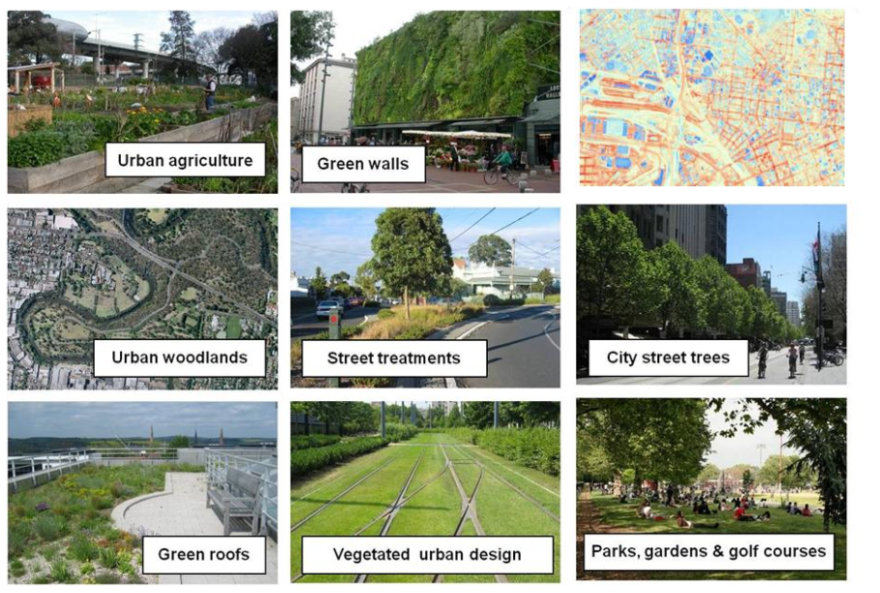

Slide 13
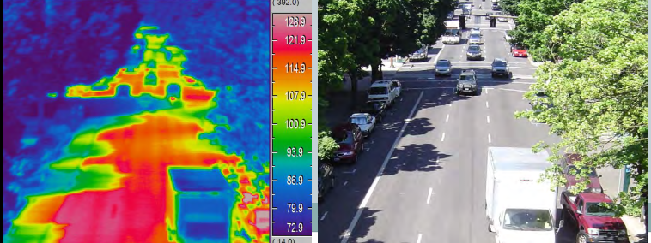

Slide 14
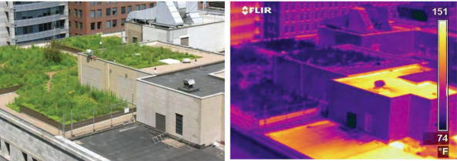

Slide 15
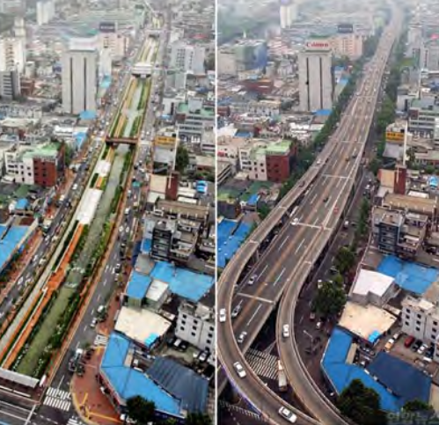
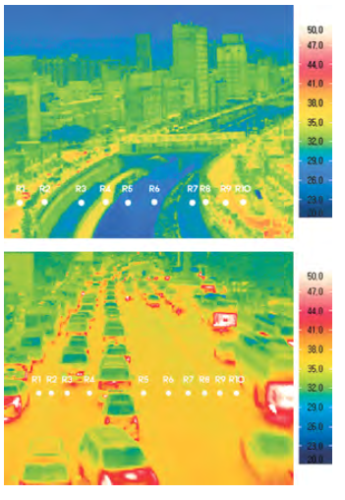

Slide 16
What Can Be Done?
Communities can take a number of steps to reduce the heat island effect, using four main strategies:
increasing tree and vegetative cover
creating green roofs (also called "rooftop gardens" or "eco-roofs")
using cool or green pavements
installing cool or reflective roofs

Slide 17
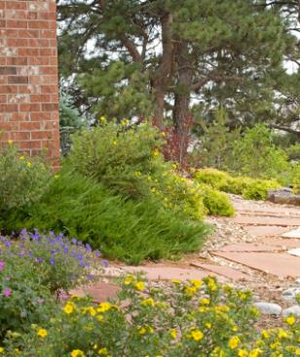
Xeriscape
Landscaping philosophy that seeks to minimize the need for water.
1. Proper planning and design
2. Soil analysis / improvements
3. Appropriate plant selection
4. Practical turf areas
5. Efficient irrigation
6. Use of mulches
7. Appropriate maintenance
Xeriscape in Colorado
Notes:
The xeriscape landscaping in the picture uses several species of hardy native plants that use little water.

Slide 18
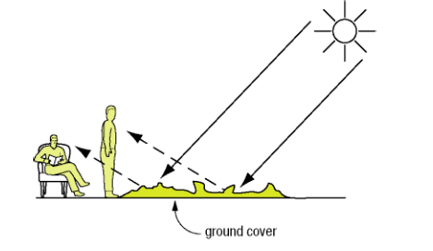
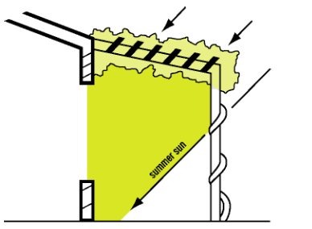
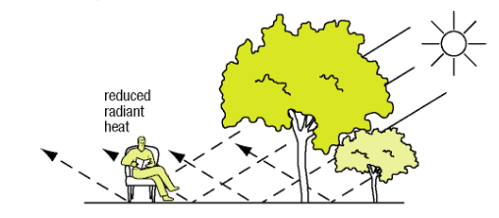
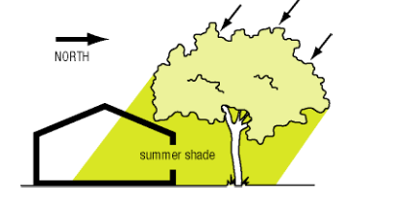

Slide 19
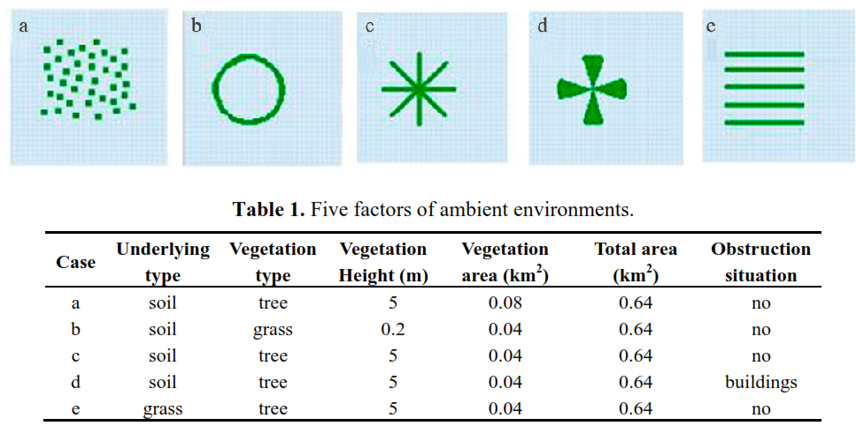

Slide 20
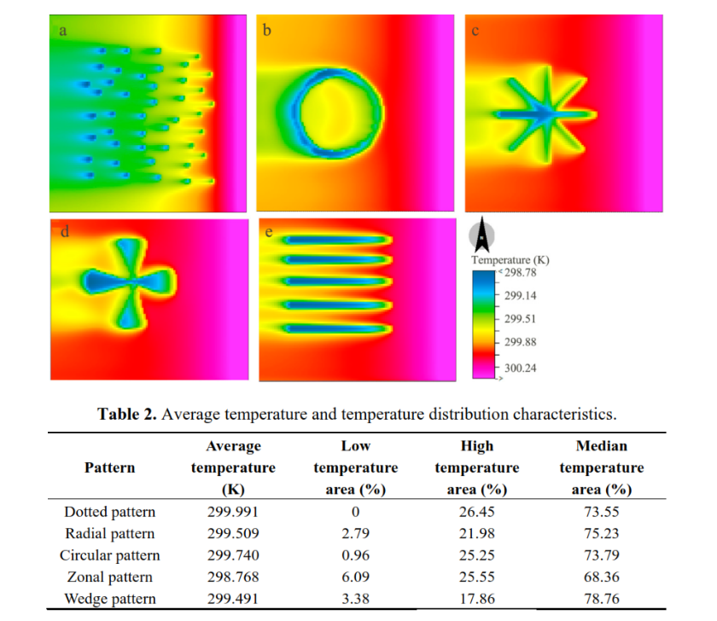

Slide 21
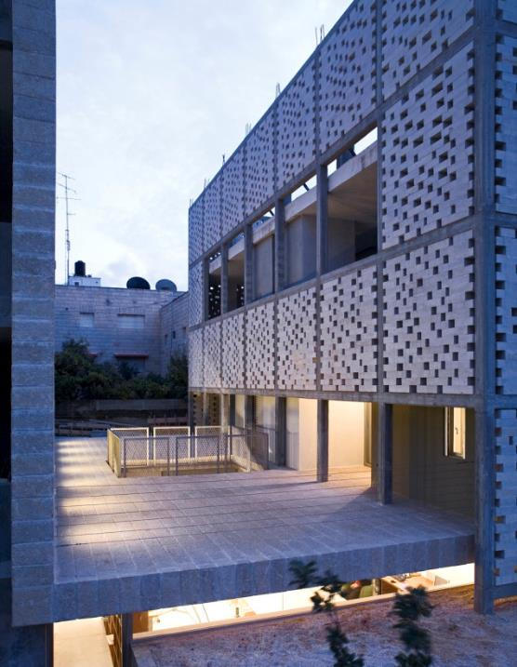
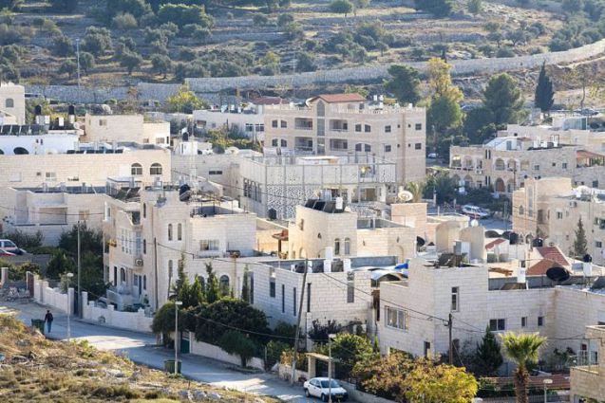
MASHRABIYA

Slide 22
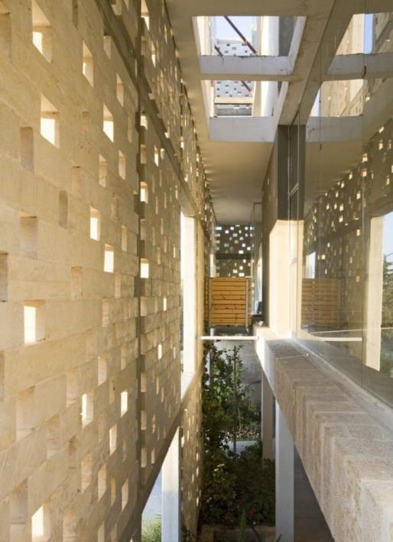
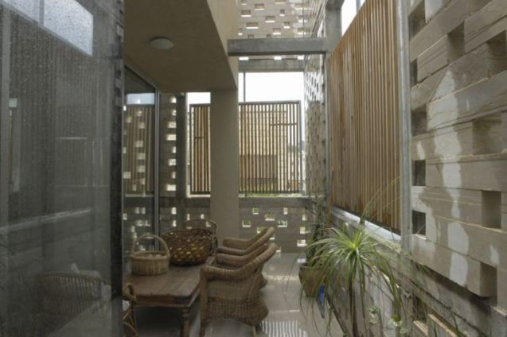

Slide 23
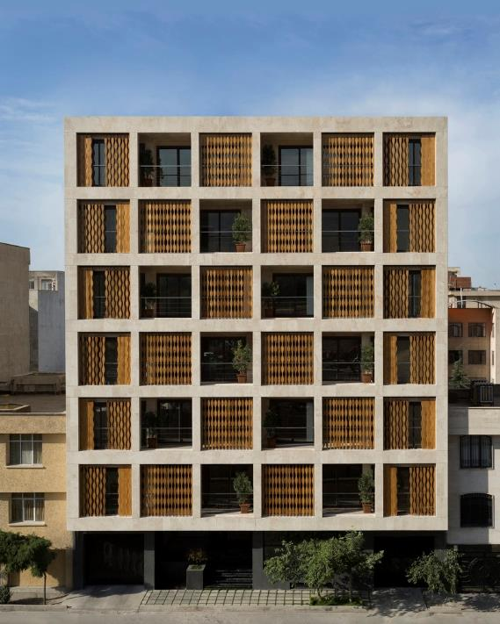
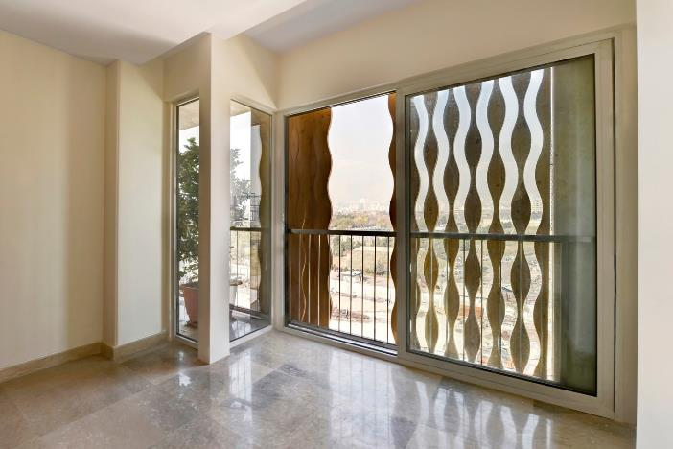
https://www.archdaily.com/780836/the-saba-apartment-sara-kalantary-plus-reza-sayadian/56a23e9ce58ecef0b1000002-the-saba-apartment-sara-kalantary-plus-reza-sayadian-photo?next_project=no

Slide 24
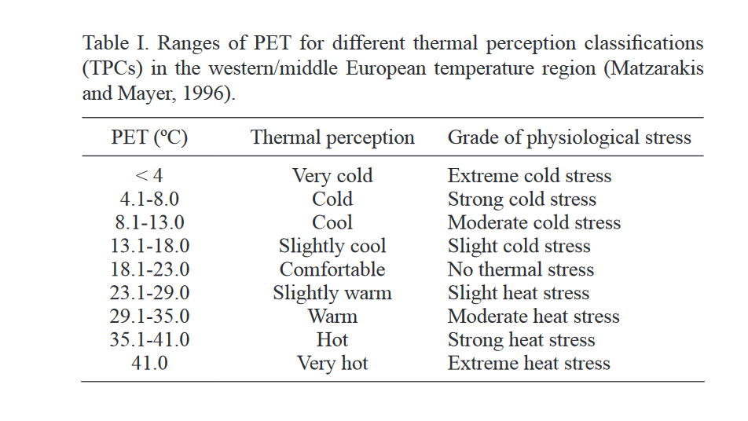
http://www.scielo.org.mx/pdf/atm/v30n4/0187-6236-atm-30-04-355.pdf

Slide 25
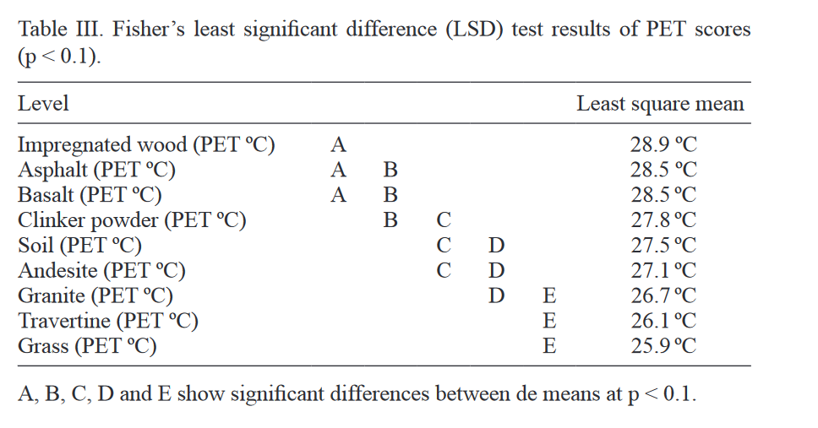
http://www.scielo.org.mx/pdf/atm/v30n4/0187-6236-atm-30-04-355.pdf

