Slide 1
Nucleic Acids Delivery Systems: A Challenge for Pharmaceutical Technologists
Merve BAŞKAN
Selin İLHAN
Songül KARSU
Melike B. URHAL

Slide 2
The clinical procedures with Nucleic Acids:
Gene Therapy
Antisense Oligonucleotide Therapy
Aptamer Therapy

Slide 3
GENE THERAPY
It is based on the substitution or addition of a functional gene into the nucleus of a living cell to treat a disease of repair a dysfunction, caused by this gene failure.
Gene Therapy Treatment Steps:
Administration
Delivery
Expression

Slide 4
GENE THERAPY
Germ Line Therapy
Somatic Gene Therapy
The transferring the functional gene into germ cells
Pass through generations
Functional gene is introduced only in specific target somatic cells
Not transmission of hereditary to the next generations

Slide 5
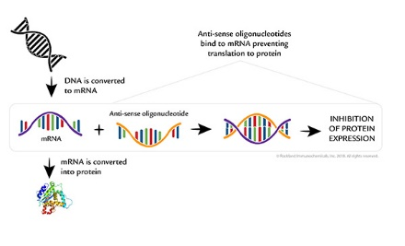
ANTISENSE OLIGONUCLEOTIDE THERAPY
It is based on using the block protein function as a drug molecular mechanism for treating diseases.
The Mechanism of Antisense Oligonucleotide Therapy
Figure 1: https://rockland-inc.com/anti-oligonucleotide-antibodies.aspx

Slide 6
APTAMER THERAPY
Aptamer: The oligonucleotide or peptide molecules that bind to a specific target molecule such as protein or nucleic acid.
Aptamers can be used for detection, isolation and targeting of specific molecules.
They can easily synthesized and chemically modified, improving their in vivo stability.

Slide 7
LIMITATION OF NUCLEIC ACIDS DELIVERY
NA alone not enter easily in the cell nucleus because of their molecular characteristics such as hydrophilicity, negative charge and large size.
DNA and RNA molecules must cross the physiological barriers before reaching the cell and are susceptible to extra and intracellular enzymatic degradations.
Therefore, new delivery systems that improve the NA nucleus cell targeting was developed such as viral and non-viral vectors.

Slide 8
NUCLEIC ACID (NA) DELIVERY SYSTEMS
NA can be delivered to patients by either ex vivo and in vivo.
NA delivery systems are classified viral and non-viral vectors as table.

Slide 9
VIRAL VECTORS
Viral vectors are the most efficient vehicles for NA transfer because of their ability to infect a large number of cells. Because viruses have evolved natural mechanisms to deliver their genetic material into cells.
Viral vectors consist of viruses that are modified to be replication-incompetent, but can deliver NA into cells.

Slide 10
Converting a Virus into a Vector
To produce a viral vector, the genes and cis-acting sequences should be separated into distinct NA molecules, to prevent their reconstitution in productive viral particles and to allow the maintenance of the efficacy and safety of the system.
An ideal NA delivery vector should have;
High specificity
Efficient NA delivering
Unrecognized by the immune system
Ability to be purified in high concentrations
Safe for the patient and the environment
Express the gene during the required period

Slide 11
Main classes of viral vectors commonly used for NA delivery
According to whether their genomes integrate into host cellular chromatin;
Retrovirus
Lentiviruses
According to persist in the cell nucleus as extra-chromosomal episomes
Adenovirus
Adeno-associated virus
Herpes simplex virus

Slide 12
Retrovirus
RNA-based vectors
Reverse transcription
To comprise a capsid and an envelope protein containing a lipid bilayer
https://www.genome.gov/genetics-glossary/Retrovirus

Slide 13
Retroviruses contains three major coding segments;
Gag: codes for core viral protein
Pol: codes for reverse transcriptase
Env: codes for viral envelope proteins
At either end of the viral genome are the long terminal repeat (LTR) sequences.
Clark D., Pazdernik N., Inherited Defects and Gene Therapy , Biotechnology (2016), P. 523-564.

Slide 14
Advantages and Disadvantages of Retrovirus
Disadvantages
Poor stability to transport NA
Risk of damaged during purification and concentration
Low carrying capacity
Inability to infect non-dividing cells
Possible insertional mutagenesis by random viral integration into the host DNA.
Advantages
Stable integration into the host genome
Generation of viral titres enough for efficient gene transfer
Ability to infect several different cell types
Capacity to transport foreign genes of reasonable sizes

Slide 15
Retroviruses are used;
Gene therapy
Suicide genes for eradication of tumors
Repairing of bone tissue
Hereditary diseases

Slide 16
Lentivirus
Subcategory of the retrovirus family
Capable of infecting non-dividing cells
They have two additional genes (tat and rev) and four accessory genes (vif, vpu, nif, vpr).

Slide 17
Advantages of Lentivirus
Long-term transgene expression
Low immunogenicity
Accommodate larger transgenes
Natural integration ability
Lentiviruses are used;
Central nervous system gene delivery
Gene therapy

Slide 18
Adenovirus
Contain a linear, double-stranded DNA genome
Package within a non-enveloped icosohedral capsid.
Adenovirus type 2 and type 5 of subgroup C have been extensively studied.
https://www.forbes.com/sites/brucelee/2018/10/25/what-is-adenovirus-the-virus-that-has-left-7-kids-dead/#5d36863c18d0

Slide 19
http://signagen.com/Introduction-to-Adenovirus

Slide 20
Advantages and Disadvantages of Adenovirus
Disadvantages
The duration of gene expression is limited
Elicit both, an innate and an acquired immune response
Advantages
Retain only cis-acting elements essential for virus packaging
Easily purified at high concentrations
Can infect a wide range of dividing and non-dividing cells.

Slide 21
Adenoviruses are used;
Gene therapy of cystic fibrosis
In vivo approaches
Treating peripheral vascular diseases
Treating coronary artery diseases
Provides antitumor activity

Slide 22
Adeno-associated Virus
Small, non-enveloped, linear single stranded DNA virus.
This virus is replication-defective and to replicate within a host cell nucleus needs a helper virus.
Adeno-associated virus genome consists of only two genes;
Rep: encoding for polypeptide replication
Cap: encoding for polypeptide capsulation
Grinevich V., Roth L.C., Knobloch H.S., Althammer F., (2016). Somatic transgenesis (Viral vectors). 243-274.

Slide 23
Advantages and Disadvantages of Adeno-associated Virus
Disadvantages
Small capacity for insertion of transgenes
Advantages
Non-pathogenic
Non-immunogenic
Infect wide variety of dividing and non-dividing cells
Found in human population but they do not appear to be associated with any disease.

Slide 24
Adeno-associated Viruses are used;
in vitro and in vivo gene transfer into muscle, brain, neurons and liver cells

Slide 25
Herpes simplex Virus
Double-stranded DNA virus
They have the ability to infect cells of the nervous system.
Herpes simplev viruses are used;
Gene vehicles for disorders such as pain, neuropathy, and other neurodegenerative diseases

Slide 26
Advantages and Disadvantages of Herpes Simplex Virus
Disadvantages
The need of much additional engineering to be efficient
Gene expression appears to be transient
Low transduction efficiency
Advantages
Large packaging capacity for transgenes
Highly infectious capacity
Virus receptors are widely expressed on the surface of numerous cell types
Recombinant virus can be easily produced to high titer and purity

Slide 27
Poxvirus and Other Viral Vectors
Poxvirus are large complex enveloped viruses with an enveloped double-stranded DNA genome.
Vaccinia virus, which has a critical role in eradication of smallpox, is included in the orthopoxvirus sub-family.
Among others, alphavirus, human cytomegalovirus, influenza virus, and foamy virus have also been used to engineer vectors with feasible insertion capacities, expression efficiencies and cell tropism of viral infection.

Slide 28
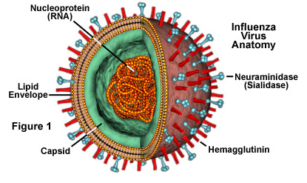
https://cronodon.com/BioTech/Poxvirus.html
The University of Chicago. Cytomegalovirus (CMV). https://pedclerk.bsd.uchicago.edu/page/cytomegalovirus-cmv (accessed 26 Nov 2019).
http://www.dengetip.com/h1n1-ve-influenza-virusleri/

Slide 29
Advantages of Poxvirus
Safety in humans
Ease of production
Stability of virus production
Feasibility of genetic manipulation for transgene expression

Slide 30
Hybrid or Chimeric Vectors
Hybrid vectors are generated by taking the best characteristics of different viruses to overcome the inherent limitations of viral vectors.
Hybrid or Chimeric Vectors are used ;
Gene transfer
Gene therapy
https://www.mdpi.com/1999-4915/1/3/1295

Slide 31
Hybrid Vectors are produced for;
To target specific tissues or cell types
To accommodate large transgenes and regulatory elements
To achieve stable and regulated transgene expression
To retain high transduction efficiency and titers
Minimizing undesired toxicity or immune responses.

Slide 32
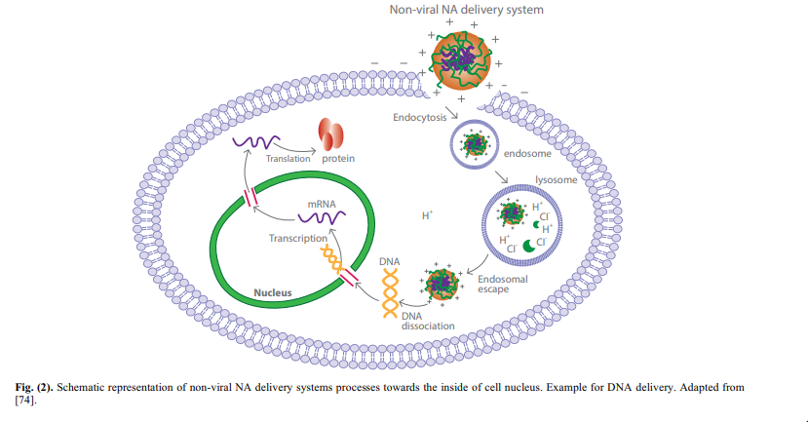
Non-Viral Nucleic Acids
Delivery System
Notes:
*The non-viral strategies for NA delivery can be divided in physical and chemical methods. Examples of physical methods are needle and jet injection, hydrodynamic, electroporation, sonoporation and gene gun.
*These techniques consist of applying a physical force that creates transient membrane holes/defects and facilitate NA transfer to the cell nucleus. According to the physical methods approach, NA are transferred to the cell nucleus without using any formulating strategy
*The figüre shows the processes required for the NA reaching the cell nucleus.
*To achieve the therapeutic target, non-viral NA delivery systems should firstly be internalized by cells, undertaking endocytosis and avoiding endosomal or lysosomal degradation. Afterwards, NA are released in the cytoplasm and entry in the cell nucleus, where the respective gene expression will be performed

Slide 33
Advantages of Non-Viral Delivery Systems
The absence of an immune response to the carrier
Their capacity to transport higher amounts of NA
High reproducibility
Acceptable chemical and physical stability
Possibility of surface modification
Targeting to specific cells or tissues
Notes:
*The use of non-viral delivery systems presents some advantages over the viral ones, such as the absence of an immune response to the carrier and their capacity to transport higher amounts of NA.
* In addition, the non-viral vectors usually present high reproducibility, acceptable chemical and physical stability, possibility of surface modification and targeting to specific cells or tissues

Slide 34
The most studied non-viral NA delivery systems are
Liposomes
Lipid nanoparticles
Polymeric nanoparticles
Micelles
Dendrimers

Slide 35
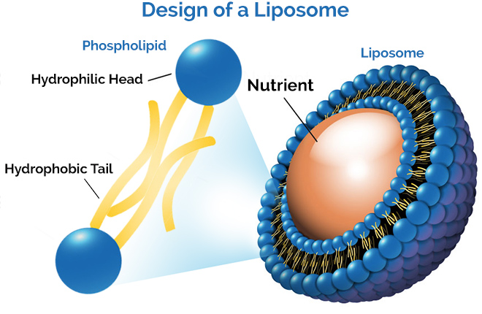
Liposomes
Notes:
*Liposomes are spherical vesicles composed by one or more phospholipid bilayers that surround an aqueous inner core.
*Phospholipids are natural components of living membrane cells, allowing for a low toxicity potential.
*These features make liposomes very attractive for controlling and targeting NA delivery to cell nucleus .

Slide 36
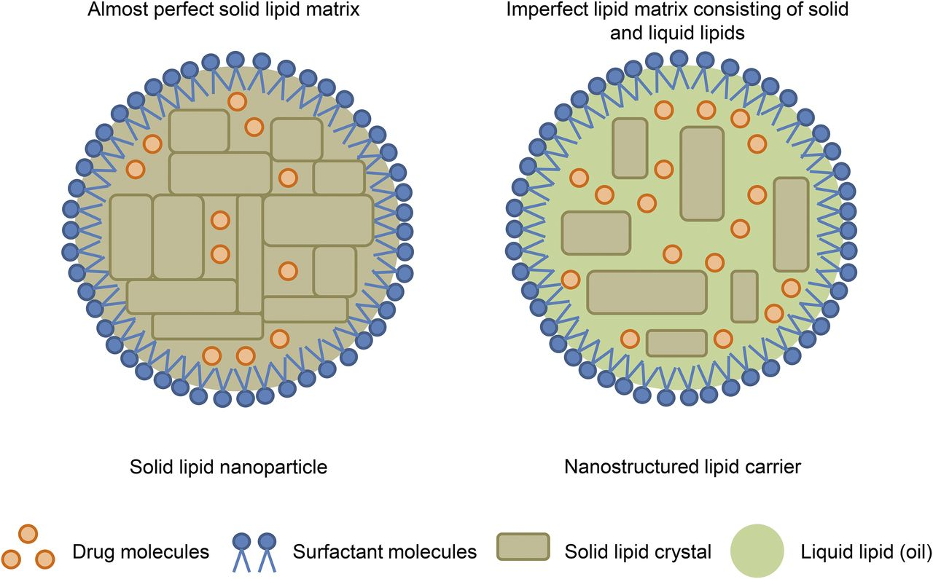
Lipid Nanoparticles
Low or non-appearance of toxicity, which is related with the use of physiological lipids and biocompatible surfactants to prepare the systems
Possibility of achieving drug controlled release and targeting effects
Drug protection against degradation
Good long-term stability
Notes:
*Lipid Nanoparticles have been claimed as superior and alternative carriers over other well-known colloidal carriers, such as liposomes and polymeric nanoparticles.
*Because they have some advantages such as low or non-appearance of toxicity, possibility of achieving drug controlled release and targeting effects, drug protection against degradation, good long-term stability .
*There are two generations of lipid nanoparticles, namely the solid lipid nanoparticles (SLN) and the nanostructured lipid carriers (NLC).
*Solid nanoparticles consist of a lipid that is solid at both body and room temperatures. In contrast, the NLC are composed by a mixture of a solid and a liquid lipid and were created to overcome some limitations observed for SLN

Slide 37
Polymeric Nanoparticles
Polymeric nanoparticles consist of colloidal carrier systems that can encapsulate either solid or liquid molecules.
Several advantages for drug delivery :
Good physicochemical stability,
Biocompatibility,
Biodegradability,
Low toxicity,
Low immunogenic response,
Sustained release mechanisms,
Easiness of production
Notes:
These systems presents several advantages such as

Slide 38
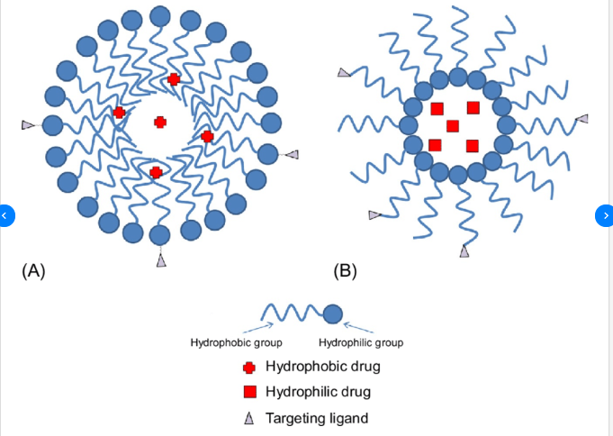
Micelles
The critical micelle concentration (CMC) is defined as the concentration of surfactants above which micelles form and all additional surfactants added to the system go to micelles
-amphylic.
-can be formed by polymers,
phospholipids or
by a mixture of both.
Schematic structures of
polymeric micelles:
(A) Typical micelle in a polar solvent and (B) reverse micelle in a nonpolar solvent.

Slide 39
DISADVANTAGES
limitations in their applications as drug carriers (e.g. toxicity, limited
number of polymers approved for clinical use) (phospholipid-based micelles have been referred as less or non-toxic,)
ADVANTAGES
for drug and NA transport over the colloidal carriers with higher size,
especially for intravenous administration
targeting purposes
allows for a prolonged blood circulation time, because they avoid elimination by the cells
of MPS.

Slide 40
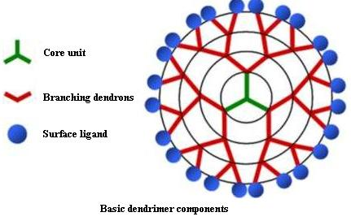
Dendrimers
Dendrimers are polymeric macromolecules with highly branched tri-dimensional structures that can host drug molecules or NA in different locals (nucleus, branches and surface)
small sizes (ranging from 1 to 100 nm) as an advantage....
a unique molecular weight and chemical structure
failure of their in vivo performance(ex:capture by the cells of the MPS)----->tailor made systems

Slide 42
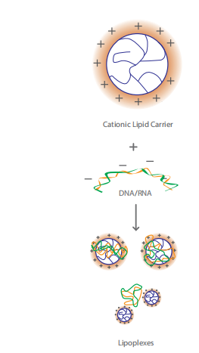
Lipoplexes
Cationic-lipid based vectors are used.(ex:liposomes/lipid nanoparticles)
By partially condensate with the negatively charged NA .
Amphiphilic lipids are the most explored
hydrophilic group can reduce transfection efficiency,
since it influences the binding capacity to the NA
Commercialy availablecationic lipids used in lipoplexes are DOTMA and DOTAP

Slide 43
DISADVANTAGES
Ineffective transfection efficiency,
the risk of potential cytotoxicity,
associated with inflammatory adverse
reactions and complement activation
ADVANTAGES
NA molecules are enclosed
( protected from enzymatic degradation, extracellular and intracellular nucleases.)
when formulated with a positive surface charge, lipoplex can direct the NA toward the target cells, by interacting with the negatively charged molecules of the surface mammalian cell membrane, . (Ex:glycoproteins , proteoglycans)

Slide 44
To improve the efficiency of lipoplexes:
In vivo NA transfer:Drawbacks common to the other non-viral vectors
lipoplexes could
also present structural instability and heterogeneity, inactivation in
blood and poor tissue targeting
--- In vivo distribution of plasmid DNA complexed to cationic liposomes,after intravenous
injection to mice.

Slide 45
Results:
the accumulation of lipoplexes in the
liver, the transgene expression in this organ is very low (bc of kupferr cells)
Arising from surface charge:
strong negative charge are usually scavenged by phagocytosis, while strong positive charge establish non-specific interactions(The stealth strategy will be applied)
rapid clearance from the systemic circulation

Slide 46
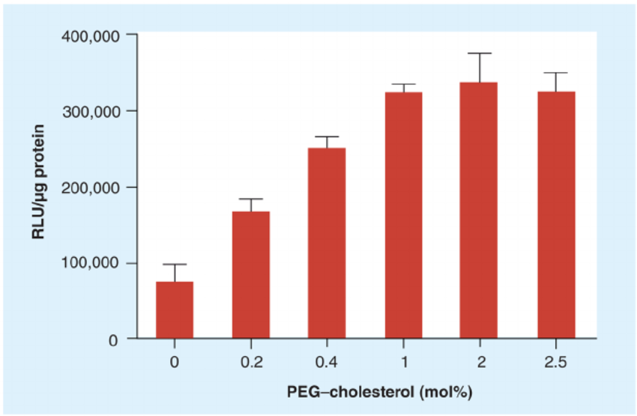
The Stealth Strategy
Effect of PEG–cholesterol concentration in lipoplexes with DOTAP/cholesterol on transfection
can increase the stability and minimize the non-specific uptake of lipoplexes
can increase their immunogenic properties and decrease the in vitro transfection efficiency, (bc of the electrostatic attraction)

Slide 47
The features affects the transfection efficiency;
-charge ratio (+/-)
- design of functional lipids
-using asymmetric lipids( lipids must disturb the biological membrane fluidity)
-size of lipoplexes(accurate size is still unknown)
for specific interaction, use of ligands (ex :small molecules, peptides or proteins, such as epidermal growth factor - EGF and antibodies) to improve the uptake selectivity of the vector into target cells
EGF--->in vivo level of gene expression

Slide 48
Other researches
1-Lipid-based small interfering RNA (siRNA) delivery device, called SAINTPEGarg
ability for the synthetic siRNA delivery and effective down-regulation of vascular endothelial (VE)-cadherin gene expression in vitro
In vitro and in vivo results are different, related
to the intracellular trafficking and processing in endothelial cells.
2-To provide both in vitro and in vivo effective level of NA; lipoplexes release their , in response to intracellular stimuli
Redox gradient explored to develop stimuli-responsive carriers for NA delivery.
.

Slide 49
3-The latter strategy,
ascorbic acid usage as a chemical reducing agent,
activates lipoplexes and mediating cell transfection.
4-Co-lipids, also called as helper lipids, have been used to improve the transfection efficiency of lipoplexes(Ex:DOPE ,DOPC)
The presences of DOPE allowed escaping from endosomal compartments and release DNA, (cationic effect)
while the DOTAP-DOPC/DNA lipoplex was largely degraded in the lysosomes.
--------------------------------------------------------------------------------------------------------

Slide 50
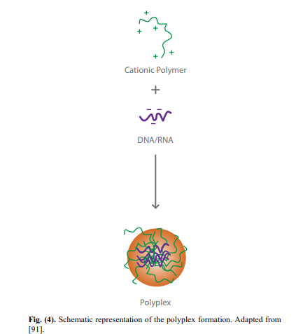
Polyplexes
Notes:
*Polymer-based NA delivery systems, usually called polyplexes, are complexes formed by electrostatic interactions between cationic polymers and NA.
*As can be seen in the figure, Polymers neutralize the negative charge of NA and concentrate it into smaller structures such as nanoparticles, micelles and dendrimers.

Slide 51
Several researchers worldwide have been studying different polyplex systems:
The efficacy for intracellular delivery of nanoparticle-based RNA polyplexes was demonstrated in a Phase I clinical trial.
The cytotoxicity and acute inflammation effects of nanoparticle-based polyplexes, which are responsible for the delivery of DNA to the cells were assessed after intravenous administration to mice.
Poly(2-hydroxyethyl methacrylate) with chitosan shell nanoparticle-based polyplexes were prepared, in order to be applied as a vehicle for DNA vaccines.
Micellar-based polyplexes were prepared for insulinlike growth factor-1 delivery, by means of hydrodynamic injection to mouse with sciatic nerve injury.
Notes:
The therapeutic goal of the study was to induce a specific gene inhibition in melanoma patients. From the results, a decrease in both specific RNA messenger and respective protein expressed, was observed for patients who received the highest doses of nanoparticles-based RNA polyplexes .
The results showed there was a body clearance of the polyplexes. Moreover, there was a lack of acute systemic inflammatory response or hepatic cytotoxicity effects. Accordingly, authors concluded that the prepared polyplexes are safe and effective systems for the treatment of Parkinson’s disease and cancer
The authors observed an in vitro enhancement of the DNA transcription for all the tested cell types. Furthermore, the prepared polyplexes effectively delivered the DNA vaccine(vaksin) into mouse skeletal muscles, after intramuscular administration
The results showed that the polyplexes provided a remarkable therapeutic effect for the treatment of peripheral nerve injury,

