Slide 1
SYMBOLISM
Symbolism refers to any use of symbols – something standing for its natural qualities in another context, with human meaning added.
e.g. Eagle symbolises power and dominance
Dove symbolises love and peace

Slide 2
The Sick Rose
BY WILLIAM BLAKE
O Rose thou art sick.
The invisible worm,
That flies in the night
In the howling storm:
Has found out thy bed
Of crimson joy:
And his dark secret love
Does thy life destroy.

Slide 3
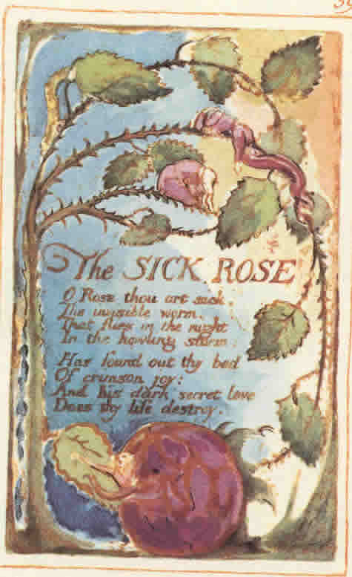

Slide 4
What figures of speech do you find in the poem in addition to symbol?

Slide 5
What are the possible symbolic meanings of the «night» and the «storm»?

Slide 6
The Road Not Taken by Robert Frost
Two roads diverged in a yellow wood,
And sorry I could not travel both
And be one traveler, long I stood
And looked down one as far as I could
To where it bent in the undergrowth;
Then took the other, as just as fair,
And having perhaps the better claim,
Because it was grassy and wanted wear;
Though as for that the passing there
Had worn them really about the same,

Slide 7
And both that morning equally lay
In leaves no step had trodden black.
Oh, I kept the first for another day!
Yet knowing how way leads on to way,
I doubted if I should ever come back.
I shall be telling this with a sigh
Somewhere ages and ages hence:
Two roads diverged in a wood, and I—
I took the one less traveled by,
And that has made all the difference.

Slide 8
What is the symbolic meaning of «two roads»?
Does the speaker feel that he has made the wrong choice in taking the road «less travelled by»? If not, why will he «sigh»?
Why will the choice between two roads that seem very much alike make such a difference?

Slide 9
ALLEGORY
Allegory means a story that suggests another story. An allegory is present in literature whenever it is clear that the author is saying, «By this I also mean that.» It refers to a work of art that has a hidden meaning that aims to teach a lesson, explain a difficult concept, or explore a historical or political situation.
E.g. Everyman is an allegorical play about every human being, and the characters (Fellowship, Goods, Good Deeds, etc.) that the protagonist interacts with symbolise what every human experiences in life.
E.g. Animal Farm by George Orwell (each of the characters representing some figure from the Russian revolution, The Lord of the Flies (an allegorical story about the conflict between good and evil) by William Golding

Slide 11
Paradox
A paradox is an apparent contradiction that is nevertheless somehow true. Its seeming impossibility startles the reader into attention and emphasises the truth of what is being said.
e.g. «To be natural is such a very difficult pose to keep up.» (from Oscar Wilde’s The Importance of Being Earnest)

Slide 12
Paradox and Irony
Paradox is a statement that contradicts itself.
e.g. «There is no one so poor as a wealthy miser.»
Irony is saying something but meaning the opposite (verbal irony). It refers to a situation which involves an incongruity between what is intended and what happens (situational irony). A situation which is known by the readers/viewers but not by the characters (dramatic irony)
e.g. Great answers indeed! (verbal irony)
e.g. He ran over by the ambulance as he was crossing the road to get to the clinic in time for his appointment. (situational irony)
e.g. Oedipus is oblivious of his unintended patricide, but the readers know that the man he kills at the junction where three roads meet is Laius – his father (dramatic irony)

Slide 13
Much Madness is divinest Sense
by Emily DICKINSON
Much Madness is divinest Sense -
To a discerning Eye -
Much Sense - the starkest Madness -
’Tis the Majority
In this, as all, prevail -
Assent - and you are sane -
Demur - you’re straightway dangerous -
And handled with a Chain -

Slide 14
What is the paradox presented in the poem?
What do the words «discerning» and «majority» imply?
How do we know that the speaker does not believe that the majority is correct?
How do the last five lines extend the subject beyond a contrast between sanity and insanity?

