Slide 1
DRUG INTERACTIONS MIDTERM ASSIGNMENT
TERBUTALINE AND PROPRANOLOL
ERGEM CEYLAN 17030150
November 2021

Slide 2
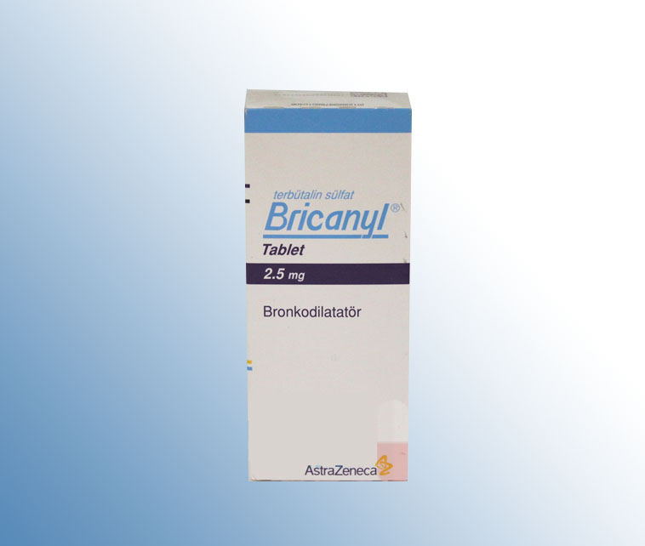
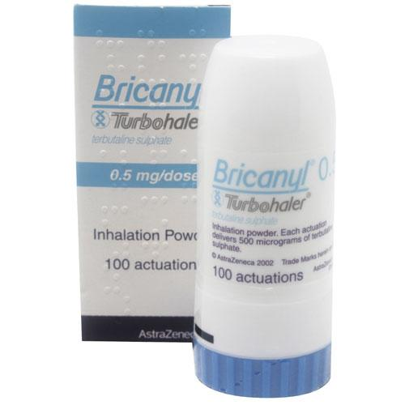
TERBUTALINE
Terbutaline is a selected beta-2 adrenergic agonist used as a bronchodilator.
It is indicated for prevention and reversal of bronchospasm in patients at least 12 years old, with asthma and reversible bronchospasm associated with bronchitis and emphysema

Slide 3
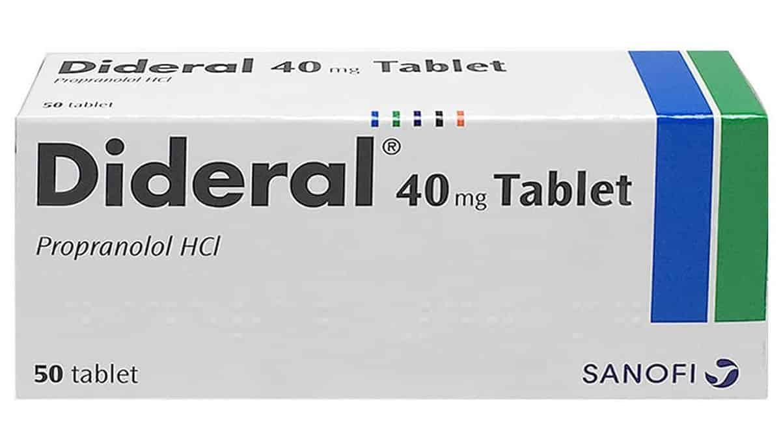
PROPRANOLOL
Propranolol is a nonselective β-adrenergic receptor antagonist.2 Blocking of these receptors leads to vasoconstriction, inhibition of angiogenic factors like vascular endothelial growth factor (VEGF) and basic growth factor of fibroblasts (bFGF), induction of apoptosis of endothelial cells, as well as down regulation of the renin-angiotensin-aldosterone system
It is primarily indicated to hypertension treatment. Propranolol is also indicated to treat angina pectoris due to coronary atherosclerosis, atrial fibrillation, myocardial infarction, migraine, essential tremor

Slide 4
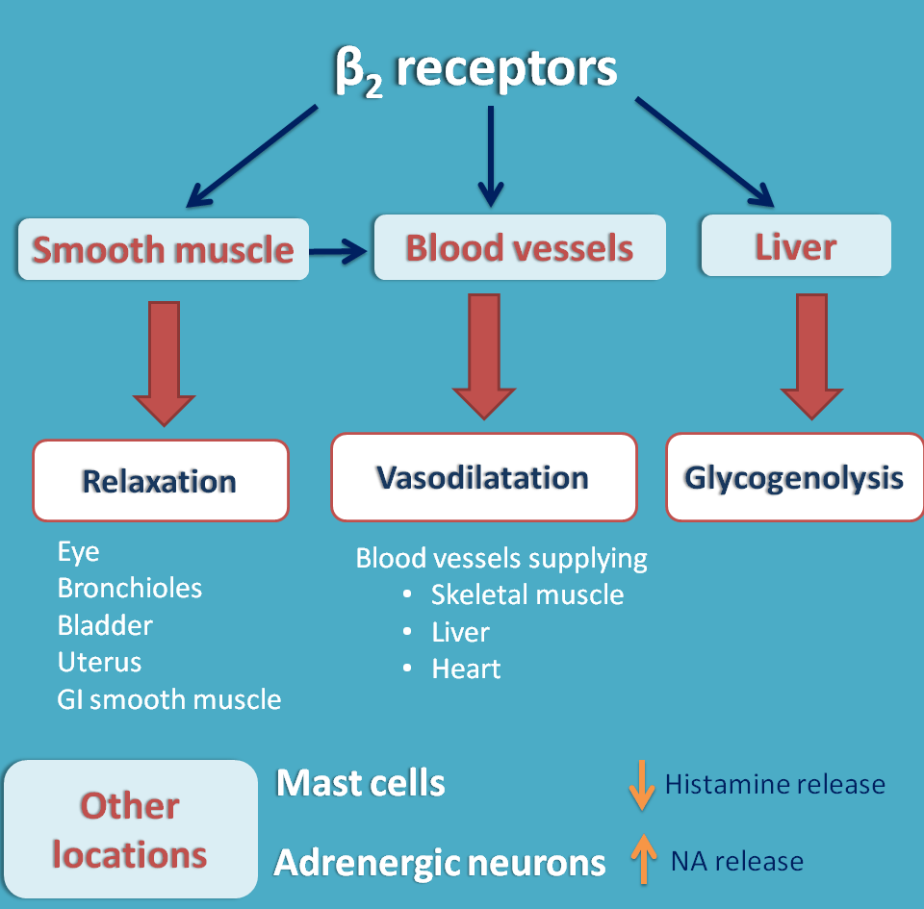
INTERACTION
There is a major interaction between terbutaline and propranolol.
Beta-blockers may antagonize the effects of beta-2 adrenergic bronchodilators and precipitate acute, life-threatening bronchospasm in patients with asthma or other obstructive airway diseases. The mechanism involves increased airway resistance and reduced bronchodilation due to blockade of beta-2 adrenergic receptors.
Likewise, beta-2 adrenergic agonists may interfere with the pharmacologic effects of beta-blockers.

Slide 5
MANAGEMENT
Concomitant use of beta-2 adrenergic bronchodilators with beta-blockers, including ophthalmic formulations, should generally be avoided. If coadministration is required, a cardioselective beta-blocker (e.g metoprolol) is usually preferred. Nevertheless, caution is advised and respiratory status should be closely monitored, as cardioselectivity is not absolute and larger doses of beta-1 selective agents may pose some of the same risks as nonselective agents. In general, nonselective beta-blockers are considered contraindicated in patients with obstructive airways disease.

Slide 6
REFERENCES
Craig TJ "Drugs to be used with caution in patients with asthma." Am Fam Physician 54 (1996): 947-53
Chafin CC, Soberman JE, Demirkan K, Self T "Beta-blockers after myocardial infarction: Do benefits ever outweigh risks in asthma?." Cardiology 92 (1999): 99-105
Chodosh S, Tuck J, Blasucci DJ "The effects of dilevalol, metoprolol, and placebo on ventilatory function in asthmatics." J Cardiovasc Pharmacol 11 (1988): s18-24
https://www.drugs.com

