Slide 1
MESLEKİ YABANCI DİL 4
KONU 1
ADVISING ITINERARIES

Slide 2
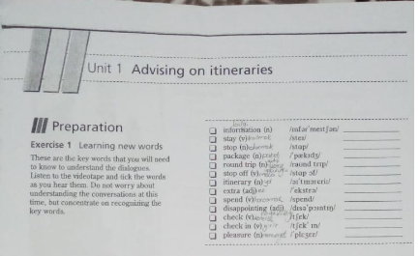

Slide 3
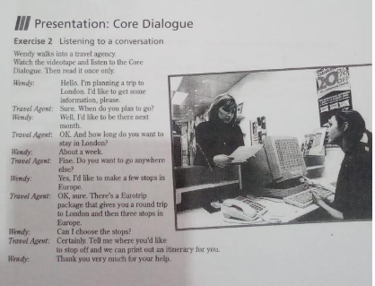

Slide 4
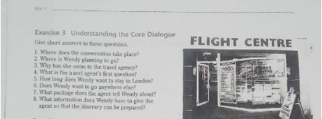

Slide 5
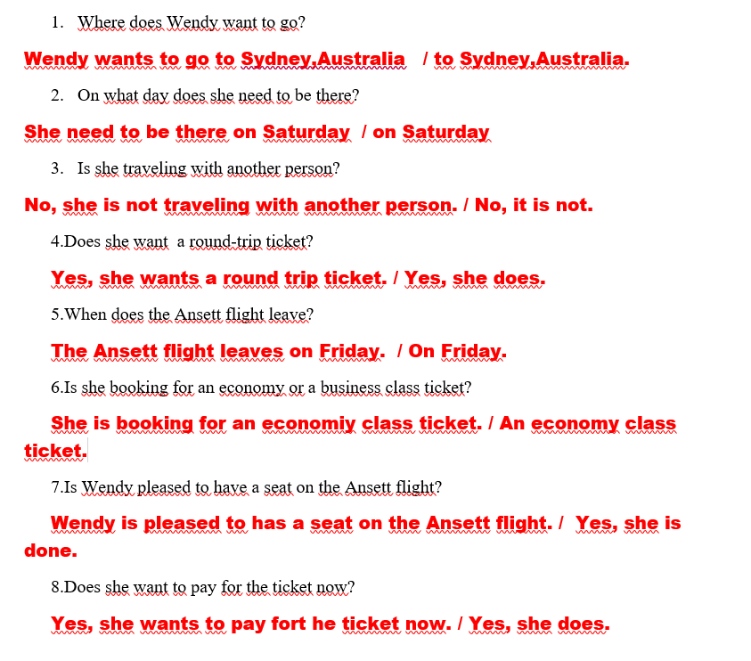

Slide 6
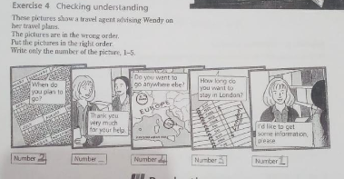

Slide 7
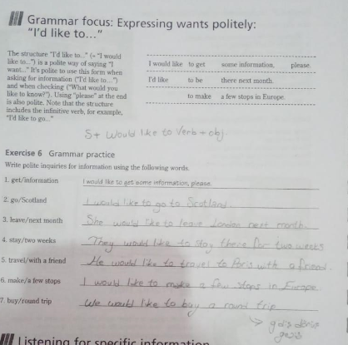

Slide 8
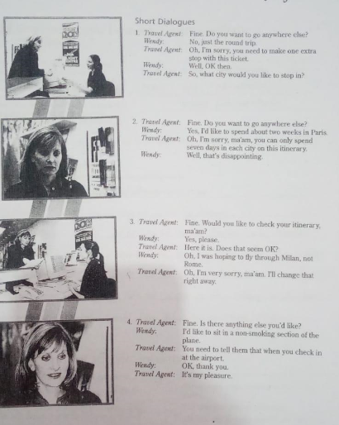

Slide 9
kaynakça
TRAVEL AND TOURİSM BASED ON A CONCEPT BY JONATHAN CRINCHTON
RUTH WAJNRYB
NÜANS PUBLISING

