Slide 1
QUALITATIVE and QUANTITATIVE TESTS of LIPIdS
Res. Asst. Aybüke ÇELİK
A.U. Faculty of Pharmacy, Department of Biochemistry
4. week

Slide 2
Lipids in circulation are divided into four main groups.
- Cholesterol and esters
- Triacylglycerols
- Phospholipids and fatty acids.

Slide 3
- Since the solubility of lipids in water is low, they circulate in the form of micelles in the form of lipoproteins which are bound to proteins.
The disorders associated with the metabolism and transport of lipoproteins are closely related to atherosclerosis.
The Serum normal lipid values ​​are 300-800 mg%.

Slide 4
Cholesterol;
75% esterified with fatty acids
The rest is in the form of free cholesterol Its synthesis in liver (up to 80%) and intestinal mucosa.
Cholesterol is converted to bile acids and metabolized.

Slide 5
MODIFIED PHOSPHOVANILLIN EXPERIMENT
Principle: It is based on the color reaction of lipids given with the phosphovanilline reagent after treatment of lipids with concentrated acids.

Slide 6
Assay Procedure
Take three test tubes:
For the first tube: add 100 μl of serum and add 250 μl of H2SO4 over serum,
The second tube: add 100 μl of standard cholesterol solution and add 250 μl of H₂SO₄ over that,
the third tube: add 100 μl of distilled water and add 250 μl of H2SO4 over that.
Shake all tubes. For 5 min., keep them on the boiling water bath. Then cool them down under tap water for 5 min.
Add 5 mL fosphovanilin reagent over each tubes, then mix respectively. Keep them at 37 degrees for 5 min. Wait for pink color.

Slide 7
CalculatIon
The optical densities of the sample and standard tubes are read on a spectrophotometer at 540 nm wavelength against the blank.
$\frac{Asample}{Astandard}$X 800= %mg total lipid
(Standard values for phosphovanillin test: 300-800 %mg)

Slide 8
Hyperlipidemia; Total lipid content increases in, diabetes,
chronic pancreatic disease, hypothyroidism, gout, pituitary failure,
Hypolipidemia; Total lipid content decreases in acute infections, hyperthyroidism,
hepatitis and decreases in some anemias.

Slide 9
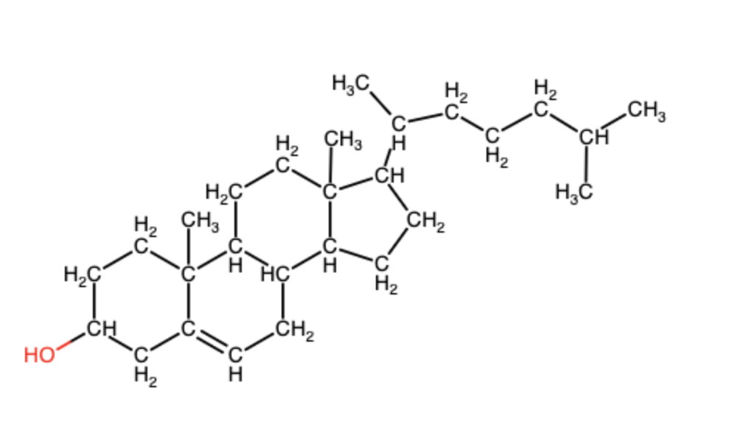
Salkowsky assay
Principle: Sterols (in this experiment, cholesterol) get red with concentrated sulfuric acid in anhydrous medium due to their unsaturation.

Slide 10
Concentrated sulfiric acid is higly hygroscopic, it removes two molecules of water from two molecules of cholesterol
It causes a connection at position 3, forming bicholestadien
Sulfiric acid simultaneously sulfonates the molecule bicholestadien at position 7,7 of aromatic ring as a final product, red colour is formed.

Slide 11
Lipids are a group of naturally occuring substances
Insoluble in water, soluble in organic solvents (chloroform)

Slide 12
Assay Procedure
Dissolve an amount of cholesterol in 3 ml chloroform.
Add a few drops of concentrated H₂SO₄ into the tube and shake.
Wait 5 minutes at room temperature
Then, red-violet color will be observed.

Slide 13
References
Ankara University Faculty of Pharmacy Biochemistry Practice Book - 2004
Practical Clinical Biochemistry: Methods and Interpretations 4th Edition-2014
Biochemistry Laboratory Manual - 2016 Basu, P

