Slide 1
Information Systems
Information economy – Real value of information
Information systems. Where we use it?
Knowledge of information systems → Your first job !
Notes:
We live in an information economy.
Information itself has real value, and in order to stay competitive, organizations require a steady flow of information about their business partners, competitors, customers, employees, markets, and suppliers.
- Information systems are increasingly being used to gather, store, digest, analyze, and make sense out of all this information.
- Regardless of your college major or chosen career, knowledge of information systems is indispensable in helping you land your first job.
- You need to understand what information systems can and cannot do and be able to use them to help you achieve personal and organizational goals in today’s high-tech world.

Slide 2
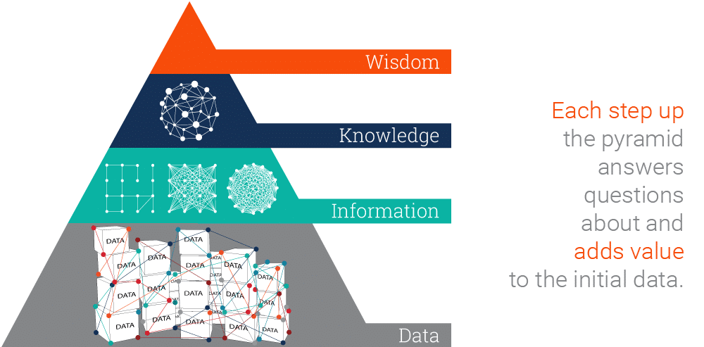
Data, Information, Knowledge, and Wisdom
Notes:
Here in the pyramid, you see the basic concepts related to an information system
They are data, information, knowledge, and wisdom bottom to top.
In the each step of the pyramid, different values are added to the initial raw data.

Slide 3
Data, Information, Knowledge, and Wisdom
Data: Raw facts, symbols
Notes:
Data consists of raw facts, such as list of students in a department, list of courses etc.

Slide 4
Data, Information, Knowledge, and Wisdom
Information: Data but organised and processed, valuable data.
Answers to "who", "what", "where", and "when" questions.
Notes:
Information is a collection of data organized and processed so that it has additional value beyond the value of the individual facts, i mean valuable data.
For example, a list that shows students and their grades grouped by courses.

Slide 5
Data, Information, Knowledge, and Wisdom
Data
PROCESS
Information
MAKE USE OF
Knowledge
Notes:
Turning data into information is a process.
- The process of defining relationships among data to create useful information requires knowledge.
- Information is data made more useful through the application of knowledge.
- “The awareness and understanding of a set of information and the ways that information can be made useful to support a specific task” is knowledge.

Slide 6
Data, Information, Knowledge, and Wisdom
Data 09/01 18:29:45: Message from InterMapper 5.8.1
Event: Critical Name: http://website-host.leeds.ac.uk Nagios Plugin Document: Unix: Webhosting Address: 129.11.1.1 Probe Type: Nagios Plugin Condition: CRITICAL – Socket timeout after 10 seconds
Time since last reported down: 39 days, 3 hours, 12 minutes, 47 seconds Device’s up time: N/A
Information This alert relates to one of our website servers. This is not normal behaviour.
Knowledge
There is a planned network upgrade in one of our data centres between 18:00 – 19:00 which is expected to cause network outages. The server is part of a clustered pair with only one node affected, so service to end users will not be interrupted.
Wisdom No action is required.
Notes:
Here you see an alert from a monitoring system.
The alert itself is data.
It’s processed using other knowledge sources and information is obtained.
Wisdom is knowledge applied in action.
We can also say that, if data and information are like a look back to the past, knowledge and wisdom are associated with what we do now and what we want to achieve in the future.

Slide 7
Quality Information
Quality of information → Quality of decision
Accessible
Accurate
Complete
Economical
Flexible
Relevant
Reliable
Secure
Simple
Timely
Verifiable
Notes:
Quality of a decision is the quality of the information used to reach that decision.
Characteristics of Quality Information are:
Accessible: Should be easily accessible by authorized users.
Accurate: i mean error free.
Complete: namely contains all the important facts.
Should also be relatively economical to produce.
Flexible: Flexible information can be used for a variety of purposes.
Relevant
Reliable: reliable information can be trusted by users.
Should be secure from access by unauthorized users.
Information should be simple, not complex.
Timely: information should be delivered when it is needed.
Information should be verifiable.

Slide 8
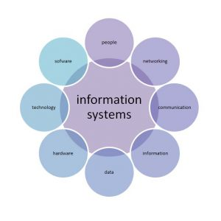
Information Systems - Definition
Notes:
A computer-based information system (CBIS) is a single set of hardware, software, databases, networks, people, and procedures that are configured to collect, manipulate, store, and process data into information.
Using a CBIS involves setting and following many procedures, including those for the operation, maintenance, and security of the system.
All of the procedures and instructions must be predefined, written, and ratified.

Slide 9
Information Systems - Types
IS
Personal
Group
Enterprise
Notes:
We can classify IS as three groups: personal, group, and enterprise.
Personal IS includes information systems that improve the productivity of individual users in performing stand-alone tasks.
Examples include personal productivity software, such as word-processing, presentation, and spreadsheet software.
Group IS includes information systems that improve communications and support collaboration among members of a workgroup.
Examples include Web conferencing software, wikis, and electronic corporate directories.
Enterprise IS includes information systems that organizations use to define structured interactions among all shareholders (employees, customers, suppliers, government agencies, and other business partners).

Slide 10
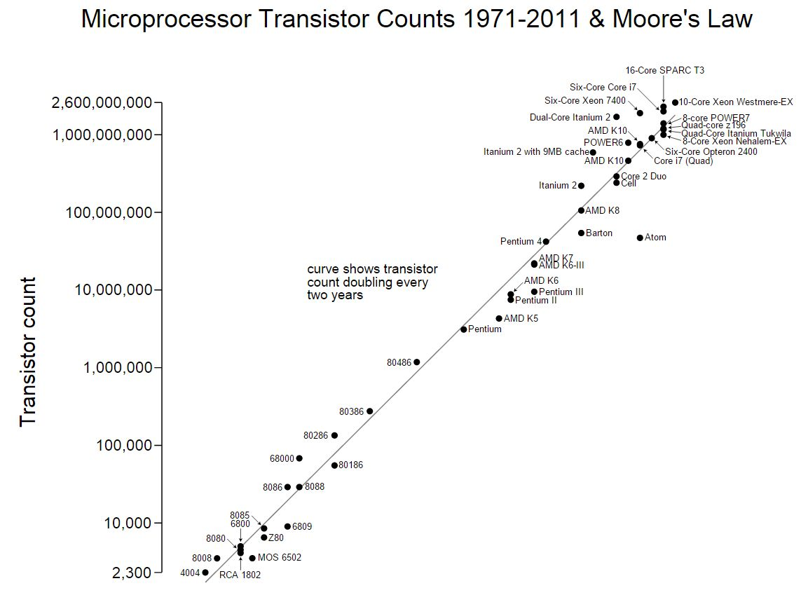
Information Systems - Concepts
Notes:
Here are the basic concepts of an IS. Afterwards we will examine them in much more detail.
Now the first, hardware. Hardware consists of computer equipment used to perform input, processing, storage, and output activities.
This graph is about the Moore Law. (Gordon Moore's Law refers to Moore's perception that the number of transistors on a microchip doubles every two years, though the cost of computers is halved.)
What is the most commonly used hardware?
Smartphones. In 2013, the number of smartphone users first exceeded the number of personal computer users.
- For many people in developing countries, a smartphone is their first computer and their only Internet-connected device.
- For those in developed countries, it is common for individuals who do have a computer to also have a smartphone.
- It is projected that roughly one-third of the world’s population will own a smartphone by 2018.

Slide 11
Information Systems - Concepts
Notes:
This cycle stands for software development process.
The second concept, software, consists of the computer programs that govern the operation of a particular computing device.
Both system software and application software are needed for all types of computers, from small handheld devices to large supercomputers.
As of June 2015, 1.6 million applications were available for devices that run under the Android operating system and roughly the same (1.5 million) available for download from Apple’s App Store.
The number of apps for each operating system is increasing by roughly 25,000 to 50,000 per month.

Slide 12
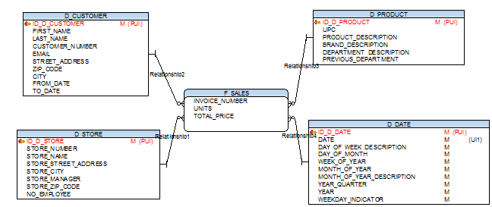
Information Systems - Concepts
Notes:
- The third one, a database, is an organized collection of facts and information, typically consisting of two or more related data files.
- Beside that a data warehouse is a system that pulls together data from many different sources within an organization for reporting and analysis.
Data warehouses and databases are both relational data systems, but were built to serve different purposes.
A data warehouse is built to store large quantities of historical data and enable fast, complex queries across all the data.
A database was built to store current transactions and enable fast access to specific transactions for ongoing business processes
- And big data is a term used to describe data collections that are so enormous and complex (from sensor data to social media data) that traditional data management software, hardware, and analysis processes are incapable of dealing with them.

Slide 13
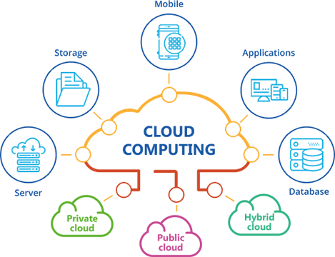
Information Systems - Concepts
Notes:
Another concept, network.
Cloud computing: A group or system of connected computers and equipment—in a room, building, campus, city, across the country, or around the world—that enables electronic communication.
And public cloud computing, a means of providing computing services wherein a service provider organization owns and manages the hardware, software, networking, and storage devices, with tenants accessing slices of shared resources via the Internet.
Samples? (MS Azure, Amazon, Google etc.)

Slide 14
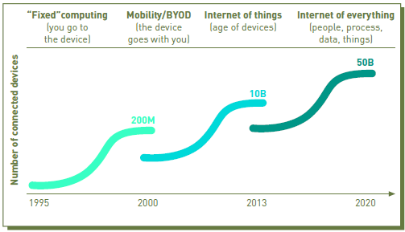
Information Systems - Concepts
Notes:
This graph shows the rapid growth of tne number of connected devices extending to years.
The internet of things (IoT): is a computing concept that describes the idea of everyday physical objects being connected to the internet and being able to identify themselves to other devices.
The term is closely identified with RFID as the method of communication, although it also may include other sensor technologies, wireless technologies or QR codes.
And a new concept, The Internet of Everything, is the connections between people, things, data and processes combined into a common interrelated system, the aim of which is to improve experiences and make smarter decisions.

Slide 15
Information Systems – Where Used?
Accounting and finance
Customer service
Human resources
Manufacturing
Research and development
Sales and marketing
Agriculture
Healthcare (e.g. imaging and CAD systems)
…
…
Notes:
Here we see the functional areas or industries where IS used.

Slide 16
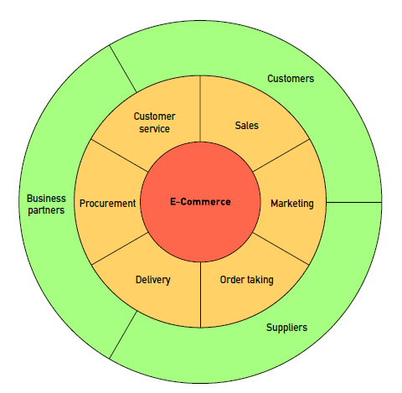
Information Systems – Where Used?
Notes:
E-commerce involves the exchange of money for goods and services over electronic networks.
It encompasses many of an organization’s outward facing processes those are shown in the figure.
Similarly mobile commerce (m-commerce) is buying and selling of goods and/or services using a mobile device.
Electronic business (e-business) goes beyond e-commerce by using information systems and networks to perform business-related tasks and functions such as gathering product demand forecasts, sharing product data.

Slide 17
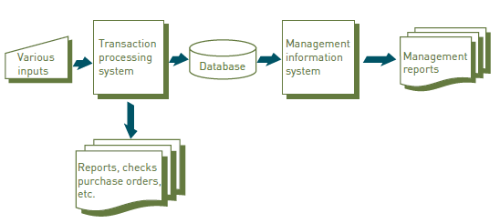
Information Systems – Where Used?
Notes:
Just a few definitions more
transaction: Any business-related exchange such as a payment to an employee, a sale to a customer, or a payment to a supplier.
transaction processing system (TPS): An organized collection of people, procedures, software, databases, and devices used to process and record business transactions.
management information system(MIS): An organized collection of people, procedures, software, databases, and devices that provides routine information to managers and decision makers.
Here we see the flow from TPS to MIS.

Slide 18
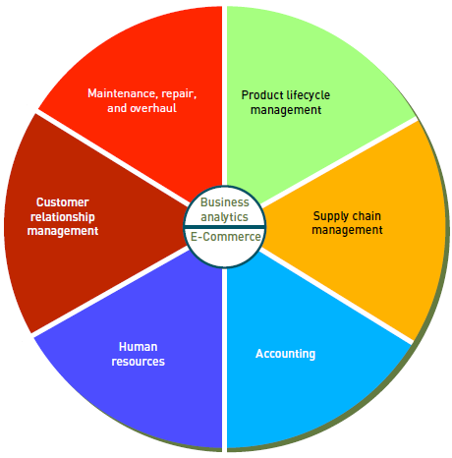
Information Systems – Where Used?
Notes:
SAP: popular ERP software.
In recent years, more organizations have begun implementing enterprise resource planning (ERP) systems that support their routine business processes, maintain records about those processes, and provide extensive reporting and data analysis capabilities.

Slide 19
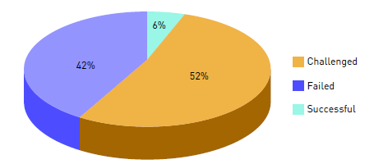
Information Systems –Management
Notes:
Good project management is a positive force that enables an organization to get results from its efforts.
Although the success rate has improved over time due to improved methods, training, and tools,
94 percent of very large (multimillion dollar efforts) software projects still fail or are challenged (i.e., are late, over budget, or lack required features)

Slide 20
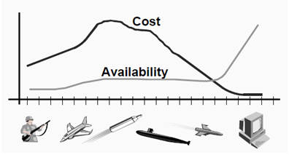
Information Systems –Security Issues
A cyber attack (on average) | $250K
Tomahawk missile | $1.45 M
Patriot missile | $4.54 M
F35(A) aircraft | $107 M
COST
AVAILABILITY
Notes:
This slide shows us the importance of cyber security.

Slide 21
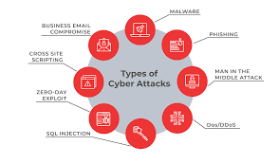
Information Systems –Security Issues
Notes:
Some types of cyber attacks:
Malware: Malicious software is installed on the victim’s systems through executable files usually without the user’s knowledge. Malware includes malicious software, including spyware, ransomware, viruses, and worms. After installation, a malware can keep track of the user’s activity or can trigger codes resulting into access to sensitive information, login details, credit cards or intellectual properties by the hacker.
Phishing: Phishing refers to spoofing or deceptive communications activities performed by the attackers that appear to originate from a credible source such as emails, messages, legitimate websites. Through phishing, attackers try to fetch sensitive information, user details, credit card numbers or make fraudulent attempts.
Man-in-the-middle attack: These attacks happen with relaying or altering the communication channels.
DoS/DDoS: A DoS/DDoS attack aims at flooding the target website with overwhelming traffic to exhaust resources and bandwidth of the system.
SQL Injection: This is injecting a nefarious code or statements into SQL queries or a database server to extract information from the database or to take a data dump of the complete database.
Zero-day exploit: Zero-day is a software security flaw which is known to the software developers. Attackers try to exploit a vulnerability before a patch or solution is implemented to capture the system with known weaknesses.
Cross Site Scripting: XSS attacks occur when a web app sends malicious code in the form of a side script to another user thus bypassing access controls of the site to same as the origin. Session theft is an example.
Business Email compromise: This is an attack to spoof business emails and gain illegal access to company accounts and ids to defraud the company or its employees.

Slide 22
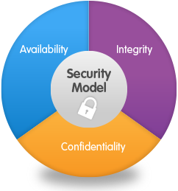
Information Systems –Security Issues
Notes:
Information is the key item of an IS.
So infosec, information security, is the most important stuff in this threatful environment.
C.I.A. !!!
How you ensure confidentiality? (Usernames and passwords, multi-factor authentication, encryption …)
How you ensure integrity? (hash functions, digital signatures)
How you ensure availability? (A disaster recovery plan, backup …)

