Slide 1
Debye-Hückel Limiting Law
The long range and strength of the coulombic interaction between ions is resposible for the departures from ideality in ionic solutions and to dominate all the other contributions to non-ideality. This domination is the basis of the Debye-Hückel theory of ionic solutions, This theory explain by qualitativley its principal conclusions.
Since oppositely charged ions attract each other, cations and anions are not uniformly distributed in solutions: anions are more likely to be found near cations, and vica versa. Overall the solution is electrically neutral, but near any given ion there is an excess of counter ions, the ions of opposite charge. Averaged over time, more counter ions than like ions pass any given ion, and they come and go in all directions. This time averaged, spherical haze around a given ion has a net charge equal in magnitude but opposite in sign to that on the central ion, and is called its ionic atmosphere.

Slide 2
This time averaged, spherical haze around a given ion has a net charge equal in magnitude but opposite in sign to that on the central ion, and is called its ionic atmosphere. The model leads to the result that at very low concentration the activity coefficient can be calculated from the Debye-Hückel limiting law.
Ionic strength is a useful concept because it allows us to consider some general expressions that depend only on ionic strength and not on the identities of the ions themselves. Debye and Hückel also assumed that any deviations in solution properties from ideality were due to the coulombic interactions (repulsions and attractions) betweenthe ions.

Slide 3
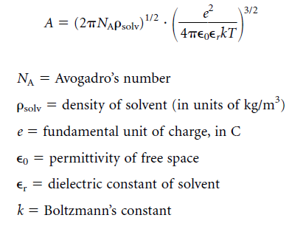
Applying some of the tools of statistics and the concept of ionic strength, Debye and Hückel derived a relatively simple relationship between the activity coefficient and the ionic strength I of a dilute solution:

Slide 4
When the ionic strength of the solution is too high for the limiting law to be valid, it is found that the activity coefficient may be estimated from the extended Debye-Hüchel law
This implies that, for example, dilute NaCl and dilute KBr solutions have the same properties, since they are composed of ions having the same charges. For more precise calculations, the size of the ions involved is a factor also. Rather than calculating an average activity coefficient individual ionic activity coefficients and are considered here. A more precise expression from Debye-Hückel theory for the activity coefficient of an individual ion is

Slide 5
The activity coefficient is dependent only on properties of the solvent and the charge and size of the ion, but not the chemical identity of the ion itself. It is therefore not uncommon to see tables of data in terms of å and the ionic charge rather than the individual ions themselves. Table 8.3 is such a table. In using data from tables like this, you must be extremely careful to make sure the units work out properly. All units should cancel, leaving a unitless number for the

Slide 6
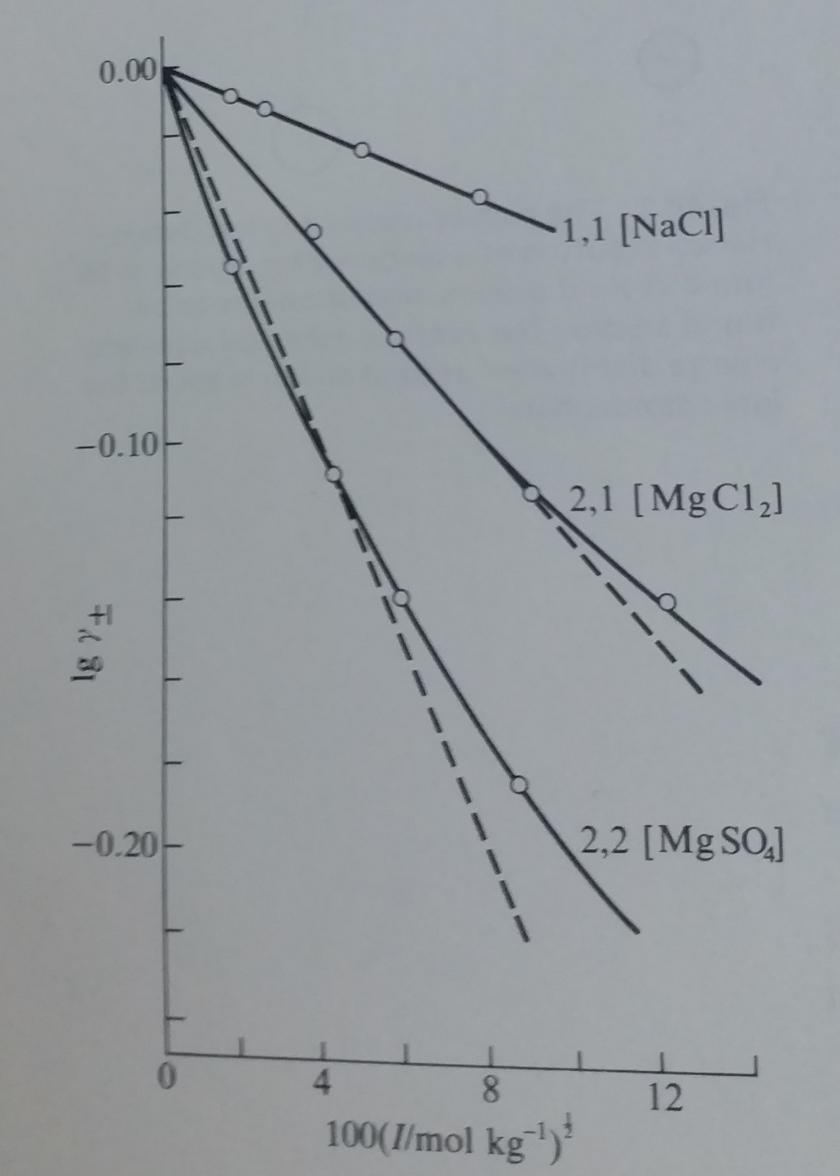
Figure shows some of these values plotted against I^{1/2} and compares them with the teorical straight lines calculated . The agreement at low molalities is impressive. Nevertheles, the departures from the theoretical curves above this molalities are large, and show that the approximation are valid only at very low concentration. For 1,1 electrolytes, this equation is more compatible

