Slide 1
Ephemeral Fever
Bovine Epizootic Fever, Ephemeral Fever, Three-Day Sickness, Three Day Fever, Three-Day Stiffsickness, Dragon Boat Disease, Lazy Man’s Disease, Dengue of Cattle

Slide 2
It is a acute-onset fever disease caused by viruses that are transmitted by culicoides in cattle.
Decreases in milk yield is economically important.

Slide 3
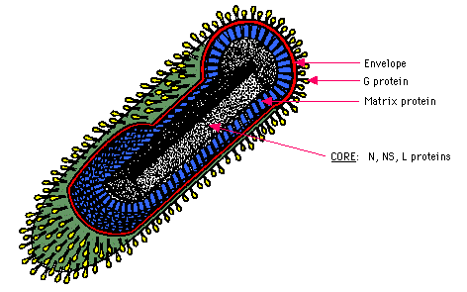
Etiology
Rabdoviridae Ephemerovirus
RNA
Enveloped,
Sensitive to Ether and Chloroform
H. A
C.C (BHK-21, Vero)
Only one serotype

Slide 4
Transmission
BEFV appears to be transmitted by arthropods, but the identity of the vector or vectors is not entirely clear.
This virus has been isolated from various genera of mosquitoes, and from a number of Culicoides species
There is no evidence that bovine ephemeral fever can be transmitted directly between animals in nature; BEFV is not spread by close contact, body secretions, or aerosol droplets.

Slide 5
Pathology
The most obvious lesion is a small amount of fibrin-rich fluid in the pleural, peritoneal and pericardial cavities, resulting from polyserositis of the pleural, pericardial and peritoneal surfaces
Edema, lobular congestion and atelectasis may be apparent in the lungs
Serofibrinous polysynovitis (with variable amounts of yellow to brown, typically gelatinous fluid), polyarthritis, polytendinitis.

Slide 6
Clinical Signs
Based on natural and experimental infections, the incubation period is thought to be 2-4 days in most cases, with a maximum of 10-11 days.
vary in individual animals
The classic course begins with a fever, which is often biphasic to polyphasic.
In lactating cows, milk production often drops dramatically during the first fever spike.
most animals become
inappetence and depressed,
with an increased heart rate,
tachypnea,
serous or mucoid discharges from the nose.
Profuse salivation,
muscle twitching,
waves of shivering or
lacrimation may also be seen.

Slide 8
Diagnosis
Most animals begin to improve a day or two after the initial signs, and recover completely within another 1-2 days.
Generally, animals lose condition rapidly during the illness, and regain their weight only slowly.
Overall, the mortality rate is usually 1-2%.

Slide 9
Diagnosis
Most cases of bovine ephemeral fever are confirmed by serology.
A rising titer should be demonstrated, but single serum samples may be suggestive in areas where this disease does not normally occur.
Virus neutralization or ELISA are the most commonly used serological tests.
IF
RT-PCR

Slide 10
Prevention and Control
Once cattle have been infected with the virus, most will not develop disease if re-exposed to the virus for many years or for life. However, some animals lose immunity after a few years, especially older animals.
In endemic areas, vaccination is generally used to prevent disease, particularly in lactating cattle and bulls.
Although culicoides control might theoretically be helpful in some situations.
Vaccination is available to prevent BEF in some countries. To achieve long lasting protection, two doses are required.

Slide 11
Vesicular Stomatitis

Slide 12
The disease is similar to the FMD.
It is characterized by a vesicles in the mucosa of oral cavity, the tongue epithelium, the feet, the coronary corium and sometimes in other parts of the body.
Horses, Cattle and Pigs are the natural hosts of the disease.
ZOONOSIS
Notifiable disease
http://www.cfsph.iastate.edu/Factsheets/pdfs/vesicular_stomatitis.pdf

Slide 13
Rabdoviridae Vesiculovirus (in the form of a bullet)
RNA
Enveloped,
Sensitive to Ether and Chloroform
The viruses that cause vesicular stomatitis have been divided into two major serotypes,
New Jersey
Indiana
http://www.cfsph.iastate.edu/Factsheets/pdfs/vesicular_stomatitis.pdf

Slide 14
No cross immunity between types.
EA (Guinea pig, Mouse, Poppy)
CC (Vero, Cattle, Pig, Kidney)
ECE (CAM and Allantoic Space)
Virus gets the neurotropic character.
http://www.cfsph.iastate.edu/Factsheets/pdfs/vesicular_stomatitis.pdf

Slide 15
Transmission
Once it has been introduced into a herd, vesicular stomatitis can spread from animal to animal by direct contact.
Broken skin or mucous membranes may facilitate entry of the virus.
Infected animals shed VSV in vesicle material.
Viruses from lesions in the mouth and on the muzzle can contaminate saliva, and to a lesser extent, nasal secretions.
However, VSV has also been detected in the saliva of some experimentally infected horses that did not have oral lesions.
http://www.cfsph.iastate.edu/Factsheets/pdfs/vesicular_stomatitis.pdf

Slide 16
Vesicular stomatitis viruses are not considered to be shed in feces, urine or milk, although they have been detected occasionally in the feces of symptomatic, experimentally infected swine.
Contaminated fomites such as food, water and milking machines are also thought to play a role in transmission.
http://www.cfsph.iastate.edu/Factsheets/pdfs/vesicular_stomatitis.pdf

Slide 17
People can be infected by contact with lesions or secretions from infected animals, particularly vesicular fluid and saliva, or when manipulating VSV in the laboratory.
Aerosol transmission has been reported in laboratories, and some cases occurred after accidental inoculation (needlestick injuries).
Some people are probably infected through insect bites, as antibodies to these viruses are common in endemic regions.
http://www.cfsph.iastate.edu/Factsheets/pdfs/vesicular_stomatitis.pdf

Slide 18
Pathogenesis
The incubation period is usually 3-7 days, but longer or shorter incubation periods have been reported.
Infection is a cyclical disease with viraemia phase.
Virus are circuleted by settling in monocytes.
http://www.cfsph.iastate.edu/Factsheets/pdfs/vesicular_stomatitis.pdf

Slide 19
Clinical Signs
Vesicular stomatitis is characterized by vesicles, papules, erosions and ulcers.
These lesions occur mainly in and around the mouth, and on the feet, udder (especially the teats) and prepuce.
A transient fever
http://www.cfsph.iastate.edu/Factsheets/pdfs/vesicular_stomatitis.pdf

Slide 21
Vesicular stomatitis lesions are painful and can cause anorexia, refusal to drink and lameness.
Some animals may develop a catarrhal nasal discharge, bleeding from ulcers, or a fetid mouth odor.
Lesions on the coronary band may result in laminitis and even loss of the hoof (or claws in pigs).
Teat lesions can lead to mastitis from secondary infections. Weight loss may be severe, and milk production can drop in dairy cows.
http://www.cfsph.iastate.edu/Factsheets/pdfs/vesicular_stomatitis.pdf

Slide 22
Diagnosis and Differential Diagnosis
Vesicular stomatitis viruses can be found in vesicle fluid, swabs of ruptured vesicles, the epithelium over unruptured vesicles, and epithelial flaps from freshly ruptured vesicles.
IF
ELISA
RT-PCR
Electron microscopy of tissue samples may be helpful in distinguishing VSV from some other viruses that cause vesicular lesions, such as FMD virus or swine vesicular disease virus.
http://www.cfsph.iastate.edu/Factsheets/pdfs/vesicular_stomatitis.pdf

Slide 23
Prevention and Control
Notifiable disease
During outbreaks, uninfected livestock should kept away from any animals that could be infected. Quarantines and animal movement restrictions can help reduce virus spread.
Commercial vaccines are available in some endemic regions
Deaths are very rare in cattle and horses.
http://www.cfsph.iastate.edu/Factsheets/pdfs/vesicular_stomatitis.pdf

Slide 24
in Humans
In general, vesicular stomatitis is reported to be an acute illness that resembles influenza, with symptoms that may include fever, muscle aches, headache, malaise, enlarged lymph nodes and conjunctivitis.
http://www.cfsph.iastate.edu/Factsheets/pdfs/vesicular_stomatitis.pdf

Slide 25
PARAINFLUENZA-3 (PI-3) INFECTION Shipping Fever

Slide 26
The PI-3 virus causes acute infections in the respiratory tract of cattle.
PI-3 rarely infects cattle and sheep, alone.
Mostly as Mix infection with other viruses and Pastorella Multicida

Slide 27
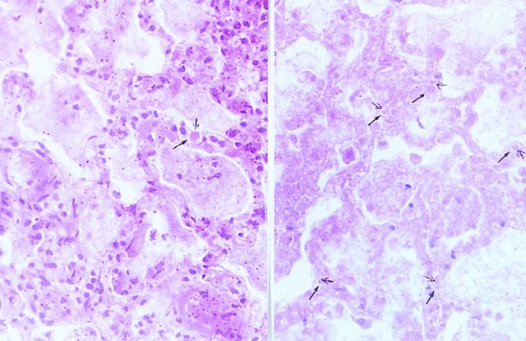
Paramyxoviridae ----- Respirovirus---- PI-3
RNA
Enveloped
Sensitive to Ether and Chloroform
One type and Reference Strain is Shipping Fever
Virus forms an inclusion body
(Intrastoplasmic and intranuclear)

Slide 28
PI-3 is extremely widespread in cattle and 80‑90% have antibody.
Cattle are reservoir.
Transmission is from animal to animal through the inhalation of aerosolized virus.
The disease is mostly subclinical.

Slide 29
Pathogenesis and Pathology
The virus is spread by inhalation through the direct contact with the nasal discharge.
Virus exist in the nasal cavity in lymphatic tissues, tonsils and respiratory mucosa.
Pathological Anotomically; interstitial pneumonia occurs.
Cessation of ciliary beating and epithelial necrosis predispose to secondary bacterial infections and coughing.
the consolidated lesions are distributed extensively and follow smaller bronchi and bronchioles.
Histologically, the IS inclusion body occurs in the early period of the infection.
W.B. MARTIN Respiratory diseases induced in small ruminants by viruses and mycoplasma* Rev. sci. tech. Off. int. Epiz., 1983, 2 (2), 311-334.

Slide 30
Clinical Signs
Clinical signs can be variable since there may be one or more viruses and bacteria involved in this disease complex.
Early clinical signs usually include:
depression,
loss of appetite,
dull eyes
These calves should be pulled from their group
and checked for fever
Combined infections of this type will result in a high percentage of cattle developing moderate to severe pneumonic lesions in which high counts of pasteurelia can be found.
Ram Kasimanickam Bovine Respiratory Disease “Shipping Fever” in Cattle Veterinary Medicine Extention August 2010

Slide 32
Calf pneumonia is a complex respiratory disease probably associated as much with management (crowding, low ventilation, high humidity, colostral deprivation, transport stress, mixing of stock from differing herds).
The agents are :
PI-3,
bovine respiratory syncytial virus,(BRSV)
infectious bovine rhinotracheitis virus,
Mycoplasmata and
Pasteurellae.
Shipping fever occurs in beef cattle after long journeys.

Slide 33
Diagnosis
The clinical signs are not specific.
Parainfluenza-3 is detection is often difficult.
Direct Diagnosis (Virus); from Nasal Discharge, Nasal Swap and virus isolation from the lungs.
IF on nasal aspirates or bronchial epithelium.
Indirect Diagnosis (Ab);
4-fold rise in ELISA antibody or Serum Neutralization in paired serum samples from several animals.

Slide 34
Prevention and Control
Correct ventilation and stocking density; avoid mixing different ages from different locations in same airspace.
Reducing stresses related to handling and shipping,
Bovine parainfluenza virus-3 vaccines are available and are usually combined with bovine herpes virus-1 and BVDV etc.

Slide 35
References
Ellis JA. Bovine parainfluenza-3 virus. Vet Clin North Am Food Anim Pract. 2010 Nov;26(3):575-93. Review. PubMed PMID: 21056802.
Anderson, D.E., Rings M.D. Current Veterinary Therapy: Food Animal Practice, 5th Ed. Saunders, St. Louis MO. 2009. pp. 178-179.
Ram Kasimanickam Bovine Respiratory Disease “Shipping Fever” in Cattle Veterinary Medicine Extention August 2010
W.B. MARTIN Respiratory diseases induced in small ruminants by viruses and mycoplasma* Rev. sci. tech. Off. int. Epiz., 1983, 2 (2), 311-334.

