Slide 1
Inspiration from Birds
https://www.aerotime.aero/24830-top-5-airbus-plane-designs-inspired-by-animals
Dr. Arzu GÜRSOY ERGEN
6

Slide 2
Designs Inspired by Birds
Jet engine evolution inspired by the Peregrine Falcon
Shielding airplane black boxes,
The Woodpecker Electrical Hammer
American football players helmet
A better ice axes for mountain climbers designed after the woodpecker.
The Bullet Train in Japan
Swimming Fins

Slide 3
THE WOODPECKER AND SHOCK ABSORBERS
Woodpeckers drum on a tree up to 22 times a second
A deceleration of up to 1200g’s during launch
Astronauts experience about 3g which forces them against padded cushions
Jet pilots feel up to 12 g forces in tight turns
Forces of 50 g or greater causes damage to the blood vessels and the brain, leading to death

Slide 4
Anatomy of the Woodpecker’s Skull

Slide 5
Woodpeckers inspire shock absorbers that can absorb up to 60,000g
Reasearchers built a mechanical shock absorbing system to protect microelectronics
Skull: a second layer of metal provides extra protection to the microelectronics
Beak: a steel metal enclosures, first line of defense
Hyoid: elastic layer is mimicked by a load- spreading layer of rubber
Spongy bone: a layer of closely packed glass beads helps absorb shock and protect the microelectronics

Slide 6
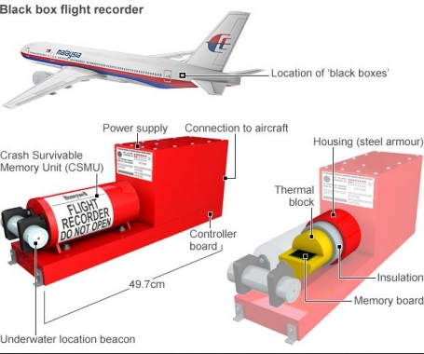
HOW CAN THIS TECHNOLGY BE APPLIED?
Today’s flight recorders withstand shocks of 1000g.
With this new technology it would stand 60,000g

Slide 7
HOW CAN THIS TECHNOLGY BE APPLIED?
Developing technology for crash protection for drivers.
Goal is getting drivers to decelerate in an accident situation without causing internal organ damage

Slide 8
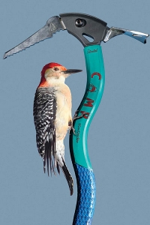
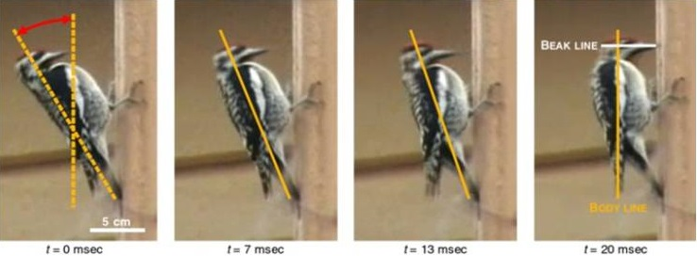
Ice axes for mountain climbers designed after the woodpecker
Weigth: 400 gr
The tail act as a brace and spring
The configuration of spine and skull
Straight shafts
Slight curve to spine
Pitchdownward like bird beak
Notes:
Woodpecker hammers
A woodpecker hammers out 25 pecks per second, hitting a tree trunk with an impact that would rip out the brains of other birds. But this master chiseler, which typically weighs a pound, uses its entire body for each blow: The tail acts as a brace and spring, and the configuration of spine and skull helps distribute the impact.
For more than 100 years, Italian sporting firm CAMP made ice axes with straight shafts. "When CAMP came to me, the first thing I did was ask, 'What is the best example of a hammer in nature?’” says designer Franco Lodato. Channelling the woodpecker, Lodato centred the shaft under the axe head and added a slight curve to the spine. Rather than setting the new pick at a near right angle to the shaft, it was pitched downward, like the bird's beak. The result was a more balanced swing, a more efficient blow, and a best seller for CAMP.
For further information, visit: http://www.fastcompany.com/magazine/129/truly-intelligent-design.html
Image from google images

Slide 9
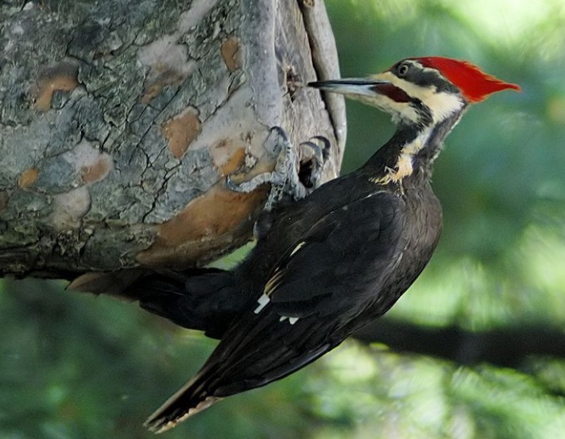
The Woodpecker Electrical Hammer
The Woodpecker electrical hammer is a tool designed for the artistic working of marble , stone and wood.
The main features of mechanical hammer is the controllable percussion strength with is automatically triggered according to the pressure exercised on the hammer.
This allow for the use of the hammer in delicate working and medium rough grinding.

Slide 10
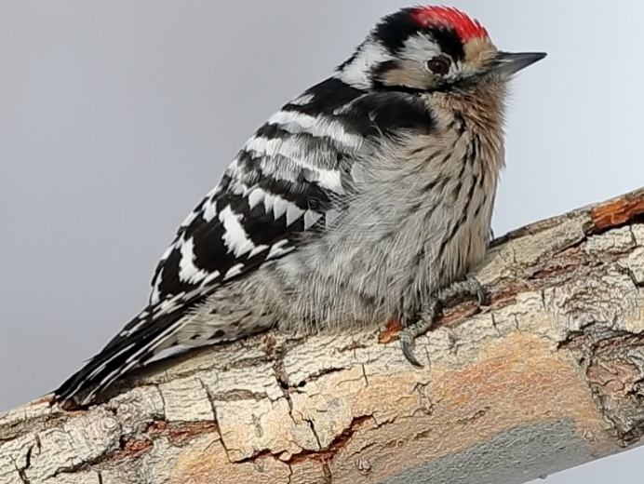
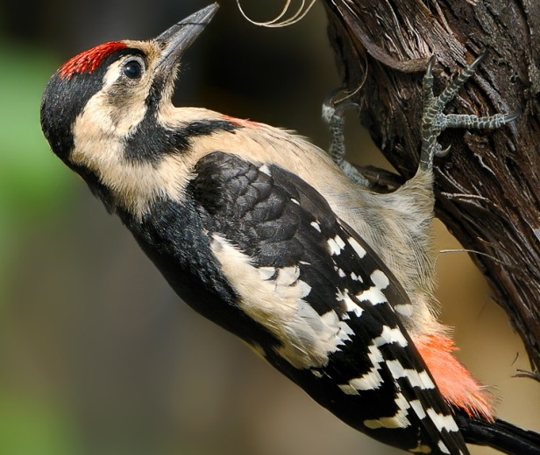
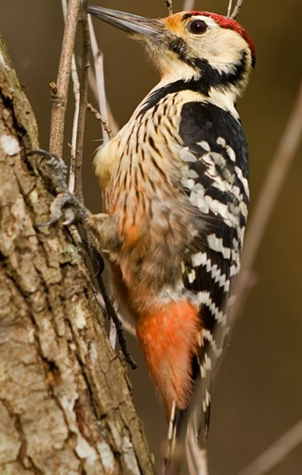
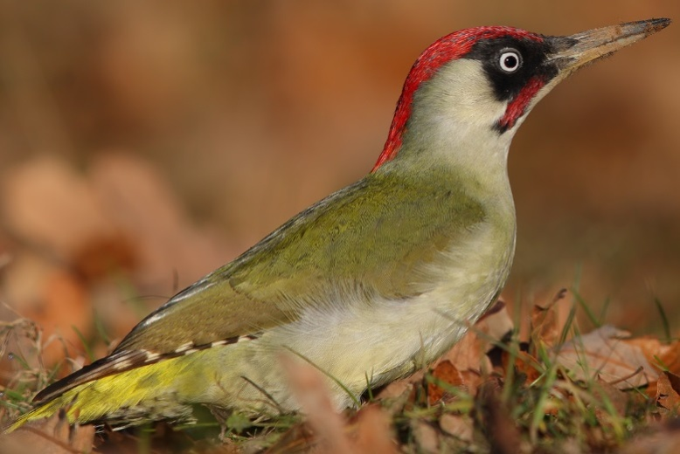
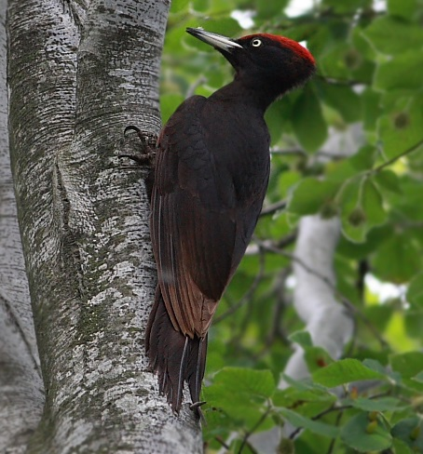
Woodpecker species in Turkey
Lesser Spotted Woodpecker@Ulusoy Bali
Syrian Woodpecker@Fikret Yorgancıoğlu
White-backed Woodpecker @Ömer Necipoğlu
European Green Woodpecker @Levent Göksoy
Black woodpecker@Hüseyin Meşe

Slide 11
Biomimicry
Designer:
What is the product made from?
How has the product been ‘inspired by nature’?
Level 1
Level 2
Level 3
How is the product designed for the whole cycle (product in a system)?
Image/s

