Slide 1
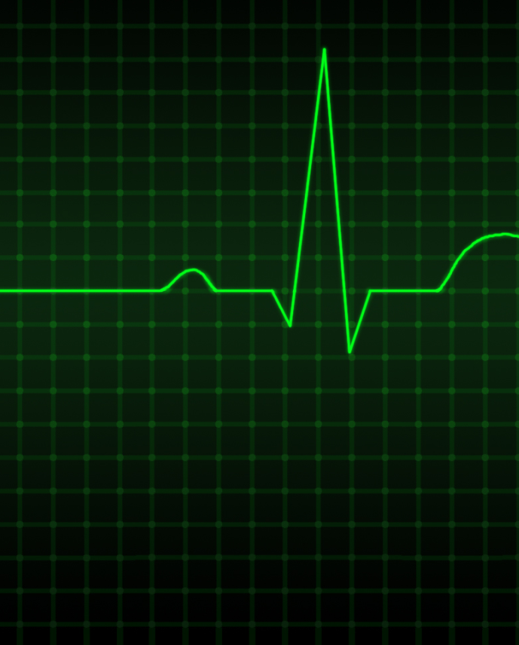
INTERPRETING ECG
Dr. Etkin ŞAFAK

Slide 2
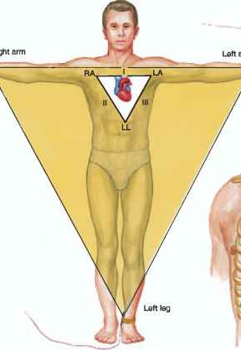
LEADS
To understand electrocardiography, leads need to be understood
Electrodes placed on the skin measure the direction of electrical current discharged by the heart
That current is then transformed into waveforms
An ECG records information about those waveforms from different views or perspectives.
Those perspectives are called leads

Slide 3
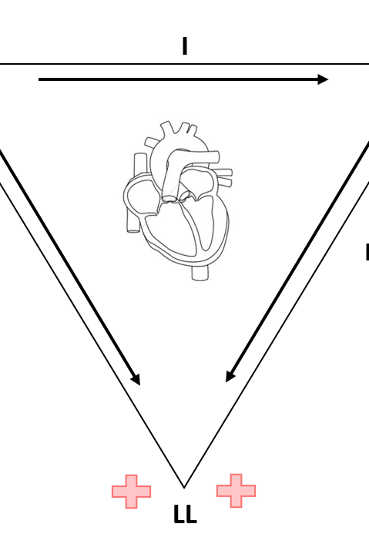
LEADS
A lead provides a view of the heart’s electrical activity between one positive pole and one negative pole.
Between the two poles lies an imaginary line representing the lead’s axis, a term that refers to the direction of the current moving through the heart.
The direction of the current affects the direction in which the waveform points on an ECG.
When no electrical activity occurs or the activity is too weak to measure, the waveform looks like a straight line, called an isoelectric waveform.

Slide 4
All about leads
Electrode placement is different for each lead, and different leads provide different views of the heart.
A lead may be chosen to highlight a particular part of the ECG complex or the electrical events of a specific cardiac cycle.
Leads II, V1, and V6 are among the most commonly used leads for monitoring,
It is necessary to adjust the leads according to the patient’s condition.

Slide 5
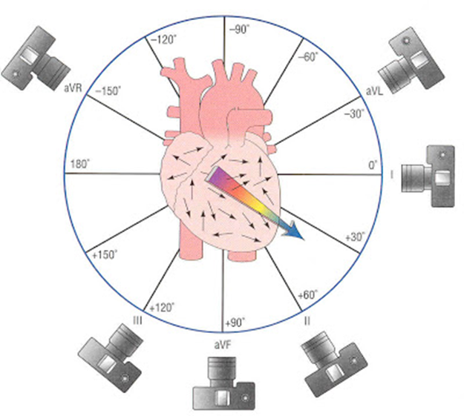
The 12-lead ECG
A 12-lead ECG records information from 12 different views of the heart and provides a complete picture of electrical activity.
These 12 views are obtained by placing electrodes on the patient’s limbs and chest.
The limb leads and the chest, or precordial, leads reflect information from the different planes of the heart

Slide 6
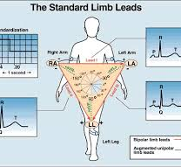
LIMB LEADS
The six limb leads—I, II, III, augmented vector right (aVR), augmented vector left (aVL), and augmented vector foot (aVF)—provide information about the heart’s frontal (vertical) plane.
Leads I, II, and III require a negative and positive electrode for monitoring, which makes those leads bipolar.
The augmented leads record information from one lead and are called unipolar.

Slide 7
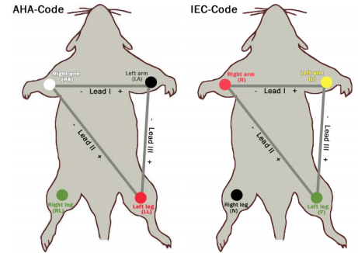
Bipolar Leads
All bipolar leads have a third electrode, known as the ground, to prevent electrical interference from appearing on the ECG recording
Lead I provides a view of the heart that shows current moving from right to left.
Because current flows from negative to positive, the positive electrode for this lead is placed on the left arm; the negative electrode is placed on the right arm

Slide 8
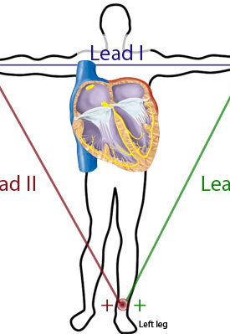
Bipolar Leads
Lead II produces a positive deflection.
Place the positive electrode on the patient’s left leg and the negative electrode on the right arm.
Lead II tends to produce a positive, highvoltage deflection, resulting in tall P, R, and T waves.
This lead is commonly used for routine monitoring
Lead III produces a positive deflection. The positive electrode is placed on the left leg; the negative electrode, on the left arm.
The axes of the three bipolar limb leads—I, II, and III—form a triangle around the heart and provide a frontal plane view of the heart.

Slide 9
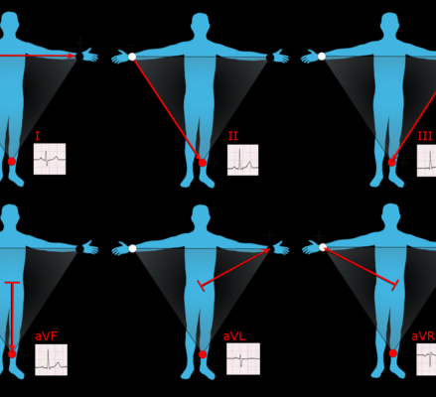
The «a» leads
aVR, aVL, and aVF are called augmented leads because the small waveforms that normally would appear from these unipolar leads are enhanced by the ECG.
They measure electrical activity between one limb and a single electrode.
In lead aVR, the positive electrode is placed on the right arm and produces a negative deflection because the heart’s electrical activity moves away from the lead.
In lead aVL, the positive electrode is on the left arm and produces a positive deflection on the ECG.
In lead aVF, the positive electrode is on the left leg and produces a positive deflection.

Slide 10
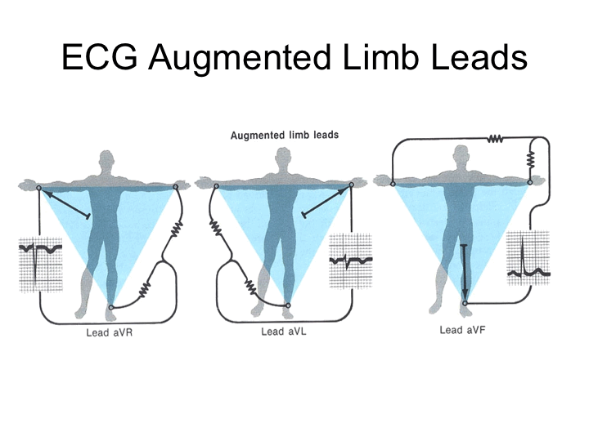
The «a» leads
These three limb leads also provide a view of the heart’s frontal plane.
Lead aVR provides no specific view of the heart.
Lead aVL shows electrical activity coming from the heart’s lateral wall.
Lead aVF shows electrical activity coming from the heart’s inferior wall.

Slide 11
PRECORDIAL LEADS
The six precordial or V leads—V1, V2, V3, V4, V5, and V6—provide information about the heart’s horizontal plane.
The precordial leads are also unipolar, requiring only a single electrode.
The opposing pole of those leads is the center of the heart as calculated by the ECG.

Slide 12
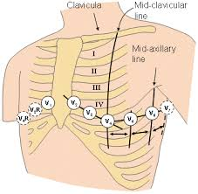
Precordial Limbs
Lead V1 electrode is placed on the right side of the sternum at the fourth intercostal rib space.
Lead V2 is placed at the left of the sternum at the fourth intercostal rib space.
Lead V3 goes between V2 and V4.
Lead V4 is placed at the fifth intercostal space at the midclavicular line and produces a biphasic waveform.
Lead V5 is placed at the fifth intercostal space at the anterior axillary line.
Lead V6, the last of the precordial leads, is placed level with V4 at the midaxillary line

Slide 13
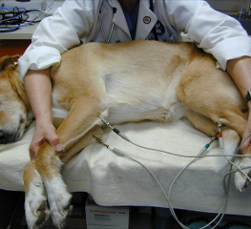
Recording ECG
Place the patient in right lateral recumbency.
Part the hair.
Attach the electrodes to the skin just proximal (above) to the elbows and stifles.
Wet the electrodes with alcohol (do not soak). If panting or excessive motion, move the front limb leads further distal on the limb.
Check the speed, amplitude, and other settings.

Slide 14
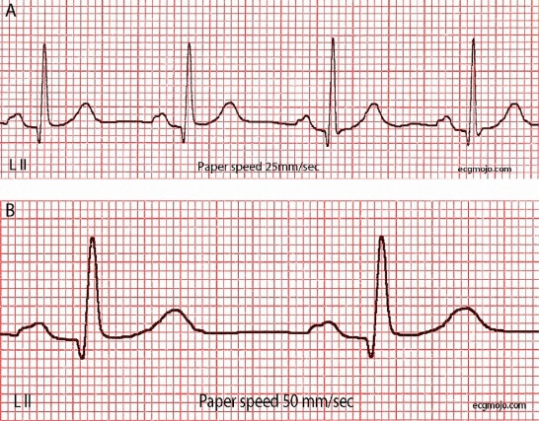
Interpreting ECG
Waveforms produced by the heart’s electrical current are recorded on graphed ECG paper by a stylus.
ECG paper consists of horizontal and vertical lines forming a grid.
A piece of ECG paper is called an ECG strip or tracing

Slide 15
Interpreting ECG

Slide 16
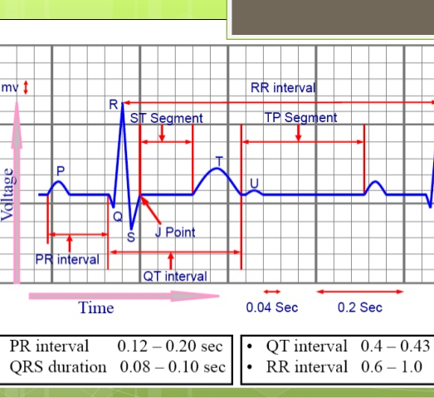
Standart deflection
Standard calibration of the ECG is 10mm/mV
At this calibration, 1 miliVolt calibration signal is expected to produce a rectangle of 10 mm height and 5 mm width.

Slide 17
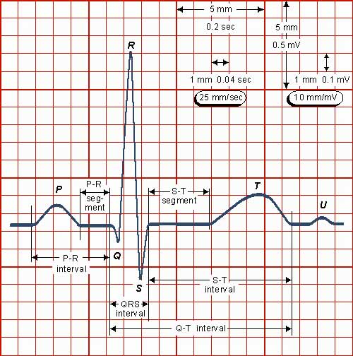
Standart deflection
When ECG waves are tall, the R or S waves may extend into the QRS complexes above or below them.
To prevent this superimposition, the whole ECG may be calibrated at 5mm/mV .

Slide 18
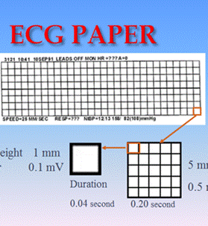
PAPER SPEED-measurement of time
The horizontal axis of the ECG strip represents time.
If recording at 50 mm/sec: 0.02 sec= 1 little box
If recording at 25 mm/sec: 0.04 sec=1 little box_

Slide 19
Methodical Approach to the ECG
Start at the left and go through each complex, identifying known waves.
HR -- fast or slow
Rhythm -- regular or irregular
Identify P waves
– normal or abnormal configuration
– is there a P for every QRS
Measurements
– P-R interval, Q-T interval, S-T segment, etc

Slide 20
ECG WAVES

Slide 21
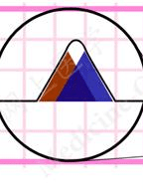
The P Wave
The P wave is the first component of a normal ECG waveform.
It represents atrial depolarization—conduction of an electrical impulse through the atria.

Slide 22
The PR interval
The PR interval tracks the atrial impulse from the atria through the AV node, bundle of His, and right and left bundle branches.
The PR interval is measured from the beginning of the P wave to the beginning of the QRS complex.
Paper speed: 25 mm/sec
0.04 sec / sq x 3 squares = 0.12 sec

Slide 23
The QRS Complex
The QRS complex is the average of the depolarization waves of the inner (endocardial) and outer (epicardial) cardiomyocytes. As the endocardial cardiomyocytes depolarize slightly earlier than the outer layers, a typical QRS pattern occurs
The letters "Q", "R" and "S" are used to describe the QRS complex
Q: the first negative deflection after the p-wave. If the first deflection is not negative, the Q is absent.
R: the positive deflection
S: the negative deflection after the R-wave
The QRS duration:

Slide 24
The QT interval
This segment tells the total duration of the ventricular event, from when the first cell depolarizes to the repolarization of the last cell
Between the beginning of the QRS complex and the end of the T wave

Slide 25
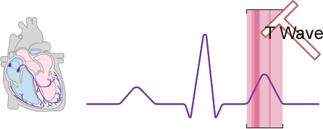
The T Wave
The T wave represents the repolarization of the ventricles.
There is no cardiac muscle activity during the T wave.

Slide 26
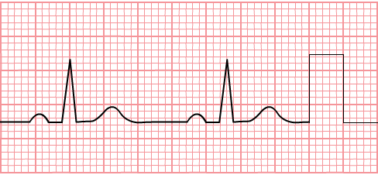
Calculation
P = 0,02 x 2 = 0,04 sec
P = 0,1 x 1 = 0,1 mV
PQ = 0,02 x 4,5 = 0,09 sec
R = 0,1 x 9 = 0,9 mV
QRS = 0,02 x 2 = 0,04 sec
T = 0,02 x 5 = 0,10 sec
T = 0,1 x 2 = 0,2 mV
QT = 0,02 x 10 = 0,20 sec
Speed: 50 mm/sec
Standardized deflection: 1 mV

Slide 27
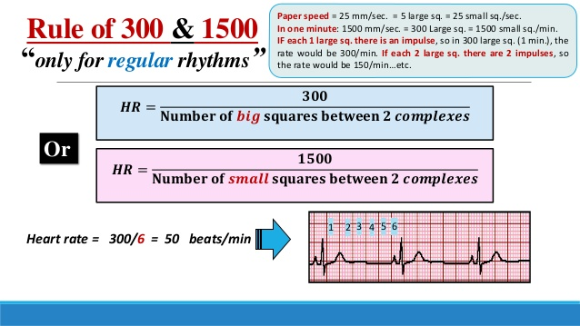
Calculating the HR:
The horizontal axis of the ECG strip represents time.
If recording at 50 mm/sec:
Heart rate = 3000 / number of 1 mm boxes between 2 beats ex: 3000 / 25 = 120 bpm (Why 3000: 3000 one mm boxes = 3000 X 0.02 sec = 60 sec = 1 min)
If recording at 25 mm/sec:
Heart rate = 1500 / number of 1 mm boxes between 2 beats

Slide 28
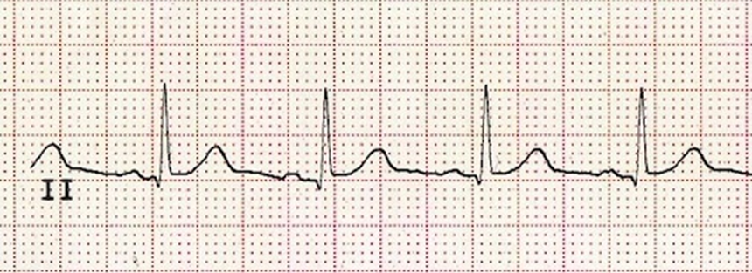
Calculating the HR:
Paper speed is 25 mm/sec = 1500 mm/min
Calculate the R-R interval: 18 mm
HR: 1500/18 = 83/min

Slide 29
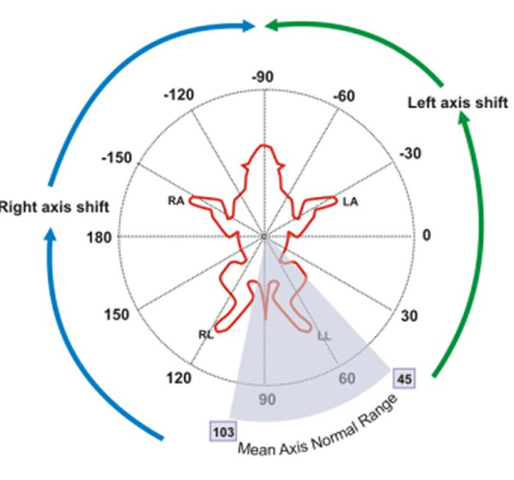
Mean Electrical Axis
The Mean Electrical Axis (MEA) is a simple clinical assessment that assesses the ventricular depolarization pattern, that is, the net direction of the electrical current as the heart beats.
It’s described as an angle from -180° to 180°, and is calculated using a 3-leads electrocardiogram (ECG).

Slide 30
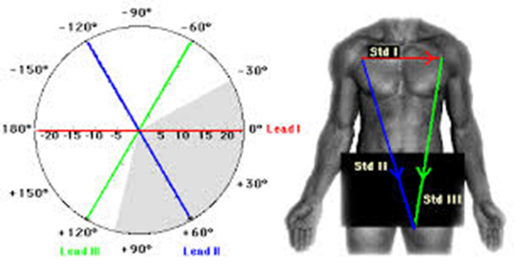
Mean Electrical Axis
Upon depolarization each myocardial fiber in the heart produces its own tiny vector.
The sum of all those vectors across the heart is measured by the ECG leads, which are comprised of a negative and positive pole.
These record a deflection greater than zero if the vector is moving towards the positive pole of the lead, and less than zero if moving towards the negative pole.
A vector moving perpendicular to the lead axis produces no deflection.
Using multiple leads we can develop a “picture” of the electrical activity of the heart.

Slide 31
Mean Electrical Axis
Because ventricular depolarization accounts for the majority of the electrical activity of the heart, we need only concern ourselves with the magnitude of ventricular vectors when evaluating the MEA.
Thus we can ignore the P and T waves, and use only the QRS complex.
The sum of the complex’s positive component (R) and negative components (Q and S) give the net deflection for that complex.
If this is 0, the complex is said to be isoelectric.
This could be seen as an ECG tracing with no QRS wave or one where the magnitude of R equals the sum of the magnitudes of Q and S.

Slide 32
Einthoven Method
Lead II = the sum of lead I and lead II.
II = III + I
Example: Lead I: R=1,2 mV, Q=0,8 mV
Lead III: R=0,6 mV, Q=0,2 mV’
What is the magnitude of the resultant vector in lead II?
II = 0,4 + 0,4 → II = 0,8 mV

Slide 33
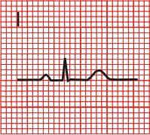
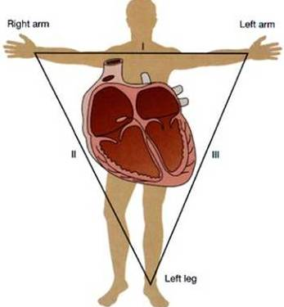
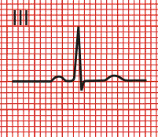
Einthoven Method
I
-
0
+
±180
-
-
±0
II
0
0
III
+30
+
+
EXMAPLE:
LI 4-0=4
LIII 10-2 =8
+60
+90
+70

Slide 34
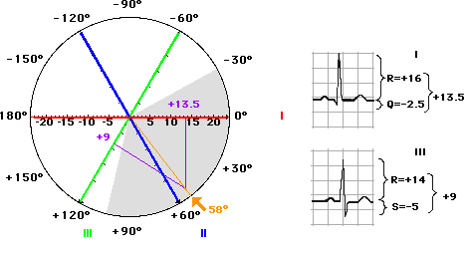
Example 2

Slide 35
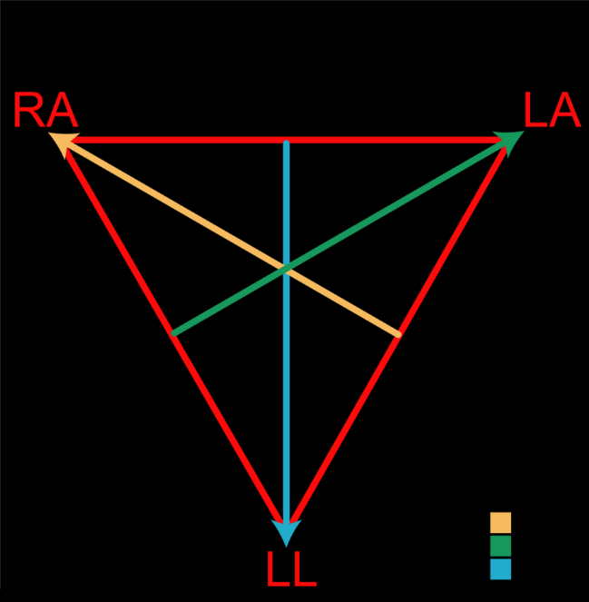
Baileys Axis System
The three bipolar leads (leads I, II and III) can be shown on Einthoven’s Triangle as three arrows, each with a positive and negative pole at one limb of the dog or cat.
There are also 3 unipolar leads in ECG recordings. These are called the augmented vector leads
Adding these to the Bailey axis, we now have a complete picture of all 6 leads and their corresponding angles.
Remember that POSITIVE net deflections of a lead point towards the arrowhead, and NEGATIVE net deflections go away from the arrowhead

Slide 36
ANY QUESTION?

