Slide 1
SPECIFIC DISEASES
Dr. Murat ÇALIŞKAN

Slide 2
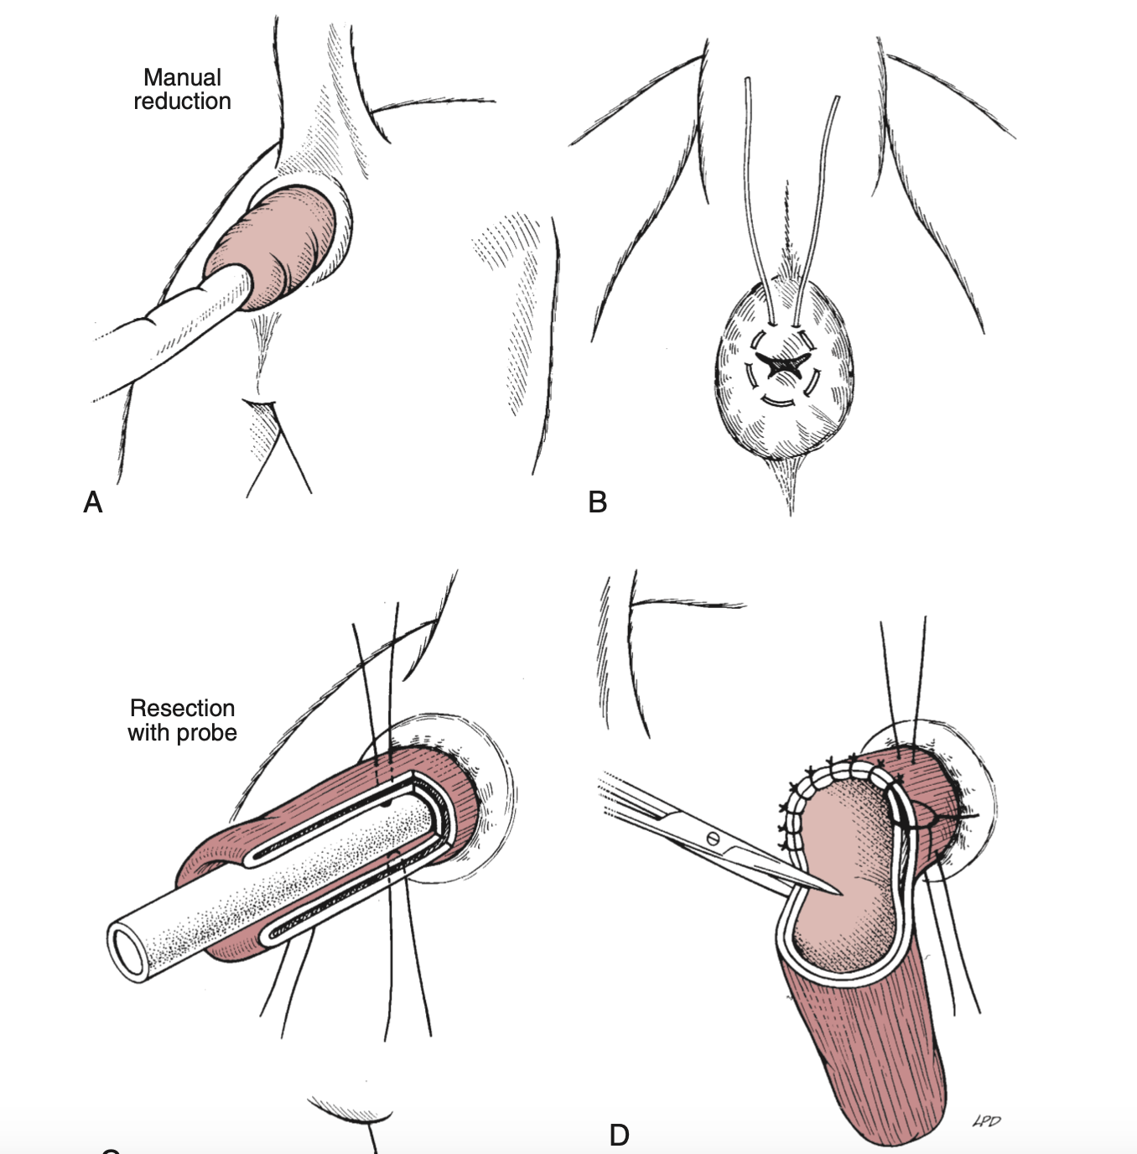

Slide 3
ANAL NEOPLASIA
•Perianal gland adenoma.
• Perianal gland adenocarcinoma
• Apocrine gland adenocarcinoma
• Lipoma • Leiomyoma • Squamous cell carcinoma • Melanoma • Lymphoma • Mast cell tumor • Miscellaneous skin tumors

Slide 5
Signs of Hypercalcemia
Anorexia • Weight loss
• Vomiting • Polyuria
• Polydipsia • Muscle weakness
• Constipation

Slide 6
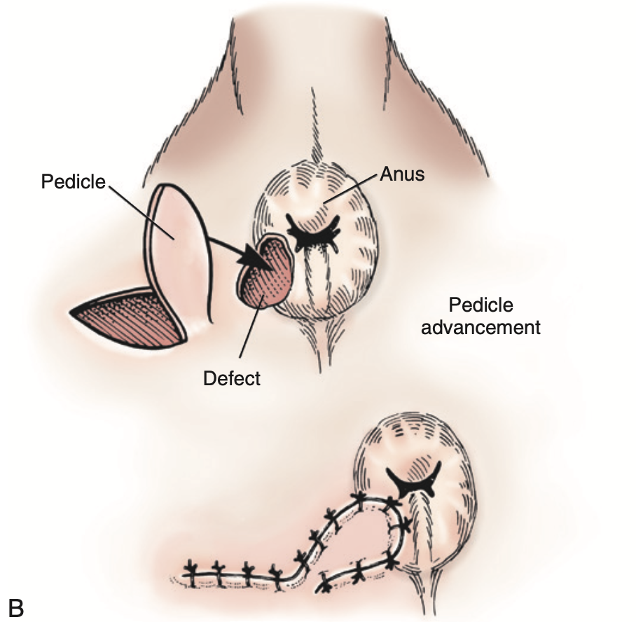
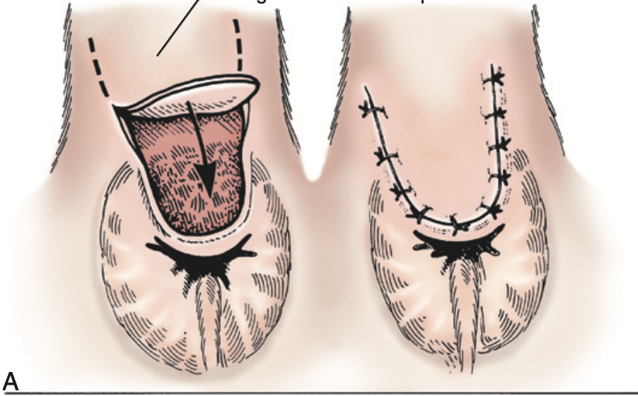

Slide 7
Possible Complications of Surgery for Perianal Tumors
Infection • Dehiscence • Tenesmus • Rectal prolapse • Dyschezia • Hematochezia • Temporary or permanent incontinence
• Anal stricture • Tumor recurrence • Metastasis

Slide 8
ANAL SAC INFECTION AND IMPACTION

Slide 9
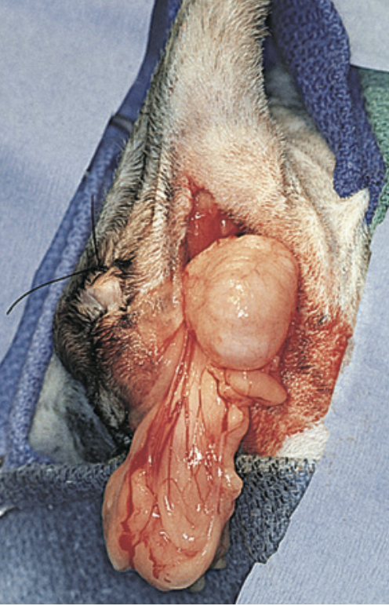
PERINEAL HERNIA

Slide 10
Conditions That Cause Straining and May Predispose to Perineal Herniation
Prostatitis • Cystitis • Urinary tract obstruction • Colorectal obstruction • Rectal deviation or dilatation
• Perianal inflammation
• Anal sacculitis • Diarrhea • Constipation

Slide 13
Possible Complications of Herniorrhaphy
• Hemorrhage
• Depression
• Anorexia • Tenesmus
• Dyschezia • Flatulence • Hematochezia • Rectal prolapse • Anal sacculitis • Fecal incontinence
• Urethral damage • Dysuria • Stranguria • Bladder atony
• Bladder necrosis • Urinary incontinence • Intestinal necrosis • Rectocutaneous or perineal
-fistula

Slide 14
RECTAL PROLAPSE

