Slide 1
REPRODÜKTİF SÜRÜ SAĞLIĞI
Prof.Dr. Şükrü Küplülü

Slide 2
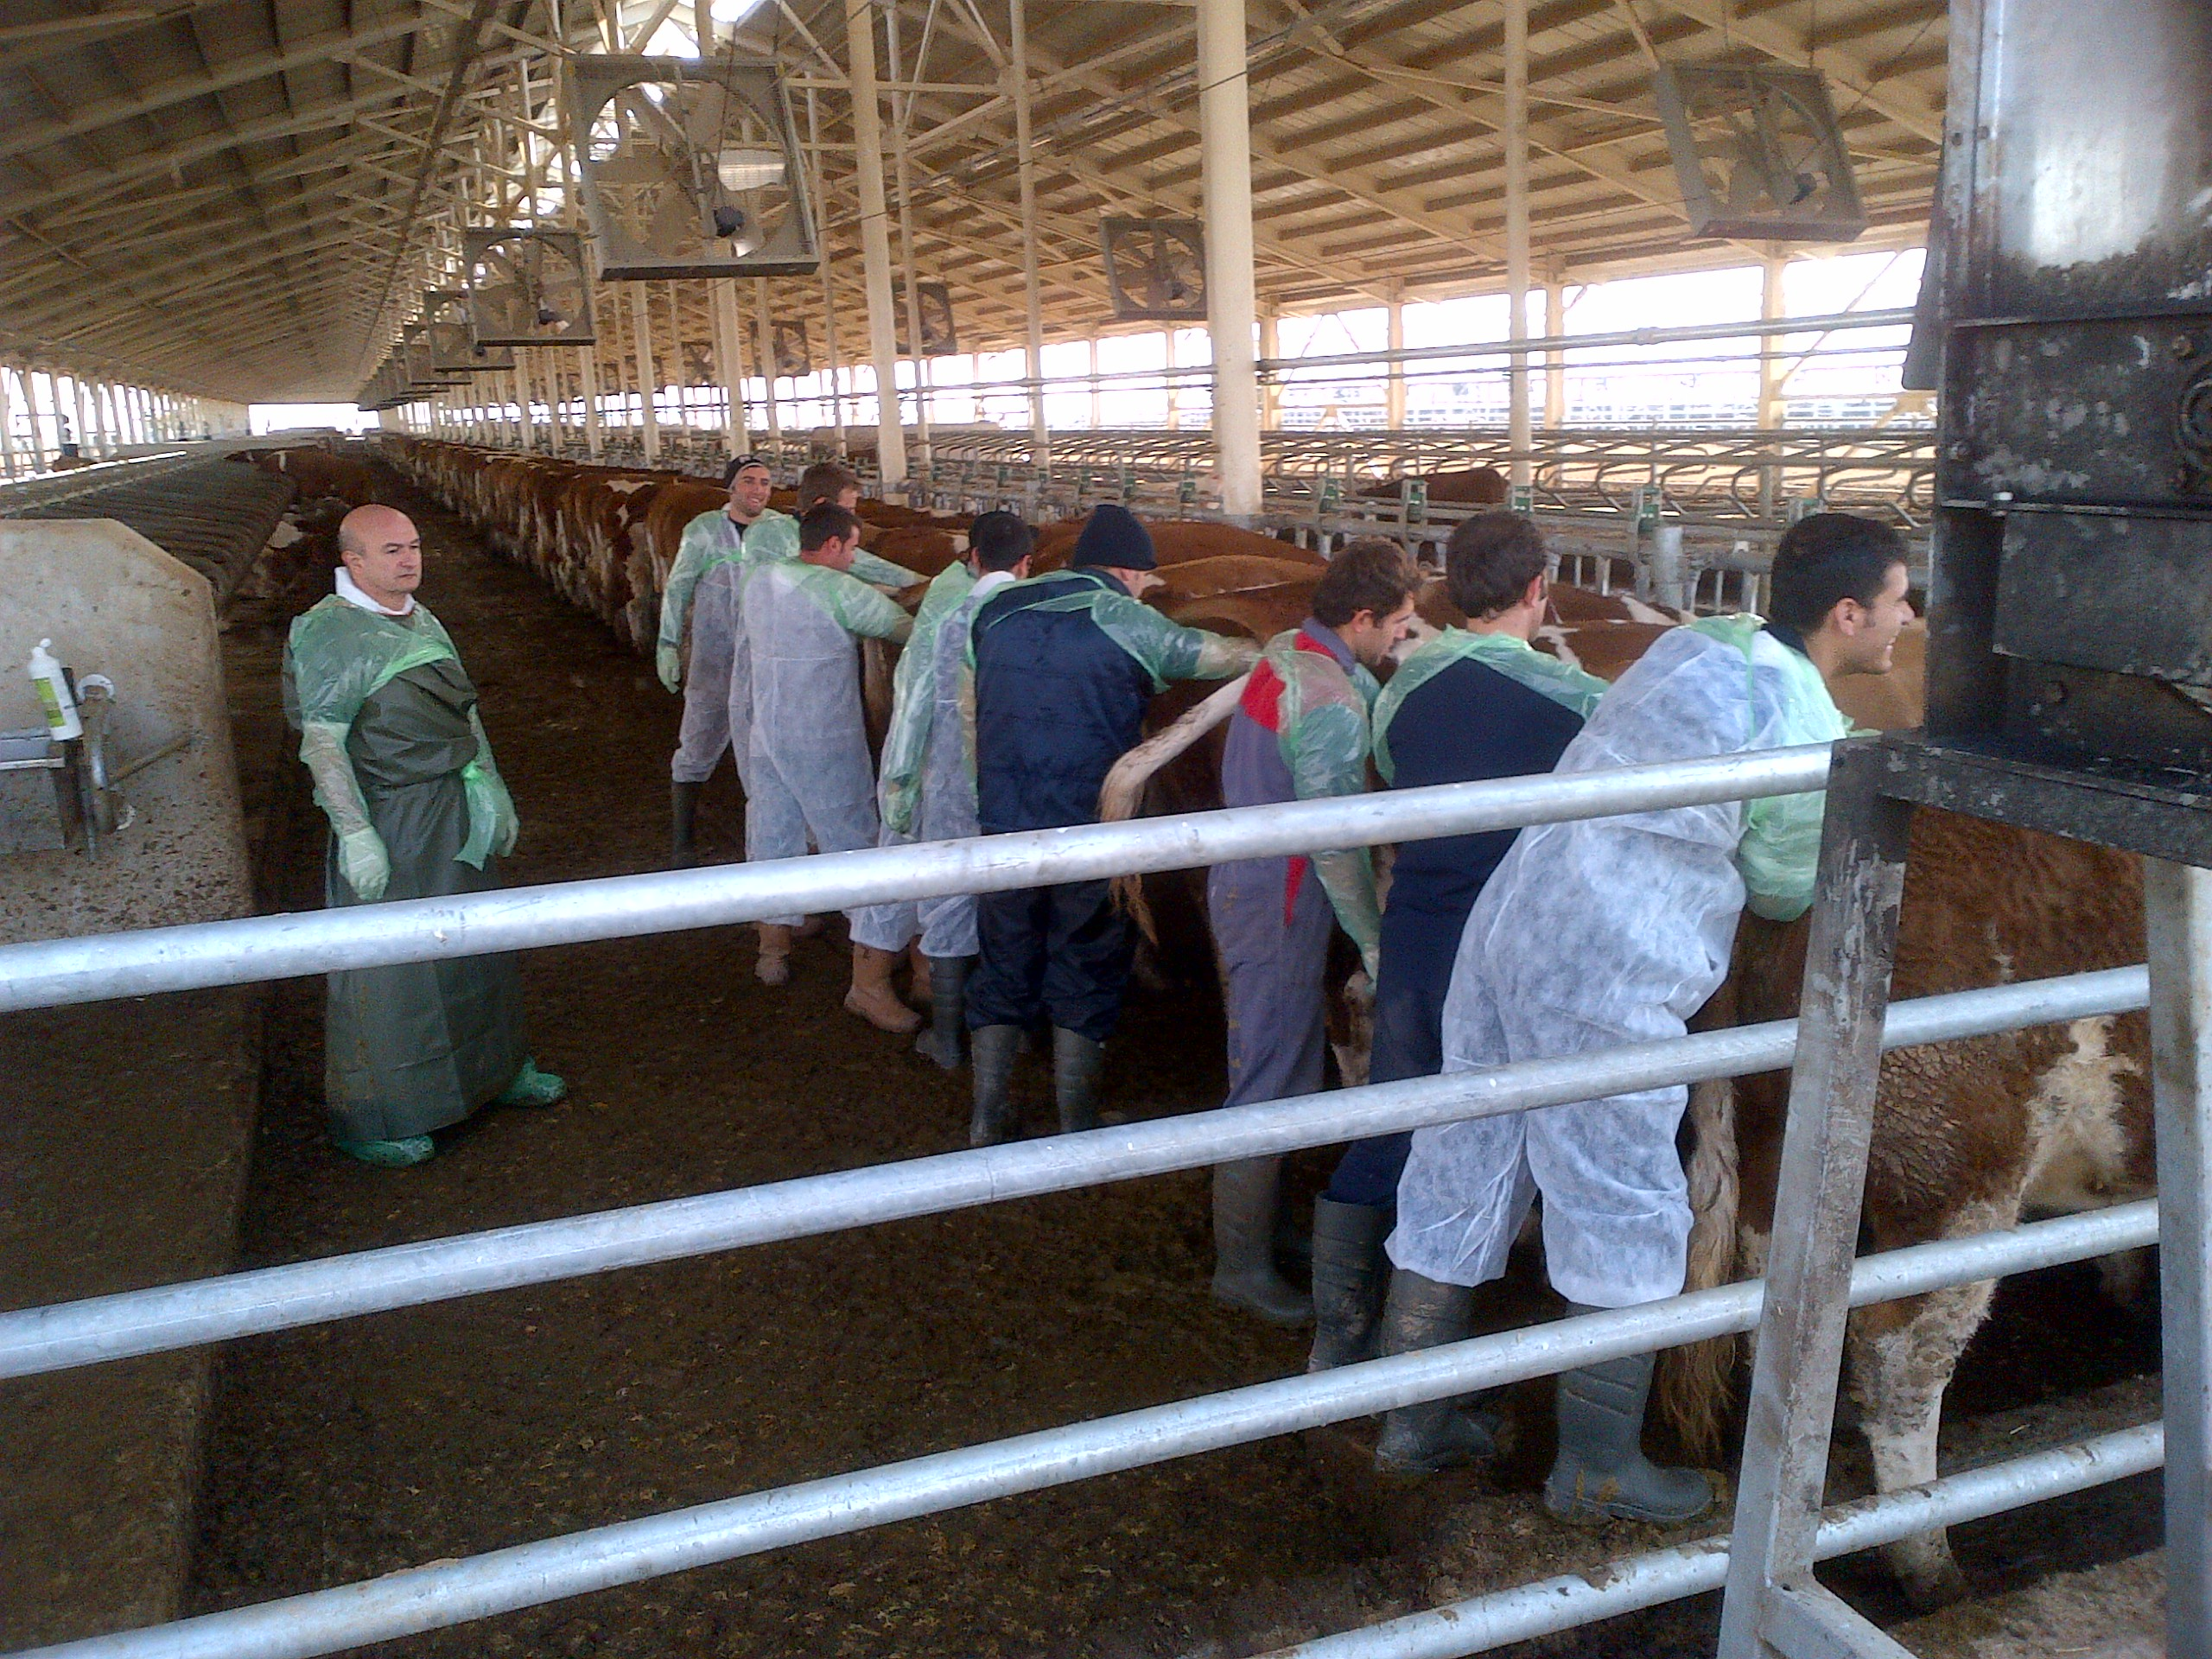
Pregnancy Examination / Rectal Examination
Rectal Examination:
Transrectally palpation of organs and tissues within the cavum pelvis and posterior of the abdominal cavity
(Küplülü ve Vurak, 2015 TİGEM)

Slide 3
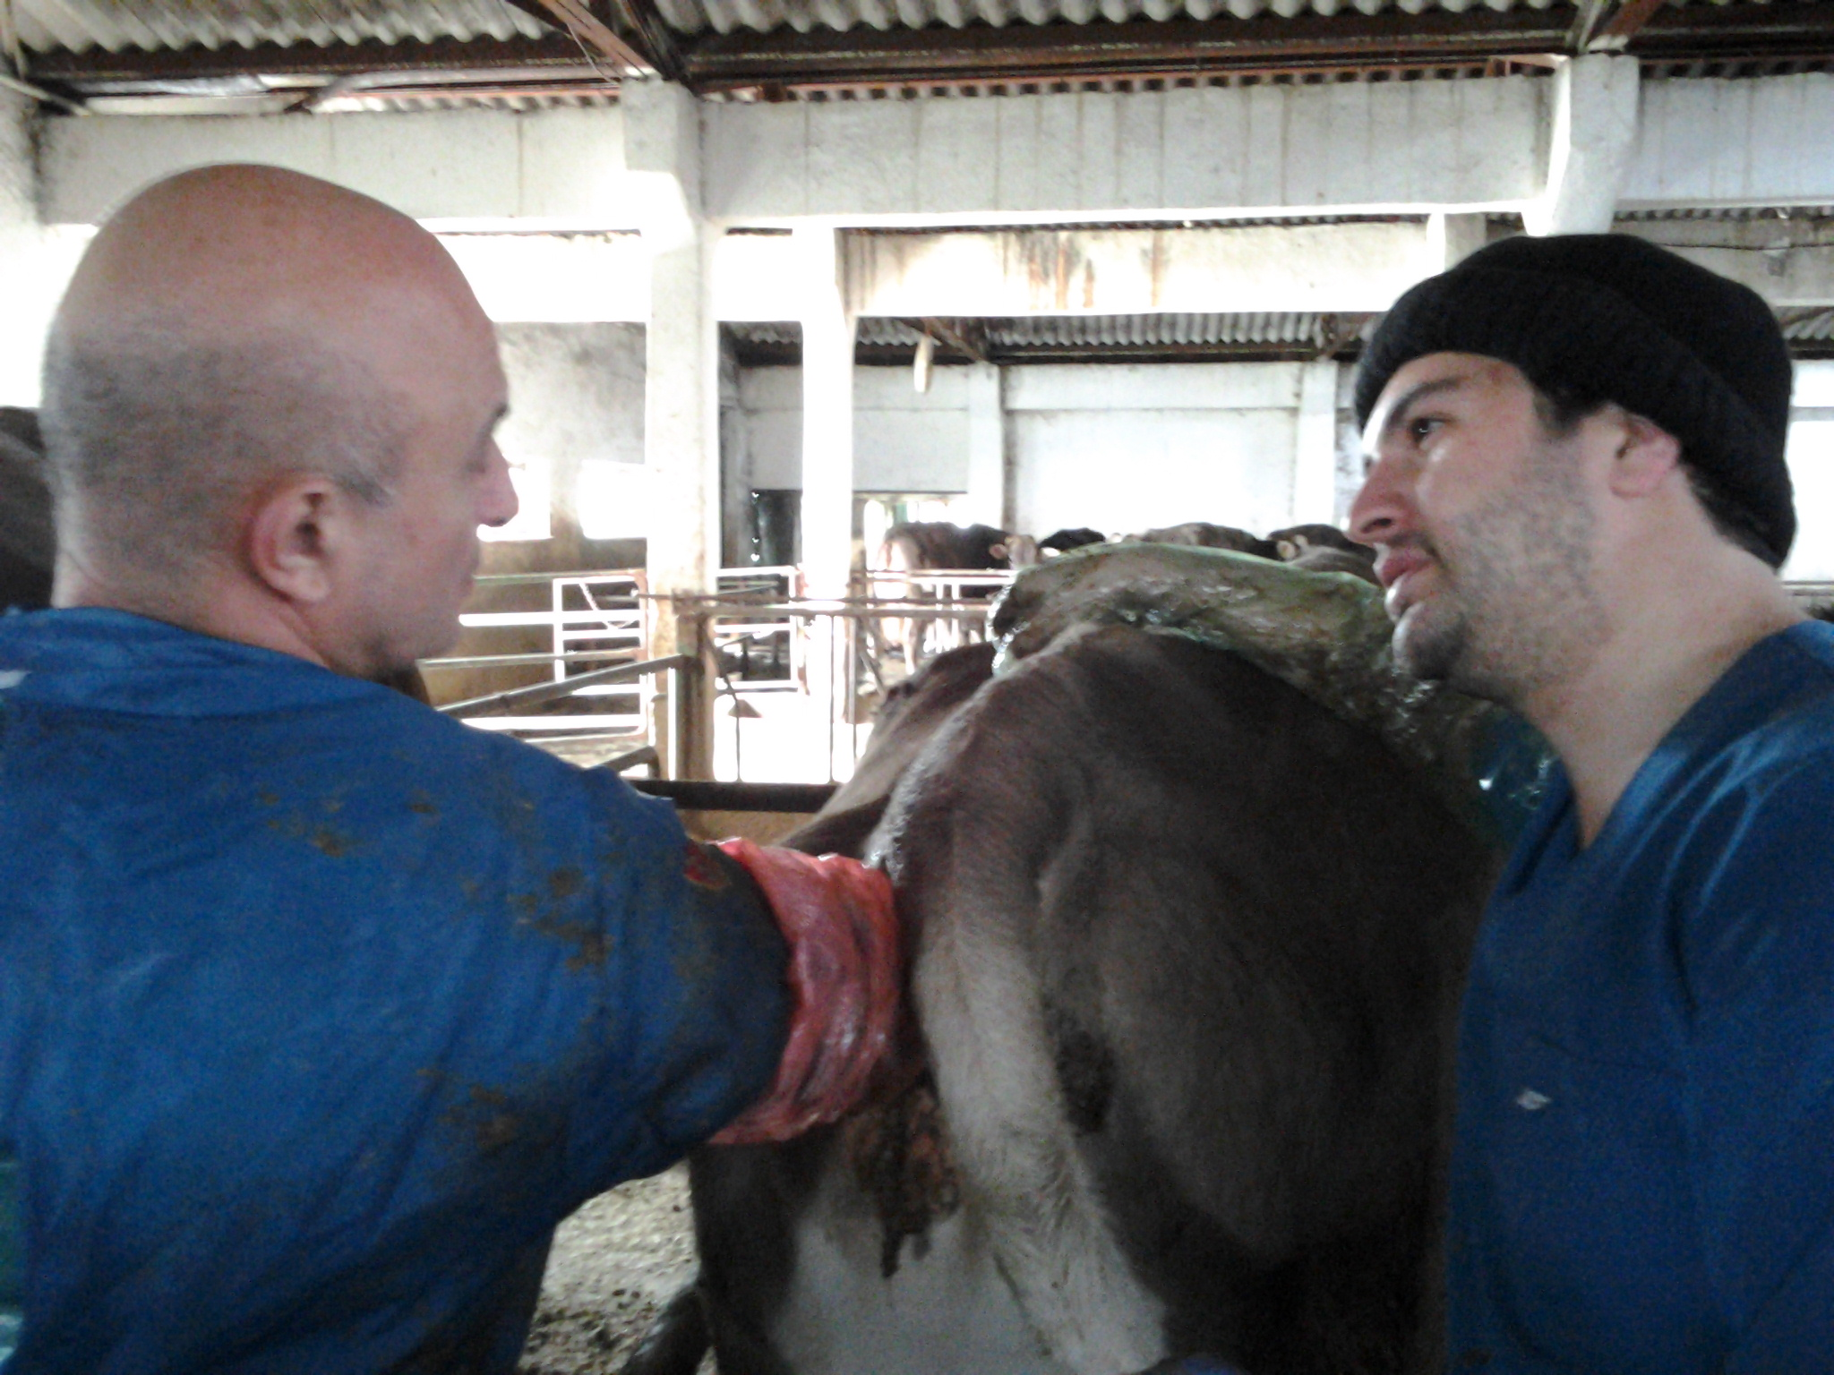
Pregnancy Examination / Rectal Examination
Main objectives of rectal examination
Diagnosis of pregnancy
Artificial insemination
Examination of reproductive organs
(Küplülü ve Vural, 2015 TİGEM)

Slide 4
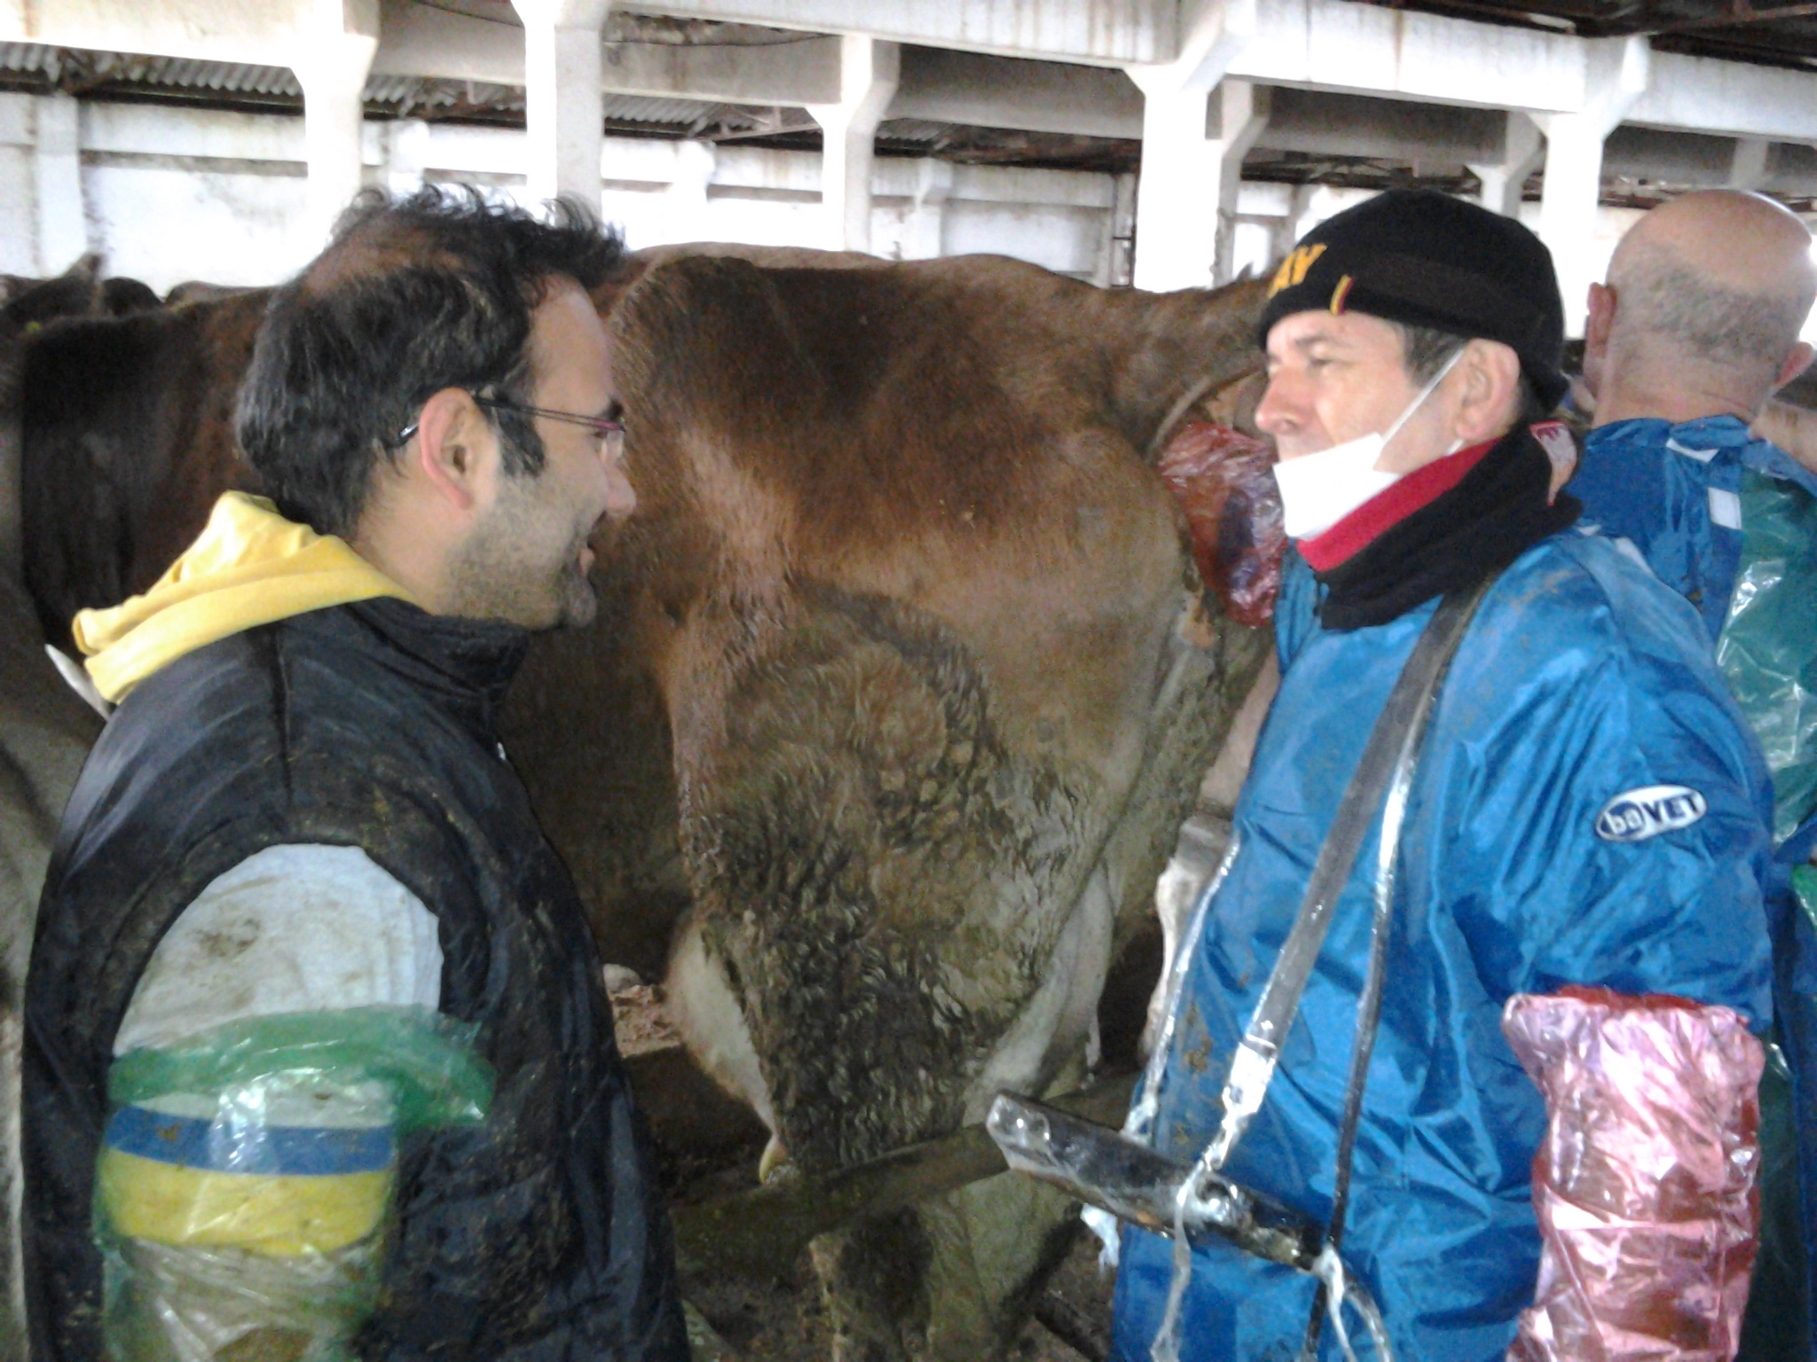
Pregnancy Examination / Rectal Examination
22-25 days with USG
pregnancy diagnosis
(Küplülü ve Vurak, 2015 TİGEM)

Slide 5
Pregnancy Examination
Estimated 25-day pregnancy
Asymmetry and pregnancy CL
(Küplülü ve Vural, 20013)

Slide 6
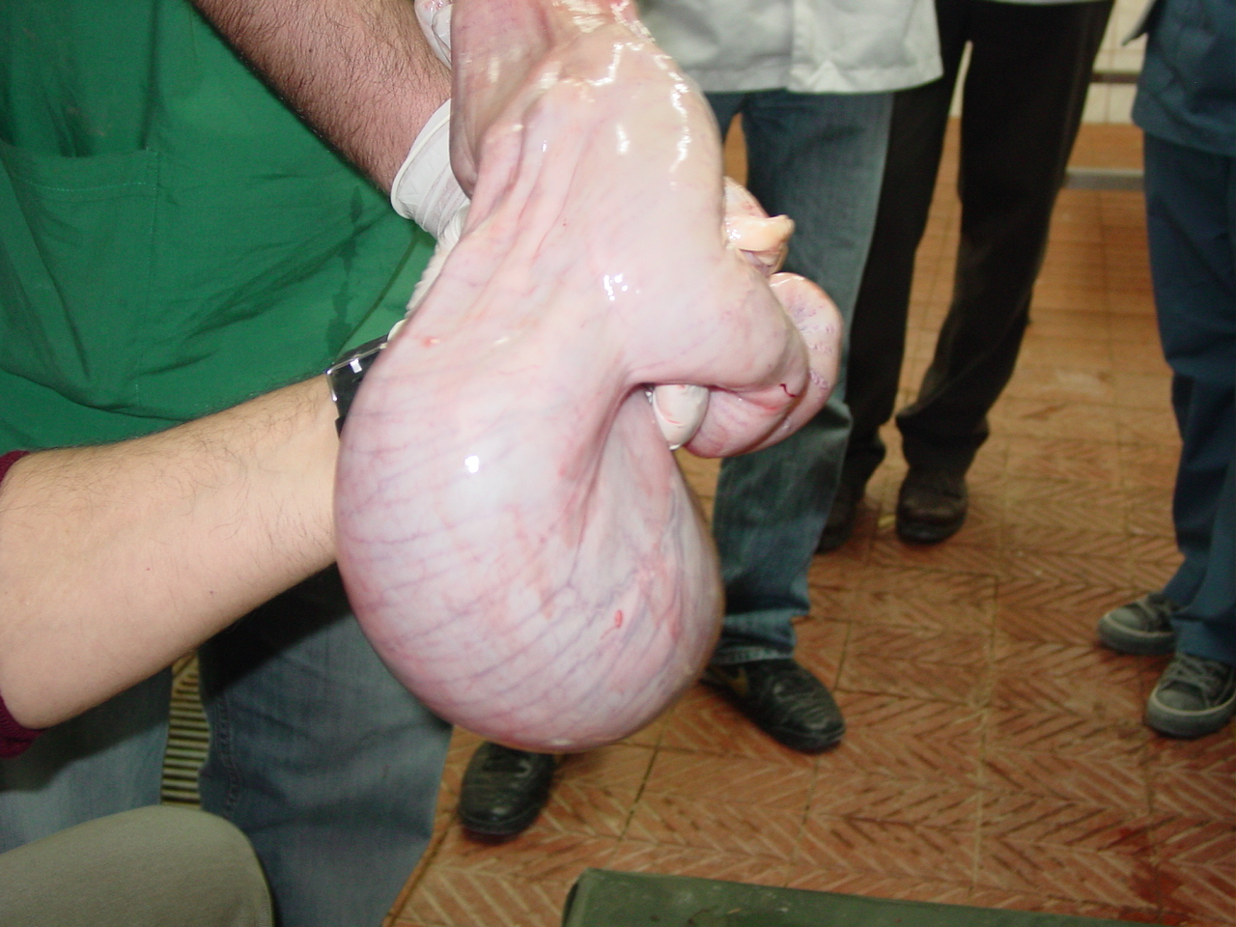
Pregnancy Examination
(Küplülü ve Vural, 20013)

Slide 7
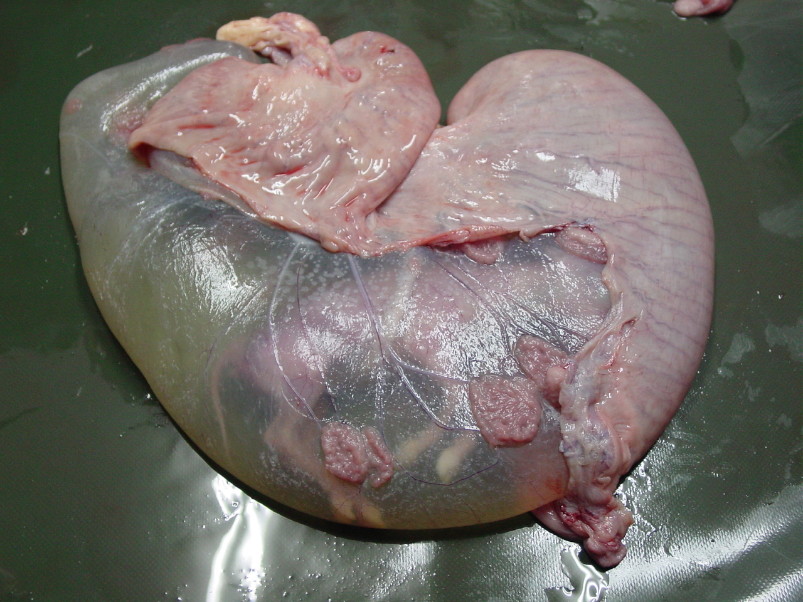
Pregnancy Examination
(Küplülü ve Vural, 20013)

Slide 8
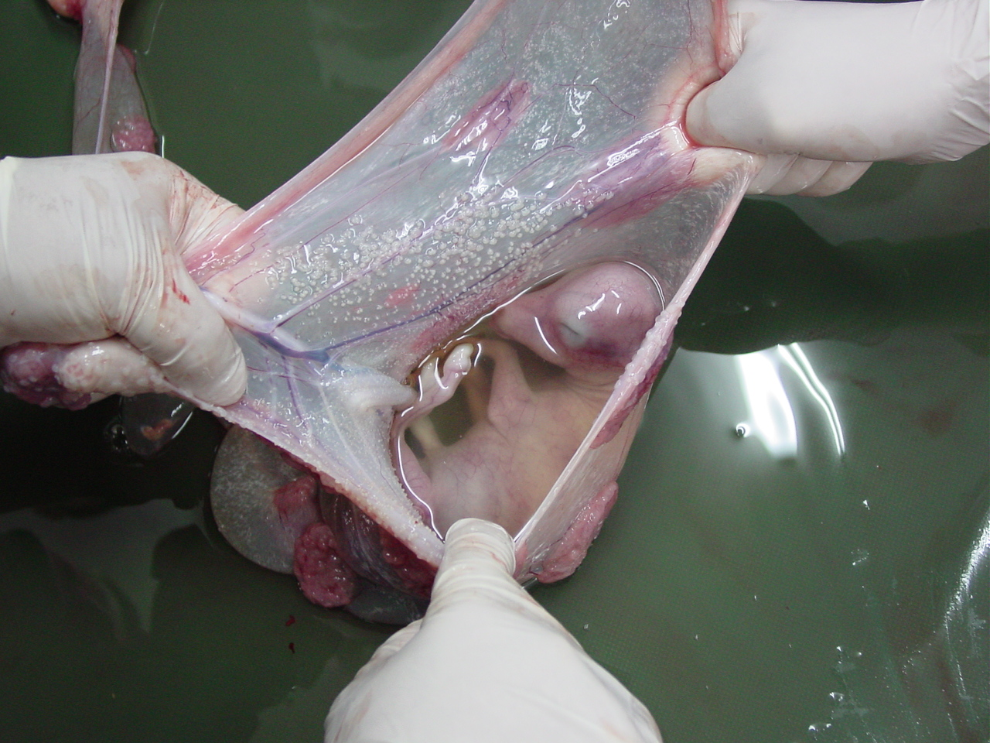
Gebelik Muayenesi
(Küplülü ve Vural, 20013)

Slide 9
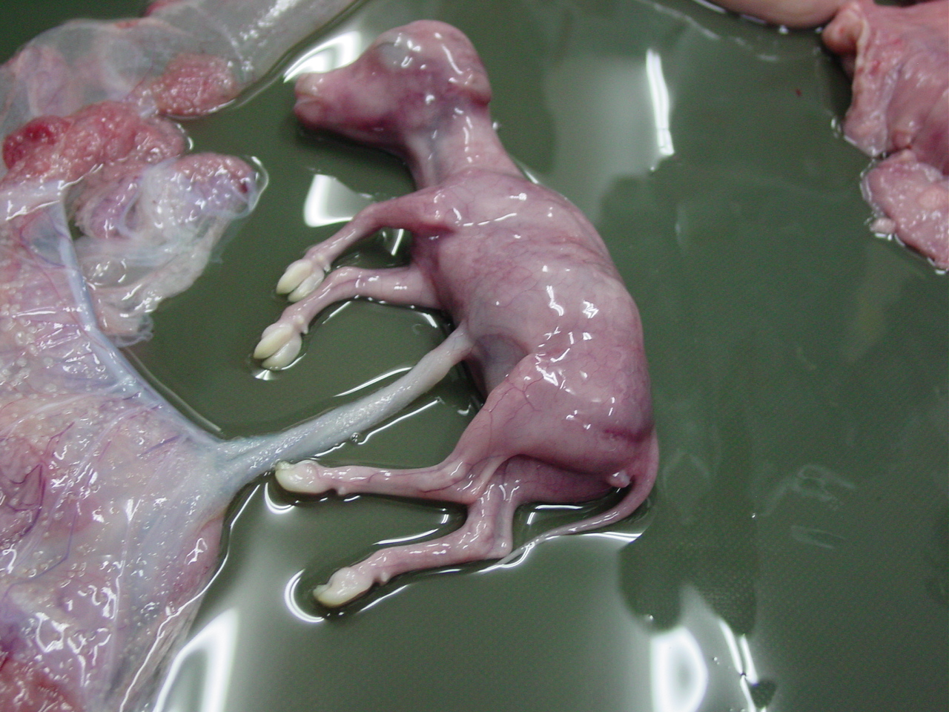
Pregnancy Examination
(Küplülü ve Vural, 20013)

Slide 10
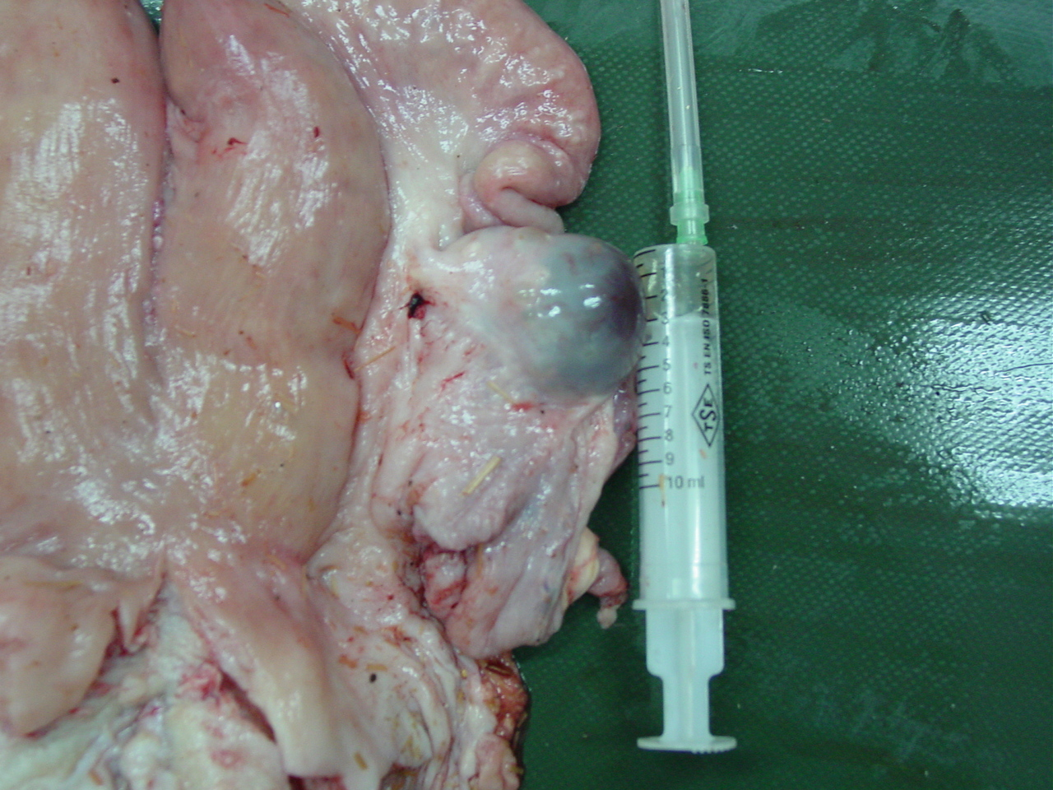
Cystic ovarium
Cysts are anovulatory follicular structures that persist for more than 10 days.
Follicular size of 2 cm or greater is considered to be "cystic".
(Küplülü ve Vural, 2013)

Slide 11
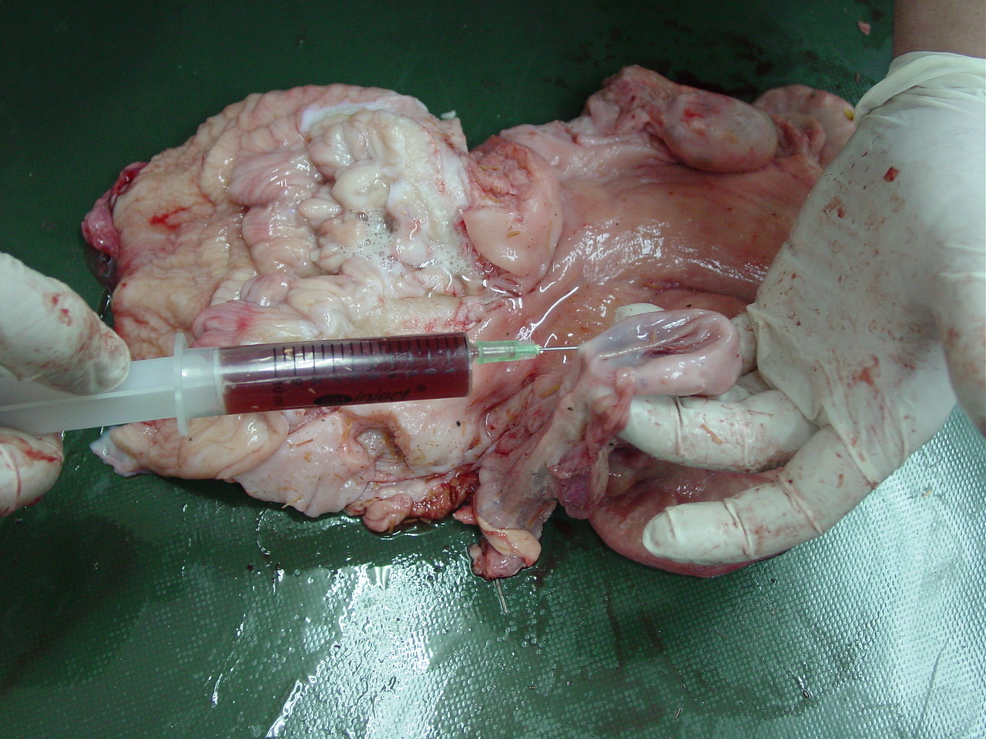
Cystic ovarium
(Küplülü ve Vural, 20013)

Slide 12
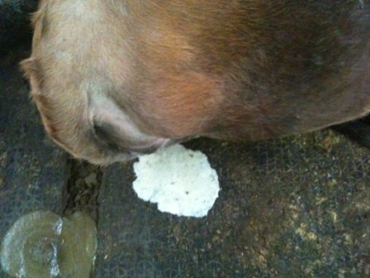
Metritis
(Küplülü ve Vurak, 2015 TİGEM)

Slide 13
Metritis
Importance of puerparal period
(Küplülü ve Vurak, 2015 TİGEM)

Slide 14
Metritis
Importance of puerparal period
(Küplülü , Vural , Polat 2012)

Slide 15
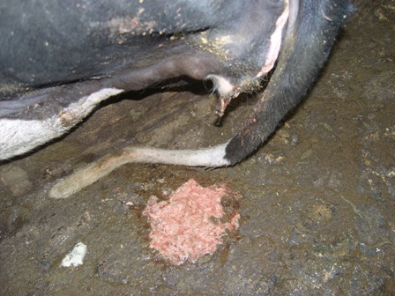
Metritis
Importance of puerparal period
(Küplülü , Vural , Polat 2012)

